Slide 1




SAGA-based Tools and Projects
  The _x0013_SAGA Team
  http://saga.cct.lsu.edu
CCT: Center for Computation & Technology

Slide 2
SAGA-based Tools + Developments
DESHL
JSAGA
GANGA/gLite [Ole]
XtreemOS
KEK
SD [Andre]
SAGA Gateways

Slide 3
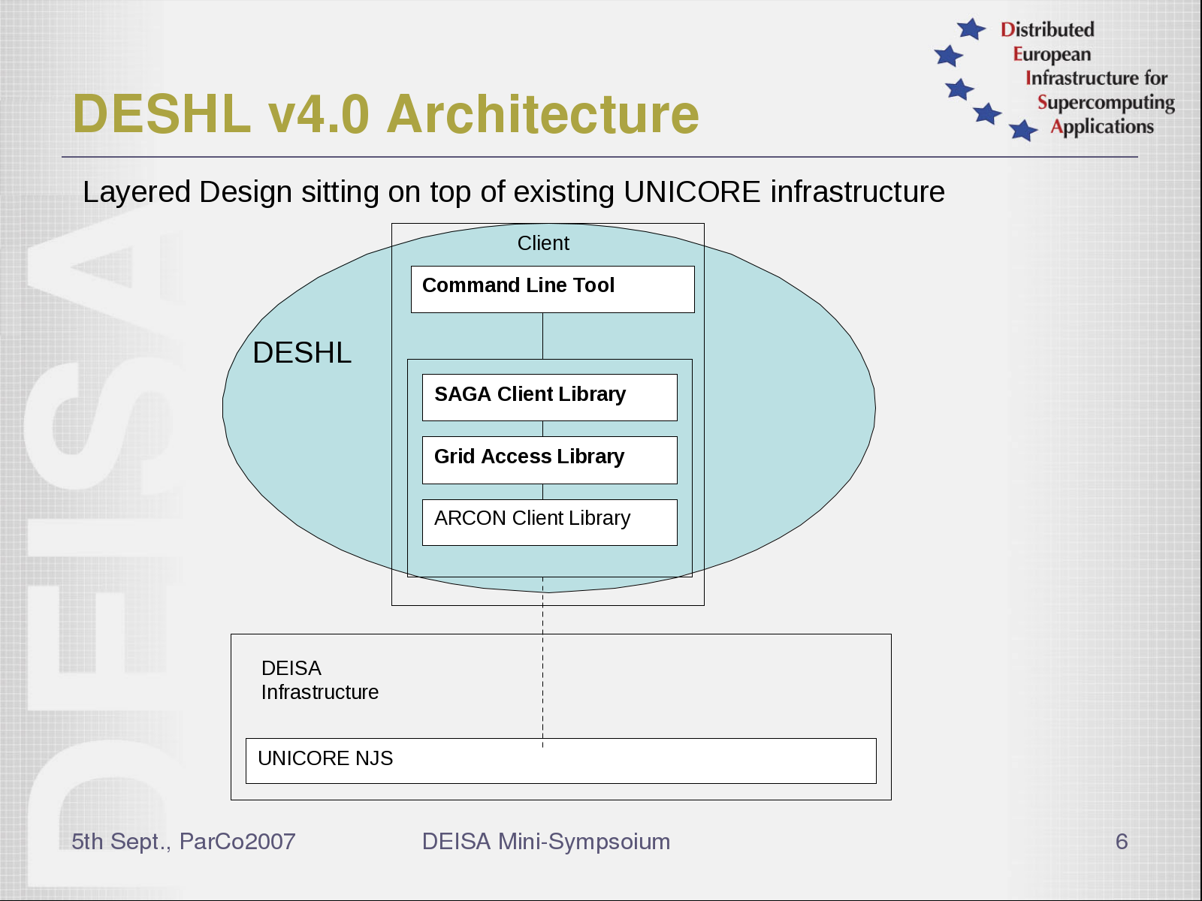
Text

Slide 4
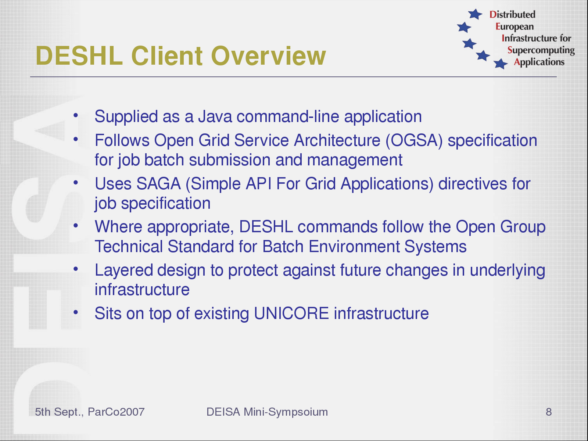
Text

Slide 5
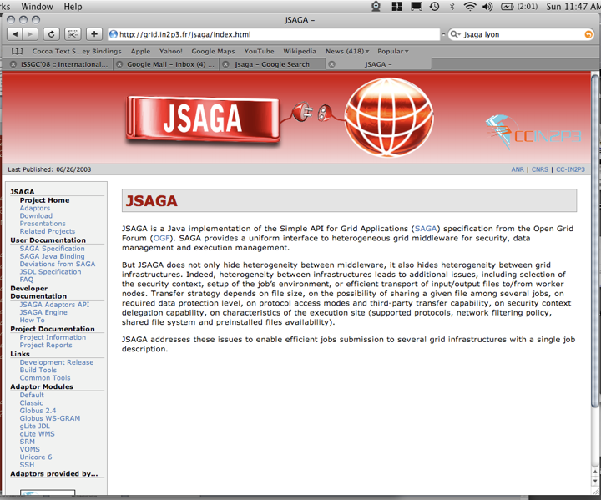
JSAGA
Text

Slide 6








JSAGA use-cases and goal
Motivations for using several grid infrastructures
increasing the number of computing resources available to user
need for resources with specific constraints
  super-computer
  confidentiality (e.g. OpenPlast industrial grid)
  small overhead (e.g. consolidation)
  interactivity
availability, on a given grid, of:
  the software (license)
  the data
cluster
Goal : permit seamless
job submission to these
heterogeneous infrastructures
JSAGA

Slide 7


Both implementer and user of SAGA
JSAGA uses SAGA in a module, which hides heterogeneity of grid infrastructures
JSAGA implements SAGA to hide heterogeneity of middlewares
Applications
JSAGA
jobs
collection
SAGA
JSAGA
core engine
+ plug-ins
Legacy APIs
JSAGA

Slide 8







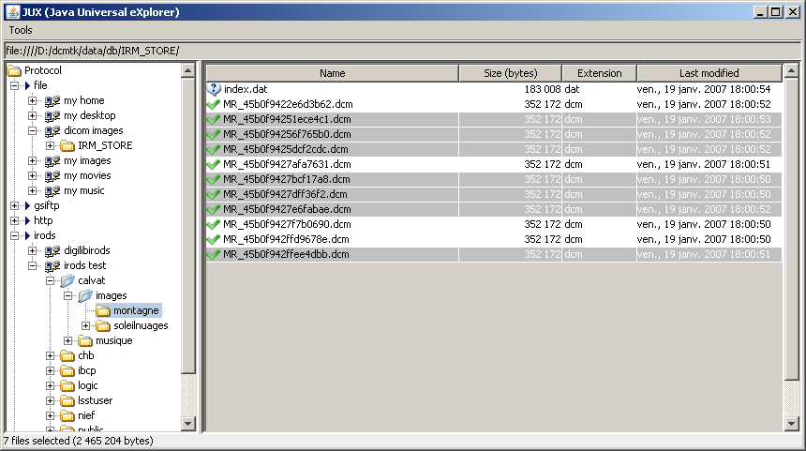
Projects using JSAGA
/
Elis@
  a web portal for submitting jobs to industrial and research grid infrastructures
SimExplorer
  a set of tools for managing simulation experiments
  includes a workflow engine that submit jobs to heterogeneous distributed computing resources
JJS
  a tool for running efficiently short-life jobs on EGEE
JUX
  a multi-protocols file browser
JSAGA

Slide 9


m/w vs. infrastructure heterogeneity
job
desc.
EGEE
hide
middleware
heterogeneity
(e.g. gLite, Globus, Unicore)
OPlast
JSAGA
gLite
plug-ins
Globus
plug-ins
JDL
RSL
staging
graph
delegate files staging
WMS
SRM
input
data
hide
infrastructures
heterogeneity
(e.g. EGEE, OSG, DEISA)
GridFTP
LCG-CE
LCG-CE
WS-GRAM
WS-GRAM
firewall
job
job
JSAGA

Slide 10
SAGA XtreemOS
Challenges:
  Linux applications should run with little (no) modifications
  Grid applications should run with little (no) modifications
  XtreemOS functionality must be provided to applications
Approach:
  Use OGF-standardized SAGA API, enabling both Linux apps (via POSIX semantics) and grid apps
  Provide extensions packages to SAGA for XtreemOS functionality and in the process contribute to standards
Text

Slide 11
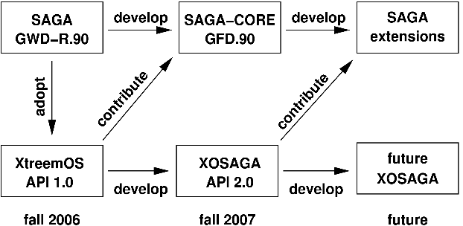
Co-evolution of SAGA Standard
& the XtreemOS API
(slide courtesy Thilo Kielmann)
CCT: Center for Computation & Technology

Slide 12
An Extension to the SAGA Service Discovery API
Antony Wilson
(Steve Fisher and Paul Livesey)
4th EGEE Users Forum – Catania 2009
Notes:
Hello, I’m Antony Wilson and I am working on the SAGA service discovery with Steve Fisher and Paul Livesey.
Today I am going to be talking about our proposal to extend to the service discovery API.

Slide 13
Service Discovery API
The specification for the Service Discovery has been finalised – GFD.144
  http://www.ogf.org/documents/GFD.144.pdf
  Loosely based around the gLite Service Discovery
  Uses the GLUE (version 1.3) model of a service
    A Site may host many Services
    A Service has multiple Service Data entries
    Each Service Data entry is represented by a key and a value
APIs in C, C++, Java and Python complete but not releasd
Adapter for gLite under development
  Based around GLUE 1.3
    Once GLUE 2 is finalised the adapter will be updated
An Extension to the SAGA Service Discovery API - Catania 2009
Notes:
As per slide

Slide 14
Service Discovery API
API allows selection based on three filters:
  serviceFilter – allows filtering on:
    type, name, uid, site, url, implementor and relatedService
  dataFilter – no predefined values
    Uses keys from Service Data entries
  authzFilter – authorization, no predefined values, useful values include:
    vo, dn, group and role (values dependent on adapter)
  NB if an authzFilter is not provided then one is automatically constructed from the users security context
    The gLite adapter will provide the VOMS proxy credentials as the default value for the security context
Each of the filter strings uses SQL92 syntax
The filters act as if they are part of a WHERE clause
An Extension to the SAGA Service Discovery API - Catania 2009
Notes:
As per slide

Slide 15
Service Discovery
Selection returns a list of ServiceDescriptions
  Each description contains:
    type, name, uid, site, url, implementor, list of relatedServices and service data (key value pairs)
Example:
discoverer = SDFactory.createDiscoverer( )
serviceDescriptions =
discoverer.listServices(“type = ‘computing service’”, “”)
loop serviceDescriptions
description.getAttribute(“name”)
  returns the value of the name attribute
  URL of information system can be passed in with the constructor, or obtained from a conf file
An Extension to the SAGA Service Discovery API - Catania 2009
Notes:
As per slide

Slide 16
Extended Service Discovery API
Problem: The service discovery API only gives basic information as it cannot represent the GLUE model in three tables
Purpose: To navigate the information model starting from a selected service
API will be independent of the underlying information system
Different information systems supported by means of adapters
  We will provide a gLite adapter
Navigation will be from entity to entity as expressed in the GLUE entity relationship models
An Extension to the SAGA Service Discovery API - Catania 2009
Notes:
As per slide

Slide 17
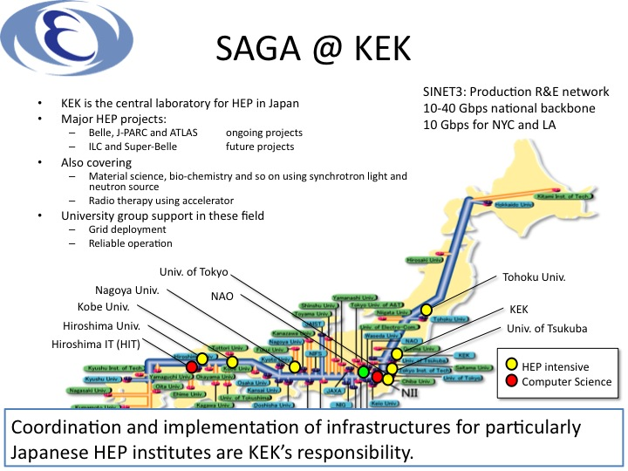

Slide 18
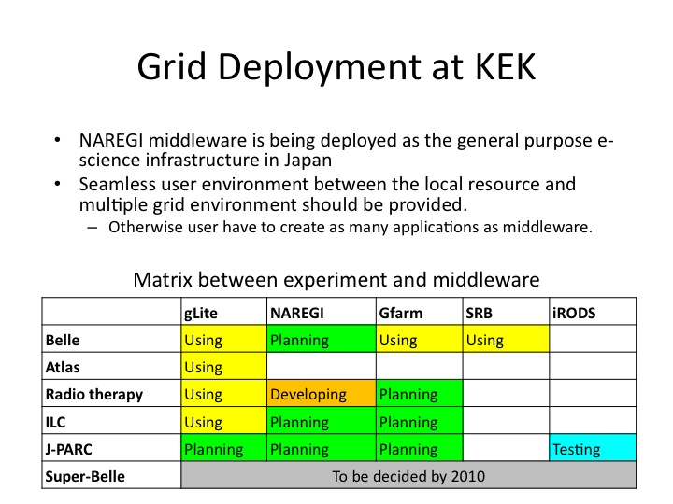

Slide 19
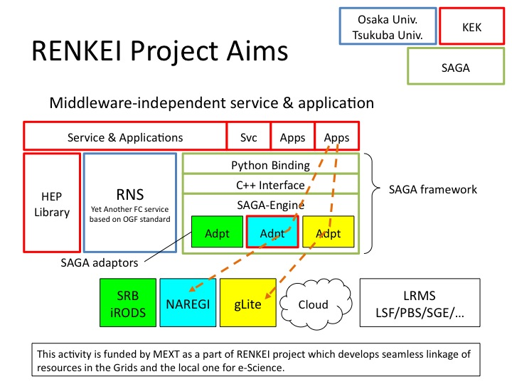

Slide 20
