Slide 1



SAGA API Examples: Shell, Python and C++
Building and Installing

Slide 2
Outline
SAGA command line tools
SAGA Python API
SAGA C++ API
Examples

Slide 3
Documentation
General information
https://svn.cct.lsu.edu/repos/saga-projects/tutorial/general_tutorial
http://saga.cct.lsu.edu/software/cpp/documentation/tutorials/loni-training-2010
API documentation
Python
http://static.saga.cct.lsu.edu/apidoc/python/latest/
C++
http://static.saga.cct.lsu.edu/apidoc/cpp/latest/
Programmers manual
http://static.saga.cct.lsu.edu/docs/programming_guide/saga_programming_guide.pdf
Example Code:
https://svn.cct.lsu.edu/repos/saga/core/trunk/examples/

Slide 4
Demo Machine
For this tutorial, we have set up a demo machine.
Accounts: {text01,…,test20}@faust.cct.lsu.edu
Passwords: test1234
Feel free to log-in an look around. SAGA is installed in /opt/saga-1.5.3-pre/ (core, python, default adaptors)
You can try to reproduce the examples if you want

Slide 5
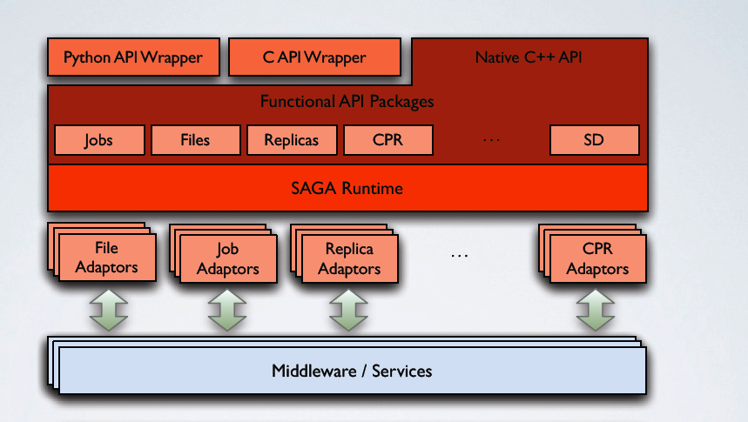
SAGA: Architecture

Slide 6
Three Ways to Use SAGA
 | Local Adaptors | Globus Adaptors | SSH Adaptors | …
 | file://localhost/... any://localhost/... | gram://remotehost/... any://remotehost/… | ssh://remotehost/… any://remotehost/…
Shell | saga-file copy src dest
 | saga-job run rm cmd
Python | import saga.filesystem dir.copy(src, dest)
 | import saga.job js.run(cmd)
C++ | using saga::filesystem::directory; dir.copy(src, dest)
 | using saga::job::job; job.run(cmd);
Notes:
Here’s the three ways how SAGA can be used:
Let’s start at the bottom with the C++ API
EPILOGUE: WE will now go briefly go through the three different Interfaces

Slide 7
Command line tools
SAGA comes with simple command line tools that allow to access basic package functionality.
The source code is very simple and a great starting point to explore the SAGA package APIs:
saga-file $SAGA_ROOT/tools/clutils/filesystem/
saga-job $SAGA_ROOT/tools/clutils/job/
saga-advert $SAGA_ROOT/tools/clutils/advert/
saga-shell $SAGA_ROOT/tools/shell/
Notes:
GIVE IT A TRY!

Slide 8
Command line tool: saga-file
Supported protocols
Depends on SAGA adaptors
Also available: Globus GridFTP, Curl (subset), KFS, Amazon EC2, Opencloud (Sector/Sphere), Hadoop (HDFS)
Supported commands:
Command | Arguments
copy | <url from> <url to>
move | <url from> <url to>
remove | <url>
cat | <url>
list_dir | <url>

Slide 9
Command line tool: saga-job
Supported protocols
Depends on SAGA adaptors
Also available: Globus Gram, Condor, OMII-GridSAM, LSF, Amazon EC2, Opencloud (Sector/Sphere)
Supported commands:
Command | Arguments
run | <rm url> <command> <arguments>
submit | <rm url> <command> <arguments>
state | <rm url> <jobid>
suspend | <rm url> <jobid>
resume | <rm url> <jobid>
cancel | <rm url> <jobid>
Notes:
Next we have

Slide 10
Command line tool: saga-advert
What is it?
Central data store with
Hierachical keys
Attributes
Filesystem like structure
Supported protocols
Depends on SAGA adaptors
Local adaptor:
Local backend: SQLite3
Remote backend: PostgreSQL
Also available: Hadoop H-Base, Hypertable

Slide 11
Command line tool: saga-advert
Supported commands:
Command | Arguments
list_directory | <advert-url> <pattern>
add_directory remove_directory | <advert-url>
add_entry remove_entry | <advert-url>
store_string | <advert-url> <string>
retrieve_string | <advert-url>
list_attributes | <advert-url>
set_attribute | <advert-url> <key> <value>
remove_attribute | <advert-url> <key>

Slide 12
Command line tool: saga-shell
All in one of all command line tools as mentioned earlier
Keeps context in between commands
Navigate (remote) filesystems (advert, replica too!)
Launch (remote) jobs, uses io redirection to access in/out
All commands are implemented using SAGA

Slide 13
Command line tool: saga-shell
Some of the supported commands
Type | Commands
File system navigation | pwd, ls, mv, cp, cd, mkdir, rmdir, touch, cat
Job package | run, suspend, resume, kill, status, ps
replica | rep_find, rep_list, rep_add, rep_remove, rep_update, rep_replicate
environment | setenv, getenv, env
permissions | add_proxy, remove_proxy

Slide 14
Python API Example: File Package
Copy a file
import saga src = saga.url("file://localhost/etc/passwd") dst = saga.url("file://localhost/tmp/passwd-copy") f = saga.filesystem.file(src, saga.filesystem.Read) f.copy(dst)
Notes:
Go ahead and try it if you want
You might end up with an “file already exists” error – that can be fixed by changing the DEST PATH

Slide 15
Python API Example: File Package
Get a directory file listing
import saga src = saga.url("file://localhost/opt/") d = saga.filesystem.directory(src) names = d.list('*') for name in names: ns = saga.name_space.entry(name) if ns.is_dir(): print 'd ', name elif ns.is_link(): print '->', ns.read_link() else: print ' ', name

Slide 16
Python API Example: Job Package #1
Submit a job
import saga
js_url = saga.url("fork://localhost/")
job_service = saga.job.service(js_url)
job_desc = saga.job.description()
job_desc.executable = "/bin/touch"
job_desc.arguments = ["-a", "touche"]
my_job = job_service.create_job(job_desc)
my_job.run()

Slide 17
Python API Example: Advert Package
Create and modify an advert entry
# host/process A import saga import time name = saga.url("advert://localhost/myentry") e = saga.advert.entry(name, saga.advert.ReadWrite|saga.advert.Create) e.set_attribute("started", time.strftime("%a, %d %b %Y %H:%M:%S +0000", time.gmtime())
# host/process B import saga name = saga.url("advert://localhost/myentry") e = saga.advert.entry(name) print "started: " + e.get_attribute("started")

Slide 18
C++ API Example: File Package
Copy a file
saga::url src (' … '); saga::url dst (' … '); saga::filesystem::file f(src, saga::filesystem::ReadWrite); f.copy(dst);

Slide 19
C++ API Example: File Package
Get a directory file listing
saga::url src (' … '); saga::filesystem::directory d (src); std::vector<std::string> names = d.list('*'); for (auto it = names.begin(); it != names.end(); ++it) { saga::name_space::entry ns (*it); if (ns.is_dir()) cout << 'd ' << *it << '\n'; else if (ns.is_link()) cout << '->' << ns.read_link() << '\n'; else: cout << ' ' << *it << '\n'; }

Slide 20
C++ API Example : Job Package #1
Submit a job
saga::url js_url("fork://localhost/");
saga::job::service js(js_url);
saga::job::description jd;
js.set_attribute("executable", "touch");
std::vector<std::string> args;
args.push_back("-a");
args.push_back("...filename…");
js.set_vector_attribute("arguments", args);
saga::job::job j = js.create_job(jd);
j.run();

Slide 21
C++ API Example : Job Package #2
Submit a job
saga::job::service js;
saga::job::ostream in;
saga::job::istream out, err;
saga::job::job j = js.run_job(
"/bin/echo -n HELLO SAGA", "fork://localhost/",
in, out, err);
std::string line;
while (std::getline(line, out))
std::cout << out << std::endl;

Slide 22
C++ API Example: Advert Package
Create and modify an advert entry
// host A saga::url name = url(' … ') saga::advert::entry e(name, advert.ReadWrite|advert.Create) e.set_attribute("started", " … " )
// host B saga::url name = url(' … ') saga::advert::entry e(name, advert.Read) std::string started = e.get_attribute("started")

Slide 23
Additional Resources: Programmers Guide
Set of very small and easy examples, one for each package/paradigm
file_copy, file_copy (async)
Error handling
Attributes
Stream (server/client)
http://static.saga.cct.lsu.edu/docs/programming_guide/saga_programming_guide.pdf

Slide 24
Example 1: hello_world
Hello world
Launch 3 jobs on different machines
Execute “/bin/echo”
No job dependency
Each job returns its passed input argument
"Hello"
"distributed"
"world!"
Jobs are launched in parallel (in separate threads)
As soon as result is collected it's printed on local console
Notes:
Here are a few practical examples, which are somewhat out of scope of this tutorial. They represent three common patterns for distributed applications:
Hello_world *uncoupled jobs”
Chaining_jobs – (“workflow”) on job’s input depends on the other’s output
Depending jobs – Centrally coordinated jobs
Feel free to check out http://saga.cct.lsu.edu/software/cpp/documentation/tutorials/loni-training-2010
There’s a document called SAGA Tutorial Exercise – it explains the following three examples in detail!

Slide 25
Example 1: hello_world
Hello world
Arbitrary sequence of results
Optimally: "Hello distributed world!"
Demonstrates
How to launch a remote job using SAGA job_service
Pass arguments using the command line
Collect result by output redirection
The source code can be found here (see ‘Example1’):
https://svn.cct.lsu.edu/repos/saga/core/trunk/examples/tutorial
The example uses localhost to spawn childs
For remote execution change HOST1, HOST2, HOST3 from "localhost" to
Notes:
Here are a few practical examples, which are somewhat out of scope of this tutorial. They represent three common patterns for distributed applications:
Hello_world *uncoupled jobs”
Chaining_jobs – (“workflow”) on job’s input depends on the other’s output
Depending jobs – Centrally coordinated jobs
Feel free to check out http://saga.cct.lsu.edu/software/cpp/documentation/tutorials/loni-training-2010

Slide 26
Example 2: chaining_jobs
Launch 3 jobs on 3 different machines
Output of previous job is needed to launch next job
Simple sequential execution, but SAGA style
Demonstrates
How to launch a job using SAGA job_service
How to feed input to launched job
How to collect output
Launched job: /usr/bin/bc
Increment the number passed as the argument
Pass returned incremented number to next job
Notes:
Here are a few practical examples, which are somewhat out of scope of this tutorial. They represent three common patterns for distributed applications:
Hello_world *uncoupled jobs”
Chaining_jobs – (“workflow”) on job’s input depends on the other’s output
Depending jobs – Centrally coordinated jobs
Feel free to check out http://saga.cct.lsu.edu/software/cpp/documentation/tutorials/loni-training-2010

Slide 27
Example 3: depending_jobs
Coordinating information from advert service
Launch a single job sequentially on a set of remote resources
Simulating checkpointing/relaunching on different resource (migration)
Maintain a single result value in advert service
Gets written by one job, and read by the next
Demonstrates
How to launch remote job using SAGA job, while maintaining environment
Assembling argument lists
Result is left in advert service, but accessed afterwards
Notes:
Here are a few practical examples, which are somewhat out of scope of this tutorial. They represent three common patterns for distributed applications:
Hello_world *uncoupled jobs”
Chaining_jobs – (“workflow”) on job’s input depends on the other’s output
Depending jobs – Centrally coordinated jobs
Feel free to check out http://saga.cct.lsu.edu/software/cpp/documentation/tutorials/loni-training-2010

Slide 28
Questions | Comments ?
We have covered:
SAGA command line tools
SAGA Python API
SAGA C++ API
Examples
Check out the tutorial website for more details and examples: http://saga.cct.lsu.edu/software/cpp/documentation/tutorials/loni-training-2010

