Slide 1



A Brief Introduction to SAGA
Building and Installing

Slide 2
All material from this tutorial can be found at: https://svn.cct.lsu.edu/repos/saga-projects/tutorial/EGI-2011

Slide 3
General Information and Documentation
General information
http://saga. cct.lsu.edu/
Documentation:
http://saga.cct.lsu.edu/software/cpp/documentation
API documentation
Python
http://static.saga.cct.lsu.edu/apidoc/python/latest/
C++
http://static.saga.cct.lsu.edu/apidoc/cpp/latest/
Programmers Guide:
https://svn.cct.lsu.edu/repos/saga/core/trunk/docs/manuals/programming_guide/tex/saga-programming-guide.pdf

Slide 4
Distributed Applications Development Challenges
Developing Distributed Applications is fundamentally hard:
Intrinsic:
Control/Coordination & execution over Heterogeneous sites
Complex Design point/Models of Distributed Applications,
Reasons for using distributed CI -- more than (peak) performance result
Extrinsic:
(Complex) Underlying infrastructure & its provisioning
Large number Programming systems, tools and environments
Lack of well-defined interfaces & abstractions
Interoperability and extensibility become difficult
Number of “effective” distributed applications that utilize resources sequentially, concurrently or asynchronously is low
Distributed CI: Is the whole > than the sum of the parts?
See: DPA Survey Paper:
http://www.cct.lsu.edu/~sjha/dpa_publications/dpa_surveypaper.pdf

Slide 5
SAGA: In a nutshell
There exists a lack of Programmatic approaches that:
Provide general-purpose, basic &common grid functionality for applications and thus hide underlying complexity, varying semantics..
The building blocks upon which to construct “consistent” higher-levels of functionality and abstractions
Meets the need for a Broad Spectrum of Application:
Simple scripts, Gateways, Smart Applications and Production Grade Tooling, Workflow…
Simple, integrated, stable, uniform and high-level interface
Simple and Stable: 80:20 restricted scope and Standard
Integrated: Similar semantics & style across
Uniform: Same interface for different distributed systems
SAGA: Provides Application* developers with units required to compose high-level functionality across (distinct) distributed systems
(*) One Person’s Application is another Person’s Tool

Slide 6
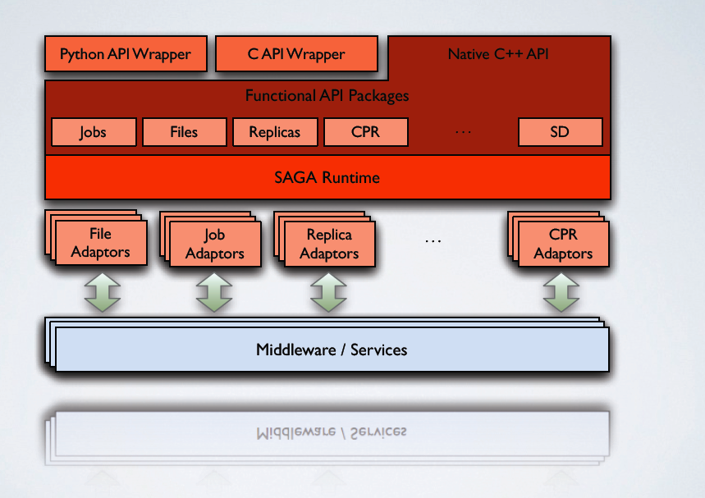
SAGA: In a thousand words

Slide 7
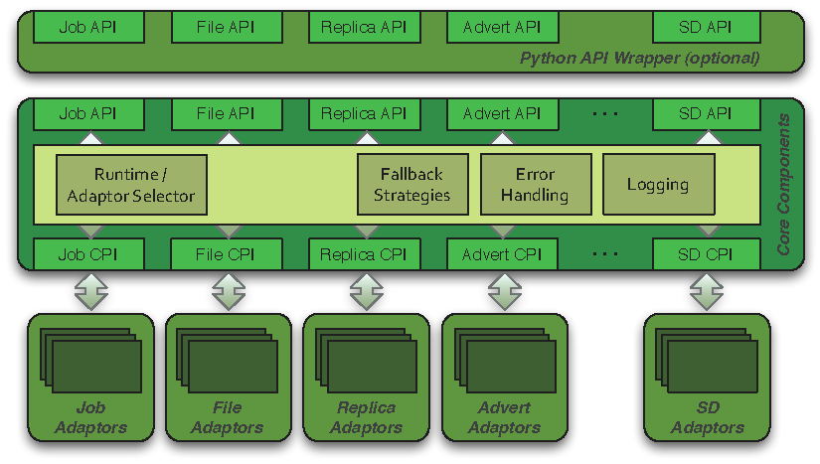
SAGA: Architecture

Slide 8
How is SAGA Used?
SAGA is used to develop applications that are distributed by definition:
Simple extensions of “localized applications” (eg scripting)
MW applications, workers submitted to >8 back-ends
Novel Distributed Programming Models (eg Rep-Exch)
SAGA: Build tools and implement abstractions that enable the execution of applications over distributed resources, without modifying the applications
Eg. Infrastructure Independent Pilot-Jobs
SAGA: To provide uniform access layers to heterogeneous CI
Uniform access to EGI (ARC, gLite, Globus and Unicore/BES)
Simplify the building of tools and Gateways

Slide 9
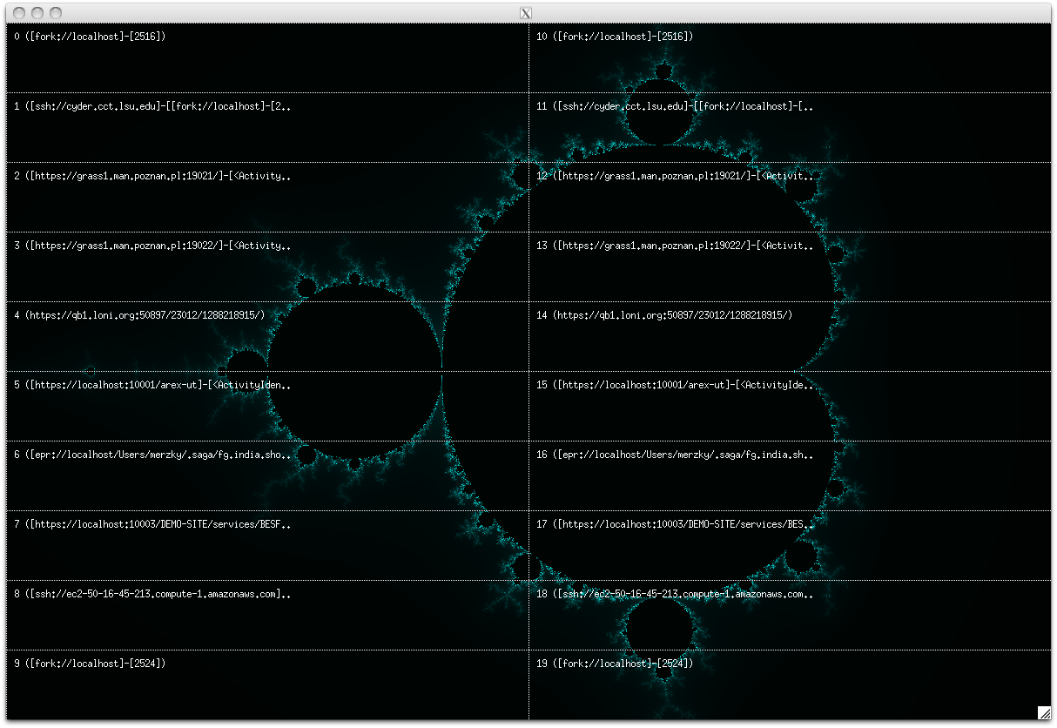
1. Develop applications that are distributed by definition

