Slide 1
A Framework for Flexible and Scalable Replica-Exchange on Production Distributed CI
Melissa Romanus, Ole Weidner, Shantenu Jha, Brian K. Radak, Emilio Gallicchio, Tai-Sung Lee, Darrin M. York, Peng He, Nan-Jie Deng, Wei Dai, Ronald M. Levy

Slide 2
Overview
Introduction
Science Problem (in short)
Async Replica-Exchange Package
SAGA/BigJob Role
Experiments
Performance Model
Systems Investigated
Systems in PJ Terms
Results
System 1
System 2
System 3
System 4
Conclusion

Slide 3
Introduction
Replica-exchange algorithms
Multiple molecular dynamics threads (replicas) are each assigned to a different thermodynamic or potential energy state of the system
Executed in parallel
Replicas travel in configurationally space as well as in state space by communication and exchange of parameters (state assignments)
RE Computationally
Scaling many loosely-coupled MPI-style simulations
Each replica represents an individual execution model with different input parameters – without Pilots, this means many jobs submitted to batch queue
Synchronous vs. Asynchronous
Synchronous (Traditional): Exchange can happen after ALL replicas reach a certain timestep
Asynchronous: When certain replicas reach a done state, they can attempt exchange without having to wait for all others to finish

Slide 4

Science Problem (in short)
“Distributed and Loosely Coupled Parallel Molecular Simulations”
Goal: Understand important aspects of the physics of protein-ligand recognition by multidimensional replica exchange (RE) computer simulations
Large numbers of loosely coupled replicas
Long simulation times (days to weeks).

Slide 5
Async Replica-Exchange Package
Python package built to perform file-based asynchronous parallel replica exchange
Job launching and monitoring occurs through the use of BigJob
A PilotJob is sent to the batch queuing system
Replicas are “subjobs”
Poll status of subjobs to see when they reach the “Done” state
Exchange of parameters = swap input files and “restart” replicas using the new files

Slide 6
Experiments
Performance Model
3 components: (1) BigJob, (2) AsyncRE framework, (3) AMBER & IMPACT
Can introduce application overhead: the fraction of the application runtime that is spent on application management logic, communication, and coordination
Measure throughput as the nanoseconds of model simulation time achieved per hour compute time on a given number of CPU cores ( = Time-to-Completion for a specific number of steps)
TTC_{steps} = T^{O}_{Q} + T_{X}
T^{O}_{Q} is the overhead time spent while the job queues
T_{X} is the total execution time
Queue time can be considered negligible if overall runtime of simulation is sufficiently long

Slide 7
Experiments
T_{X} is decomposed into the following components
T_{R} is the application kernel runtime
Overhead
T^{O}_{BJ} = overhead incurred by BigJob (time spent by BigJob on the placement and monitoring of subjobs during which no computation occurs – includews network round-trip time for communication via Redis)
T^{O}_{RE} = overhead introduced by Async RE package (i.e. when the framework executes management tasks – finding matching exchange partners for a set of replicas and no computation time is occurring)
T^{O}_{K} = overhead introduced by the application kernel (i.e. the kernel supports thread-level parallelism but doesn’t scale linearly with the number of threads)
ULTIMATE GOAL
De-compartmentalize these components to get the following equation:
TTC_{steps} = [ T_{R} + T^{O}_{BJ} + T^{O}_{RE} + T^{O}_{K} ]*
* not achieved in this paper

Slide 8
Systems Investigated (aka SCIENCE!)
MD engines
IMPACT (implicit solvent)
System 1: Host/guest binding of cyclooctanol/β-cyclodextrin. The exchange parameters are all permutations of the system temperatures and an alchemical parameter coupling the host/guest interactions.
System 2: Folding of the TrpCage mini-protein. The exchange parameters are all permutations of the system temperature and the coupling weight of a Go-type biasing potential.
AMBER (explicit solvent)
System 3: Umbrella sampling of the backbone conformational space of alanine dipeptide. The exchange parameters are all permutations of harmonic biasing potentials of each torsion. (i.e. CLASSICAL AMBER RUN)
System 4: Hybrid quantum mechanical/molecular mechanical umbrella sampling of phosphoryl transfer in 2-hydroxy ethyl ethyl phosphate, a model reaction for base catalyzed RNA cleavage. The exchange parameters are all permutations of harmonic biasing potentials on the breaking and forming bonds (i.e. QM/MM AMBER RUN)

Slide 9
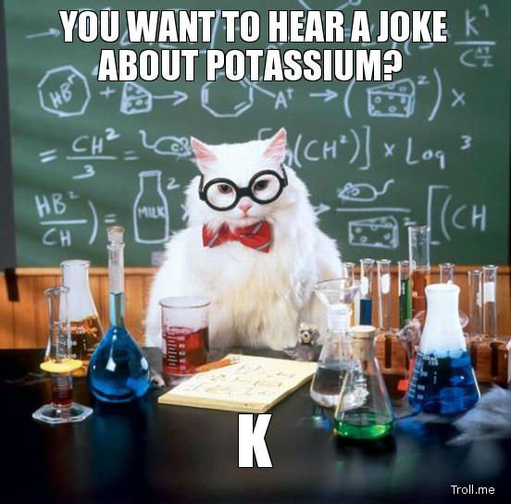
Too Much Chemistry!

Slide 10
Let’s Talk Pilots
IMPACT (Systems 1 and 2): Fixed Pilot Size, fixed Pilot runtime, and varying number of replicas in proportion to the number of cores per replica
AMBER (System 3): Fixed Pilot Size, approx. fixed cycle length (in CPU time) while varying the number of concurrent jobs (i.e. the number of cores per job) and the simulation time of each cycle
AMBER (System 4): Fixed replica count (192) while varying Pilot size

Slide 11
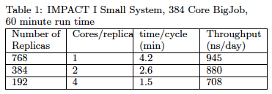
Results – System 1
Nominal maximal throughput: 1300 ns/day (uninterrupted MD at the measured MD CPU speed [4.2 minutes for 10ps per replica])
Observed throughput / maximum = 73%
This corresponds to the overhead imposed by replica exchange coordination (i.e. T^{O}_{BJ} + T^{O}_{RE} )
Parallel efficiency (more cores introduces parallel overhead)
76% for 2 cores
67% for 4 cores
Replica exchange coordination overhead remains approx constant
Indicates ASyncRE+BigJob capable of handling 4000 subjob launches per hour

Slide 12
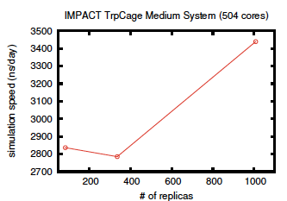
Results – System 2
Nominal maximal throughput: 4.7 μs/day
Observed throughput / maximum = 75%
This corresponds to the overhead imposed by replica exchange coordination (i.e. T^{O}_{BJ} + T^{O}_{RE} )
With 12-cores we obtain 2.8 μs/day
6-fold speed up in terms of single-replica MD throughput

Slide 13
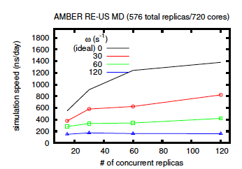
Results – System 3
Length of each simulation cycle (i.e. the frequency with which simulations are coordinated) was fixed in real time by varying the simulation time per cycle
Ideal performance = black line
Diminished results due to coordination overheads
Launch frequency seems to be fairly uniform at higher freq. (see blue line)
Conclusion: Generally, the number of replicas can be increased with only a minor performance hit

Slide 14
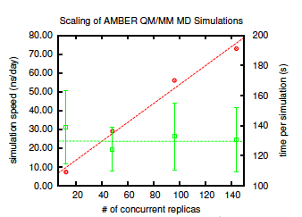
Results – System 4
QM/MM is not generally considered parallelizable
But, we can increase the statistical power of short trajs that can be obtained in a reasonable time frame
Scaling relies exclusively on ASyncRE and BigJob to handle hundreds/thousands of concurrent simulations
Performance increases linearly with core count – no apparent coordination cost for additional simulations
QM/MM simulations are serial

Slide 15
BigJob Discussion
Demonstrated that we could run thousands of replicas using a single general purpose framework
For serial runs, with normal individual simulation cycle times, we see linear scaling by the ASyncRE/BigJob framework (QM/MM) – Good!
For IMPACT systems, we see approx. ratio of observed throughput over maximum 73-75% -- indicating that the overhead by BigJob and the RE Engine ~25% - we don’t have finer grained results of whether this is BigJob or RE overhead
We concluded that we are trying up to 4,000 subjob launches per hour efficiently – this does not really “tax” BigJob since it translates to about 1 job/sec

Slide 16

BigJob Discussion cont’d
For IMPACT medium system, we achieve a 6-fold speedup over single-replica MD throughput
ASyncRE code implements buffer to keep BigJob at peak efficiency (i.e. so that the pilot is not sitting and waiting for jobs) – tries to perform exchanges in a non-blocking way
For AMBER Umbrella Sampling, increasing frequency seems to have uniform performance hit at higher freq. of exchange
May indicate that the overhead observed/introduced is from BigJob since ASyncRE will need to perform more exchanges at higher freq.

Slide 17


