Slide 1
Methods and Models of Federating Distributed Cyberinfrastructure

Slide 2
The Motivation: Federating DCI
What is Federation?
Federation is the collective and concurrent utilization of DCI [1]
Integration and interoperability are necessary conditions
Types and levels of Federation
Intra (within XSEDE)
Inter (across administrative domains)
Why Federate DCI?
Application scalability [2]
Peak (time) and steady-state demand, heterogeneous workload
Application characteristics and sophistication increase
Beyond “pure” HPC or HTC, mixed modes (HP-HTC)
Resource utilization efficiency
Exploit diversity, yet preserve specificity
Will advance the state of theory and practice on XSEDE by providing extensible solutions to an important and strategic application
Notes:
(~need to be careful with DOE argument)
Address (manage) diversity yet preserve (keep) specificity

Slide 3
The CI Problem: The Challenge
We are still learning how to architect large-scale distributed systems!
First generation of DCI characterized by “gluing it” together [3]
Many local solutions, lack of end-to-end solutions
Lack of Models and Methods for simple, scalable execution on DCI
Execution Profiles -- set of decisions – varies significantly
Execution, Compute and Data models supported by DCI inconsistent
“Leaky abstractions” and tools influences application [4]
Conceptual and Implementation Challenges of Federating DCI
How (what level?) to federate resources? When to utilize resource X?
How to manage heterogeneity and complexity?
Abstractions and middleware for resource management?
Optimal Mapping Tasks to Resources
More than scheduling
Application characteristics <==> Federated resource profiles

Slide 4
The Science Problem
Scientific advances often require large-scale federated resources
Example: ATLAS – one of the LHC experiments
Relies heavily on DCI for all computing needs
Discovery of Higgs leading to Nobel Prize enabled by use of DCI
Scale and complexity of computing will increase by factors of 2-10 in future
Need more resources and utilize resources efficiently
Need better federation of heterogeneous resources
Similar questions are being asked of CMS/ALICE
And LBNE, AMS, LSST, LIGO …
“Long Tail of Science”
Scaling remains difficult for individual scientists
< 1% can do O(100) tasks of O(10GB) over O(10) nodes
Campus Bridging: a type of federation of resources
We propose to address both practical and conceptual problem and provide interoperable/extensible implementations

Slide 5
The Team
RADICAL@Rutgers
Triple point of Computer Science theory and principles, Cyberinfrastructure Development and Computational Science
Abstractions-based, Standards-driven RADICAL Cybertools [5]
UTA
Led revolutionary change in HEP computing model through the PanDA workload management system [6]
First practical exascale federated system
BNL
Leads PanDA project jointly with UTA
Is the host US national laboratory in charge of ATLAS
Why this team?
A team of CI/computer scientists and physicists, complementary skills
Complementary AND complete capabilties

Slide 6
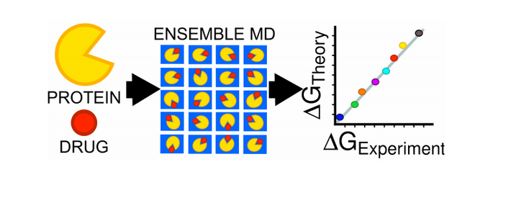
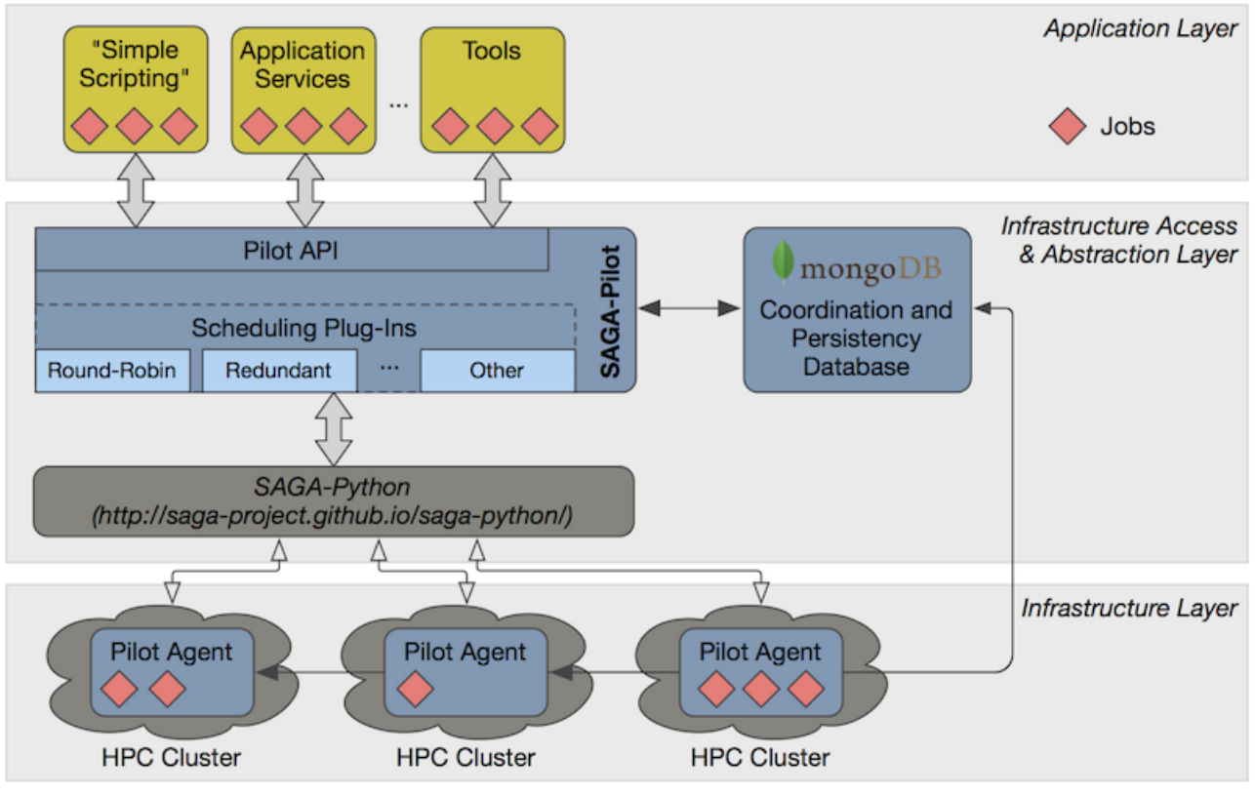
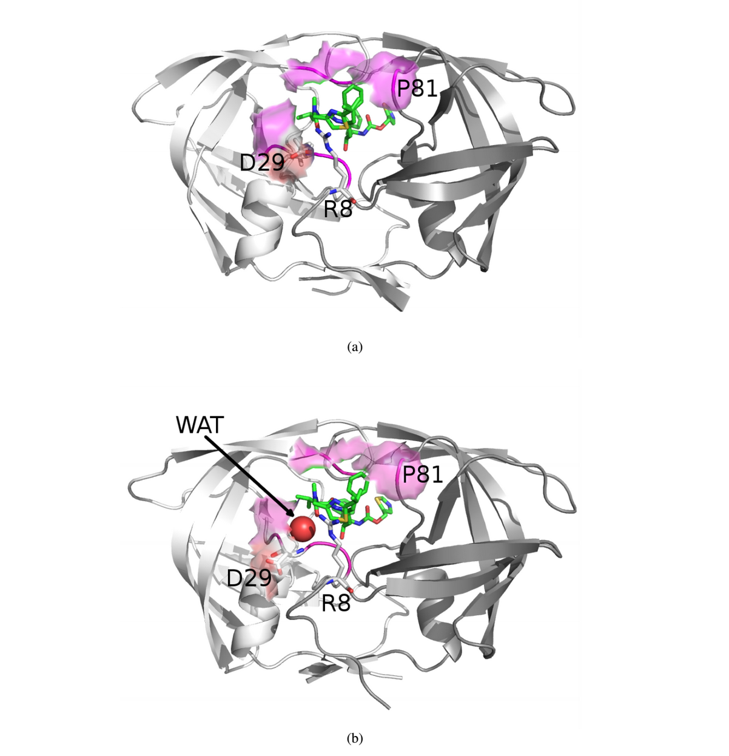
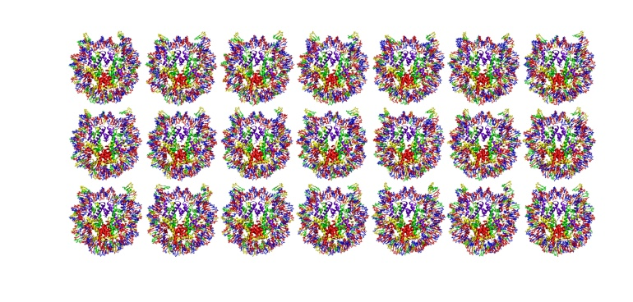
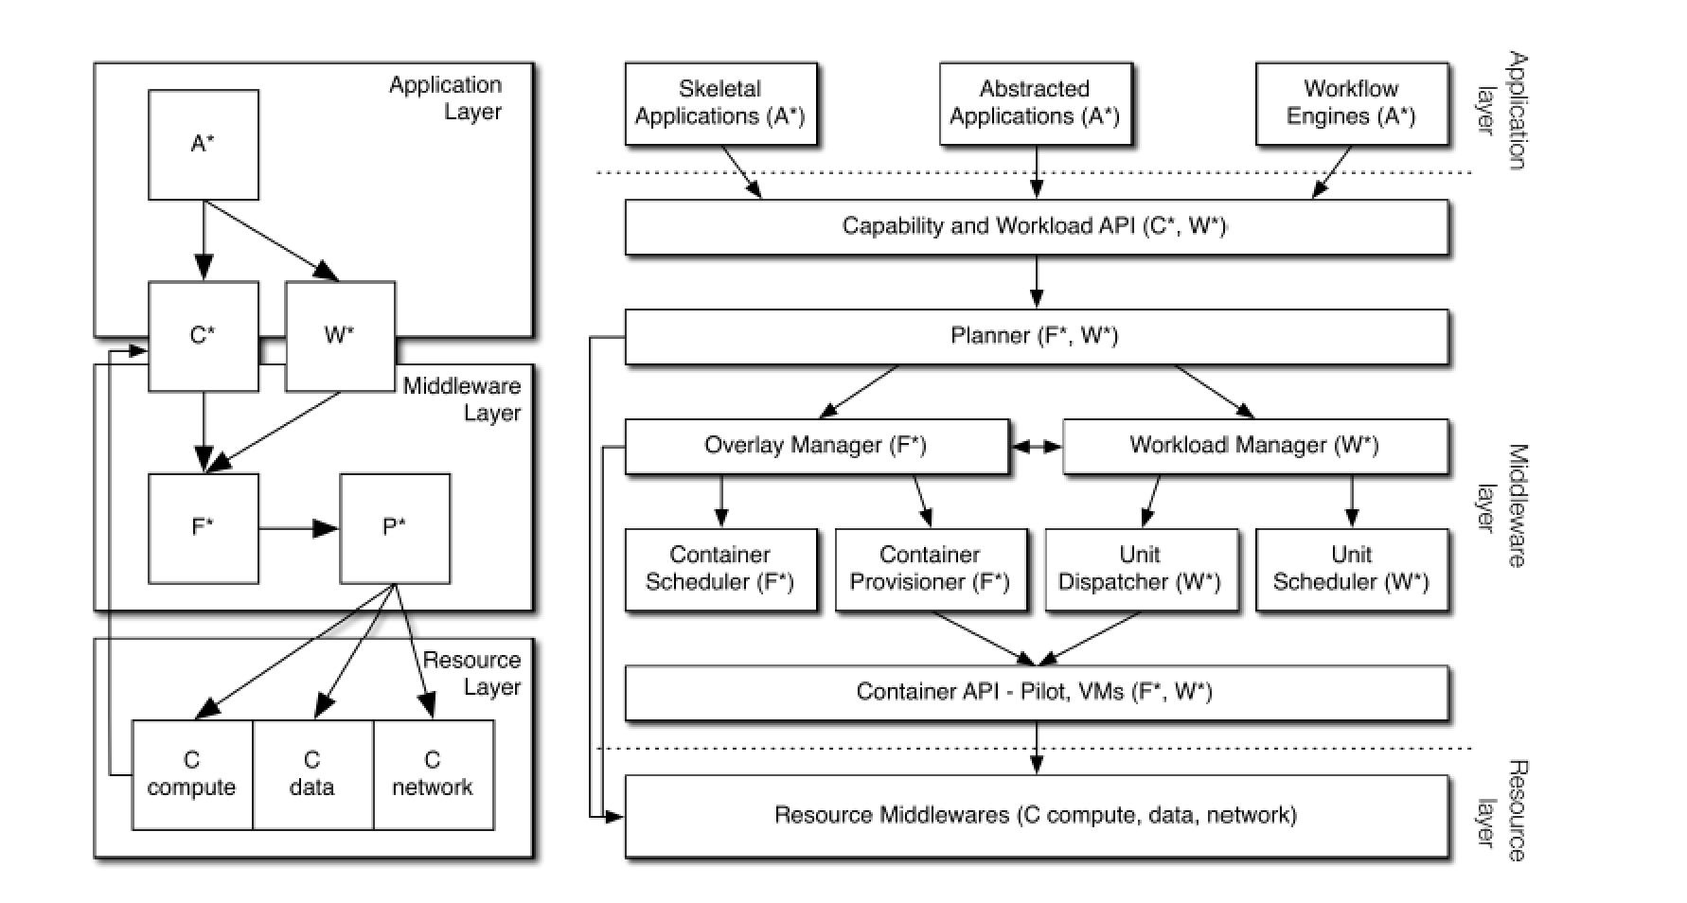
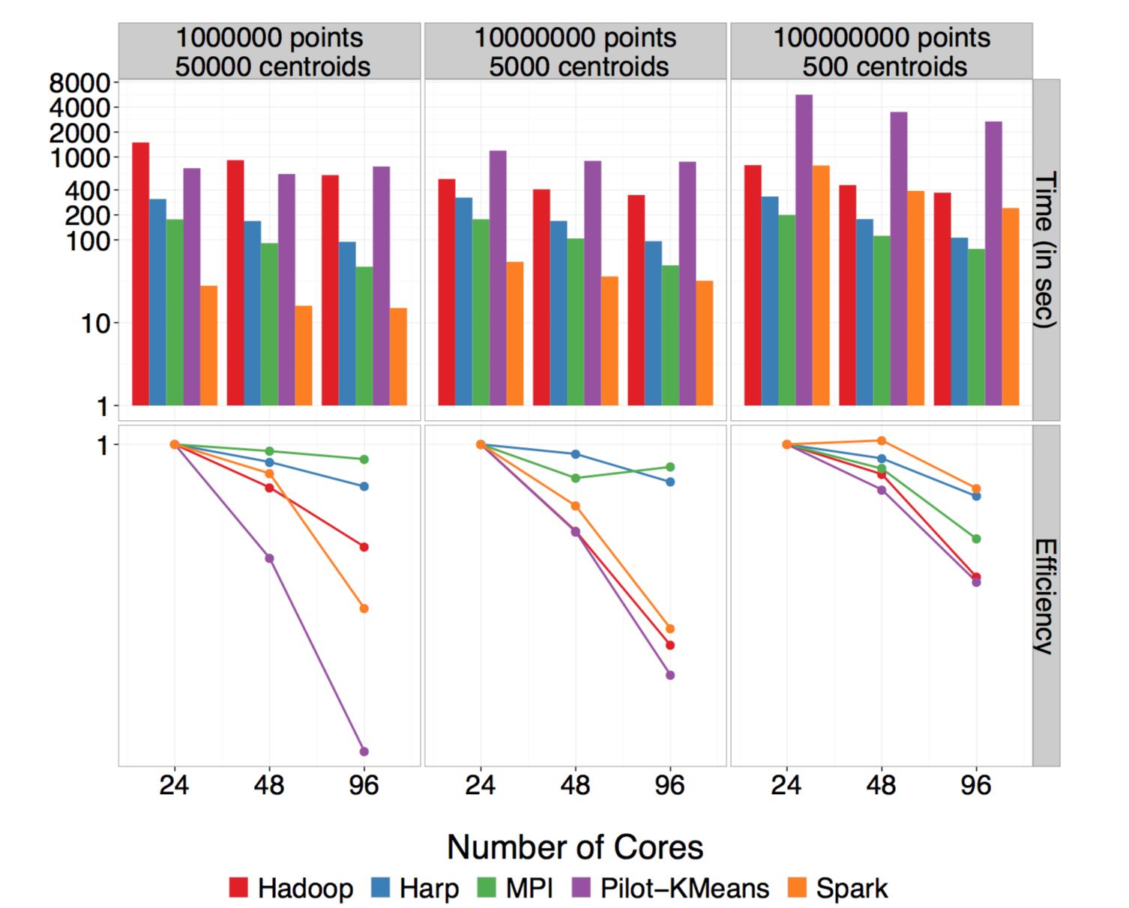
RADICAL: Research in Advanced Distributed Cyberinfrastructure Lab http://radical.rutgers.edu & http://radical.rutgers.edu/projects/radical-cybertools
Specific Approach: (i) Understand Application requirements, (ii) adapt tools and approaches, (iii) refine and optimize for scalable, extensible end-to-end solutions
General Approach: Build Tools that Make Using XSEDE easier (manage compelexity of distribution and heterogeneity) efficient (small software footprint) and effective (meet user requirements)

Slide 7
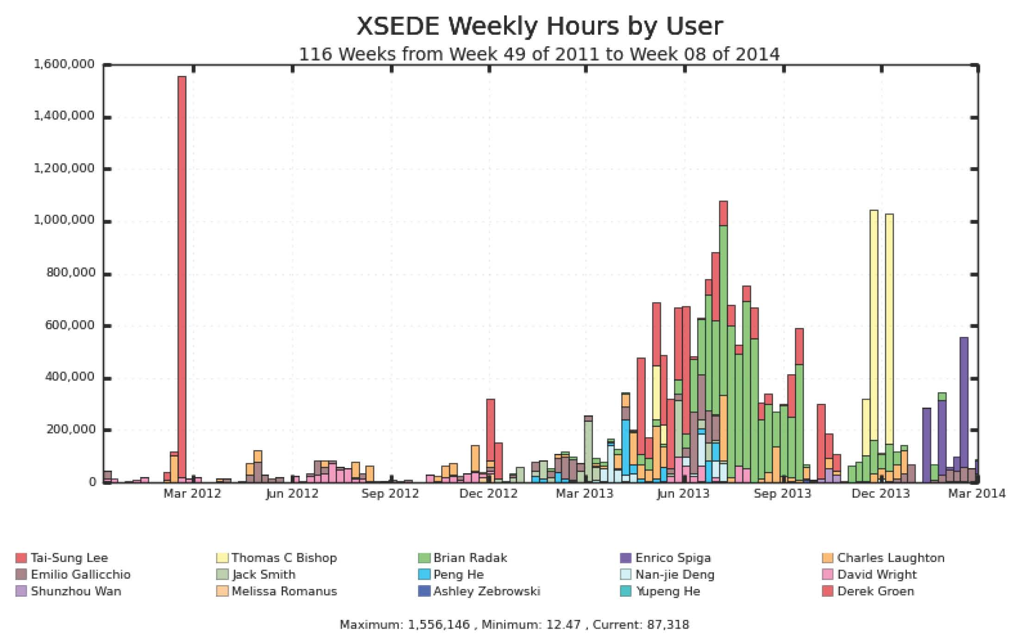
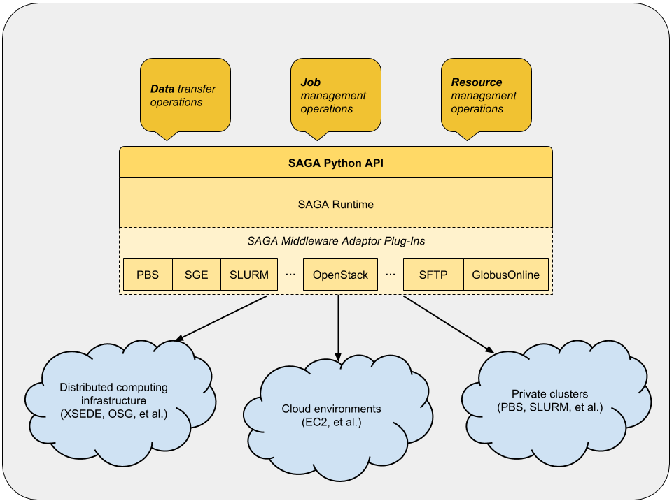
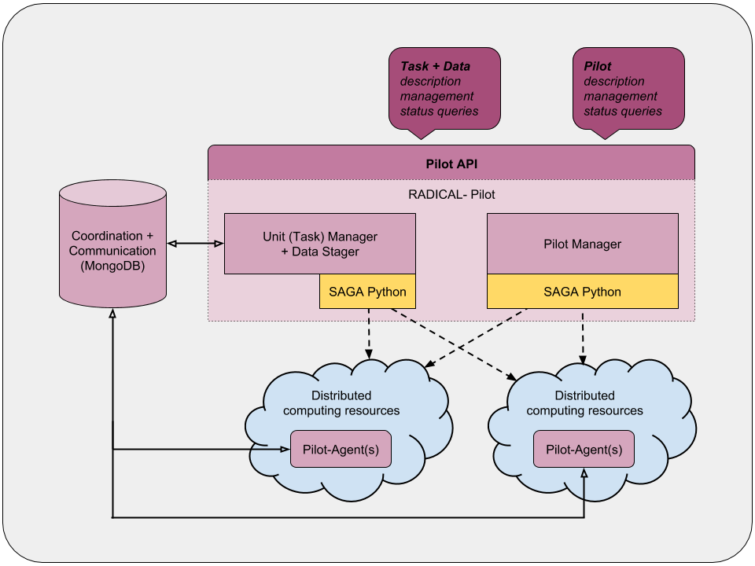
SAGA: Interoperability Layer
SAGA – Simple API for Distributed (“Grid”) Applications:
Allows access to different middleware / services through Python implementation of Open Grid Forum GFD.90.
Also unified semantics across middleware, backend plug-ins (“adaptors”).
HOW SAGA is Used?
Uniform Access-layer to DCI, e.g, XSEDE,
Build tools, middleware services and capabilities
Pilot-Jobs, workflow systems, science gateways and web portals
Domain-specific (distributed) applications, libraries and frameworks
Functional component as well as a specific component XSEDE Architecture [7]

Slide 8
What is PanDA?
Production and Distributed Analysis system developed for the ATLAS experiment at the LHC
Deployed on WLCG resources worldwide
Now also used by AMS
Being evaluated for ALICE, LSST and others
Many US and international partners: NSF, DOE HEP, DOE ASCR, CERN IT, OSG, Academia Sinica TW, NorduGrid, European grid projects, Russian grid projects, …
References:
https://twiki.cern.ch/twiki/bin/viewauth/Atlas/PanDA
http://www.usatlas.bnl.gov/twiki/bin/view/PanDA/WebHome
http://panda.cern.ch:25880/server/pandamon/query

Slide 9
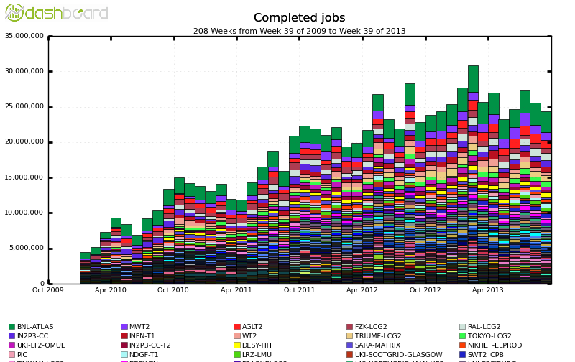
Jobs/month Completed by PanDA (ATLAS)
First exascale WMS! 1.2 exabytes processed in 2013
Current scale – 25M jobs completed every month at > O(100) sites
~O(10⁹) CPU hours a year!

Slide 10
Short Term Plan
Methods: Tools and Implementation
Essential Integration and Simple Interoperability
SAGA + PANDA Integration to utilize multiple XSEDE resources
Common data models, movement & management
Integrate PD2P with P*
Models: Conceptual Challenges
How to federate resources?
Investigate approaches and how they map to different use cases?
XSEDE Use Cases: (i) Federation and Interoperability [1] and (ii) FCI [2]
“Deep” versus “Light” federation of DCI
What abstractions and data-models are needed to “manage” federation?
Metrics: Science
Enable transparent access to at least two XSEDE resources for ATLAS (i.e. PanDA supported execution)

Slide 11
Medium Term Plan
Methods: Tools and Implementation
Deep Federation: Beyond Interoperability and Integration
Supporting common Execution Profiles
Controlled distribution of increasingly demanding and heterogeneous workloads across XSEDE
Models: Conceptual Challenges
How to balance workloads across different resource types
Refine and define models of workloads
W*: Underlying model of workloads
Metrics: Science
Provide O(10⁸) CPU-hrs/year == 20-25% increase in overall cycles utilized for US-ATLAS (~5% of ATLAS)
US Tier II provides ~10⁸ CPU-hrs/year
~1-2% of XSEDE

Slide 12
Long Term: From 2 to ∞
Methods: Tools and Implementation
Integration with XSEDE Execution Management Service (EMS)
“PANDA as an XSEDE Service”
Models: Conceptual Challenges
Efficiency of load-balancing and resource utilization
C.f. Titan is at best 90% utilized.
Dynamic resource utilization and “Dynamic On Demand” Federation
What and When to federate
Metrics: Science
Enable XSEDE for multiple experiments and application communities through PanDA-XSEDE-EMS
Will deliver an “Independent” White-Paper/Technical Report
“Experience, Best Practice and Architecture for Federating Next-Generation NSF DCI and Science”

Slide 13
Impact
Methods:
Current customized and point approaches not sustainable or scalable
Application/project specific
Existing heroic effort limited to “big projects”, not long-tail
Provide Building Blocks: From Interoperability to Federation
Integration and Interoperability: Specific services and capabilities
Federation: Common Models + Integration + Interoperation + Tools
Execution service used by different workflow systems and tools
Models:
Analyze and understand different approaches to Federation
Conceptual basis to reason about best Federation level and approach
Metrics:
Existing: ATLAS, CMS/ALICE and LIGO and LSST
Simulation-based (eg Biomolecular) and other data-intensive
Blue Print for federating future NSF DCI and Application
Notes:
As often happens reflection/reexamine based upon experience/lessons learned
“Innovation at higher levels”
NGMW: Well defined semantics at each layer.. models

Slide 14
References
XSEDE Federation and Interoperability Use Case, S. Jha et al
http://goo.gl/Ge7U61
XSEDE First Connecting Instrumentation Use Cases, K De et al
http://goo.gl/otXtJu
“Distributed computing practice for large-scale science and engineering applications”, 2013, Jha, Katz et al, doi: 10.1002/cpe.2897
P*: Model for Pilot-Jobs, IEEE e-Science 2012, Jha et al,
http://dx.doi.org/10.1109/eScience.2012.6404423
RADICAL Cybertools
http://radical-cybertools.github.io/
PanDA Production and Analysis backend. 17th International Conference on Computing in High Energy and Nuclear Physics March 2009. Journal of Physics Volume 219, 210. K.De et al
XSEDE Architecture
https://www.xsede.org/documents/10157/281380/XSEDE+Architecture+2012-03-03+Level-1-and-2+ver+1.pdf
Notes:
As often happens reflection/reexamine based upon experience/lessons learned
“Innovation at higher levels”
NGMW: Well defined semantics at each layer.. models

