Slide 1
Designing and Implementing Standards-based Application Access to Clouds
Shantenu Jha, Andre Merzky,
Matteo Turilli, Ole Weidner
CAC, Rutgers

Slide 2
Project Overview
The Problem
  Science & Enterprise applications at scale need performance & flexibility
    Optimized applications are pinned to a specific platform, e.g., Hadoop
    Flexible run anywhere but performance is unpredictable, e.g., T_{x}, T_{q}
  As cloud infrastructure evolves – diverse, heterogeneous, new features and services, exploiting flexibility with performance will be a challenge
The Hypothesis
  Lessons from the Grid experience should be extended to the cloud paradigm as infrastructure evolve and need to be federated
    Complex Systems fail for simple and complex reasons alike!
  “Managing complexity is not the same as extracting simplicity”
    Extracting simplicity whilst managing complexity requires abstractions
The Solution
  SAGA-OCCI: Standards support Interoperability
    Standards simplify systems via interfaces,
  Standards enable innovation at higher-levels
    E.g. Pilot-abstractions facilitate effective resource management
Notes:
Please include start/stop dates and the project budget.

Slide 3
Background
SAGA
  Standards based Application Level Interoperabilty
  Stable syntax and semantics on application side
  Portability of programming abstractions and constructs
  How is SAGA Used?
    Uniform access and scripting layer to infrastructure
    Build applications, tools and services that use distributed infrastructure
OCCI
  Management Interface to virtual machines/resources
  Provides standards based system level Interoperability
  Stable syntax and semantics on service side
SAGA and OCCI are complementary community standards

Slide 4
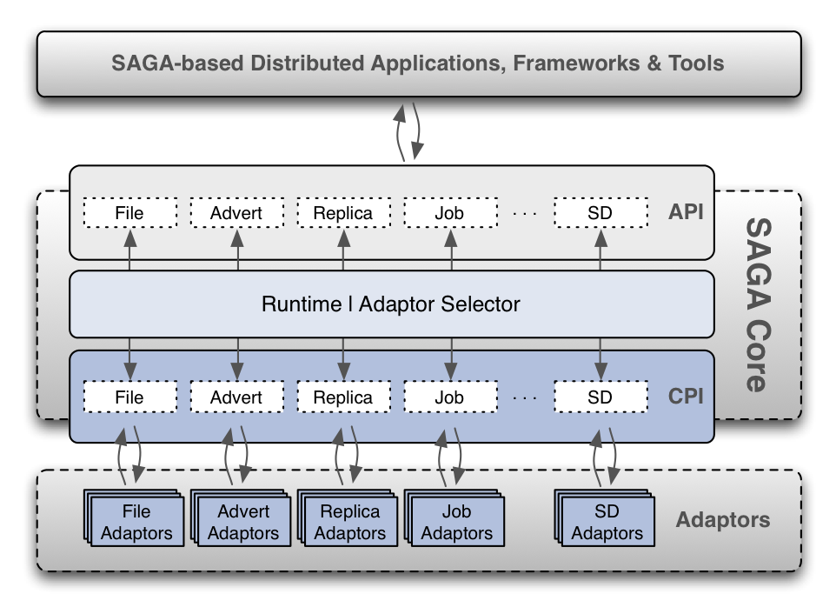
Background
SAGA: Community Standard for Distributed Applications
http://saga-project.org
Notes:
Distributed Applications generally defined.. Tools ⬅➔ Applciations

Slide 5

Background
OCCI: Open Cloud Computing Interface
http://occi-wg.org/
OGF specification of a RESTful Protocol and API for cloud management tasks
  Especially for, but not limited to IAAS. Focus on interoperability
Allows for the management and linking of compute, storage, network and locally defined resources.
Leverages “mixins”: an extension mechanism to defined new type of (aggregated) resources such as templates or tags.
Multiple implementations available: See URL
Currently adopted within many enterprise and academic projects/infrastructure
  Increasing uptake e.g., EGI federation cloud test-bed

Slide 6
Project Task: Overview
Having conceptualized the interface driven by several application use cases, now design and validate extensions to SAGA and OCCI technical specifications
  Using existing SAGA Python and OCCI Python renderings
Task 1: Enable integration of SAGA and OCCI
  Implement a prototype adapter
Task 2: Testing & deployment on grid/cloud test-bed and platforms
  Harden capabilities against the common platforms:
    AWS, Google Compute Engine
    FutureGrid and other academic and local clouds
Task 3: Scalability and Application Integration

Slide 7
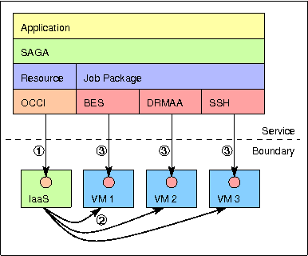
Task 1: Development
The immediate next steps
  Design and validate extensions to SAGA and OCCI technical specifications
Enable integration of SAGA and OCCI
  Specify interface between
  Implement a prototype adapter
    Use python versions of SAGA and OCCI
  Design unit and validation testing protocols

Slide 8
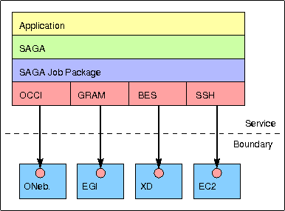
Task 2: Testing and Scaling
Scale-up, Scale-out and across
Testing and deployment on Grid and Cloud test-bed
    FutureGrid and other academic/local clouds
Harden capabilities and make production grade quality on most popular common platforms:
  Enterprise: AWS, Google Compute Engine
  Academic/Enterprise: OpenStack, OpenNebula, Reservoir
Notes:
Scaling at multiple levels: up, out and across

Slide 9
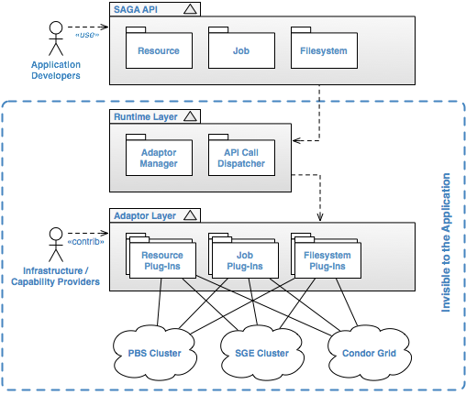
Activities and outcomes
Advances with the Python development of SAGA
  http://saga-project.github.com/saga-python/
  Supports multiple back-ends:
    PBS, TORQUE, SGE, SLURM, Condor, SFTP, iRODS
    Single interface to all clusters – local and remote
    Increase list of backends on demand
  Improve documentation, usability
  Automated testing
    Good SWE best practice

Slide 10
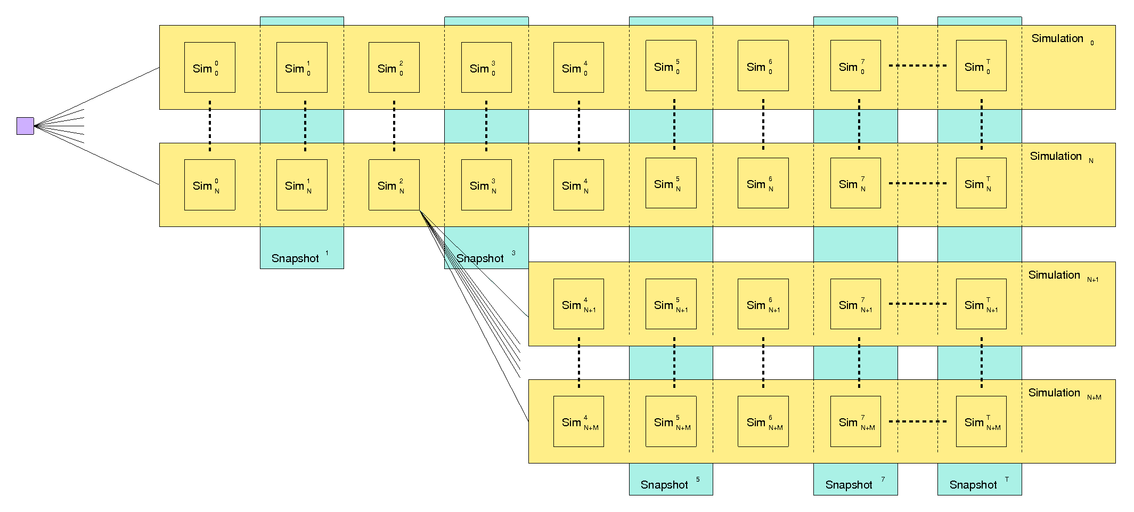
Activities and outcomes
“Classic” Use Case :
  Very common application execution pattern
    Ensemble or parameter-sweep
  How can this popular pattern be better supported?
  Specific test case:
    Clouds and Clusters
    Combined the two enable performance and flexibility

Slide 11
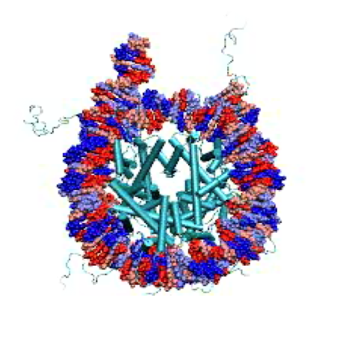
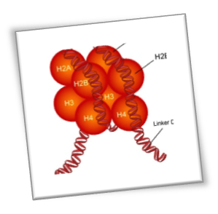
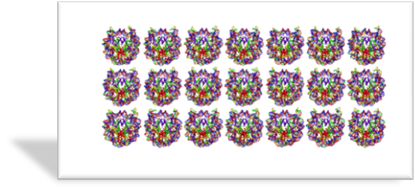
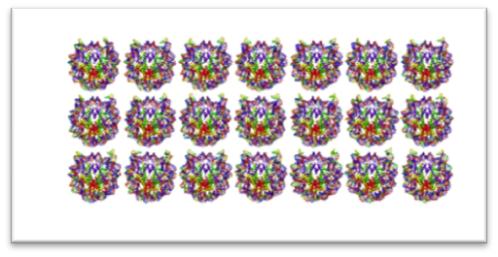
Example of Task 3: Scalable Online Comparative Genomics of Mononucleosomes
Typical Run
  210 Simulations (5 x 21 x 2)
  2400 Cores on Lonestar for ~21 hrs
  ~50,000 SUs
  ~750 GB of output
Total:
  10+ Runs (2100 sims)
  4 Restarts
  ~500,000+ CPU-hours!
  ~7.5 TB of output
Slide courtesy: Tom Bishop, Jack Smith

Slide 12
Ongoing and future work
Finalizing the Python development of SAGA
Planning Task 1 and 2
Task 3: Integrating/testing and scaling with a range of applications and application types
  Including large-ensembles and data intensive applications.
Integration with higher-level tools and services (e.g. Pilot-abstractions, Workflow tools, Gateways etc.)
  Will support massively concurrent execution
  As well as more complex, yet simplified “workflows”

Slide 13
Deliverables and benefits
Deliverables:
  Quality production grade adaptors between SAGA and OCCI
    Single interface to nearly every major cloud platform
    One mode of accessing proliferation and heterogeneous cloud offerings via existing standards
  Enable scalable and flexible application execution
    Provide a common simple, job and data model across most commonly used grids/clusters and cloud
Benefits:
  Standards facilitate interoperability and extensibility, and thus permit innovation at higher and other levels
  Enable advanced, efficient and simplified usage of clouds and federated infrastructure
Notes:
List chronologically, including future deliverables, and indicate where you are in the list.

Slide 14
Team and Leverage
Team Lead: Prof. Shantenu Jha
Research Team:
  Andre Merzky: Community Standards and developer
  Matteo Turilli: Cloud Federation and testbed
  Ole Weidner: Research Programmer and developer
Will leverage existing developments and research into dynamic distributed data-intensive (D3) applications

