Slide 1
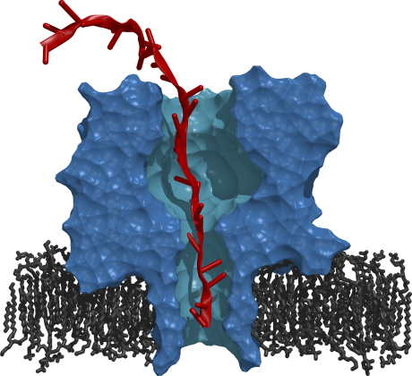

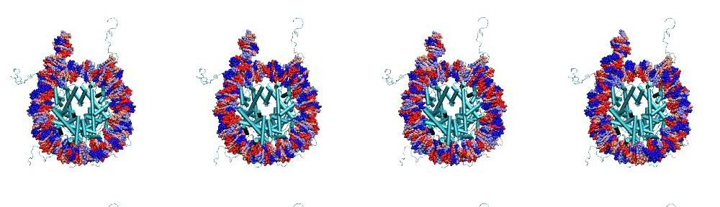
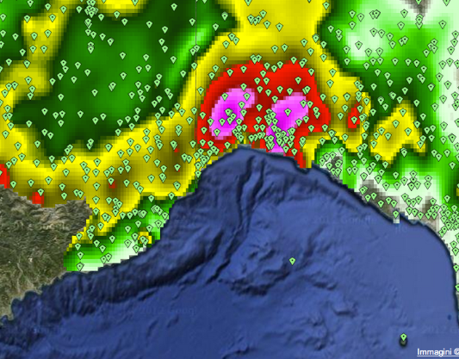
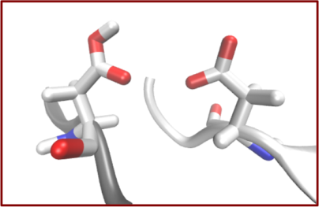
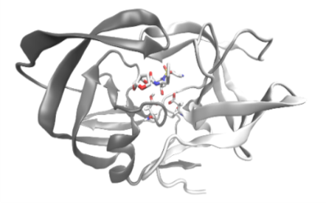
DARE: A Standards-based Middleware for Science Gateways
http://radical.rutgers.edu
EGI Manchester
09th April , 2013

Slide 2
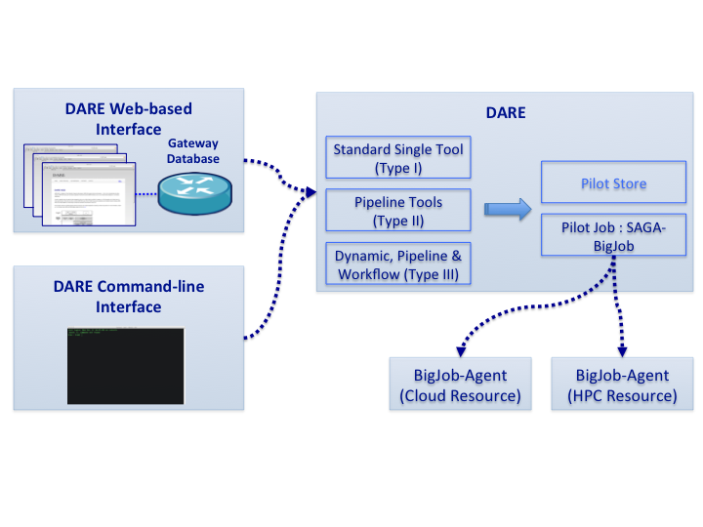
Distributed Application Runtime Environment (DARE)
Design Objectives:
Separation of Concerns:
Agile, flexible user customization versus resource management
Use standard-based access layer
SAGA and SAGA-based Pilot Job (BigJob)
Pilot-Job as a flexible execution environment

Slide 3
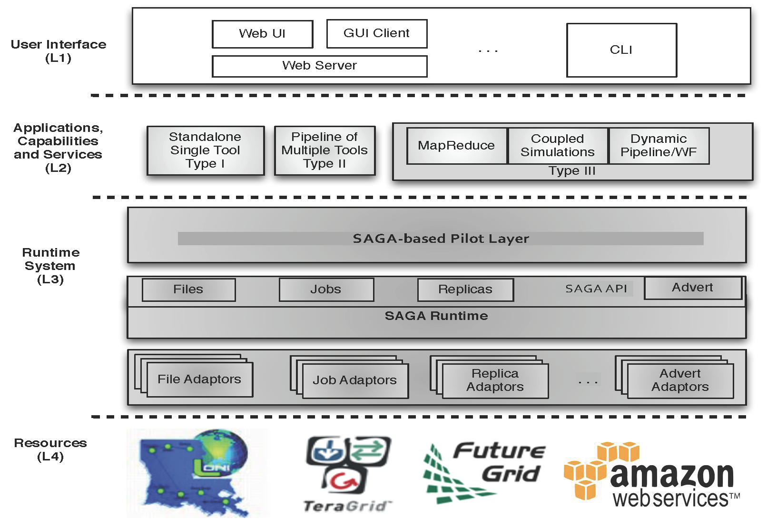
DARE: Standard-based Integrated Middleware

Slide 4
SAGA: Resource Interoperability and Standards-based Access Layer
http://saga-project.org

Slide 5
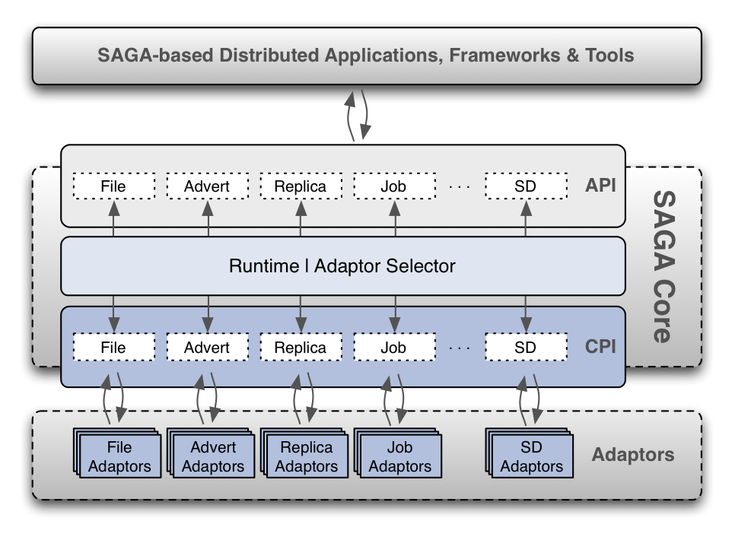
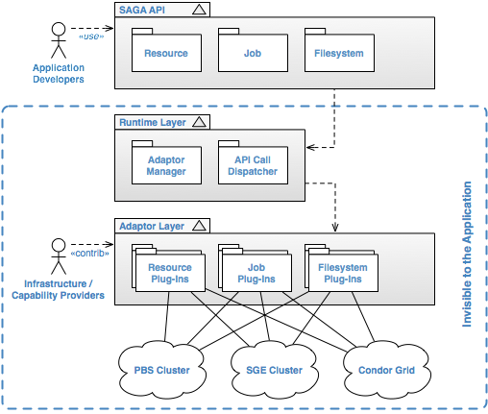
SAGA: Standard for Distributed Applications

Slide 6
SAGA: Interoperability layer
HOW SAGA is Used?
Uniform Access-layer to DCI
XSEDE, DATAONE, UK NGS and NAREGI/RENEKI and Clouds
Application “Scripting Layer” to DCI
Improved and enhanced HTHP ensembles
Build tools, middleware services and capabilities that use DCI (e.g. Gateways, Pilot-Jobs)
One persons applications is another persons tool!
WHAT is SAGA Used for?
Support production-grade science and engineering
Aircraft design (Airbus), HEP (search for Higgs & neutrinos!)
Research tool to design, implement reason about distributed programming models, systems and applications

Slide 7
SAGA-Python
Re-architected implementation of saga (BlisS) that provides
support for bulk optimization
support for callbacks
support for asynchronous operations
Implements ‘official’ OGF python language bindings
Implements the job, file, replica and resource APIs
Supports multiple backends:
PBS, TORQUE, SGE, SLURM, Condor, SFTP, iRODS, (GSI-)SSH
local schedulers (PBS, SGE, ...) can be accessed remotely via SSH tunnels
Website:
http://saga-project.org
http://saga-project.github.com/saga-python/
https://github.com/saga-project/saga-python

Slide 8
BigJob: A Reference Implementation of the P* Model

Slide 9
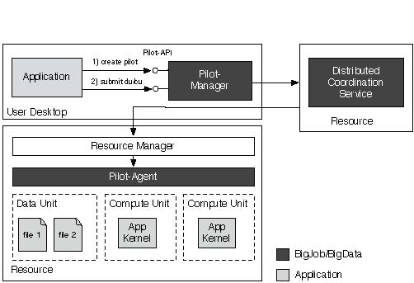
BigJob: Implementation of the P* Model

Slide 10
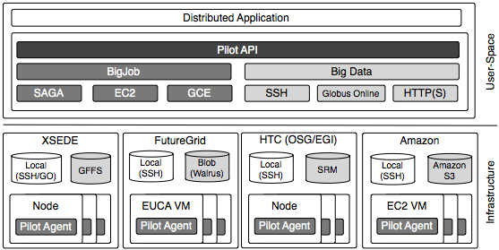
BigJob: Resource Interoperability

Slide 11
DARE-BigJob: A Flexible and Extensible Gateway using Pilot-Abstractions
http://gw68.quarry.iu.teragrid.org:8080/
http://saga-project.org

Slide 12
DARE-BigJob: Motivation and Goals
Intellectual Motivation: Gateways are usable but not very flexible
Best of both worlds?
Aim: Provide compositional flexibility (a la command-line), whilst providing transparent (and powerful) resource management and managing the runtime complexity of DCI ?
To provide a lightweight extensible gateway that helps in supporting multiple and flexible usage modes on XSEDE and OSG
Pilots are powerful paradigm for resource utilization.
Pilots don’t have to be passive elements.
P* Model establishes Pilots as an active element
BigJob used extensively on XSEDE. Lower the barrier for its uptake
Make it simple for the usage of Pilot-Jobs on XSEDE
Will extend to OSG and possibly to EGI

Slide 13
DARE-BigJob: Practical Information
DARE-BigJob: Latest in the family of gateways built upon DARE
Passive E.g., DARE-HTHP, DARE-NGS, DARE-Cactus
It is written in Python --- from top to bottom, front to back
BigJob is a SAGA based general purpose pilot-job framework. SAGA based BigJob acts as a intermediary in submitting jobs from DARE to a heterogeneous Computing resource.
Django is a high level python web framework to support clean, pragmatic design.
Celery is an asynchronous task queue based upon distributed message passing and scheduling as well.

Slide 14
DARE-BigJob: Control Flow
Flowchart
Django
Stores Job information and user authentication
Sqlite 3 Database
DARE-BigJob Website
User input for files, pilot information, tasks
File input, pilot information and tasks
Enqueue tasks
Celery Coordination service
Celery Worker
Passes tasks, created pilot
Distributed coordination service for BigJob
Pilot Manager
Resource (Futuregrid, XSEDE)
Resource Manager
Pilot Agent
Data Unit
Compute Unit

Slide 15
DARE-BigJob: Scripting Example (1)
Scripts to generate a single task
def tasks():
compute_unit = {
"executable": "/bin/echo",
"arguments": ["Hello", "$ENV1", "$ENV2"],
"environment": ['ENV1=env_arg1', 'ENV2=env_arg2'],
"number_of_processes": 4,
"spmd_variation": "mpi",
"output": "stdout.txt",
"error": "stderr.txt"}
return compute_unit

Slide 16
DARE-BigJob: Scripting Example (1)
Generating multiple tasks
def tasks(NUMBER_JOBS=10):
tasks = []
for i in range(NUMBER_JOBS):
compute_unit_description = {
"executable": "/bin/echo",
"arguments": ["Hello", "$ENV1", "$ENV2"],
"environment": ['ENV1=env_arga’ + i, 'ENV2=env_argb’ + i],
"number_of_processes": 4,
"spmd_variation": "mpi",
"output": "stdout-%s.txt” %i,
"error": "stderr-%s.txt” % i}
tasks.append(compute_unit_description)
return tasks

Slide 17
DARE-BigJob
Registration
Request for an Invite
http://gw68.quarry.iu.teragrid.org/invite/request/
Once approved by admin you will receive invite to join to the email you submitted
Using that link we can complete Registration through Google/Yahoo and login.
Authentication
Use Google/Yahoo Accounts to login.
Separate password to login is not required

Slide 18
DARE-BigJob
Login
http://gw68.quarry.iu.teragrid.org/log-in/ (dareuser, password)
Note to self: Remove the username and password before posting!!
Create and edit Tasks
http://gw68.quarry.iu.teragrid.org:8080/my-tasks/
Click on button “Add a Task” and add necessary scripts.
Starting Pilots
http://gw68.quarry.iu.teragrid.org/job/bigjob/
Click Start-Pilot button for lonestar. it submits pilot (pbs+ssh) to queue from predefined account on lonestar (smaddi2).
Select task you want to run and hit “Add Task”

Slide 19
Acknowledgements/Funding Sources
People:
Sharath Maddineni (now consultant for Google)
Joohyun Kim (LSU)
Sanket Wagle (Rutgers)
Yaakoub el-Khamra (TACC)
Ole Weidner (Rutgers)
Active:
NSF CAREER Award 2012 (OCI-1253644)
CDI NSF-CDI (NSF CHE 1125332)
ExTENCI (NSF OCI)
SCIHM NSF-OCI (OCI-1235085)
AIMES DoE-ASCR (DE-FG02-12ER26115)
Compute Time:
NSF TeraGrid TRAC award TG-MCB090174
NSF FutureGrid Award (No. 42)
Recent Past:
NSF/LEQSF (2007-10)-CyberRII-01
NSF HPCOPS NSF- OCI 0710874 award
UK EPSRC (GR/D0766171/1) and e-Science Institute, UK
NSF OCI 1059635
NIH Grant Number P20RR016456

Slide 20
DARE-BigJob: Implementation
Celery strength is to execute short running tasks with a task queue.
We leverage this functionality by creating tasks in that queue for the following
Task queue for starting/stopping Pilot agents, compute units
Status reporting for the user on the website about the task and pilot statuses.
Celery invokes asynchronous BigJob calls for creating pilots/tasks

Slide 21
DARE-BigJob: Implementation
The gateway uses a website to define task, create a pilot and provide input files to run the job.
The user is exposed to very little python syntax so that scientists from different fields can focus on submitting jobs to the gateway instead of spending time installation, setup and debugging the code
All the task submitted to a pilot will have same jobid and pilot url to keep track of each tasks. The user entered tasks specific information is validated and stored into Django Models( database).
Celery acts as a messenger between the Web frontend and SAGA BigJob. It passes the new tasks onto the pilot container so that BigJob manager can schedule these tasks on respective resources.
Notes:
Test

