Slide 1
SAGA: tasks & task bulks
Realization of bulk operations within the C++ reference implementation
at GGF17, Tokyo, Japan, Stephan Hirmer

Slide 2
A G E N D A
Introduction: the SAGA task model
The big picture
Adding meta-information to saga::task
Analyzing & bundling task bulks
Executing bulks
Monitoring tasks – monitoring bulks
Demo
Results

Slide 3
The SAGA task model
saga::task
  saga::task::run()
  saga::task::wait(double timeout)
  saga::task::cancel()
  saga::task::get_state()
saga::task_container
  saga::task_container::run()
  saga::task_container::wait()
  saga::task_container::cancel()
  saga::task_container::add_task(saga::task)

Slide 4
The big picture
add meta-information to
the tasks
saga::task_container tc;
saga::directory dir(dir_path);
for(int i = 0; i < 100; i++)
{
saga::task t =
dir.copy<saga::task>(src,dest[i],…)
tc.add(t);
}
tc.run();
[…] // some other code
tc.wait(-1.0);
[…] // continue …
bundle tasks into bulks
by analyzing them
execute “similar” task
together (bulks)
monitor tasks & task
bulks

Slide 5
Adding meta-information
recently:
  bound functor was put in a task
  functor was executed within a thread
now:
  functor separated from parameters
  + meta-information are put in the task
  functor is executed with parameters in a thread
task controls parameters + meta-info

Slide 6
Analyzing & bundling tasks
in task_container::run()
  using meta-information for analysis
  bundling “similar” tasks together
according to different strategies
  same operation
  same api object
  etc …

Slide 7
Executing bulks (I)
Two different strategies:
  common points
    foreach bundle of “similar” tasks
      selecting suitable bulk-adaptor
      organizing parameter passing from task to
      selected bulk-adaptor by using a visitor concept
  simple strategy
    assuming that the adaptor is able to execute all
    the tasks within the bulk

Slide 8
Executing bulks (II)
  more improved strategy
    only trying to execute a given sub-bulk shows if a selected bulk-adaptor is really able to execute the given sub-bulk
    selected bulk-adaptor tries to execute all the tasks using its specialized bulk handling
    returns a subset (may be empty) of tasks he couldn’t execute
    new bulk-adaptors are selected until all bulks are executed
    if necessary, fall back to one-by-one execution.

Slide 9
Monitoring bulks
Problem:
  During the execution of a task within a bulk, the link between the task-object & the real execution gets lost.
Solution:
maintain list of links between task-object and the executing bulk-adaptor.
  using uuids

Slide 10
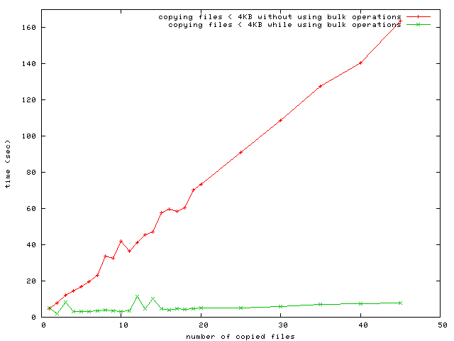
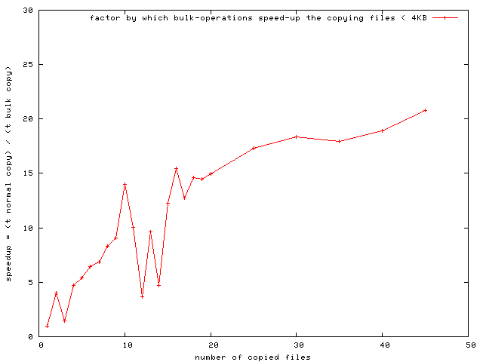
Results (I) - Benchmarks
Please note:
These are first results,which has to be still verified and analysed.
Benchmarks:
Copying n files from server A to server B
using the GridLab Fileservice with gsi authentification.

Slide 11
Results (II)
Problems:
  SAGA specific
    saga::task_container not derived from saga::task
    no templates allowed in api-classes
  General:
    globus not available for Windows

Slide 12
thank you very much for your attention …

