Slide 1
Pilot-MapReduce: An Extensible and Flexible MapReduce Implementation for Distributed Data
Pradeep Mantha, Andre Luckow, Shantenu Jha
The RADICAL Group
http://saga-project.org

Slide 2
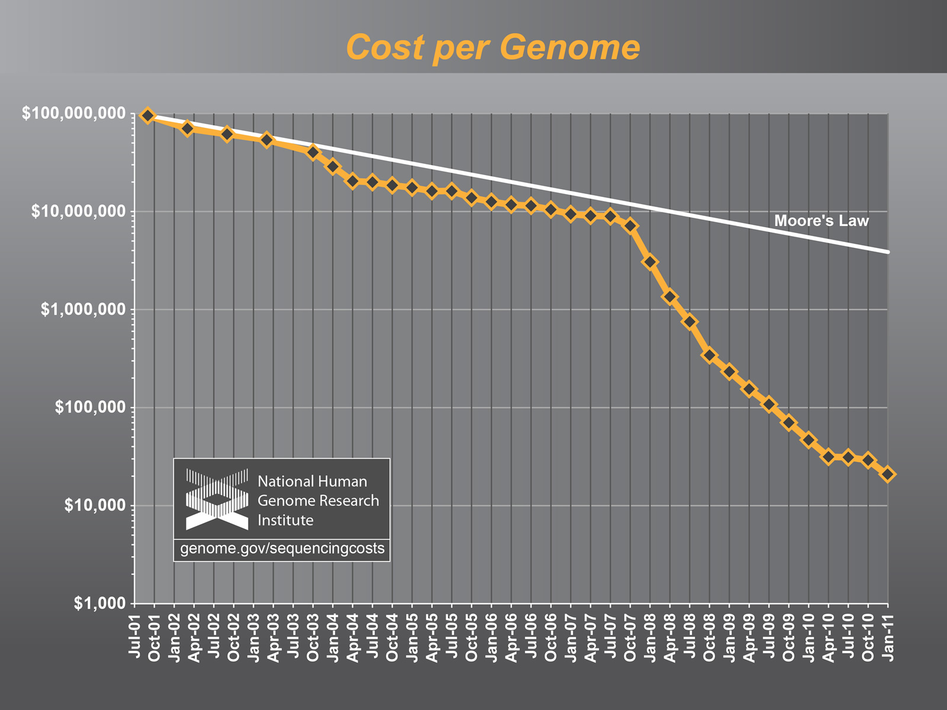
The Challenge of Integrating Compute and Data at Scale
Notes:
Just one representative example: defy simple categorization.

Slide 3
Overview
  Understanding the Landscape of Distributed CI and Applications
P* Model of Pilot-Abstractions
  SAGA: A Standards layer upon which other abstractions are built
  Uniform abstraction for compute and data
  Interoperability and Extensibility
Pilot-MapReduce
  MapReduce Topologies: Lokal, Distributed, Hierarchical
  MapReduce on WordCount
  MapReduce based next-generation gene sequencing data
Conclusion
Notes:
Delicate balancing act: --- vision of the future but rooted in reality – with rigorous research.
PJ analogy with WF
Be sure to define “applications” – eScience, scientific applications…

Slide 4
Landscape of DCI and Applications: Empirical Assertions
The space of possible DA is large (and rich), but the number of effective and extensible DA small
  More than just submitting jobs here and there!
  Whole must be greater than the sum of the parts
Developing DA is a hard undertaking
  Intrinsic and Extrinsic Factors
  Coordinating across resources
There are missing abstractions and poor implementations
  Many local solutions, lack of end-to-solutions, especially tools
  Missing conceptual frameworks and systems approach to tools
Accept, if not embrace “distributedness”
  Manage it, but also exploit it
  The ability to reason: distributed performance, decomposition or aggregation!
Clouds are an important and useful development but not a panacea
Notes:
Whereas the choice of tools will
always be in influenced by soft factors, we are focussing on the absence
of tools, services and capabilities that enable the developer to
reason about the above hard factors

Slide 5
DCI Challenges: Infrastructure Perspective
  Fundamental: How to design and implement DCI such that the whole is greater than the sum of the parts? [where each of the parts is complex heterogeneous systems!!]
  DCI is not just scaling up a single computing resource
  Avoid redundancy, exploit commonality
DCI is complex: Heterogeneous software, access-layers, policy..
  Middleware: Heterogeneity and semantic incompatibility
  Slow/lack of agreement towards a standards-based solution
  Difficult to integrate services & software (service-level Interop)
  This is not Google (i.e., uniform, single top-down solution), as much of a socio-cultural challenge as a technical one
Distributed Computing Practice for Large-Scale Science & Engineering Applications, Jha, Cole, Katz, Parashar, Rana and Weissman, CCPE (in press)
Notes:
Development is definitely a challenging
aspect of these application, our analysis demonstrates that deployment
and execution concerns are important too (and in many/some cases the
dominant barrier!).

Slide 6
DCI Challenges: Application Perspective
End-to-end application support missing
  Many moving and changing parts, insufficient / partial coverage
Well defined interfaces
  Standard-layers handle hard parts, allowing innovation elsewhere
  Effective dynamic resource utilization and execution models
    Beyond simple static single batch-mode…
“Complex” coordination requirements
  How to manage coordination?
Abstractions to support: Where, when, how to distribute?
  Both Development and System/Infrastructure level abstractions
Notes:
Whereas we agree that the choice of tools is a result of
non-quantitative factors, we also believe, a
distributed application has some unique challenges: a distributed
application/developer has to reason about the environment that the
application will execute in, has to make assumptions about the runtime
availability, and has to assume a failure model that transcends
complete knowledge of the application or even predicates it upon
knowledge of a system/resource.

Slide 7
Middleware IDEAS: Development Objectives
Interoperable: Heterogeneity and Environmental Complexity
    Ability to work within and across multiple DCI concurrently
    Horizontal (Service) and Vertical Interoperability (Application)
Dynamic: Beyond static execution & resource allocation models
    Decisions at both deployment and run-time
    Dynamical execution is almost fundamental at scale
Extensible: Support new functionality & infrastructure without wholesale refactoring, i.e., lower coupling to tools & infrastructure
    Abstractions based tools and systems building
Adaptive/Autonomic: Flexible formulation, self-*
Scalable: Along many dimensions and design points
Challenge: To develop DA and provide DCI, effectively and efficiently with IDEAS as first class objectives, with simplicity an over-aching concern
Notes:
Can’t just do one, i.e.,, Dynamic. Needs to be done with the support of others
“Information Service is only required to determine decisions at the deployment stage not run time”
“Tool X provides Dynamic Decision Capabilties”

Slide 8
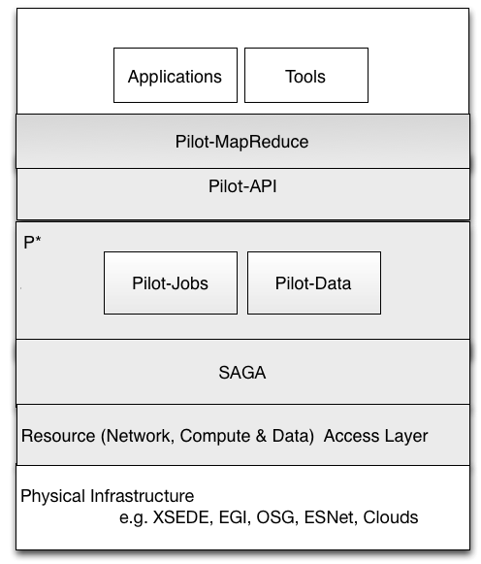
P* Model of Pilot-Abstractions

Slide 9
SAGA: In a nutshell
There exists a lack of DC capabilities that:
  Provide basic & most common grid functionality for applications and thus hide underlying complexity, varying semantics..
  The building blocks upon which to construct “consistent” higher-levels of functionality and abstractions
  Meets the need for a broad spectrum of Application and Infrastructures
Simple, integrated, stable, uniform and community-standard
  Simple and Stable
  Integrated: Similar semantics & style across primary functional areas
  Uniform: Same interface for different distributed systems
  The building blocks upon which to construct “consistent” higher-levels of functionality and abstractions
  OGF-standard, “official” Access Layer/API of EGI, NSF-XD

Slide 10
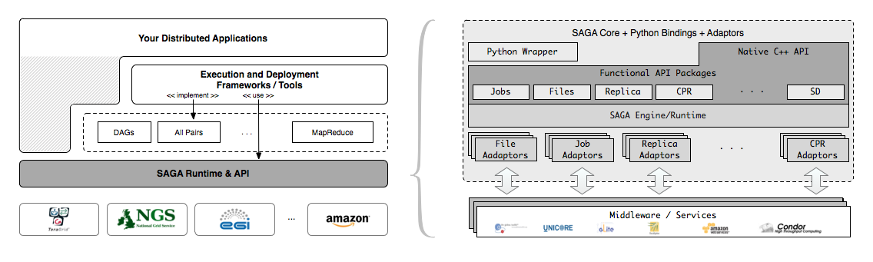
SAGA – An Overview
SAGA provides the base layer upon which other abstractions and capabilities are provided
http://www.saga-project.org

Slide 11
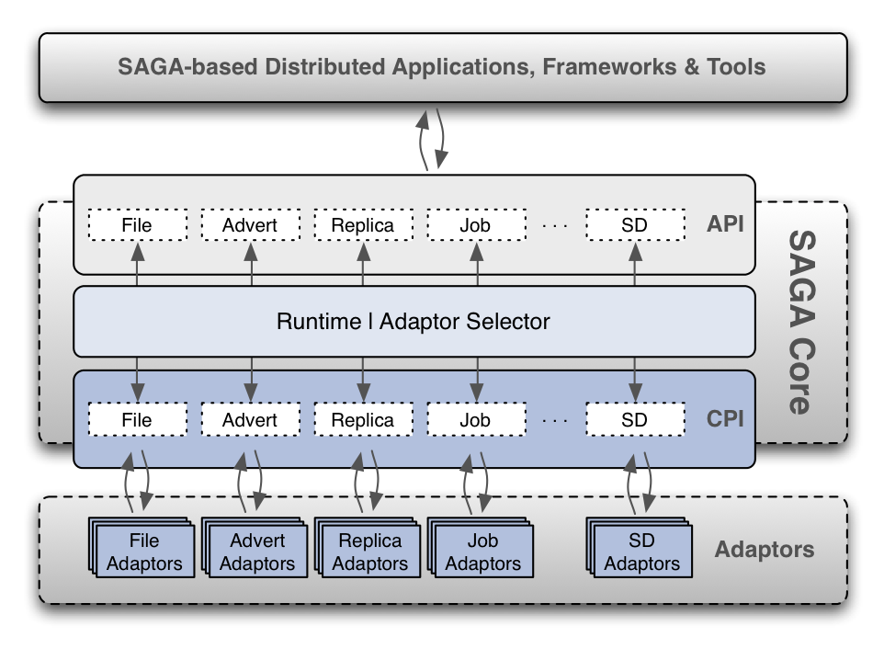
SAGA: OGF Standard for Distributed Applications

Slide 12
SAGA: Abstraction upon which other abstractions are built
HOW SAGA is Used?
  Uniform Access-layer to DCI
    EGI, XSEDE, DATAONE, UK NGS and NAREGI/RENEKI and Clouds
  Application “Scripting Layer” to DCI
    Improved and enhanced HTHP ensembles
  Build tools, middleware services and capabilities that use DCI
    e.g. Gateways, Pilot-Jobs
WHAT is SAGA Used for?
  Support production-grade science and engineering
    Aircraft design (Airbus) to the search for Higgs and neutrinos!
  Research tool to design, implement reason about distributed programming models, systems and applications

Slide 13
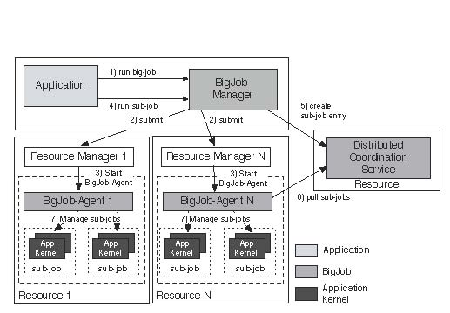
Understanding Pilot-Jobs: Abstractions for Dynamic Execution
SAGA Pilot-Job (BigJob)

Slide 14
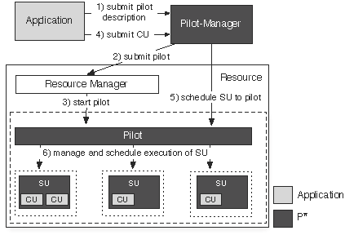
P* Model of Pilot-Abstractions

Slide 15
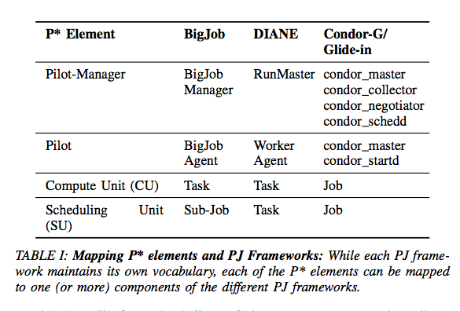
Towards a common model for Pilot-jobs, Luckow, Santcroos, Merzky, Weidner and Jha, to appear in proceedings of HPDC’12

Slide 16
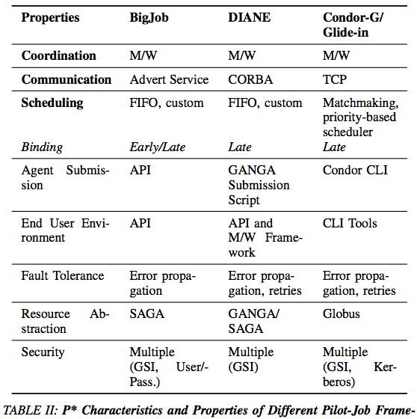

Slide 17
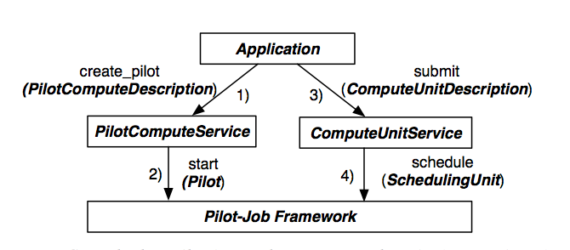
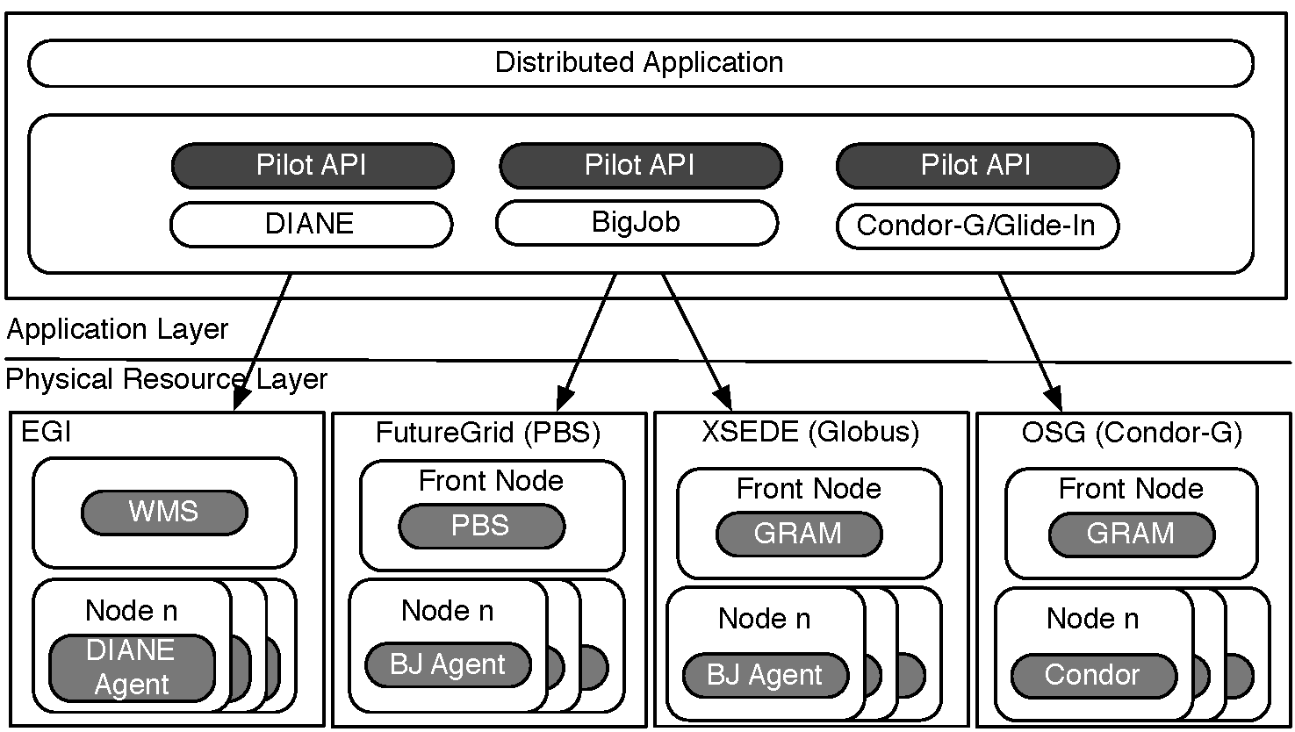
Exposing the P* Model: The Pilot-API

Slide 18
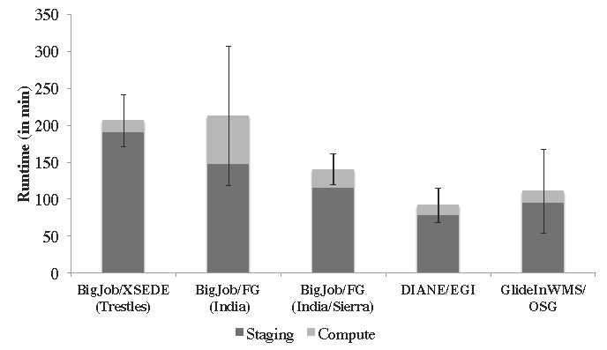
Accessing Multiple DCI & Pilot-Jobs via Pilot-API
128 BFAST tasks, O(10) GB

Slide 19
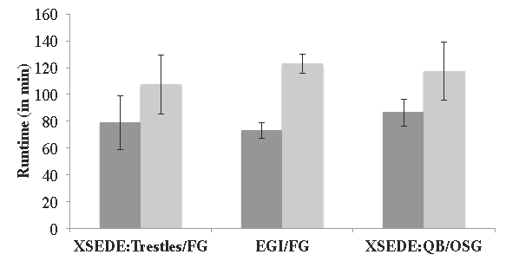
Pilot-Job Interoperability via Pilot-API

Slide 20
The Challenge of Integrating Compute and Data at Scale

Slide 21
Pilot-Abstraction for Dynamic Distributed Data?
Similar levels of heterogeneity in the data infrastructure
  File systems, storage, transport protocols, …
Support application level capabilities to specify dependencies at a logical level rather than specific file level
  First class support for Affinities (D-C, D-D)
Typically placement and scheduling of data is decoupled from the compute-tasks
  Integrated approach to compute and data ?
Dynamic decision for data
  Analogous to late-binding of data
  Fluctuating resources as a fundamental property of DCI
Abstraction for other factors and not application specific way:
  Varying data sources, fluctuating data rates, etc

Slide 22
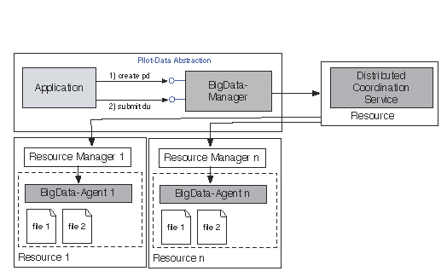
Pilot-Data: Abstraction for Dynamic Distributed Data
In analogy with BigJob - BigData (before Big Data was BigData!)

Slide 23
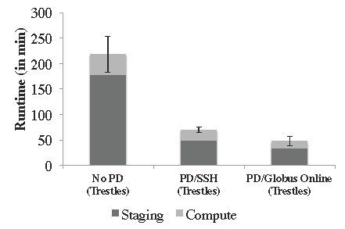
Pilot-Data: Coupled Data Management and Efficient Transfer

Slide 24
Overview
Understanding the Landscape of Distributed CI and Applications
  Introduce IDEAS as design objectives
SAGA: A Standards-based Approach to DCI and Applications
  Layer upon which other abstractions are built
P* Model of Pilot-Abstractions
  Uniform abstraction for compute and data
  Interoperability and Extensibility
P* Implementations are Supporting Large-scale S&E
  Map-Reduce based next-generation gene sequencing data
  Structural biology and patient-specific medicine
  Generalized ensemble and advanced sampling algorithms
Notes:
Delicate balancing act: --- vision of the future but rooted in reality – with rigorous research.
Be sure to define “applications” – eScience, scientific applications…

Slide 25
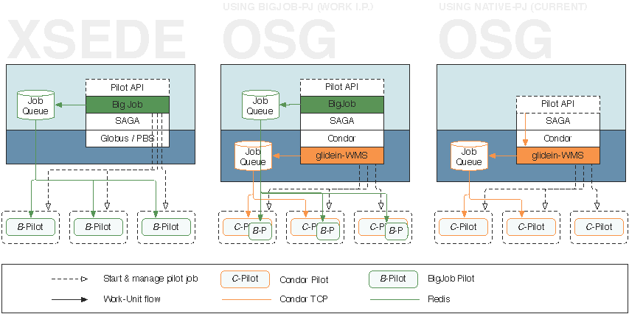
Deployment Context: Limitations of Abstractions

Slide 26
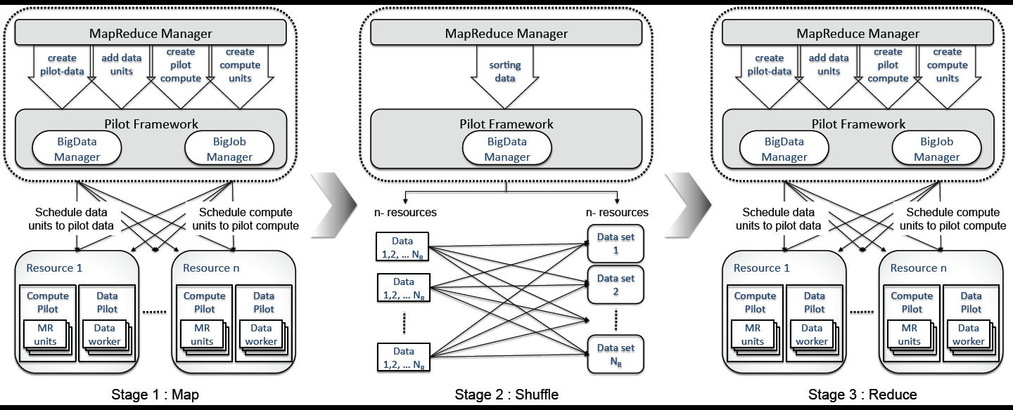
Pilot-MapReduce

Slide 27
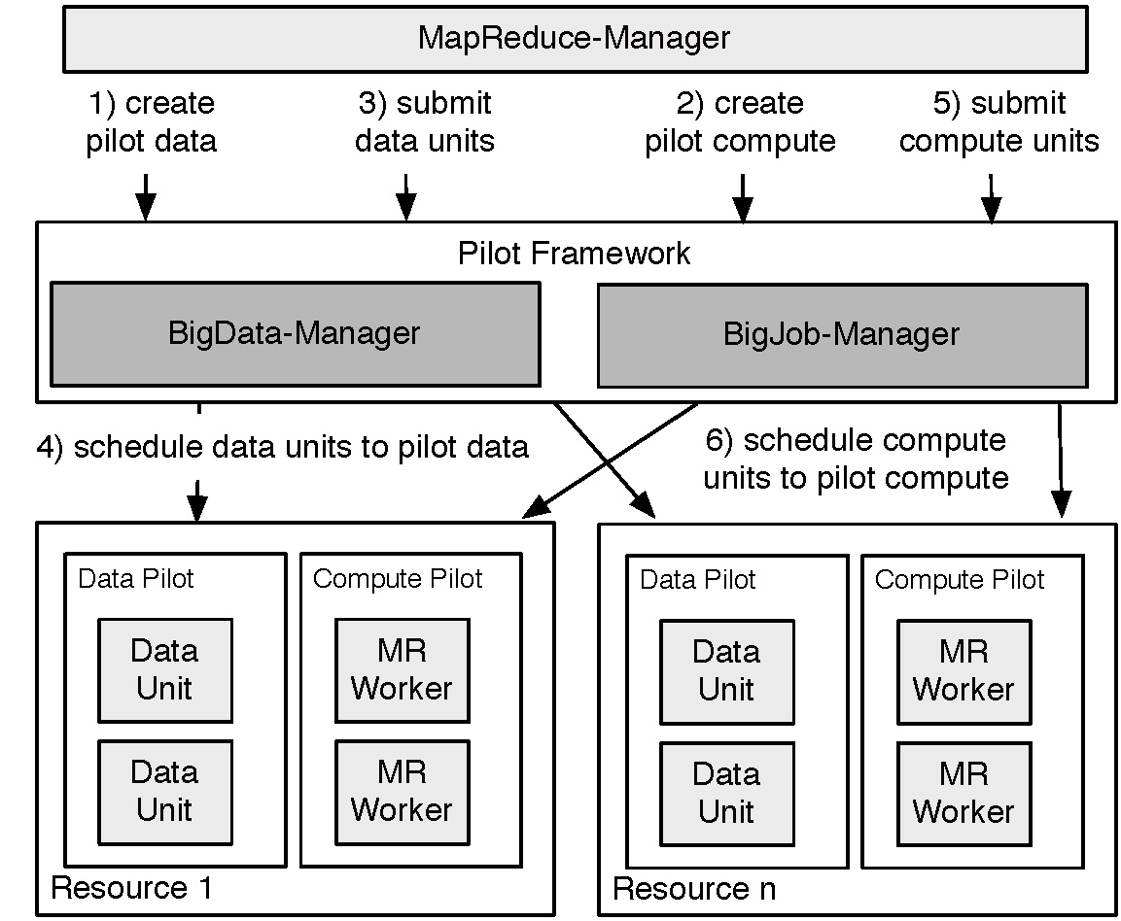
Pilot-MapReduce (for NGS)

Slide 28
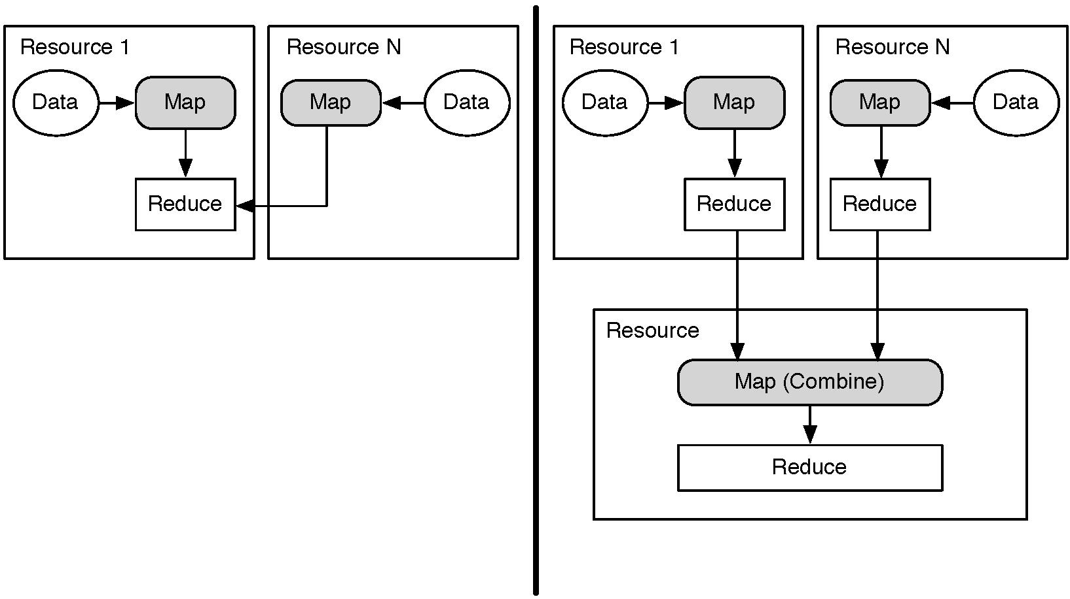
Distributed (DMR) versus Hierarchical (HMR)

Slide 29
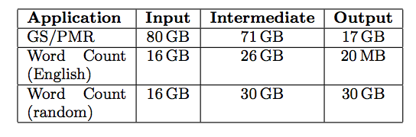
DMR vs HMR vs Iterative MR?
Depends upon the Application characateristics
Notes:
Maslov Mental Model!

Slide 30
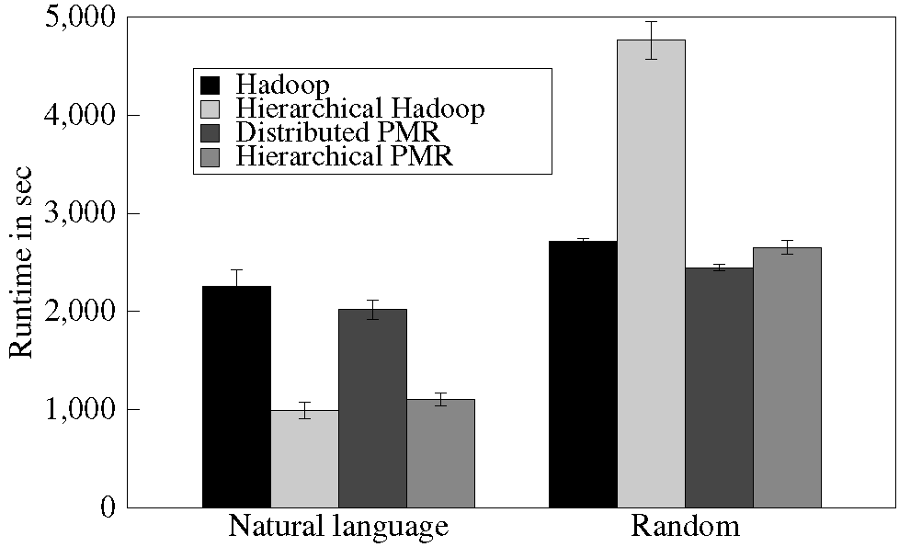
Hadoop vs PMR (for distributed data scenarios)

Slide 31
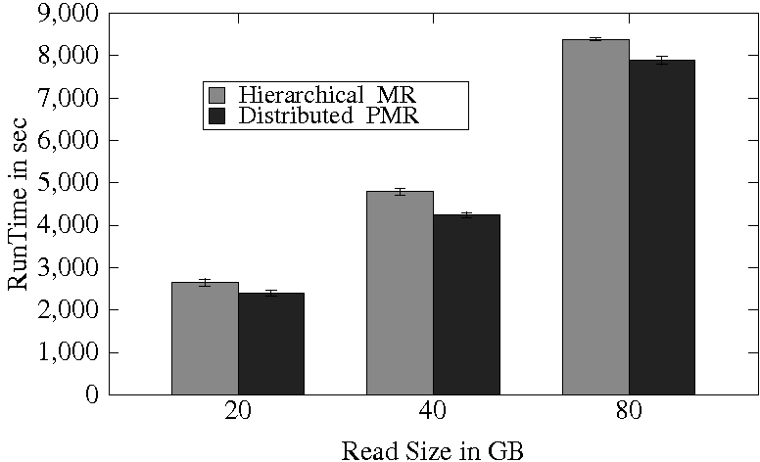
Hadoop vs PMR (for distributed data scenarios)

Slide 32
P* Model of Pilot-Abstractions Redux

Slide 33

Conclusion and Future Work

Slide 34
Acknowledgments
SAGA and RADICAL Group Members
  http://saga-project.org
NSF/LEQSF (2007-10)-CyberRII-01
NSF HPCOPS NSF- OCI 0710874 award
NSF CHE 1125332
NSF-ExTENCI (OCI-1007115)
UK EPSRC (GR/D0766171/1) and e-Science Institute, UK
NSF OCI 1059635
NIH Grant Number P20RR016456
NSF TeraGrid TRAC award TG-MCB090174
NSF FutureGrid Award (No. 42)

Slide 35
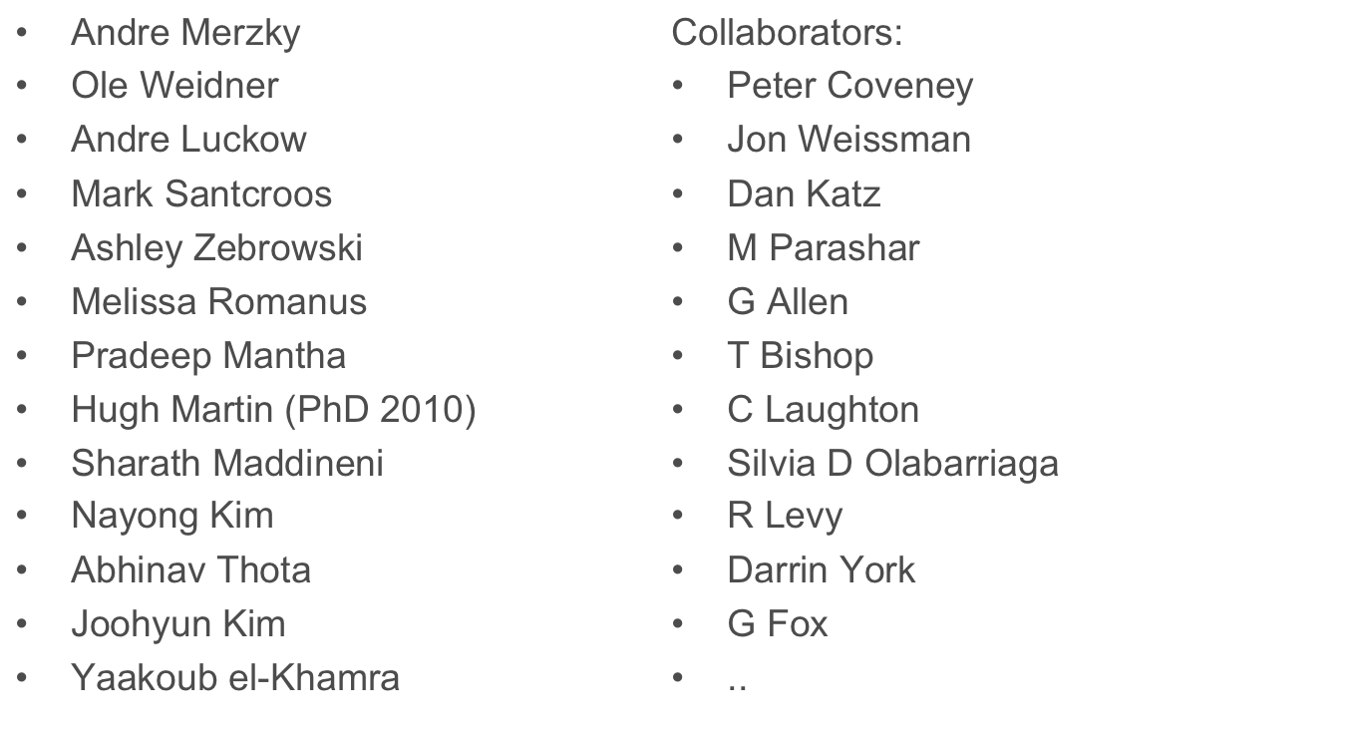
Some of the People Who Make it Happen

