Slide 1
ECSS Fellowship Project: High-Throughput Computing for the Comparative Genomics of Mononucleosomes Using BigJob
Jack A. Smith, PhD
Marshall University
XSEDE CC ECSS Fellow, 2012-13

Slide 2
Outline
Project Team
Project Overview
Nucleosome Modeling
SAGA/BigJob
Adding Workflow Management
Activities as ECSS Fellow
Project Outcomes
Expectations vs Realizations

Slide 3
Project Team
LA Tech – Theoretical Molecular Biology Lab
Dr. Tom Bishop
James Solow
Rutgers University – RADICAL Group
Dr. Shantenu Jha
Melissa Romanus
Pradeep Kumar Mantha
TACC – XSEDE ECSS
Yaakoub El Khamra
Marshall University & WV HEPC
Dr. Jack Smith

Slide 4
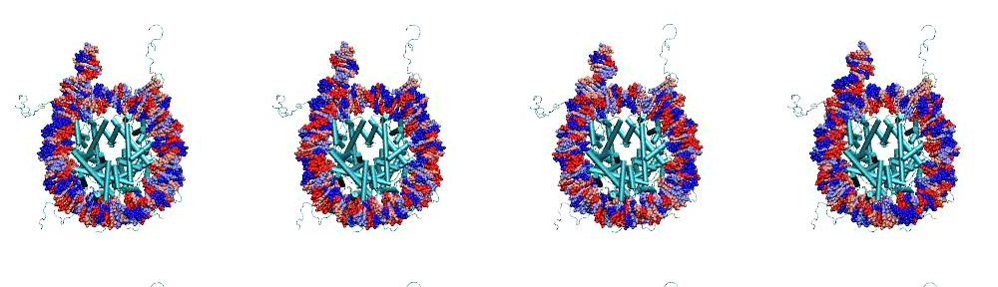
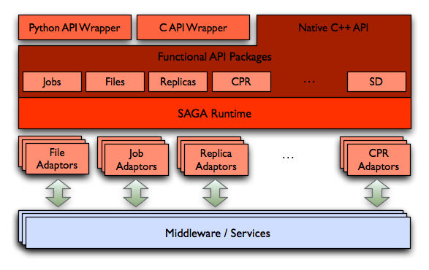
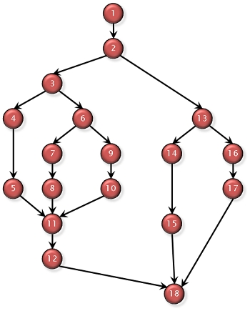
Project Overview
Nucleosome Modeling
SAGA/BigJob
Adding Workflow Management

Slide 5
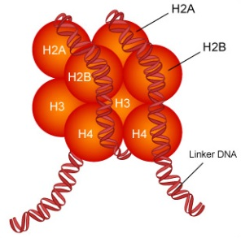
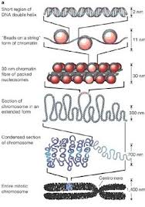
Nucleosome Modeling
Nucleosome
DNA strand of ~150 base pairs
Histone octamer ~800 residues
Superhelix of ~1.7 turns
Current Study - 105 Nucleosomes
5 Chromosome regions
21 Displacements (center +/- helical repeat)
NAMD Molecular Dynamics
Simulation box with ~45K waters
All-atom simulation ~160K atoms
20 Nanoseconds in 1-nanosecond steps

Slide 6
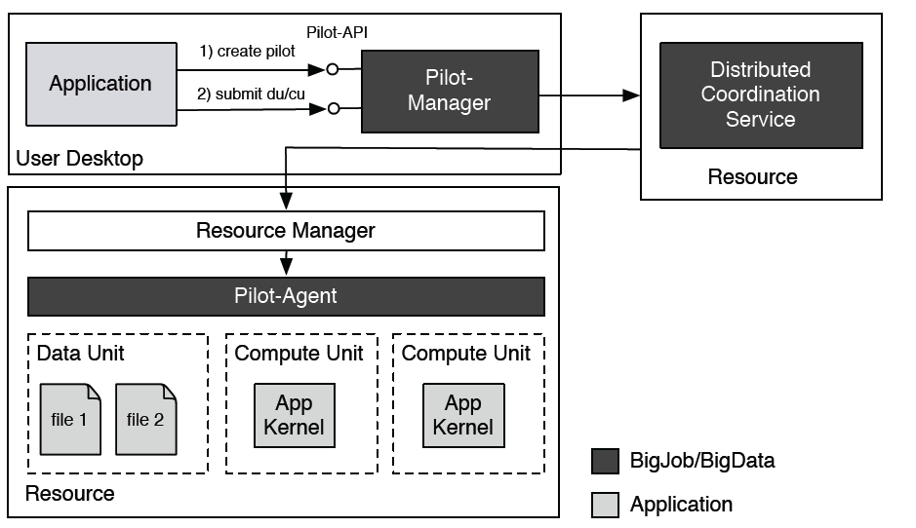
SAGA/BigJob
Built on SAGA (Simple API for Grid Applicatons)
OGF (Open Grid Foundation) GFD.90 standard
Middleware + resource-specific adapters
BigJob based on Pilot-Job concept
Ensemble of jobs (sub-jobs) as one job
Distributed compute and data resources
Python Implementation
GitHub Site:
https://github.com/saga-project/BigJob
https://github.com/saga-project/experiments
Documentation
http://saga-project.github.com/BigJob/sphinxdoc/

Slide 7
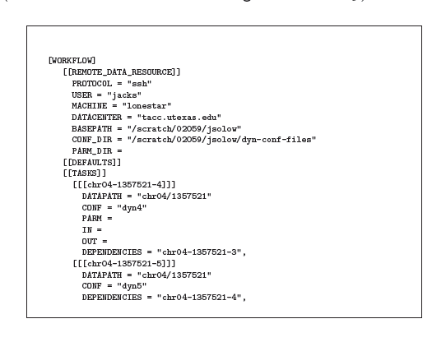
Adding Workflow Management
External Config file with task definitions
Input file locations
Output options
Dependencies
Script to generate workflow (tasks)
Traversing previous output directories
Inspecting critical files to determine completion
Various assumptions about file-naming
Could not depend on NAMD Config inspection
3 Tiers of queuing, resource allocation, orchestration
Within BigJob script – tasks (w/ dependencies)
Within Pilot-Job (Pilot-Compute) – sub-jobs
Within SGE system – batch jobs
Log and status files to monitor and analyze progress

Slide 8
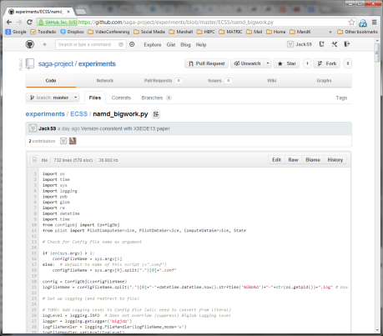
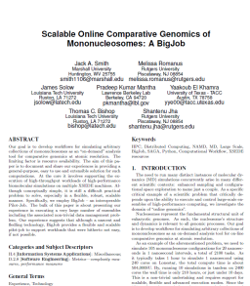
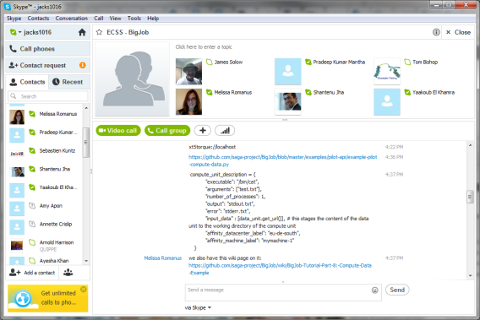
Activities as ECSS Fellow
Developed BigJob (pilot) script in Python
Implemented workflow logic
Wrote script to generate workflow Config from output files
Experimented with data staging (Pilot-Data)
Worked mostly on Lonestar @ TACC
Some on Kraken @ NICS, Stampede @ TACC, Thy @ LA Tech
Worked with Tom Bishop and James Solow (graduate student) on simulation, who
Moved ~8TB of data to and from Lonestar
Developed NAMD Config files
Worked with Yaakoub El Khamra on TACC and XSEDE ECSS issues
Worked with RADICAL Group on development
Participated on SAGA/BigJob user & developer discussion lists
Contributed to SAGA/BigJob GitHub site
Weekly Skype calls with whole team
XSEDE 13 paper
Computational Workflow

Slide 9
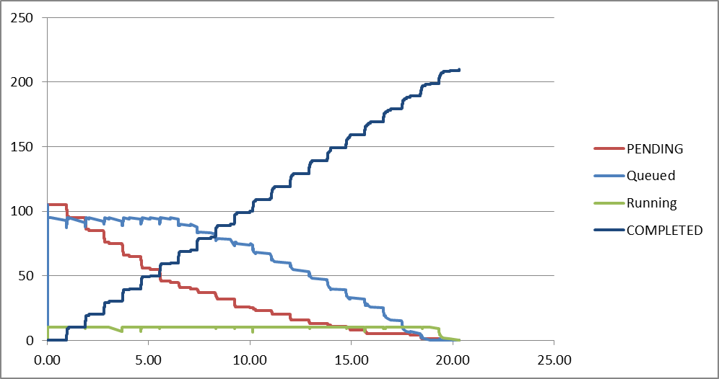
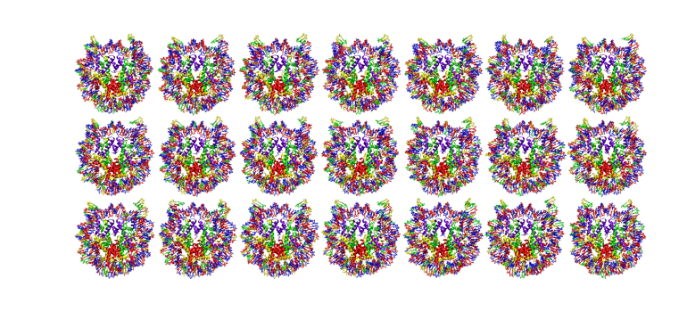
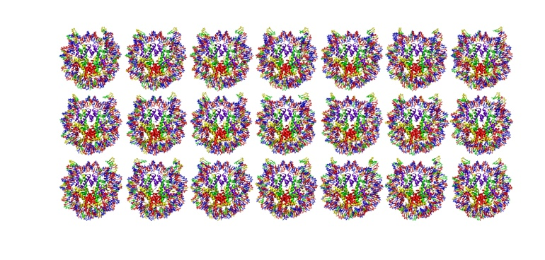
Project Outcomes
Typical BigJob Run
210 Simulations (5 x 21 x 2)
2400 Cores on Lonestar for ~21 hrs
~50,000 SUs
~750 GB of output
Total:
10+ Runs (2100 sims)
4 Restarts
~500,000+ SUs
~7.5 TB of output
Various Issues
Had to defer data staging for various reasons → all local
Ungraceful shutdown if one component terminates

Slide 10
Expectations
Realizations
Mentorship by ECSS staff
Limited interaction with user
Limited ownership of tool development
Time at TACC facility
Regular daily/weekly schedule
In-depth experience with primarily one new tool
Assisting user with developed tools on prototypical runs
Weekly updates to ECSS staff
Project report to ECSS
Mentorship by multiple groups
Close interaction with user and tool development teams
Almost sole ownership of tool development
Remote collaboration
Small and large chunks of time with great variation
Experience with wide breadth of tools, from NAMD to Python and version control (Git) to LaTeX
Doing production runs with developed tools
Regular group Skype sessions
Co-author on paper (journal)

