Slide 1
SAGA practical
ISSGC 2009
http://issgc-server-01.polytech.unice.fr/saga/

Slide 2
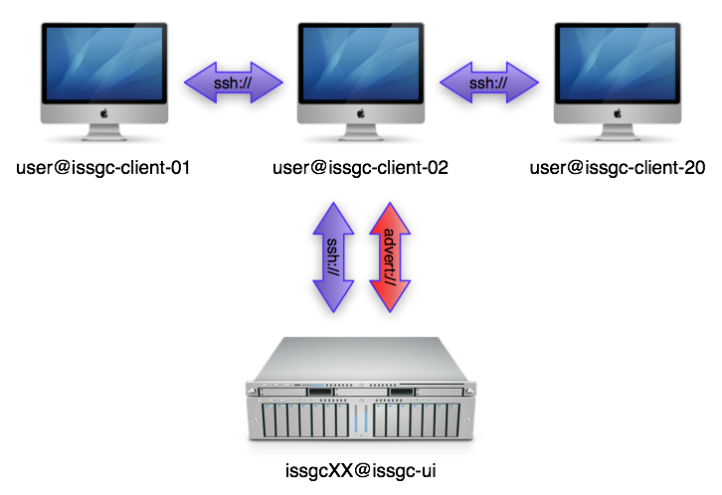
INFRASTRUCTURE

Slide 3
Login
issgc01 > 134.59.140.152 /home/user/issgc01/
issgc02 > 134.59.140.152 /home/user/issgc02/
issgc03 > 134.59.140.152 /home/user/issgc03/
issgc04 > 134.59.140.153 /home/user/issgc04/
issgc05 > 134.59.140.153 /home/user/issgc05/
issgc06 > 134.59.140.153 /home/user/issgc06/
issgc07 > 134.59.140.156 /home/user/issgc07/
issgc08 > 134.59.140.156 /home/user/issgc08/
issgc09 > 134.59.140.156 /home/user/issgc09/
issgc10 > 134.59.140.157 /home/user/issgc10/
issgc11 > 134.59.140.157 /home/user/issgc11/
issgc12 > 134.59.140.157 /home/user/issgc12/
issgc13 > 134.59.140.158 /home/user/issgc13/
issgc14 > 134.59.140.158 /home/user/issgc14/
issgc15 > 134.59.140.158 /home/user/issgc15/
issgc16 > 134.59.140.159 /home/user/issgc16/
issgc17 > 134.59.140.159 /home/user/issgc17/
issgc18 > 134.59.140.159 /home/user/issgc18/
issgc19 > 134.59.140.160 /home/user/issgc19/
issgc20 > 134.59.140.160 /home/user/issgc20/
issgc21 > 134.59.140.160 /home/user/issgc21/
issgc22 > 134.59.140.161 /home/user/issgc22/
issgc23 > 134.59.140.161 /home/user/issgc23/
issgc24 > 134.59.140.161 /home/user/issgc24/
issgc25 > 134.59.140.162 /home/user/issgc25/
issgc26 > 134.59.140.162 /home/user/issgc26/
issgc27 > 134.59.140.162 /home/user/issgc27/
issgc28 > 134.59.140.163 /home/user/issgc28/
issgc29 > 134.59.140.163 /home/user/issgc29/
issgc30 > 134.59.140.163 /home/user/issgc30/
issgc31 > 134.59.140.164 /home/user/issgc31/
issgc32 > 134.59.140.164 /home/user/issgc32/
issgc33 > 134.59.140.164 /home/user/issgc33/
issgc34 > 134.59.140.165 /home/user/issgc34/
issgc35 > 134.59.140.165 /home/user/issgc35/
issgc36 > 134.59.140.165 /home/user/issgc36/
issgc37 > 134.59.140.166 /home/user/issgc37/
issgc38 > 134.59.140.166 /home/user/issgc38/
issgc39 > 134.59.140.166 /home/user/issgc39/
issgc40 > 134.59.140.167 /home/user/issgc40/

Slide 4

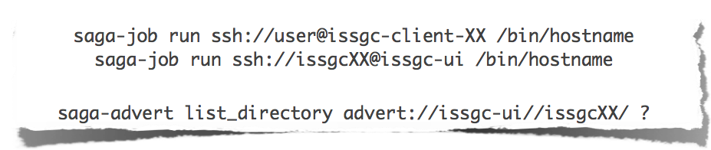
Enter the saga world
Make sure everything works:

Slide 5
command line tools
SAGA comes with simple command line tools that allow to access basic package functionality.
The source code is very simple and a great starting point to
explore the SAGA package APIs:
  saga-advert http://issgc-server-01.polytech.unice.fr/saga/cltools/advert/
  saga-file http://issgc-server-01.polytech.unice.fr/saga/cltools/file/
  saga-job http://issgc-server-01.polytech.unice.fr/saga/cltools/job/
  saga-replica http://issgc-server-01.polytech.unice.fr/saga/cltools/replica/

Slide 6
Documentation
API documentation
  http://issgc-server-01.polytech.unice.fr/saga/apidoc/
Programming manual
  http://issgc-server-01.polytech.unice.fr/saga/manual.pdf

Slide 7
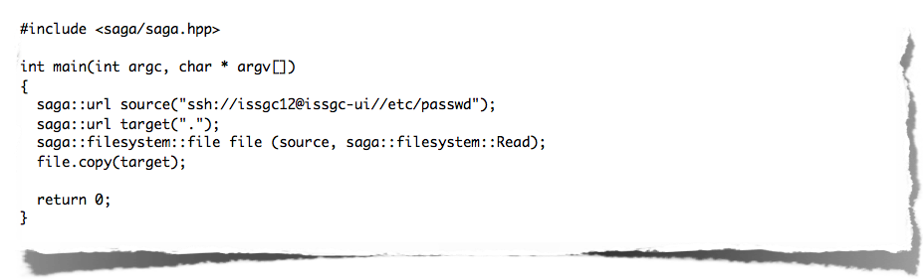
unit 1: A SIMPLE SAGA APP
Simple file copy example: copy.cpp

Slide 8

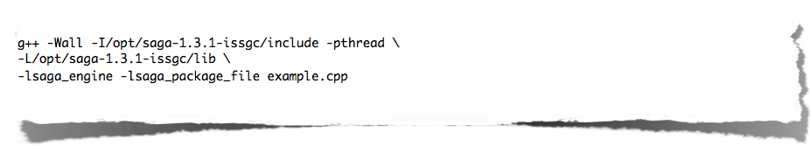
unit 2: compiling and linking
Simple file copy example: Makefile
Or do it the hard way:

Slide 9

RUNNInG A SAGA APPLICATION
Make sure that the SAGA libraries can be found by the loader. saga-env.sh takes care about that.
If something goes wrong - use SAGA_VERBOSE:

Slide 10

EXAMPLE 1: hello_world
The source code can be found here:
  http://issgc-server-01.polytech.unice.fr/saga/examples/hello_world.cpp
Change these lines:

Slide 11
EXAMPLE 3: DEPENDING_jobs
The source code can be found here:
  http://issgc-server-01.polytech.unice.fr/saga/examples/depending_jobs.cpp
Change this line:
Make sure the advert entry is empty

Slide 12
EXAMPLE 3: DEPENDING_jobs
Copy executable
Run the example:
Retrieve result from the advert service

Slide 13
Conclusion
We saw simple examples from three different API packages:
  advert package
  job package
  file package
All the example code was rather simple, but of course it can be used to develop applications of arbitrary complexity
More packages available:
  replica, service discovery, cpr, streams

Slide 14
THANKS
http://saga.cct.lsu.edu

