Slide 1


A Hybrid CFD-MD Approach
for Solving Nano-scale Flow Field
Soon-Heum Ko*, Nayong Kim, Shantenu Jha
Center for Computation and Technology, LSU
Jan. 29, 2011

Slide 2
Outline
Introduction and Motivation
Accuracy of a Hybrid CFD-MD Approach
  Accuracy of the Individual Domain
  Spatial Accuracy on a Hybrid Region
  Temporal Coupling Scheme
Numerical Simulations
  A Sudden-start Couette Flow
  Oscillating Boundary Problem
Concluding Remarks

Slide 4



Introduction
A Hybrid CFD-MD Approach
  Solves the bulk flow region by the computational fluid dynamics (CFD) technique and applies the molecular dynamics (MD) methodology to acquire higher-resolution near the solid-fluid interface
CFD
Macroscopic fluid
Geometrically complex
fluidic system
MD
Microscopic fluid
Able to describe
intermolecular effect
Empirical boundary modeling
for accurate wall boundary
Excessive computational cost
on solving real-scale systems
A Hybrid CFD-MD Approach

Slide 5
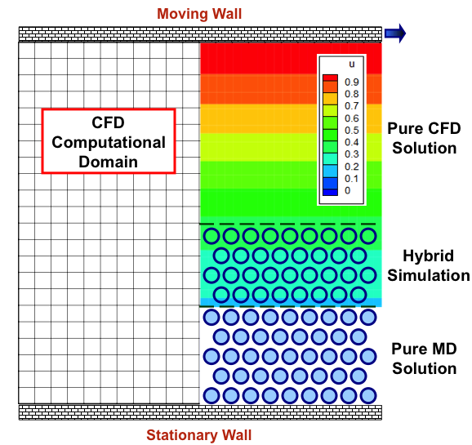


Introduction
Numerical Issues
External
Force
Forces to maintain
system’s ensemble
Accuracy of
a continuum solver
Imposing continuum
solution to higher
DOF domain
Buffer
CFD
to
MD
Performance of coupled simulation:
Co-scheduling
Load balancing
Particles following
the continuum solution
Accuracy of
a particle
solver
Buffer
Minimizing
the locality of
sampled profile
MD
to
CFD
Sampled molecular properties imposed

Slide 7
Numerical Modeling
LAMMPS (Large-scale Atomistic/Molecular Massive Parallel Simulator) Package
  Newton’s 2nd Law
    Van der Waals Force via Lennard-Jones Potential
      Cut-off Length: 2.2 σ
    Verlet Algorithm for Time Integration

Slide 8
Numerical Modeling
In-house Continuum Hydrodynamics Code
  Incompressible Navier-Stokes Equations
    Pseudo-compressibility
    Roe’s FDS (Convention) / Central Differencing (Diffusion)
    LU-SGS (Lower Upper Symmetric Gauss Seidel) /
    Dual Time Stepping for Unsteady Flow Simulation

Slide 10
Hybrid Modeling (Space)
Continuum-to-Particle Hybrid BC
  Focus: How to impose continuum solution into particle domain without harming particles’ DOF
  Proposed Techniques
    Alternating Schwarz method (Hadjiconstantinou et al.)
      Two domains decoupled on time domain
    The direct flux exchange approach (Flekkoy et al.)
      Flux values conserved on the hybrid layer
    Constrained Lagrangian dynamics (O’Connell et al.)
      Constrained Lagrangian dynamic equation to describe molecular motion

Slide 11
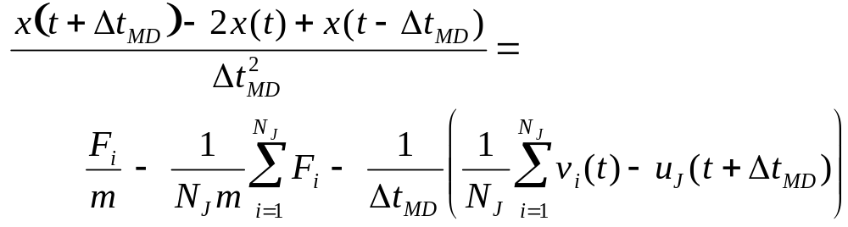
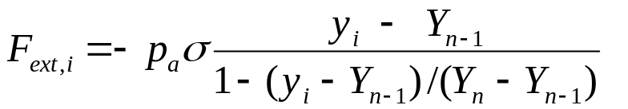
Hybrid Modeling (Space)
Implementation of Constrained Lagrangian Dynamics
  Constrained MD Equation
    Drive multi-DOF molecular motion following the continuum solution
  External Force Equation
    On outmost upper MD layer
    Holding particles within MD simulation domain (considering the ensemble of molecular system)

Slide 12
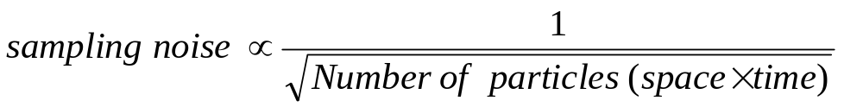
Hybrid Modeling (Space)
Particle-to-Continuum Hybrid BC
  Focus: How to suppress the locality of atomic samples for non-fluctuating BC on CFD domain
  Characteristics of Sampling Noise
    Sampled MD properties over a finite spatial/temporal range do not match the analytic/continuum solution (denoted as the sampling noise)
    The pattern of the noise in nano-scale fluid system is more complex than the above numerical expression
      Interaction with solid element
      Geometric configuration
      Characteristics of fluid particle

Slide 13


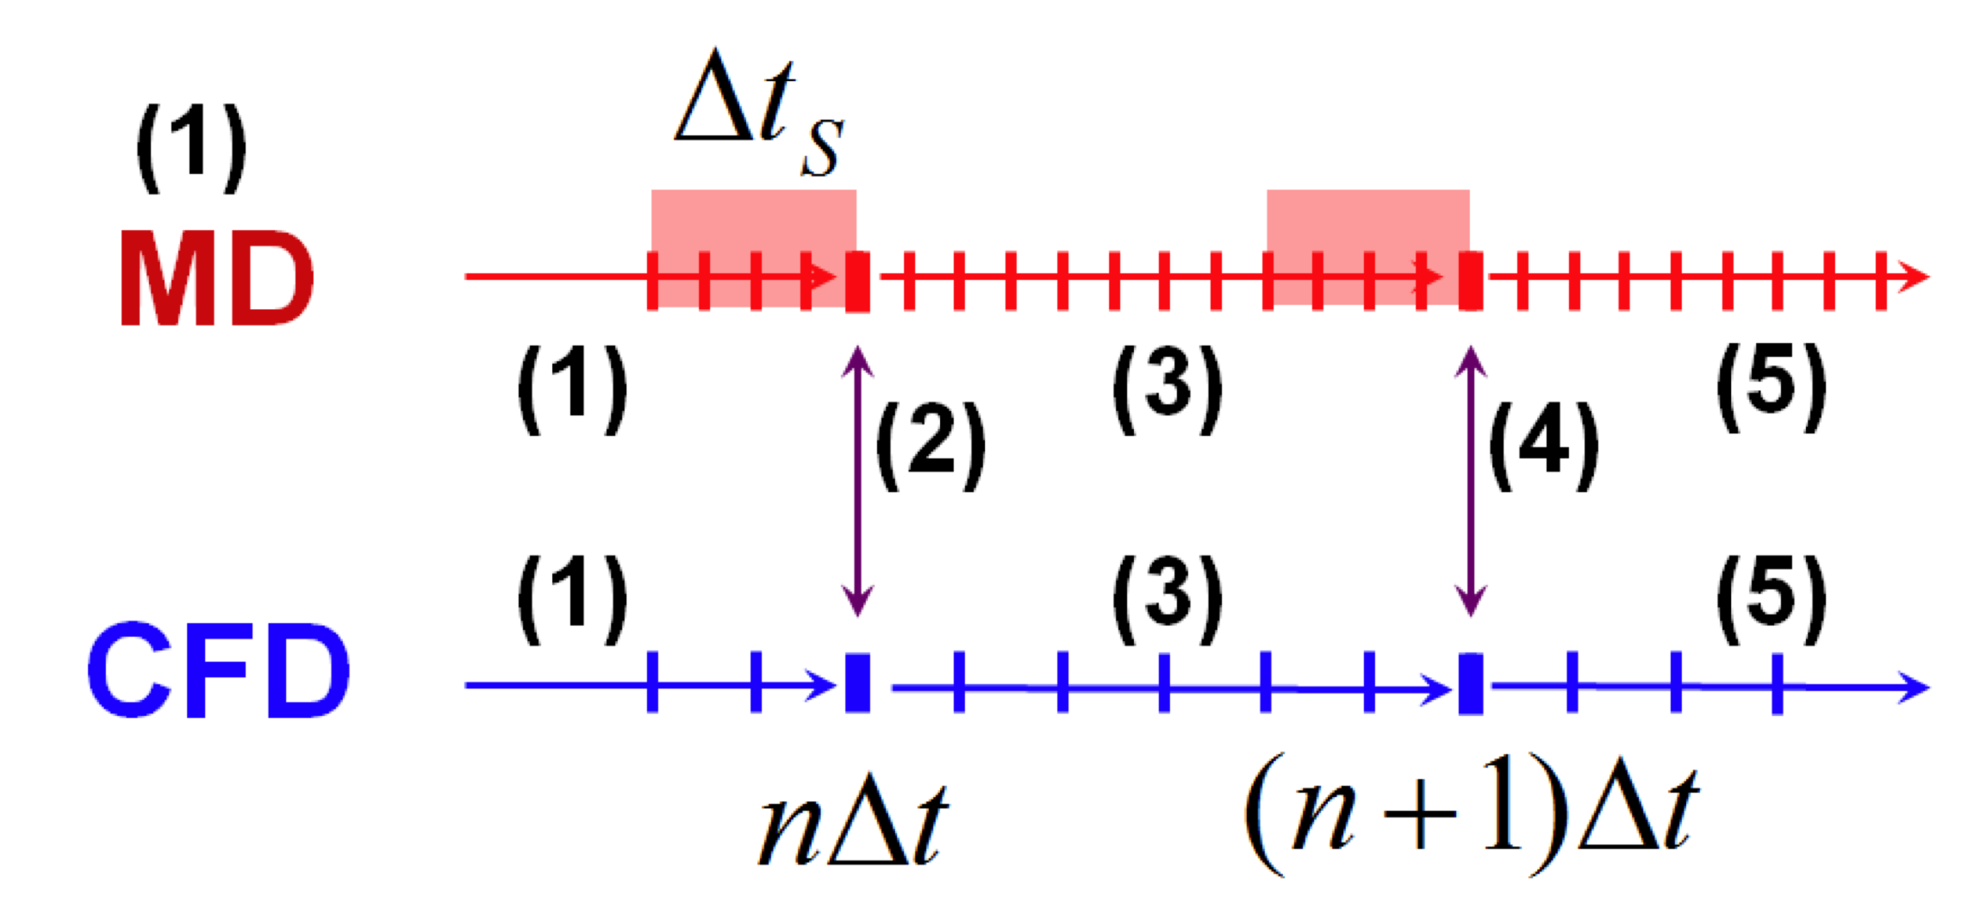

Hybrid Modeling (Space)
Coupling Parameters for Accurate Hybrid Simulation
  Conditions determined by the sampling noise measurement from the stationary MD simulation
External Force
CFD to MD
time
MD to CFD
How often the sampling is performed
(Sampling Interval)
How long the sampling is performed
(Sampling Duration)
Where the sampling is performed (Layer Position)
How many particles participate in sampling
(Layer Size)

Slide 14
Hybrid Modeling (Space)
Sampling Multiple Replicas
  Conduct multiple replica simulations (different initial condition) and sample these results
  Pros and cons
    Computationally easier to conduct the simulation
      Easily get allocations on multiple smaller jobs
    (Solution is not identical to the result by an individual simulation on larger system domain)
    Slight benefit on parallel performance
      512(Core)*1(Job) VS 128(Core)*4(Job) in Weak Scale
    (Computational cost itself does not change)

Slide 16
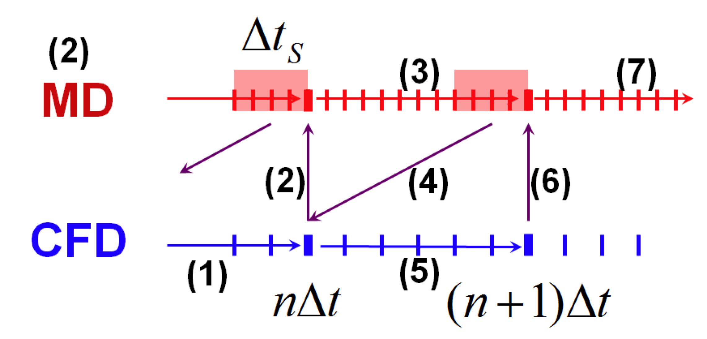
Hybrid Modeling (Time)
Conventional Temporal Coupling Schemes
  (1) Synchronized and (2) sequential coupling
    Parallel performance is better in synchronized coupling
    Backward-averaged atomic solution imposed as the hybrid BC in continuum domain
      Time-lagging phenomena
    Extrapolation from previous two solutions
      Overshoot/undershoot

Slide 17
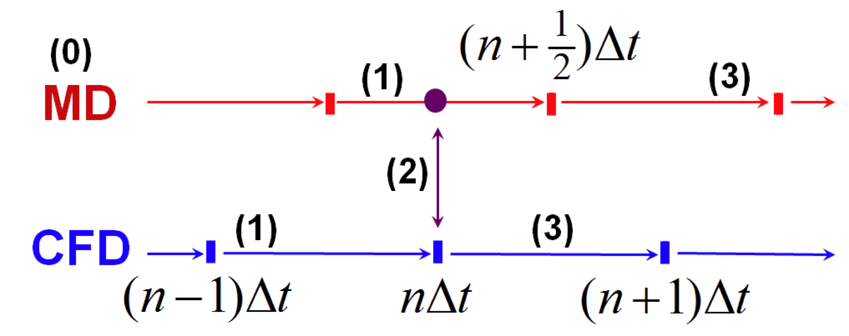
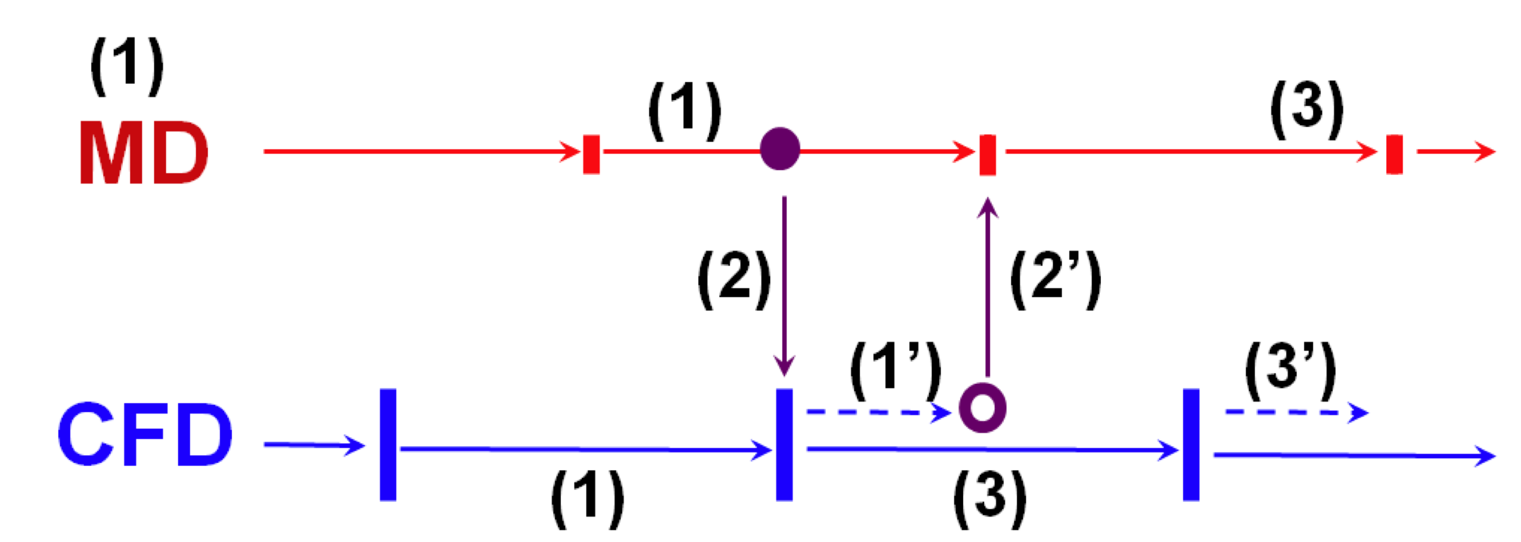
Hybrid Modeling (Time)
Prediction-correction Approach
  CFD solver provides ½-interval next solution to MD and rolls back to previous solution
    Central-averaged molecular profile is imposed as CFD BC
      Time-lagging resolved
    Extrapolation from current solutions
      Overshoot/undershoot can be alleviated
    Computational cost on CFD domain increased by 1/2
      CFD Workload << MD Workload in most cases
      Longer prediction step for better boundary condition imposition

Slide 19
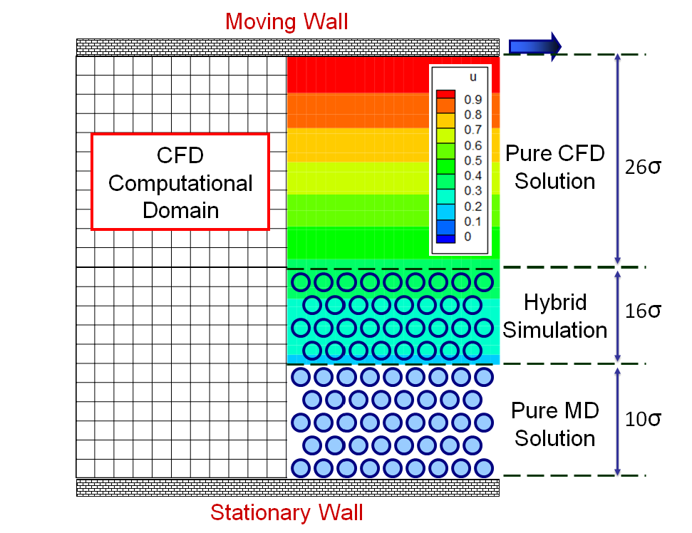
Numerical Results
Validation – A Sudden-start Couette Profile
  Liquid Argon
    Characteristic time scale τ=2.2×10⁻¹² sec)
  Nano-scale channel (52σ≈176Å)
  Coupling Parameters
    Sampling duration =
    Sampling interval = 10τ
    Layer size = 2σ
    Layer position =
    10σ above bottom wall
    System’s length = 140σ
      Solution’s noise within 5% of
      continuum solution

Slide 20
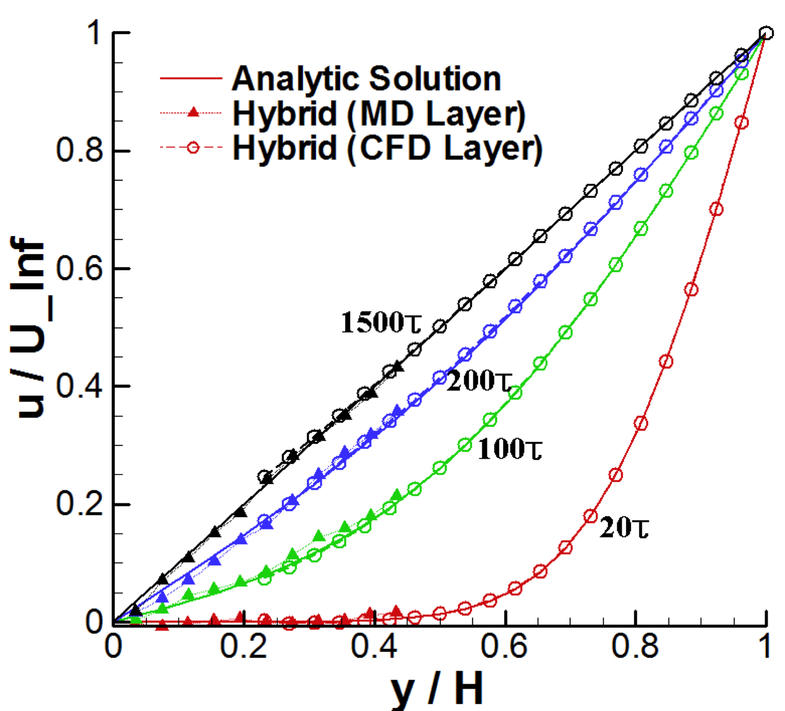
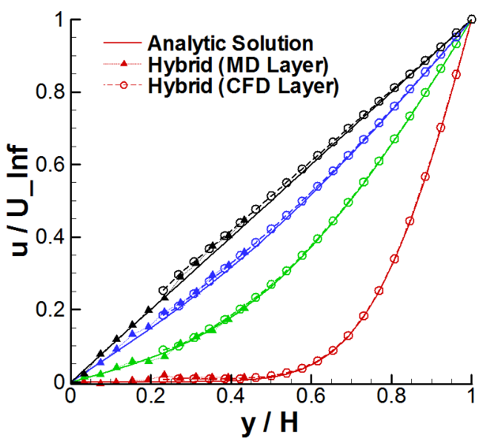
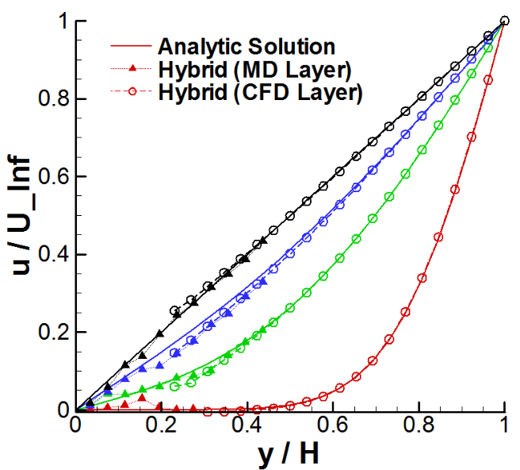
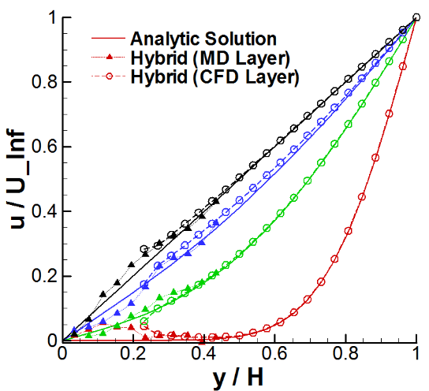
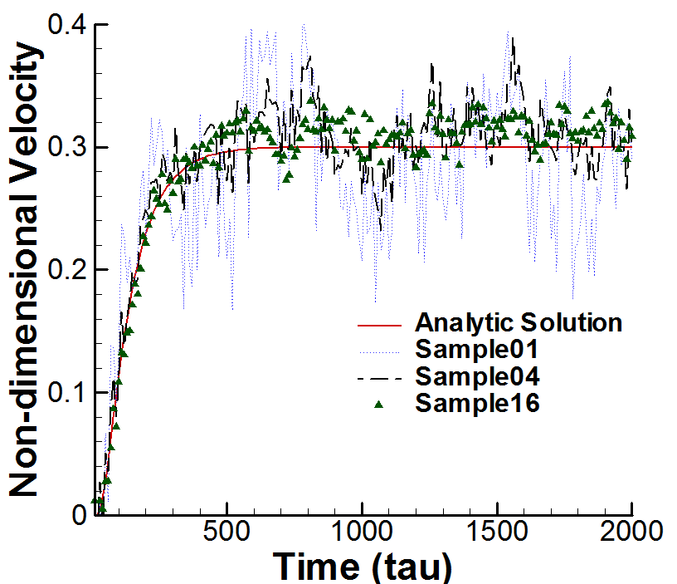
Numerical Results
Couette Flow Solutions
  Velocity of upper plate = 1 σ/τ (≈155m/s)
  Moderate flow with 0.25 σ/τ
    Requires multiple samples for acceptable accuracy

Slide 21
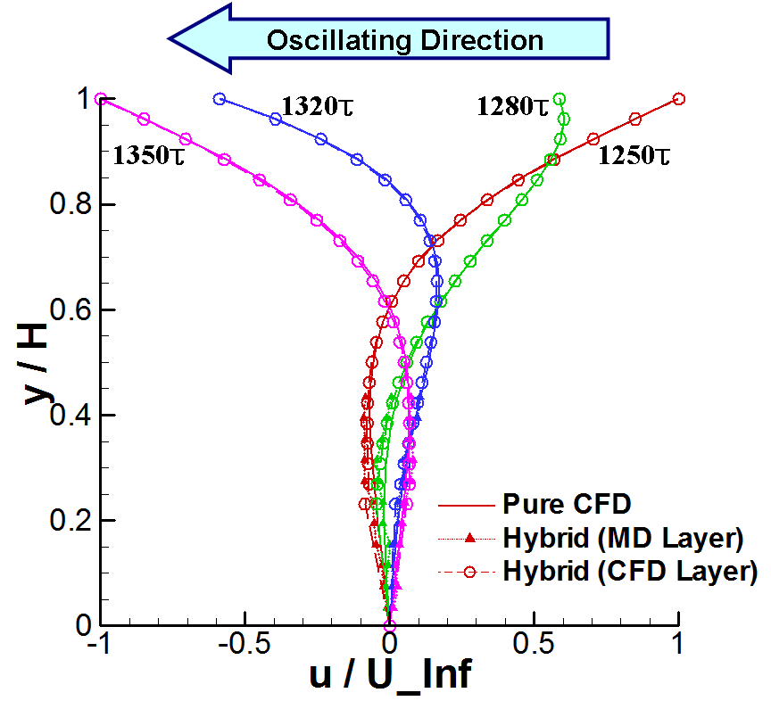
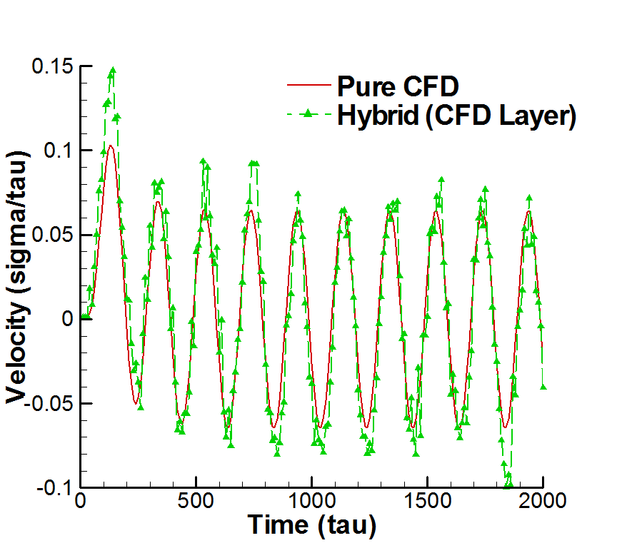
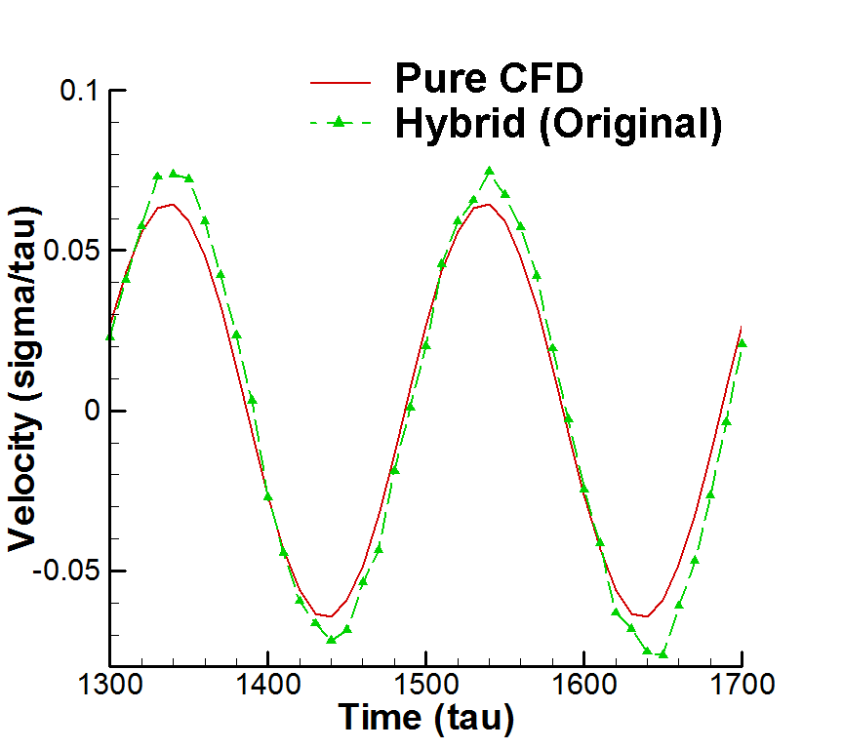
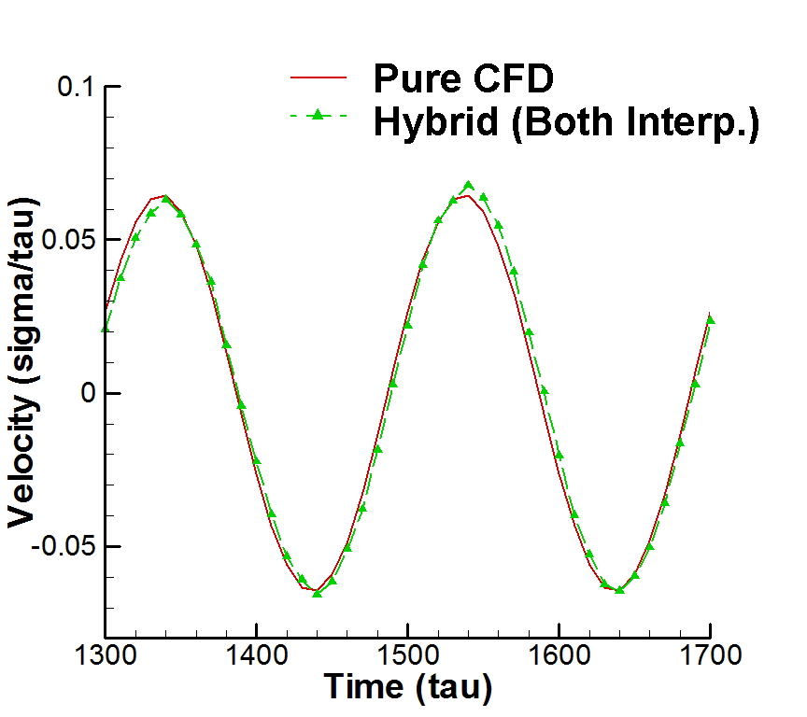
Numerical Results
Oscillating Boundary Problem
  Upper plate oscillating with period = 200τ
    Larger noise in solution (lower macroscopic velocity)
    Eliminating unphysical overshoot/undershoot

Slide 23
Concluding Remarks
  A hybrid CFD-MD approach is a powerful tool for acquiring higher-resolution solution near the solid interface with the acceptable computational cost
  For the accurate solution,
    Accuracy of individual MD and CFD solvers
    Spatial accuracy on hybrid boundaries (Hybrid schemes for molecular domain; Suppressing sampling noise)
    Temporal accuracy (Without time lagging or overshoot/undershoot)
  should be guaranteed

Slide 24
Concluding Remarks
  Researches have been devoted on
    Particle-to-continuum BC: Determining optimal coupling parameters / Sampling multiple replicas for alleviating sampling noise
    Temporal coupling: A prediction-correction approach for time-accurate boundary condition imposition
  Nano-scale flow simulations on
    A sudden-start Couette flow for the validation of numerical techniques implemented
    Moderate-velocity flow simulation through multiple replica sampling
    Time-accurate oscillating boundary flow profile by the improvement of temporal coupling scheme

