Slide 1


Grid Interoperability at the Application Level Using SAGA
Shantenu Jha^{12*}, H Kaiser¹, A Merzky¹, O Weidner¹
¹Center for Computation and Technology, LSU
² Department of Computer Science, LSU
*Also with NeSC, Edinburgh and UC-London
CCT: Center for Computation & Technology

Slide 2
Outline
Interoperability: An Application's Perspective
  Application vs Service
  Grid Aware vs Unaware
SAGA: Brief Introduction
SAGA: Providing interoperability at different levels
SAGA in relation to GIN
Application Examples
Center
CCT: Center for Computation & Technology

Slide 3
Motivation
GIN:
  Interoperation at the service level
  Bottom-up approach
Specific Application Projects:
  SPICE, Cactus BH simulation; not scalable
  Top-down approach
e-Science Applications must be able to utilise infrastructure
  Handle current heterogeneity and future developments
Applications: Interoperation --> Interoperability

Slide 4
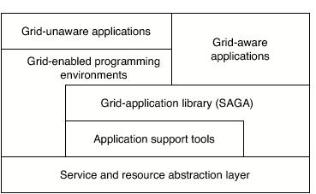
Application Level Interoperability (1)
Rough Taxonomy of Applications
Some applications are Grid-unaware and want to remain so
  Use tools/environments (e.g, NanoHub, GridChem)
  May run on Grid-aware/Grid-enabled environments (e.g. Condor) or programming environment (e.g, MPICH-G2)
Some applications are explicitly Grid-aware
  Control, Interact & Exploit distributed systems at the application level

Slide 5
Application Level Interoperability (2)
Some Features (not definition!) of ALI:
  Beyond compiling, no further changes for platform
  Automated, scalable and extensible solutions to use new resources, and not via bilateral arrangements
  Semantics of any services are consistent (eg error handling)
  ALI often requires QoS, and other considerations
  GU applications require mostly SLI
  In general, establishing interoperabilty for GU is easier than GA applications

Slide 6
SAGA: In a Nutshell
  A lack of:
    Programming interface that provides common grid functionality with the correct level of abstractions?
    Ability to hide underlying complexities, varying semantics, heterogenities and changes from application program(er)
  Simple, integrated, stable, uniform, high-level interface
  Simplicity: Restricted in scope, 80/20
  Measure(s) of success:
    Does SAGA enable quick development of “new” distributed applications?
    Does it enable greater functionality using less code?

Slide 7
Copy a File: Globus GASS
int copy_file (char const* source, char const* target)
{
globus_url_t source_url;
globus_io_handle_t dest_io_handle;
globus_ftp_client_operationattr_t source_ftp_attr;
globus_result_t result;
globus_gass_transfer_requestattr_t source_gass_attr;
globus_gass_copy_attr_t source_gass_copy_attr;
globus_gass_copy_handle_t gass_copy_handle;
globus_gass_copy_handleattr_t gass_copy_handleattr;
globus_ftp_client_handleattr_t ftp_handleattr;
globus_io_attr_t io_attr;
int output_file = -1;
if ( globus_url_parse (source_URL, &source_url) != GLOBUS_SUCCESS ) {
printf ("can not parse source_URL \"%s\"\n", source_URL);
return (-1);
}
if ( source_url.scheme_type != GLOBUS_URL_SCHEME_GSIFTP &&
source_url.scheme_type != GLOBUS_URL_SCHEME_FTP &&
source_url.scheme_type != GLOBUS_URL_SCHEME_HTTP &&
source_url.scheme_type != GLOBUS_URL_SCHEME_HTTPS ) {
printf ("can not copy from %s - wrong prot\n", source_URL);
return (-1);
}
globus_gass_copy_handleattr_init (&gass_copy_handleattr);
globus_gass_copy_attr_init (&source_gass_copy_attr);
globus_ftp_client_handleattr_init (&ftp_handleattr);
globus_io_fileattr_init (&io_attr);
globus_gass_copy_attr_set_io (&source_gass_copy_attr, &io_attr);
&io_attr);
globus_gass_copy_handleattr_set_ftp_attr
(&gass_copy_handleattr,
&ftp_handleattr);
globus_gass_copy_handle_init (&gass_copy_handle,
&gass_copy_handleattr);
if (source_url.scheme_type == GLOBUS_URL_SCHEME_GSIFTP ||
source_url.scheme_type == GLOBUS_URL_SCHEME_FTP ) {
globus_ftp_client_operationattr_init (&source_ftp_attr);
globus_gass_copy_attr_set_ftp (&source_gass_copy_attr,
&source_ftp_attr);
}
else {
globus_gass_transfer_requestattr_init (&source_gass_attr,
source_url.scheme);
globus_gass_copy_attr_set_gass(&source_gass_copy_attr,
&source_gass_attr);
}
output_file = globus_libc_open ((char*) target,
O_WRONLY | O_TRUNC | O_CREAT,
S_IRUSR | S_IWUSR | S_IRGRP |
S_IWGRP);
if ( output_file == -1 ) {
printf ("could not open the file \"%s\"\n", target);
return (-1);
}
/* convert stdout to be a globus_io_handle */
if ( globus_io_file_posix_convert (output_file, 0,
&dest_io_handle)
!= GLOBUS_SUCCESS) {
printf ("Error converting the file handle\n");
return (-1);
}
result = globus_gass_copy_register_url_to_handle (
&gass_copy_handle, (char*)source_URL,
&source_gass_copy_attr, &dest_io_handle,
my_callback, NULL);
if ( result != GLOBUS_SUCCESS ) {
printf ("error: %s\n", globus_object_printable_to_string
(globus_error_get (result)));
return (-1);
}
globus_url_destroy (&source_url);
return (0);
}

Slide 8
SAGA Example: Copy a File
High-level, uniform
#include <string>
#include <saga/saga.hpp>
void copy_file(std::string source_url, std::string target_url)
{
try {
saga::file f(source_url);
f.copy(target_url);
}
catch (saga::exception const &e) {
std::cerr << e.what() << std::endl;
}
}
Provides the high level abstraction, that application programmers need; will work across different systems
Shields gory details of lower-level m/w system
Like MapReduce – leave details of distribution etc. out

Slide 9
SAGA: Scope
Is:
  Simple API for Grid-Aware Applications
    Deal with distributed infrastructure explicitly
  High-level (= application-level) abstraction
  An uniform interface to different middleware(s)
  Client-side software
Is NOT:
  Middleware
  A service management interface!
  Does not hide the resources - remote files, job (but the details)

Slide 10
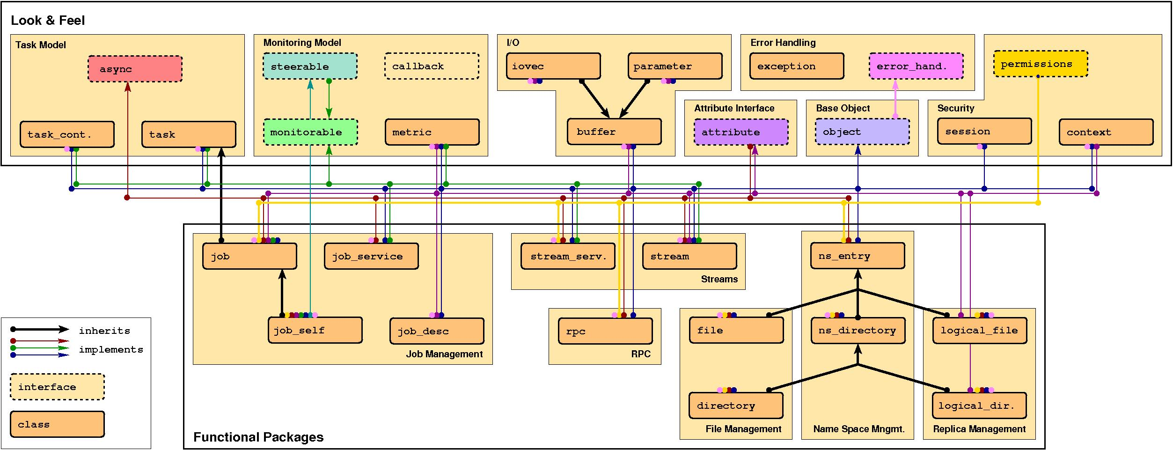
SAGA: Class Diagram

Slide 11
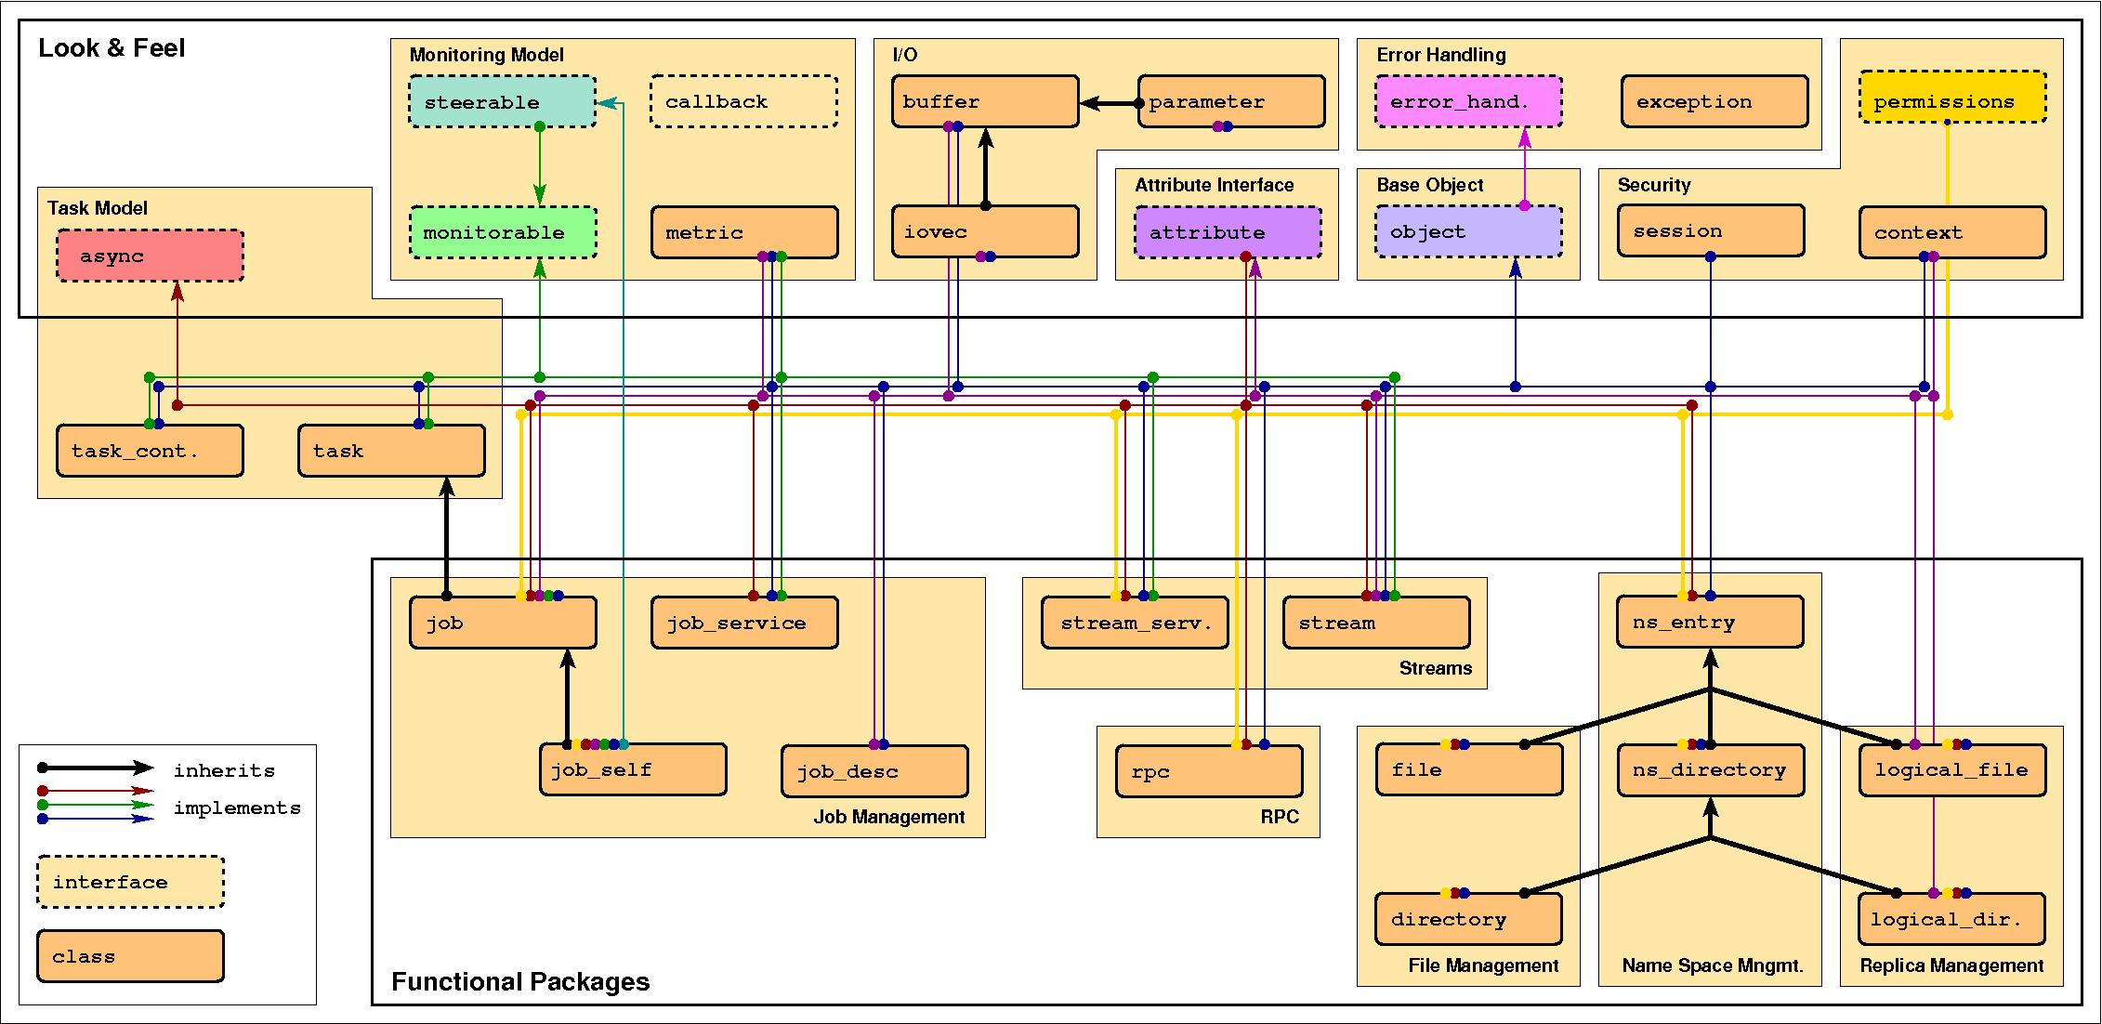
SAGA: Class Diagram (2)

Slide 12
SAGA API: Towards a Standard
The need for a standard programming interface
  “Go it alone” versus “Community” model
  Reinventing the wheel again, yet again, and again
  MPI as a useful analogy of community standard
  OGF the natural choice; establish SAGA-RG
“Tedium” of the standardisation process?
  Not all technology needs to be standardised upfront
  Standardisation not a guarantee to success
Requirements Document
  Design and requirements derived from 23 Use Cases
  Different projects, applications and functionality

Slide 13
SAGA API: Design & Specification
Open Grid Forum: Design and requirements derived from 23 Use Cases (some “correlated”)
  Different projects, applications and functionality
    Biological, Coastal-modelling, visualization ..
  Functional Areas: Job Mgmt, Resource Mgmt, Data Mgmt, Logical Files, Streams....
  Non-functional Areas: Asynchronous, QoS, Bulk
Interface is language independent, object-oriented and each sub-system is independent
Specificed using Scientific Interface Description Language (SIDL)
  extensible and easily implementable

Slide 14
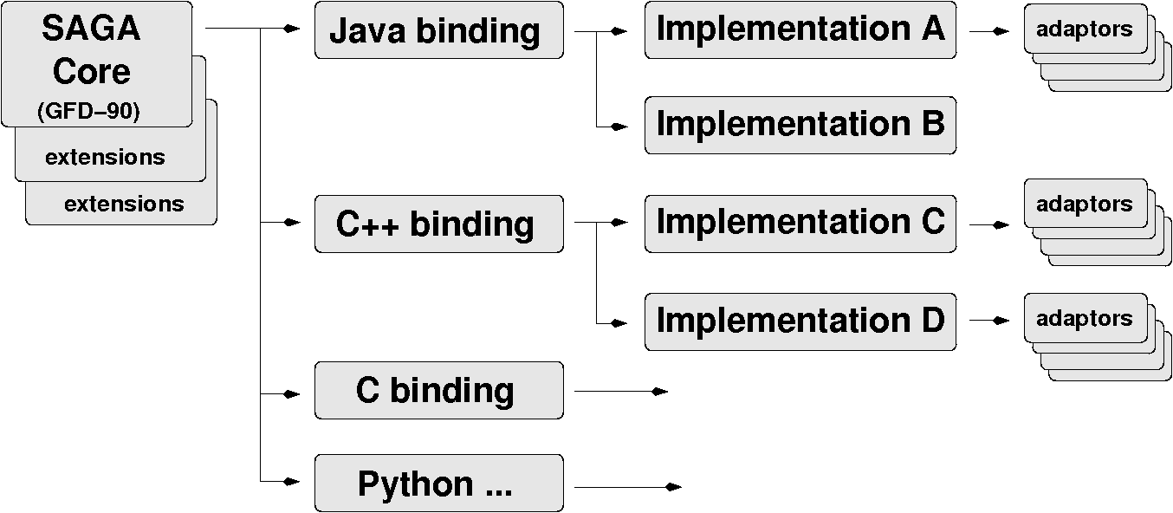
The SAGA Landscape

Slide 15
SAGA Interface: Providing Interoperabiltiy
Job Submission API
01: // Submitting a simple job and wait for completion
02: //
03: saga::job_description jobdef;
04: jobdef.set_attribute ("Executable", "job.sh");
05:
06: saga::job_service js;
07: saga::job job = js.create_job ("remote.host.net", jobdef);
08:
09: job.run();
10:
11: while( job.get_state() == saga::job::Running )
12: {
13: std::cout << “Job running with ID: “
14: << job.get_attribute(“JobID”) << std::endl;
15: sleep(1);
16: }

Slide 16
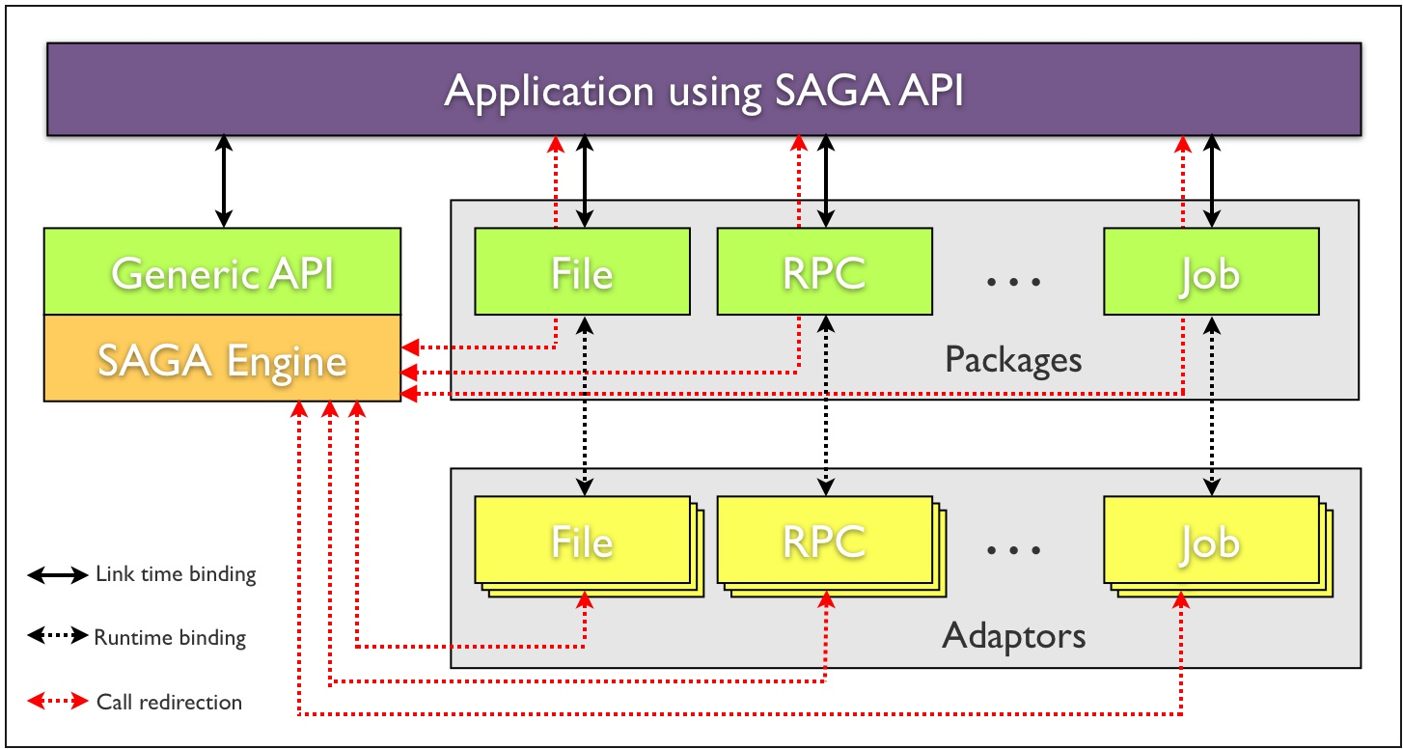
SAGA C++ (LSU)

Slide 17
SAGA Implementation
How it supports Interoperability
Requirements
Overall Architecture
    Horizontal, Extensibility, Vertical
Generic Call Routing
    Route API calls to appropriate MW adaptors; underlying technology is Abstract Objects
Lessons Learnt
    Uniform implementations for different languages; C, C++, Python and Java
    Flexible adaptor selection (more than one)

Slide 18
SAGA Implementation (2)
Some requirements to support interoperability
Non-trivial set of requirements:
  Allow heterogenous middleware to co-exist
  Cope with evolving grid environments; dyn resources
  Future SAGA API extensions
  Portable, syntactically and semantically platform independent; permit latency hiding mechanisms
  Ease of deployment, configuration, multiple-language support, documentation etc.
  Provide synchronous, asynchronous & task versions
  Portability, modularity, flexibility, adaptabilty, extensibility

Slide 19
SAGA Implementation
How the Architecture Supports Interoperability
Horizontal Extensibility – API Packages
  Current packages:
    file management, job management, remote procedure calls, replica management, data streaming
    Steering, information services, checkpoint in pipeline
Vertical Extensibility – Middleware Bindings
  Different adaptors for different middleware
  Set of ‘local’ adaptors
Extensibility for Optimization and Features
  Optimization: e.g. Bulk optimization, modular design
  Features: e.g latency hiding, late binding etc.
  PIMPL = Private (API..) + Implementation (Engine)

Slide 20
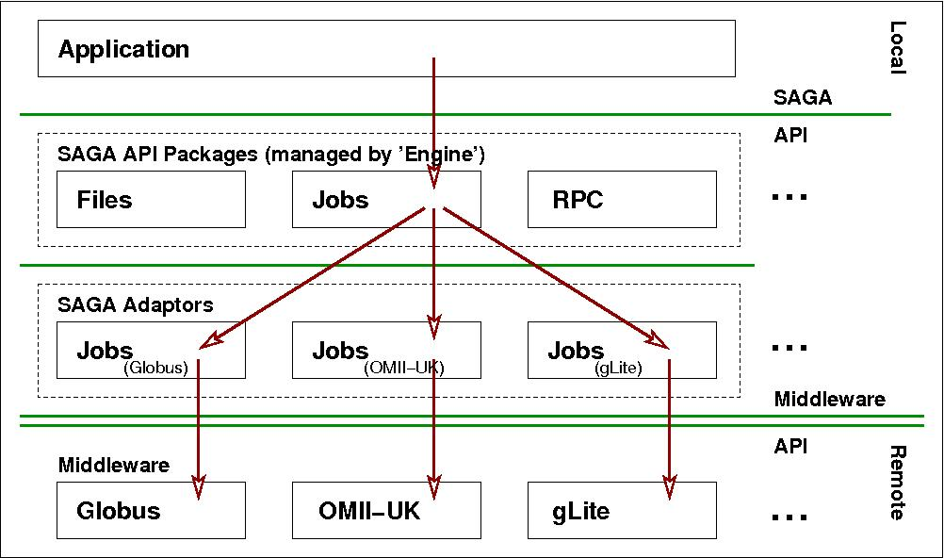
SAGA: Interoperable Job Submission

Slide 21
SAGA and (the five areas of) GIN
SAGA and ...
  Job Submission & Management
    SAGA exposes same functionality as OGSA-BES at a higher level of abstraction e.g., job id w/o contacting job service
    Same job state model as BES (not a random coincidence)
  Data Management and Movement
    Data movement protocol agnoistic
    Supports pseduo-schema (any://remote.host.net/dir/file.typ) and allows implementation to determine
  Authorization and Identity Management
    Essentially not exposed at application development level
  Cross Grid Applications
  Information Services and Modelling

Slide 22
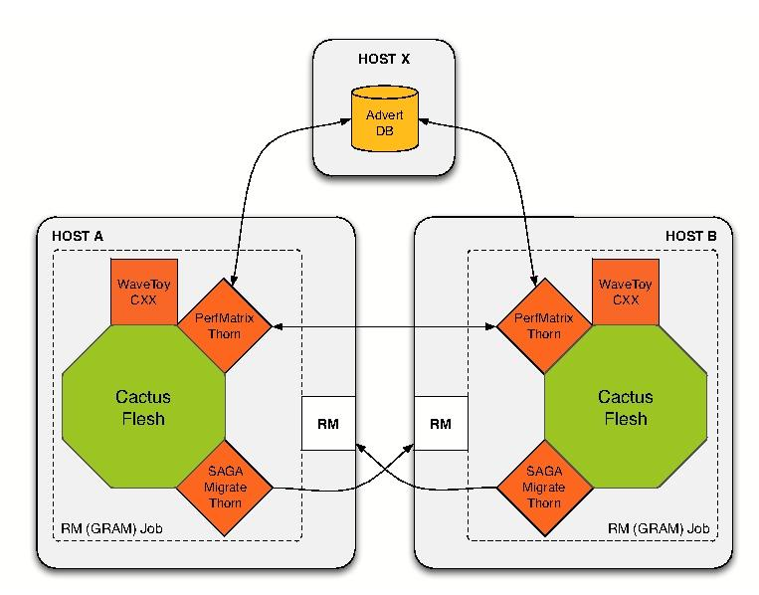
Network Performance Aware Application (1)
Capable of acquiring application-specific network characteristic data and determining ideal migration target across heterogeneous grids without changes in the application

Slide 23
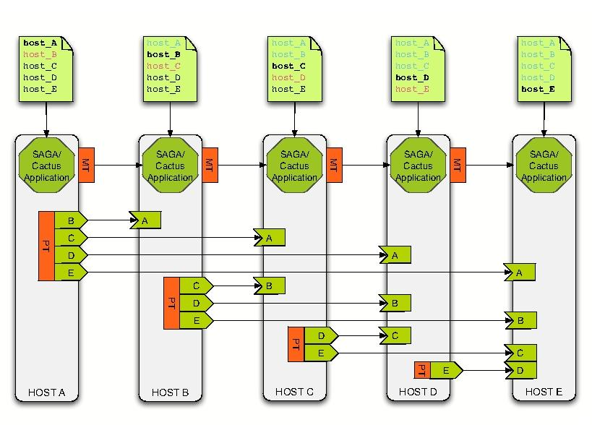
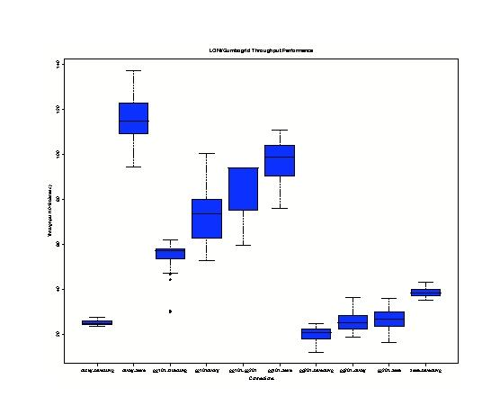
Network Performance Aware Application (2)

Slide 24
Future Work
Many applications under development...
Middleware bindings (adaptors): Key to “realising' interoperability
Use SAGA based applications in the next generation of GIN demonstrations(!)
  Suggestions for applications?
  US TeraGrid and EU Deisa?

Slide 25
Acknowledgments
Funding Agencies:
  UK EPSRC:
    Through OMII-UK “OMII SAGA” project
    Through NeSC, Edinburgh Distributed Programming Abstractions
  US NSF
    Cybertools projects
  CCT Internal Funds

Slide 26
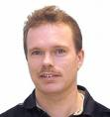





Acknowledegments: The SAGA Team
Hartmut Kaiser
Thilo Kielmann
Andre Merzky
Ceriel Jacobs
Ole Weidner
Kees Verstop
+ Many other students

Slide 27
Upcoming API Extensions
MessageBus
  Structured data transfer, also many-to-many
Service Discovery
  Based on GLUE schema
Adverts
  Persistent storage of application-level data
Checkpointing/Recovery
  Based on GridCPR

Slide 28
SAGA Implementation (2)
How it supports Interoperability
Implementation must be portable and both syntactically and semantically platform independent
Must cope with evolving Grid standards, environments, middleware; also co-existence of 'diverging'
Support fail-safety, hide dynamic resource

Slide 29
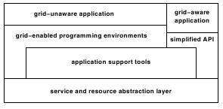
Application Level Interoperability (1)
Grid Aware: Explicit marshalling of Grid resources, eg GridSAT
Grid Unaware: e.g BOINC, Apps in a portal

