Slide 1
Conventional Job Submission
1 BigJob
2 BigJobs on
1 Machine
2 BigJobs on
2 Machines
Resource1
Resource1
Resource1
R1
R2
Job1
Job2
BigJob1
BigJob1
BigJob2
BigJob1
BigJob2
t₀
(Waiting)
(Waiting)
(Waiting)
(Waiting)
t₁
CFD
(or MD)
(Waiting)
(Waiting)
(Waiting)
CFD
MD
CFD
MD
CFD
MD
(Concurrency)
CFD
MD
t₂
CFD
(or MD)
MD
(or CFD)
Time Axis
CFD
MD
t₃
% Width represents the size of each job

Slide 2
Conventional Job Submission
1 BigJob
1 BigJob with
Load Balancing
Resource1
Resource1
Resource1
Job1
Job2
BigJob1
BigJob1
t₀
t₀
(Waiting)
t₁
CFD
(or MD)
t₁=t₂
(Inactive)
CFD
MD
CFD
MD
t₂
CFD
(or MD)
MD
(or CFD)
CFD
MD
Time Axis
(Active)
t₃
% Width represents the size of each job
t₃

Slide 3
Application Manager
BigJob/Load Balancing
3) BigJob Start Monitoring
4) Submit Sub-Jobs
7) Sub-Job Monitoring
Advert
Service
1) Submit BigJob
Remote Resource
Resource Manager
2) Start BigJob
BigJob
Multi-Physics Agent
5) Launch coupled subtasks
CFD
MD
6) Coupled Simulation, Checkpointing
Notes:
Same color for a pair of push-pull steps

Slide 4
Application Manager
Changed Job Configuration
BigJob
Launcher
BigJob
Monitor
Sub-job
Launcher
Sub-job
Monitor
Load
Balancing
Queue
Wait
Sub-Job Start
Wait for
Complete
Sub-Job Perforn-ance
Submit
Advert Service
Remote Resource
Notes:
Same color for a pair of push-pull steps

Slide 5
BigJob Application Manager
9) Processor
Reallocation
on Sub-Jobs
Load Balancing
Function
3) BigJob Launch
Monitoring
4) Submit Sub-Jobs
10) Restart Sub-Jobs
7) Sub-Job Monitoring
8) Performance
Information
of Applications
Advert
Service
1) Submit BigJob
Remote Resource
Resource Manager
2) Start BigJob
BigJob
Multi-Physics Agent
5) Launch coupled subtasks
CFD
MD
6) Coupled Simulation, Checkpointing

Slide 6
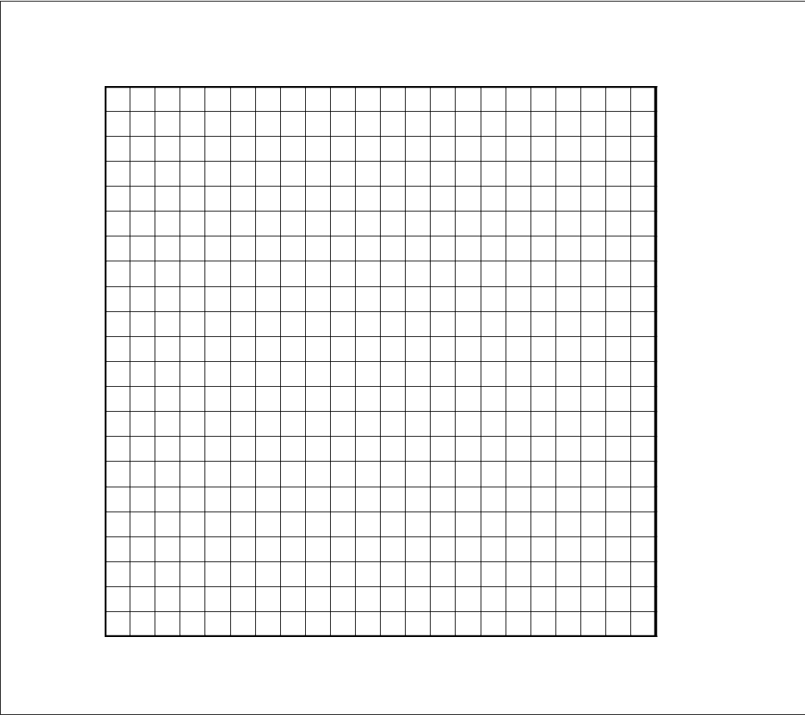
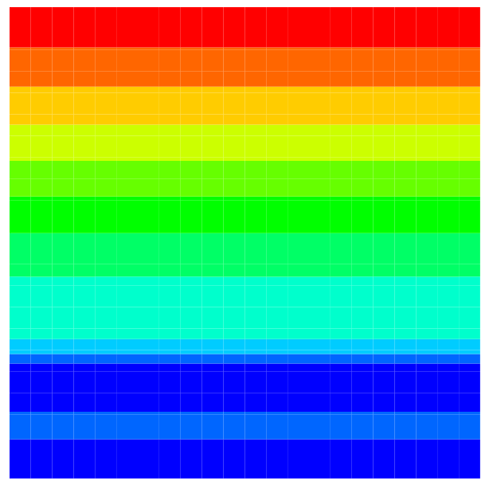

Moving Wall
CFD
Computational
Domain
Pure CFD
Solution
Hybrid
Simulation
Pure MD
Solution
Stationary Wall

Slide 7
Artificial Force
to Strap Particles
within Domain
External Force
Buffer
CFD to MD
Constrained MD
Equation Imposed
Buffer
Particle Dynamics
Imposed as BC
for Continuum Approach
MD to CFD

Slide 8
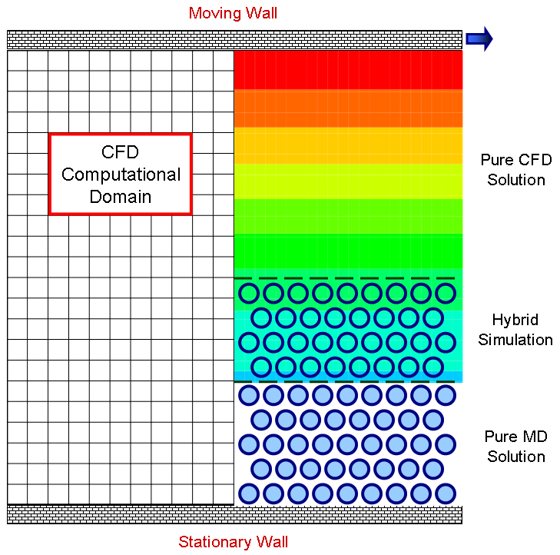
Artificial Force
to Strap Particles
within Domain
External Force
Buffer
CFD to MD
Constrained MD
Equation Imposed
Buffer
Particle Dynamics
Imposed as BC
for Continuum Approach
MD to CFD

Slide 9
Job Running Time
t₀
t₁
t_{f}
BigJob Wait
Sub-job Run
Sub-job Re-run
Sub-job Re-run
•••
CFD
CFD
CFD
BigJob
Allocation
•••
•••
MD
MD
MD
Job Size
BigJob
Sibmission
Sub-job
Setting
Load Balancing
and Re-start
End BigJob
Allocation

Slide 10
Conventional Job Submission
1 BigJob
1 BigJob with
Load Balancing
Resource1
Resource1
Resource1
t₀
Job1
Job2
BigJob1
BigJob1
t₁
CFD
t₁”
t₁’
CFD
MD
CFD
MD
t₂
CFD
MD
CFD
MD
Time
CFD
MD
t_{f2}
t_{f3}
t_{f1}’
CFD
MD
t_{f1}
CFD
MD
t_{f0}
CFD
MD

Slide 11
Conventional Job Submission
1 BigJob
1 BigJob with
Load Balancing
t₀
Job1
Job2
BigJob1
BigJob1
t₁
CFD
t₁’=t₂’
CFD
MD
CFD
MD
t₂
CFD
MD
Time
CFD
MD
t_{f1 LB}
CFD
MD
t_{f1}
CFD
MD
t_{f0}
CFD
MD

Slide 12
2 BigJobs on
1 Machine
2 BigJobs on
2 Machines
Resource1
R1
R2
t₀
BigJob1
BigJob2
BigJob1
BigJob2
t₁
CFD
MD
CFD
MD
t₁”
CFD
MD
t₁’
t₂
CFD
MD
Time
t_{f2}
CFD
MD
t_{f3}
CFD
MD
t_{f1}
t_{f0}

Slide 13

CFD Domain
Fluid System
Overlapping
Region
MD Domain

Slide 14
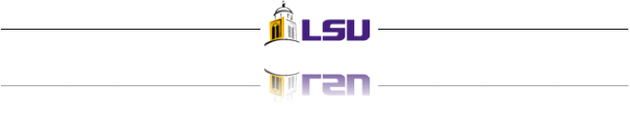
y
F(y)
External Force
Buffer
Constrained MD Equation
CFD to MD
Buffer
Averaged Particle Velocity
MD to CFD

Slide 15
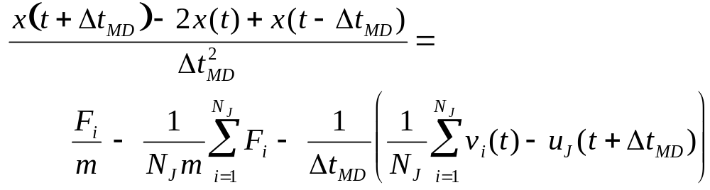
Constrained MD equation of motion
Acceleration on the particles
Average velocity in the cell
Average force in the cell
CFD velocity
Forces on the particles caused by interaction

Slide 16
26σ
16σ
10σ

Slide 17
CFD Running
CFD on the Queue
CFD Inactive
Waiting
Run
Wait
Data
Run
Wait
Data
……
Jobs Prepared and Setup
MD on the Queue
Run
Exchange
Run
Exchange
……
MD Running
t=0
Time-to-completion

Slide 18
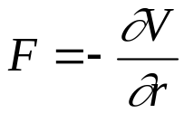
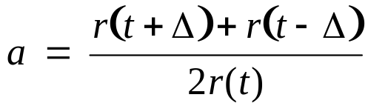
길이의 단위를 a, 에너지의 단위를 b, 질량의 단위를 입자의 질량 m(입자의 질량은 모두 같은 것으로 가정), 온도의 단위를 볼쯔만 상수 k_{b}로 정합시다. 그러면, 레너드-존스 포텐셜은 V(r) = 4(r⁻¹²-r⁻⁶)이 되고, hard sphere 포텐셜에서 입자 지름은 1이 됩니다. 또한, 두 경우 모두 '입자에 작용하는 힘 = 가속도'가 되죠. 또한 boltzman factor는 e^{-T} 가 됩니다.
결국 F=ma 에서
      V 는 potential energy 에의해 계산가능
      r 은 atom 간의 거리

Slide 19
Artificial Force
to Strap Particles
within Domain
External Force
Buffer
CFD to MD
Constrained MD
Equation Imposed
Buffer
Particle Dynamics
Imposed as BC
for Continuum Approach
MD to CFD

Slide 20
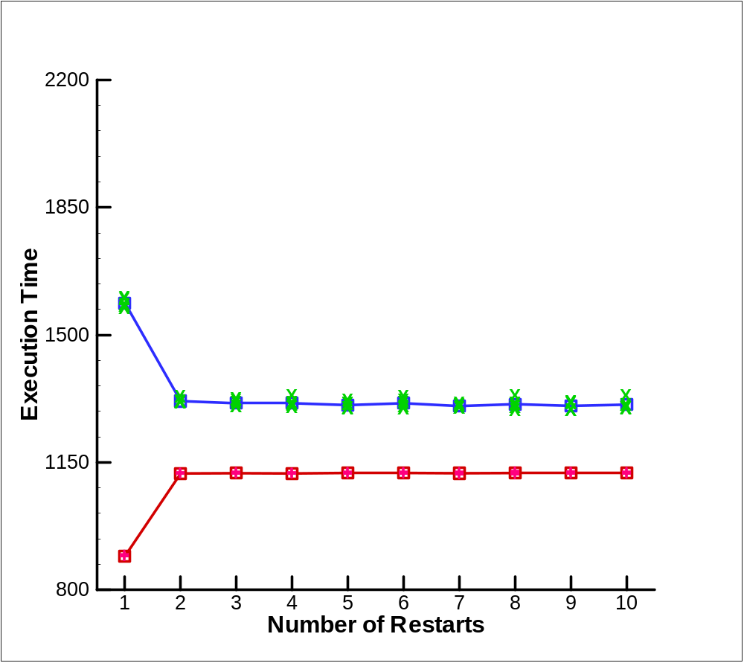
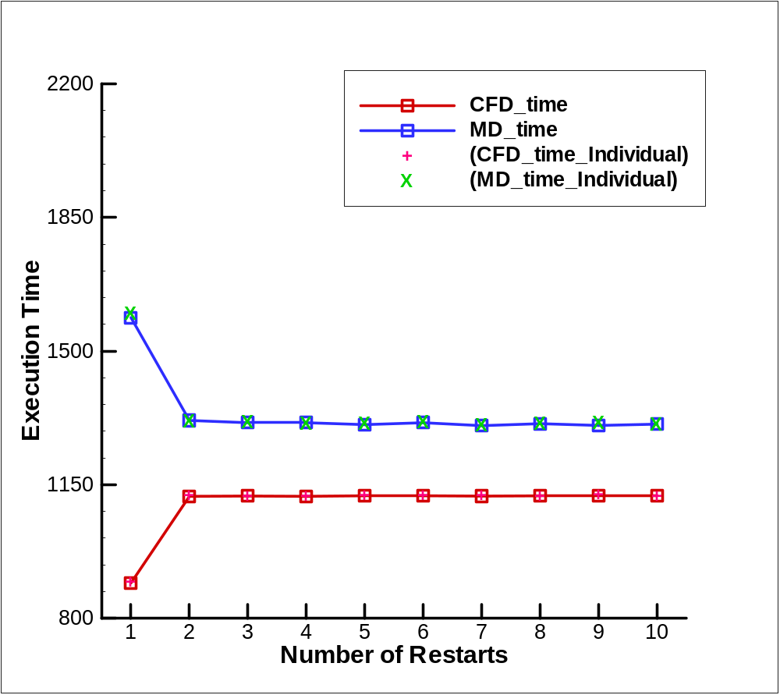

Slide 21
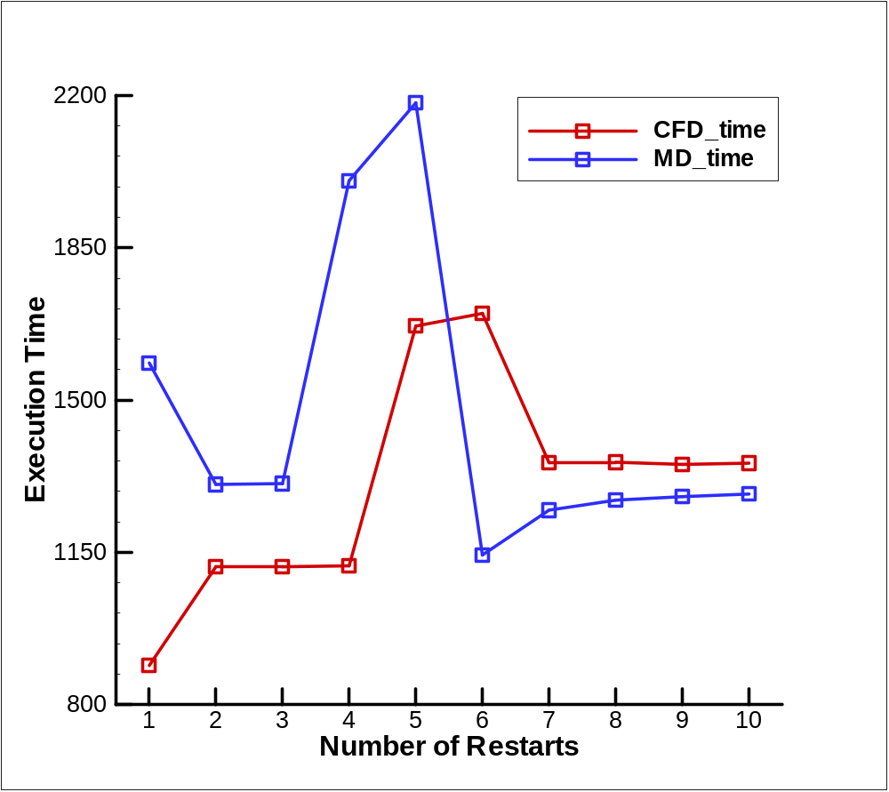

Slide 23
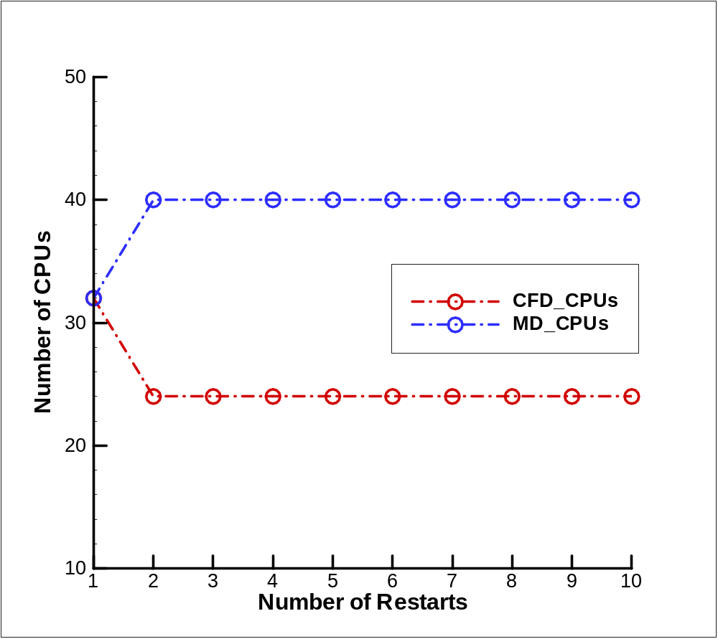

Slide 24
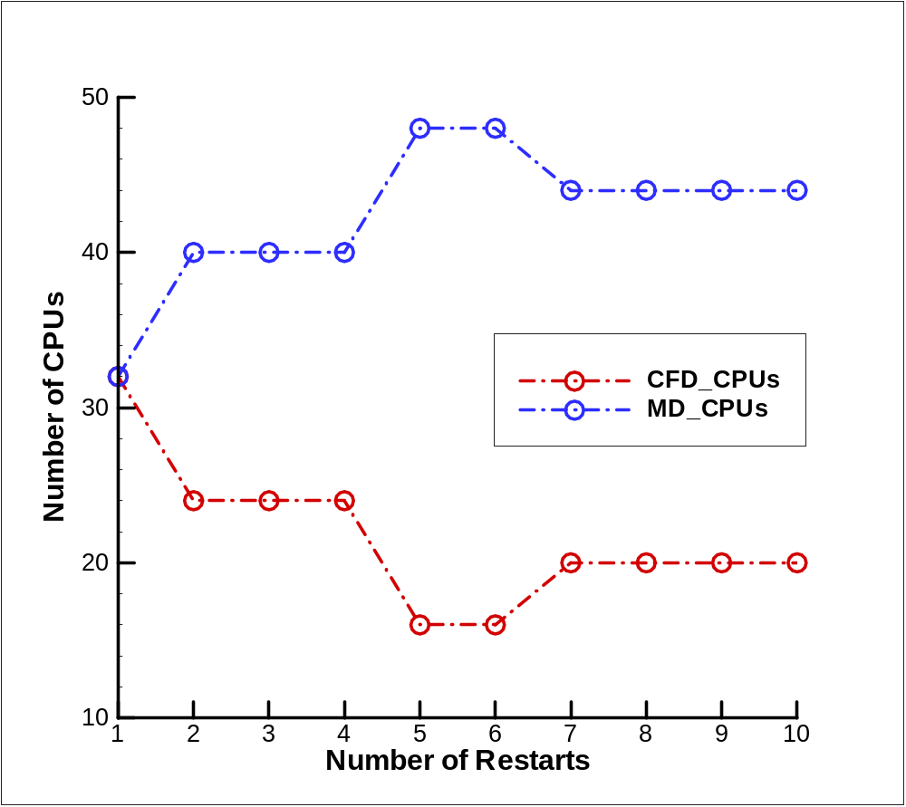

Slide 26
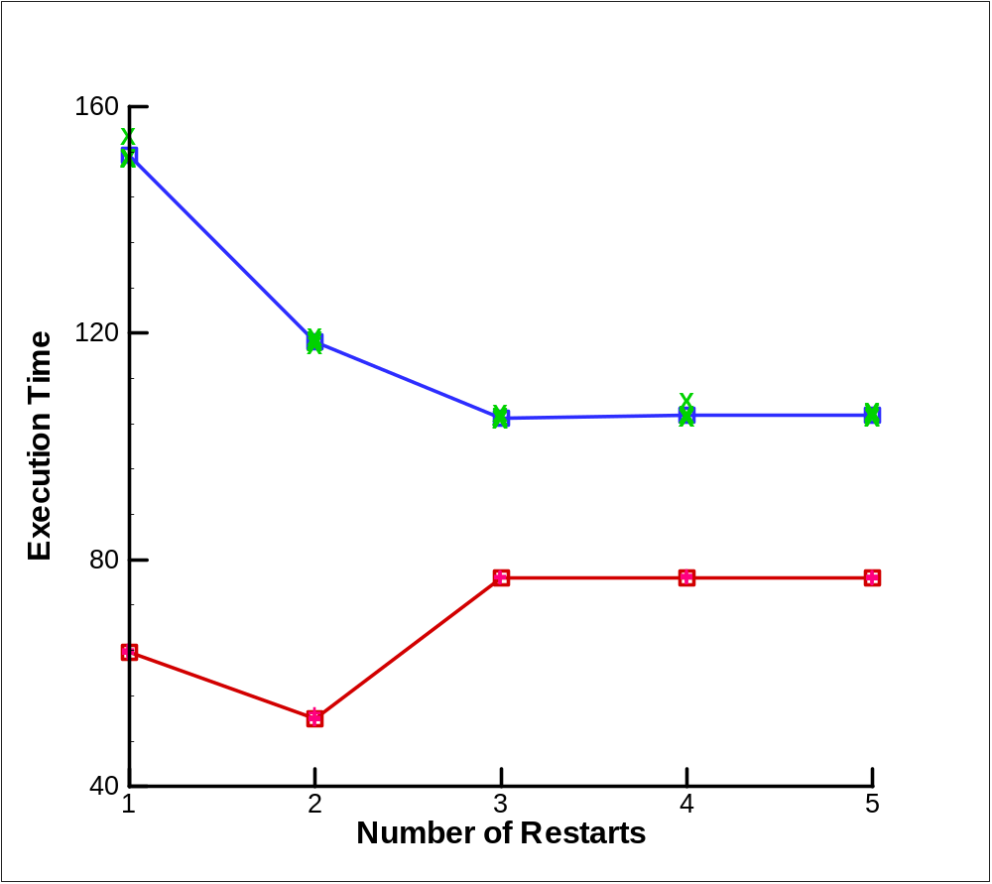
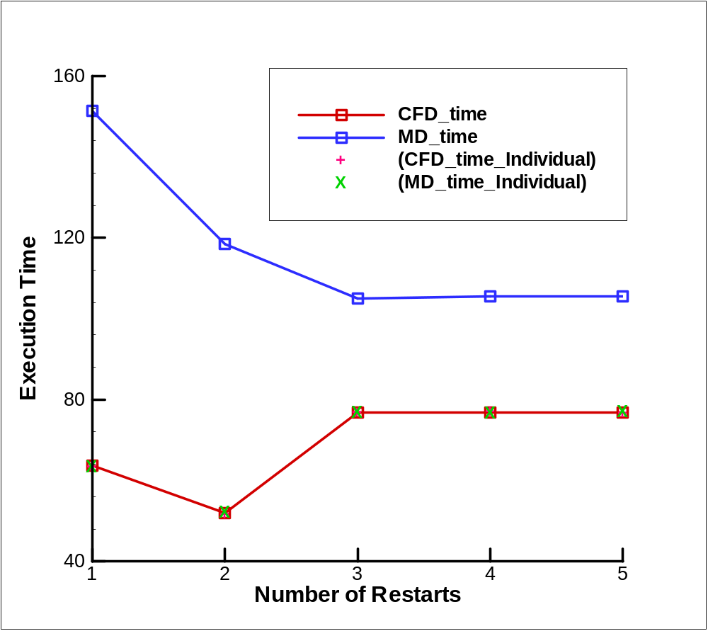

Slide 28
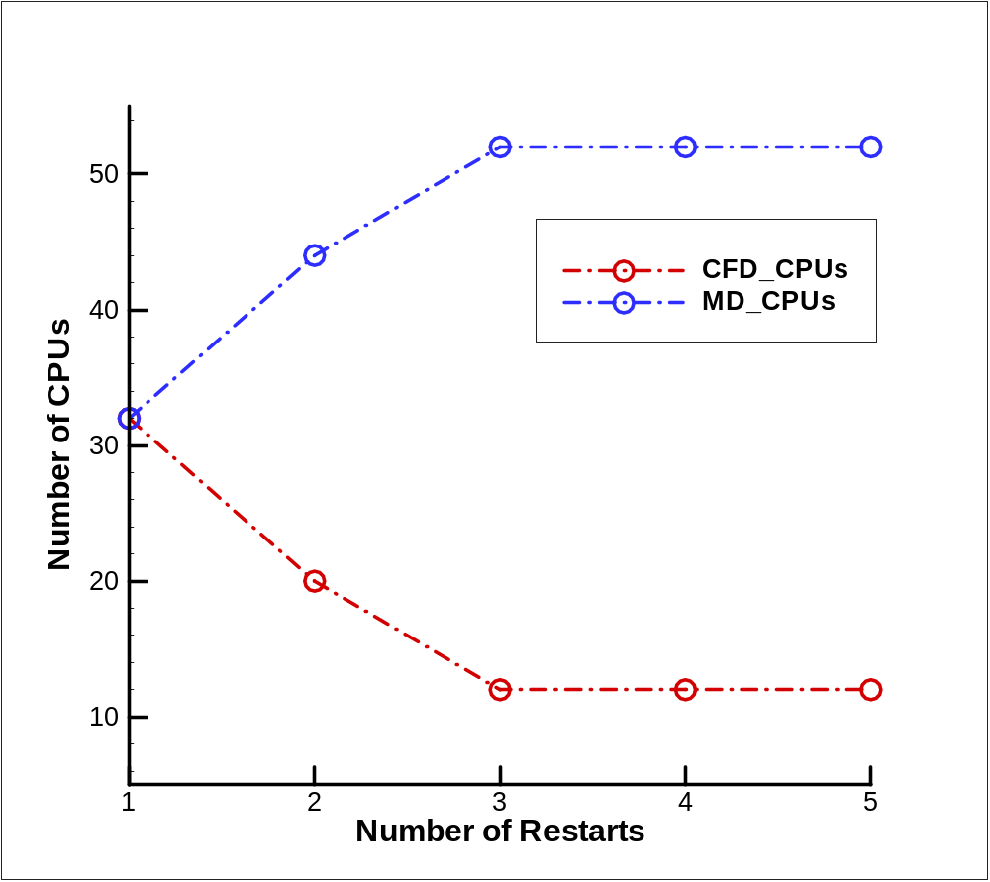

Slide 30
CFD
Fluid
Domain
Hybrid
MD

Slide 31
Initial positions and velocities,
Boundary conditions,
Atom types, etc.
INPUT
Compute forces/energies on each atom
based on neighbor list
Apply boundary conditions, thermostats
based on requirement
Obtain new velocities and positions of atoms
using time integration algorithm
Compute magnitudes of interest
No
t > t_{max}
Yes
OUTPUT
Velocity, Pressure,
Trajectories, Force, etc.

Slide 32
Artificial Force
to Strap Particles
within Domain
External Force
Buffer
CFD to MD
Constrained MD
Equation Imposed
Buffer
MD to CFD

Slide 33

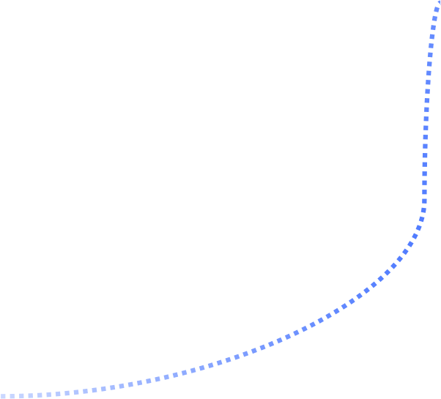

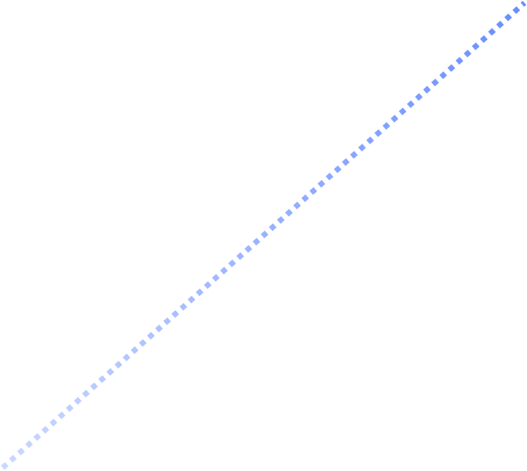
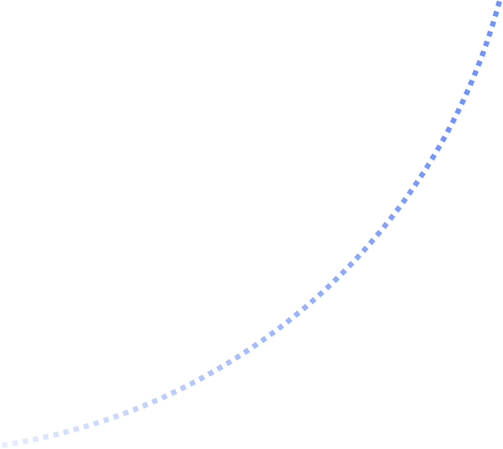
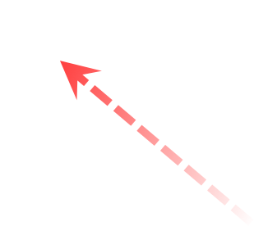
V_{MAX}
Pure MD
Coupling
Pure CFD
MD -> CFD
Buffer
Verification and Test of CFD-MD coupling
CFD -> MD
Computing pure CFD (CFD only) for entire system and calculate
velocity profile w.r.t. height and variable simulation time.
Run CFD-MD coupling simulation and calculate velocity profile
same as pure CFD.
Compare two velocity profiles for verification of CFD-MD coupling simulation method.
Velocity
Simulation time increasing
0
0
H_{MAX}
Height
CFD (Pure CFD and/or Coupling CFD)
MD (Coupling MD)

Slide 34
Schematic Diagram of Hybrid CFD-MD Simulation
1s
Moving upper wall
Pure CFD region
22s
10s
CFD-MD overlap region
12s
MD region
1s
Stationary wall

Slide 35

Schematic Diagram of Overlap Region
External Force
CFD
MD
Applying
Constrained MD
CFD
MD
CFD
MD
Buffer
MD
CFD
2s
MD
CFD

Slide 36
Information Exchange b/w CFD and MD
CFD
MD
Passing information of velocities based on its belonging region
(CFD grid) from CFD to MD.
These information using on constrained MD equation.
Examples of variables ;
xCFDu1 -> x-directional velocity on 1st cell layer
…
yCFDu3 -> y-directional velocity on 3rd cell layer
MD
CFD
Passing averaged particle velocities to CFD on the target region.
The velocities are used as boundary condition on CFD computation.
Examples of variables ;
upperAvgVelx -> x-directional average velocity on upper cell
…
lowerAvgVelz -> z-directional average velocity on lower cell
…

Slide 37



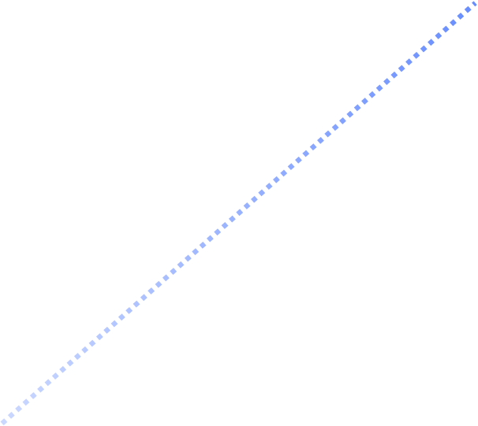

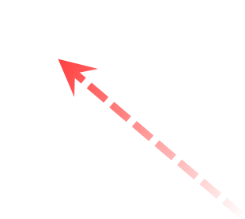
V_{MAX}
Pure MD
Coupling
Pure CFD
MD -> CFD
Buffer
Verification and Test of CFD-MD coupling
CFD -> MD
Computing pure CFD (CFD only) for entire system and calculate
velocity profile w.r.t. height and variable simulation time.
Run CFD-MD coupling simulation and calculate velocity profile
same as pure CFD.
Compare two velocity profiles for verification of CFD-MD coupling simulation method.
Velocity
Simulation time increasing
0
0
H_{MAX}
Height
CFD (Pure CFD and/or Coupling CFD)
MD (Coupling MD)

Slide 38



MD
CFD
Initial positions and
Velocities, Boundary
conditions, Atom types
Flow parameters and
Mesh information
Read grid, Metric calculation
Compute forces/energies
on each atom
Initialization of the flow
Apply boundary conditions
and thermostats
Apply physical
boundary conditions
Time integration for updating
particle dynamics
Compute the spatial flux
Compute magnitudes of
interest
Time integration for updating
flow properties
No
t = n * ∆t
No
Yes
Data exchange b/w MD and CFD
Moving wall
MD Output:
Velocity,
Pressure
CFD Output:
Velocity
Boundary Data
from CFD
Boundary Data
from MD
Stationary wall
No
t > t_{target}
No
End

Slide 39
