Slide 1
Conventional Job Submission
1 BigJob
2 BigJobs on
1 Machine
2 BigJobs on
2 Machines
Resource1
Resource1
Resource1
R1
R2
Job1
Job2
BigJob1
BigJob1
BigJob2
BigJob1
BigJob2
t₀
(Waiting)
(Waiting)
(Waiting)
(Waiting)
t₁
CFD
(or MD)
(Waiting)
(Waiting)
(Waiting)
CFD
MD
CFD
MD
CFD
MD
(Concurrency)
CFD
MD
t₂
CFD
(or MD)
MD
(or CFD)
Time Axis
CFD
MD
t₃
% Width represents the size of each job

Slide 2
Conventional Job Submission
1 BigJob
1 BigJob with
Load Balancing
Resource1
Resource1
Resource1
Job1
Job2
BigJob1
BigJob1
t₀
t₀
(Waiting)
t₁
CFD
(or MD)
t₁=t₂
(Inactive)
CFD
MD
CFD
MD
t₂
CFD
(or MD)
MD
(or CFD)
CFD
MD
Time Axis
(Active)
t₃
% Width represents the size of each job
t₃

Slide 3
Application Manager
BigJob/Load Balancing
3) BigJob Start Monitoring
4) Submit Sub-Jobs
7) Sub-Job Monitoring
Advert
Service
1) Submit BigJob
Remote Resource
Resource Manager
2) Start BigJob
BigJob
Multi-Physics Agent
5) Launch coupled subtasks
CFD
MD
6) Coupled Simulation, Checkpointing
Notes:
Same color for a pair of push-pull steps

Slide 4
Application Manager
Changed Job Configuration
BigJob
Launcher
BigJob
Monitor
Sub-job
Launcher
Sub-job
Monitor
Load
Balancing
Queue
Wait
Sub-Job Start
Wait for
Complete
Sub-Job Perforn-ance
Submit
Advert Service
Remote Resource
Notes:
Same color for a pair of push-pull steps

Slide 5
BigJob Application Manager
9) Processor
Reallocation
on Sub-Jobs
Load Balancing
Function
3) BigJob Launch
Monitoring
4) Submit Sub-Jobs
10) Restart Sub-Jobs
7) Sub-Job Monitoring
8) Performance
Information
of Applications
Advert
Service
1) Submit BigJob
Remote Resource
Resource Manager
2) Start BigJob
BigJob
Multi-Physics Agent
5) Launch coupled subtasks
CFD
MD
6) Coupled Simulation, Checkpointing

Slide 6



Moving Wall
CFD
Computational
Domain
Pure CFD
Solution
Hybrid
Simulation
Pure MD
Solution
Stationary Wall

Slide 7
Artificial Force
to Strap Particles
within Domain
External Force
Buffer
CFD to MD
Constrained MD
Equation Imposed
Buffer
Particle Dynamics
Imposed as BC
for Continuum Approach
MD to CFD

Slide 8
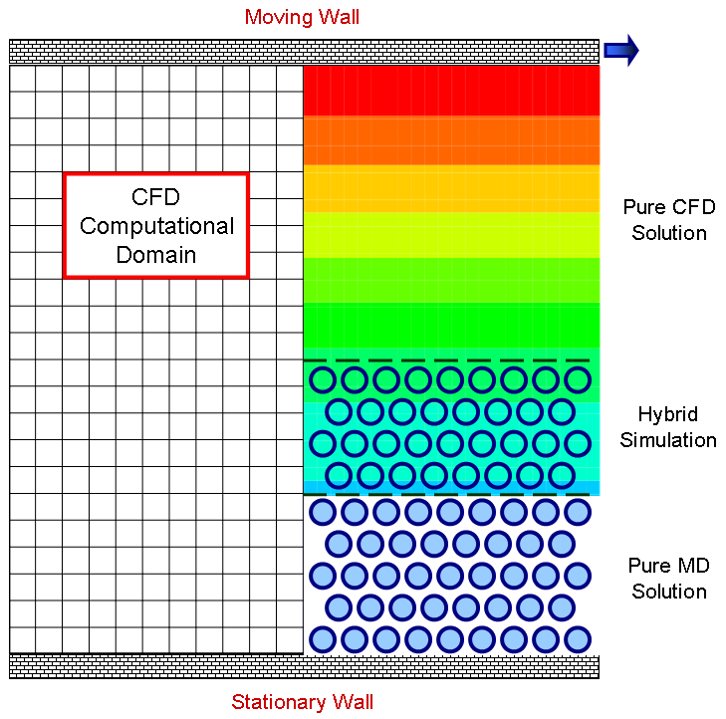
Artificial Force
to Strap Particles
within Domain
External Force
Buffer
CFD to MD
Constrained MD
Equation Imposed
Buffer
Particle Dynamics
Imposed as BC
for Continuum Approach
MD to CFD

Slide 9
Job Running Time
t₀
t₁
t_{f}
BigJob Wait
Sub-job Run
Sub-job Re-run
Sub-job Re-run
•••
CFD
CFD
CFD
BigJob
Allocation
•••
•••
MD
MD
MD
Job Size
BigJob
Sibmission
Sub-job
Setting
Load Balancing
and Re-start
End BigJob
Allocation

Slide 10
Conventional Job Submission
1 BigJob
1 BigJob with
Load Balancing
Resource1
Resource1
Resource1
t₀
Job1
Job2
BigJob1
BigJob1
t₁
CFD
t₁”
t₁’
CFD
MD
CFD
MD
t₂
CFD
MD
CFD
MD
Time
CFD
MD
t_{f2}
t_{f3}
t_{f1}’
CFD
MD
t_{f1}
CFD
MD
t_{f0}
CFD
MD

Slide 11
2 BigJobs on
1 Machine
2 BigJobs on
2 Machines
Resource1
R1
R2
t₀
BigJob1
BigJob2
BigJob1
BigJob2
t₁
CFD
MD
CFD
MD
t₁”
CFD
MD
t₁’
t₂
CFD
MD
Time
t_{f2}
CFD
MD
t_{f3}
CFD
MD
t_{f1}
t_{f0}

