Slide 1


SAGA: A Quick Tour
There exists a lack of:
  Programmatic approaches that provide common grid functionality at the correct level of abstraction for applications
  Ability to hide underlying complexity of infrastructure, varying semantics, heterogeneity and changes from the application-developer
Simple, integrated, stable, uniform and high-level interface
  Simple: 80:20 restricted scope
  Integrated: Similar semantics & style across commonly used distributed functional requirements
  Stable: Standard
  Uniform: Same interface for different distributed systems
SAGA: Provides the high-level abstraction that application developers need that will work across different distributed systems
  Shields details of lower level middle-ware and system issues
  Enables the details of distribution to be left out

Slide 2
Job Submission Interface
01: // Submitting a simple job and wait for completion
02: //
03: saga::job_description jobdef;
04: jobdef.set_attribute ("Executable", "job.sh");
05:
06: saga::job_service js;
07: saga::job job = js.create_job ("remote.host.net", jobdef);
08:
09: job.run();
10:
11: while( job.get_state() == saga::job::Running )‏
12: {
13: std::cout << “Job running with ID: “
14: << job.get_attribute(“JobID”) << std::endl;
15: sleep(1);
16: }
Text
The interface is simple and the actual function
calls remain the same

Slide 3
File API Example
01: // Read the first 10 bytes of a file if file size > 10 bytes
02: //
03: saga::file my_file (“griftp://gridhub/~/result.dat);
04:
05: off_t size = my_file.get_size ();
06:
07: if ( size > 10 )
08: {
09: char buffer[11];
10: long bufflen;
11:
12: my_file.read (10, buffer, &bufflen);
13:
14: if ( bufflen == 10 )
15: {
16: std::cout << buffer << std::endl;
17: }
18: }

Slide 4
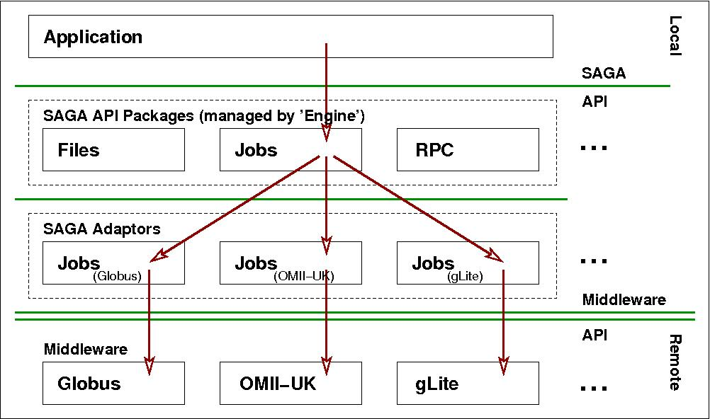
SAGA: Job Submission
Role of Adaptors (middleware binding)‏
Text

Slide 5
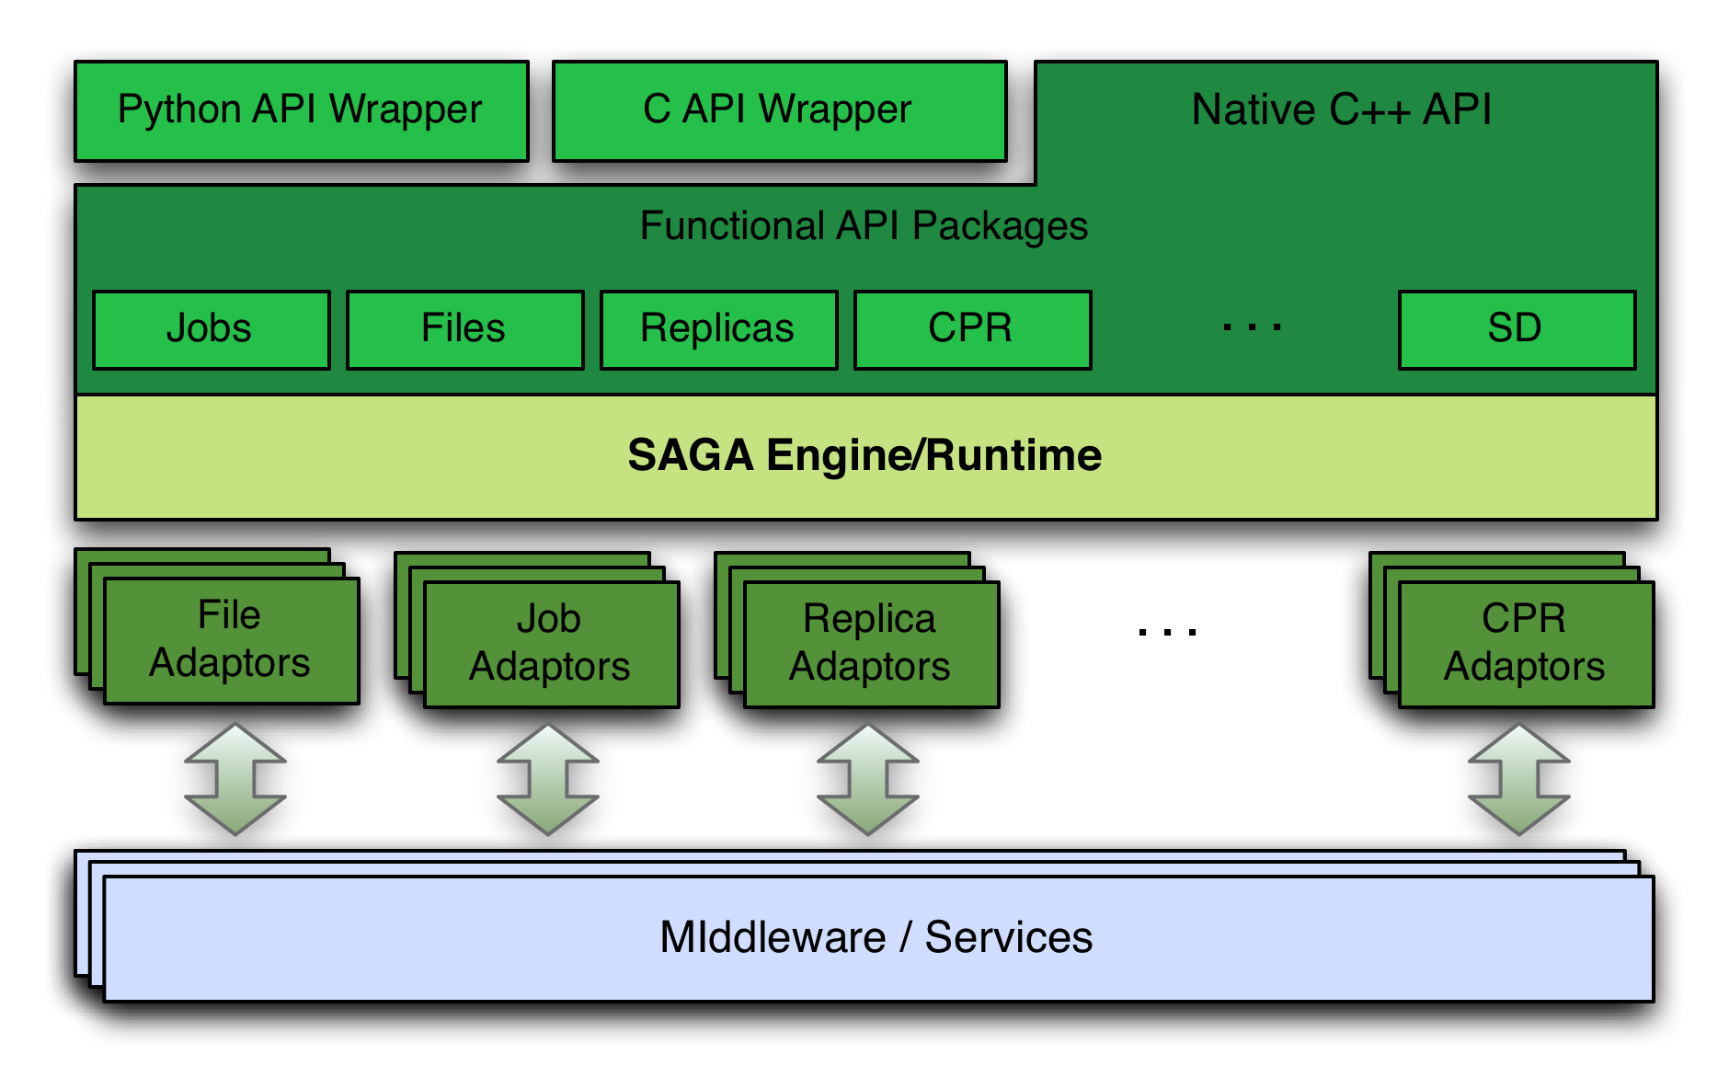
SAGA Landscape

Slide 6
Distributed Applications (1)
What is a Distributed Application?
Distributing a legacy Application:
  Focus mechanisms to support distributed execution
    Science Gateways, Condor..
    No-coupling or coordination between tasks
      E.g., Replica Ensemble
Distributed Applications with Multiple Components
  Naturally decomposed; aggregate (coordination)
      E.g. DDDAS, sensor-based applications
  Decompose a Large problem into sub-components
      Degree-of-coupling (e.g freq/vol of comm)
      Flexibility (scheduling, ordering)

Slide 7
Distributed Applications (2)
Coordination
Challenge: Coordination of multiple-components
  Decompose a large problem into sub-problem
  Designing De Novo Distributed Application
    E.g. GridSAT (Wolski), Distributed Reasoning (Bal)
Coupling components set coordination strategy
  Coupling is high:
      Low flexibility in placement, ordering, resource selection; or Communication (e.g. MPIg)
  Coupling is low:
      High flexibility in placement, ordering..
        E.g. (Identical?) Replica-Exchange

Slide 8
Distributed Applications (3)
What makes a DA a DA?
  Vectors: Axes representing application characteristics, the values of which help us understand:
    The application requirements, and
    Design and Constraints of solutions, tools
Application Vectors:
    Executable Unit
    Communication
    Coordination
    Execution Environment
    See Omer Rana’s talk after Keynote 1

Slide 9
Frameworks: Capturing Application Requirements, Characteristics & Patterns
Pattern: Commonly recurring Modes of Computation
Abstraction: Mechanism to support patterns and application characteristics
  Development, Deployment and Execution
Frameworks that support Patterns:
  MapReduce, Master-Worker, Hierarchical Job-Submission
Frameworks that provide the abstractions and support the requirements & characteristics

Slide 10
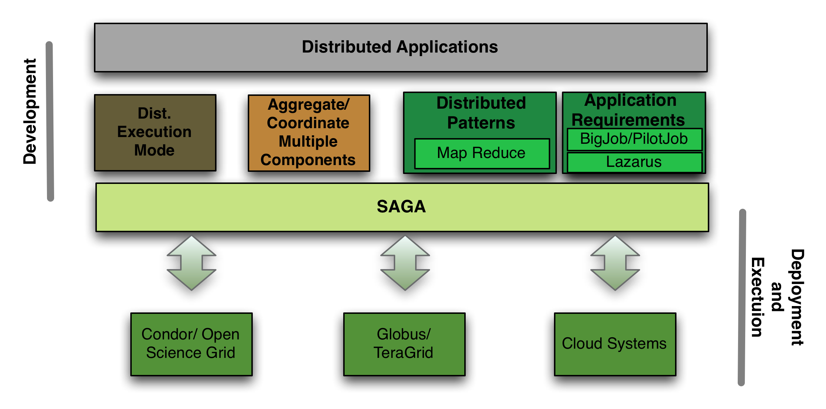
SAGA and Distributed Applications

Slide 11
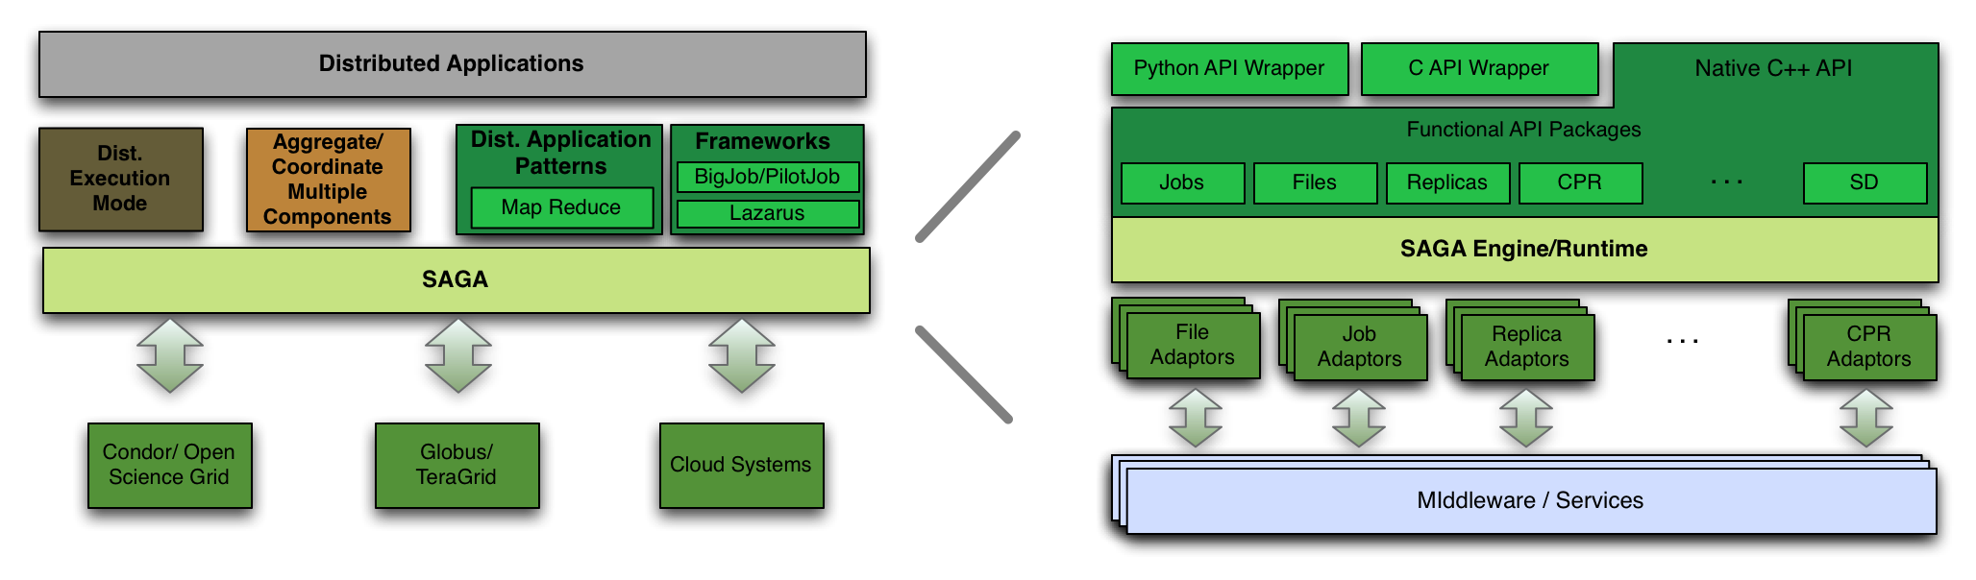
SAGA: Bridging the Gap between Infrastructure and Applications
Focus on Application Development and Characteristics, not infrastructure details

Slide 12
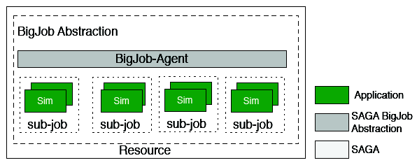
Abstractions for Distributed Computing (1)
BigJob: Container Task
Adaptive:
Type A: Fix number of replicas; vary cores assigned to each replica.
Type B: Fix the size of replica, vary number of replicas (Cool Walking)
-- Same temperature range (adaptive sampling)
-- Greater temperature range (enhanced dynamics)

Slide 13
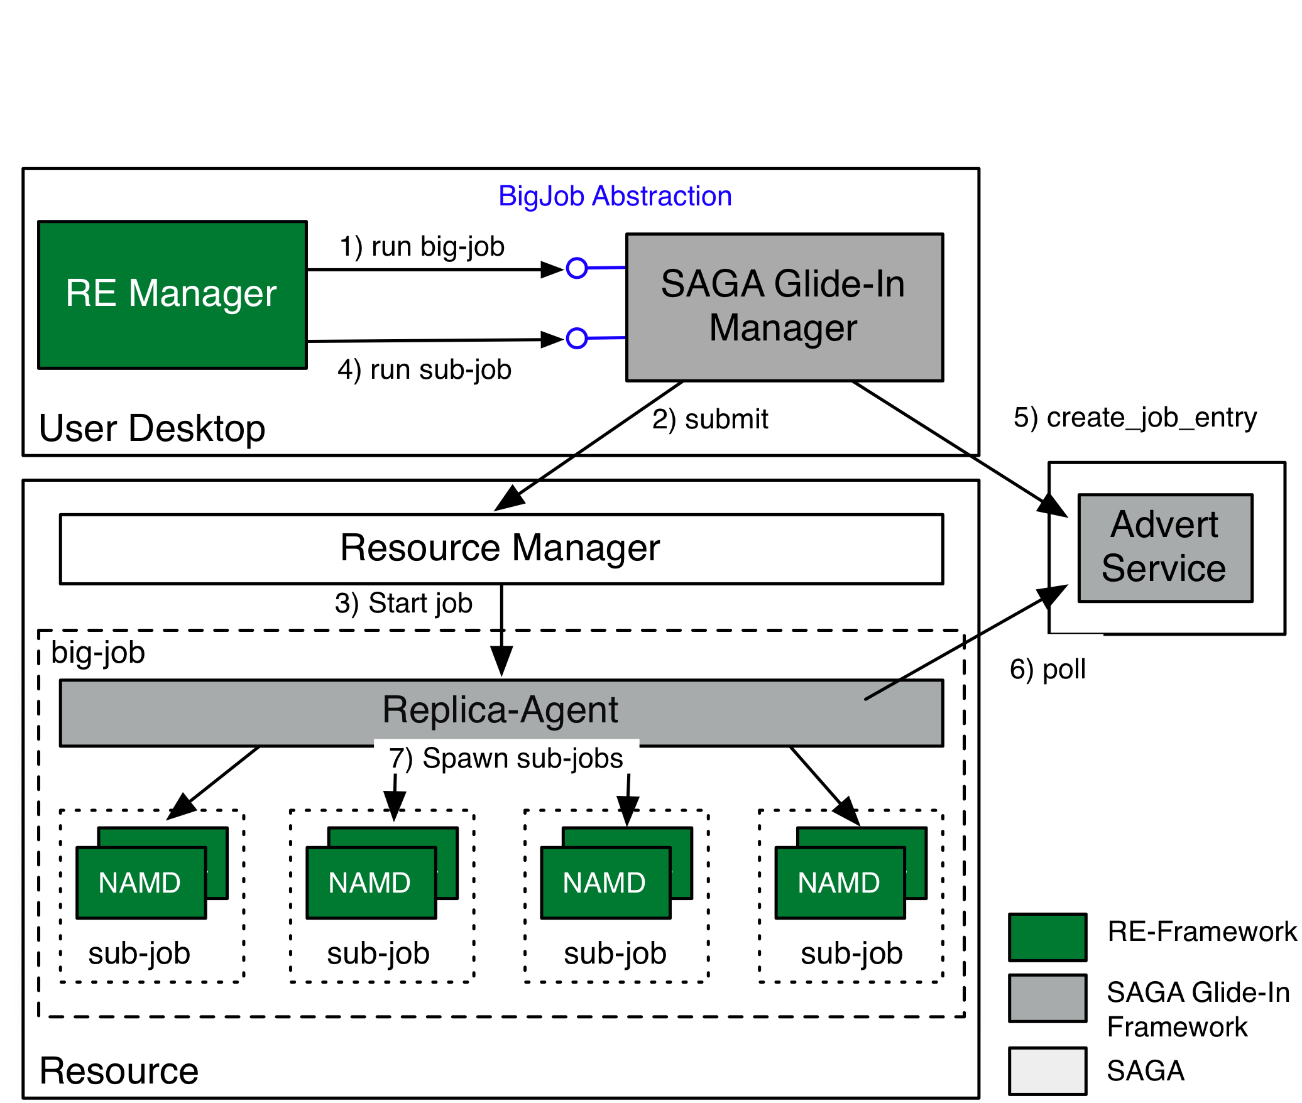
Abstractions for Distributed Computing (2)
SAGA Pilot-Job (Glide-In)

Slide 14
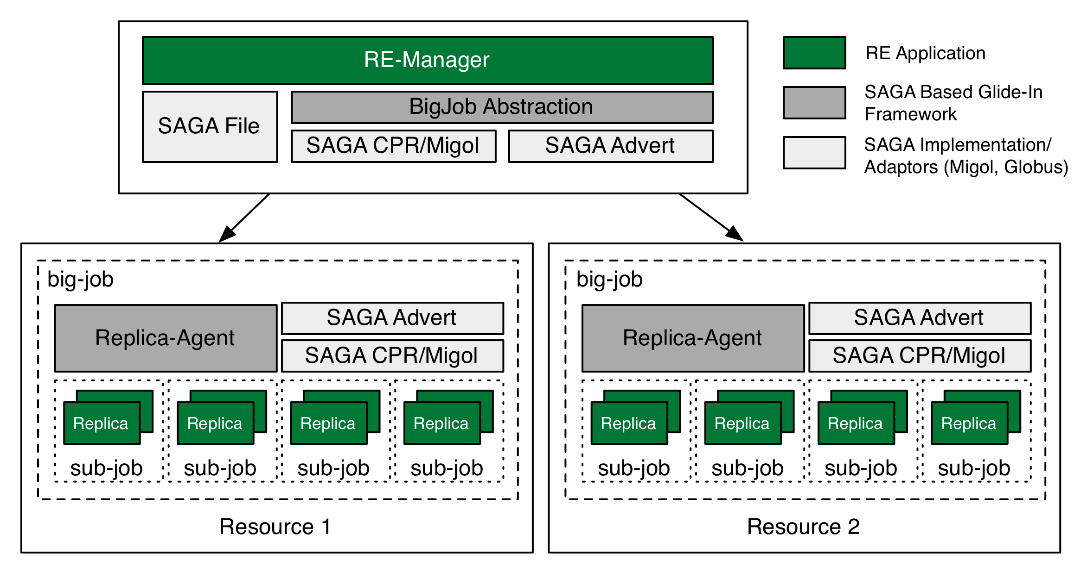
Coordinate Deployment & Scheduling of
Multiple Pilot-Jobs
FAUST production-level implementation coming:
http://macpro01.cct.lsu.edu/~oweidner/faust/

Slide 15
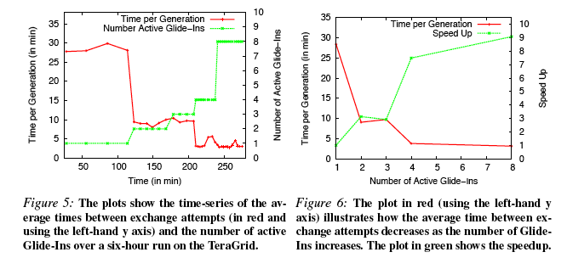
Scale-Out: Dynamic Execution &
Resource Aggregation

Slide 16
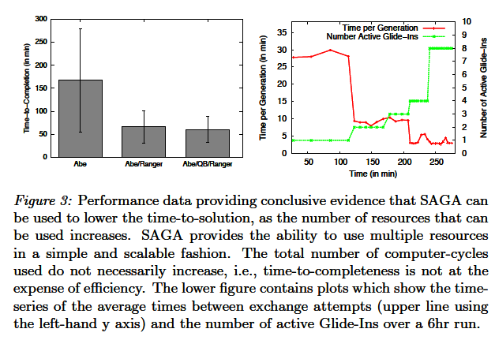
Using Multiple Resources
Performance Enhancements

Slide 17
Acknowledgements
Funding Agencies:
UK EPSRC: DPA, OMII-UK
US NSF: Cybertools, HPCOPS, GridChem
NIH: LaCATS, INBRE-LBRN
CCT Internal Resources
People:
SAGA: Hartmut Kaiser, Ole Weidner, Andre Merzky, Joohyun Kim, Andre Luckow, Lukas, Kate Stamou
DPA Theme:
DPA Team: Manish Parashar, Omer Rana (& Jon Weissman, D Katz)
Cybertools: Abhinav Thota, Jeff, N. Kim

Slide 18
Related Work
FAUST Framework being applied to heterogeneous component problems:
  Problems size too large to fit onto 1 machine
  But concurrent use of multiple resources introduces co-scheduling problems
  Framework that supports multiple-components
      Same BigJob (different components)
      Different BigJob, same Resource
      Different BigJob, different Resource
  Multi-physics, CFD-MD at UK eScience 2009, IEEE eScience 2009

