Slide 1
HEALTH ANALYTICS · ISE 503
Predicting High-Cost
Medicare Patients
5%
of patients drive
50% of costs
Before They Become High-Cost
72%
of future high-cost
patients captured
Sagarika Raju · Vansh Chanchlani
University of Southern California · ISE 503 Health Analytics · Spring 2026
Slide 1 / 10

Slide 2
PART A · THE PROBLEM
2 / 10
Your ACO Is Flying Blind on Next Year's Costliest Patients
5%
$85,798
$0
of Medicare patients
drive 50% of all costs
annual spending threshold
for top-5% patients in 2023
proactive identification
in most ACOs today
By the time a patient is identified as high-cost, the hospitalizations have already happened, and the savings window has closed. Your care management team needs a forward-looking tool that ranks patients by predicted risk before the year begins.
Our answer: Use last year's Medicare claims to predict who will be in the top 5% of spending next year, and flag them for proactive outreach before avoidable hospitalizations occur.

Slide 3
PART A · HEALTH ANALYTICS FRAMEWORK
3 / 10
What We Set Out to Do — and For Whom
OBJECTIVE
TARGET POPULATION
Predict which Medicare patients will be in the top 5% of spending in Year 2 using only Year 1 claims data
Fee-for-service Medicare beneficiaries with 12 months of Part A & B enrollment. Medicare Advantage excluded.
DECISION / USE CASE
INTENDED AUDIENCE
Ranked risk-score list delivered each January so care managers can prioritize outreach before costs materialize
ACO Medical Director and care coordination team allocating limited outreach capacity across a large panel
EVALUATION FOCUS
BOUNDARIES
AUC-ROC: measures how well the model ranks patients by risk, regardless of class imbalance
Identification only. Tool informs clinical judgment, it does not replace it or automate any care decision

Slide 4
PART B · DATA & METHODS
4 / 10
From Raw Claims to a Prediction-Ready Dataset
01
CMS Medicare PUF
02
Claims Linkage
03
Feature Engineering
04
Label Creation
Verified government source
8,671 beneficiaries (2022)
9,179 beneficiaries (2023)
Inpatient · Outpatient · Carrier
3 file types · BENE_ID join key
2022 - & 2023 - year filter
30 features built
14 base + 16 clinical
Trajectory · ICD codes
Top 5% of 2023 spending
Threshold: $85,798
167 high-cost / 3,172 non
30 Features Across 5 Categories:
Prior Spending
Utilization Type
Diagnosis Burden
Chronic Disease Flags (8)
Spending Trajectory

Slide 5
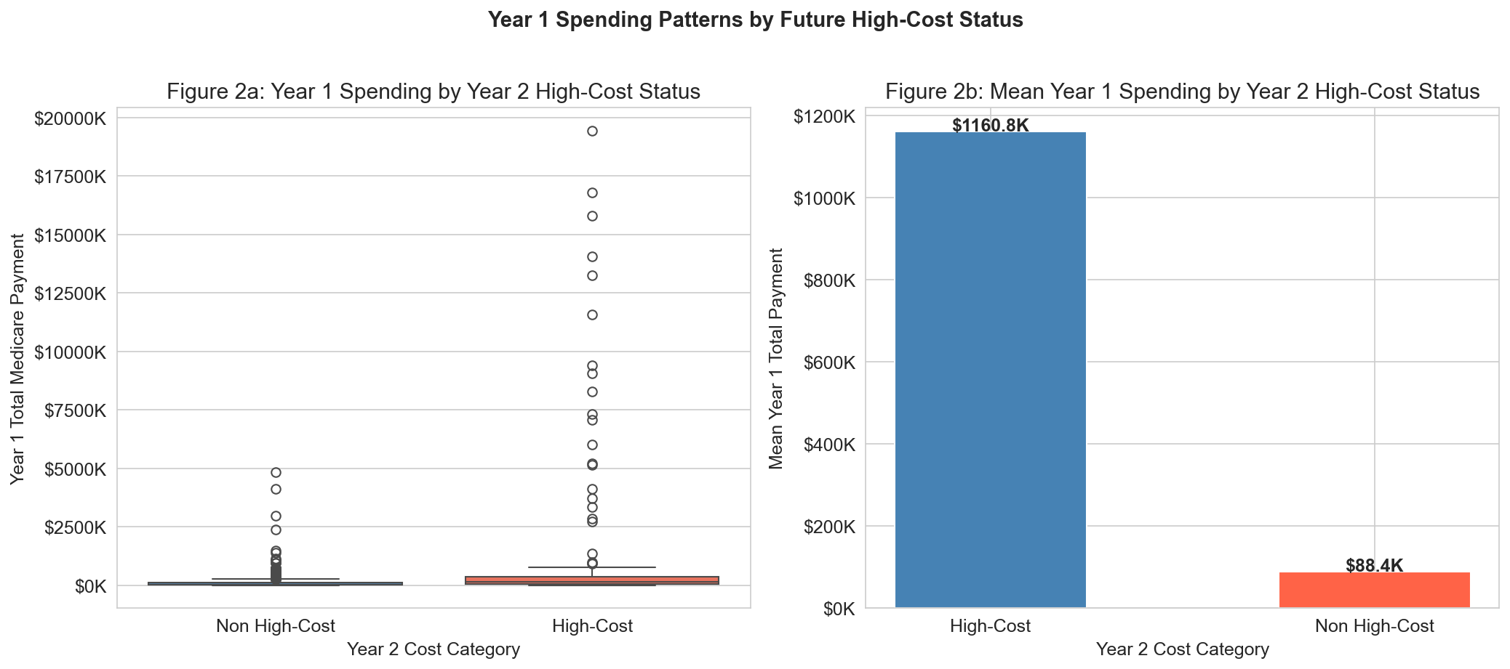
PART B · EXPLORATORY DATA ANALYSIS
5 / 10
The Data Already Tells a Story
13x Spending Gap
Future high-cost patients had mean Year 1 spending of $1,160K vs $88K for
non-high-cost patients a 13x differential that validates prior spending as the dominant predictor.
Right-Skewed Costs
Year 2 spending is heavily right-skewed. Most patients cluster near zero
while a tiny tail drives disproportionate cost confirming the top-5%
concentration pattern.
Demographics Signal
Males have a 5.8% high-cost rate vs 4.3% for females. High-cost patients
peak younger (~65) than non-high-cost (~70), reflecting acute catastrophic
events.
Disease Prevalence
41.5% cardiovascular, 36.8% renal, 32.8% diabetes, clinically realistic Medicare population with high chronic disease burden.
Prior-year spending is the clearest signal, and it means we can identify high-risk patients using data ACOs already have.

Slide 6
PART B · MODEL BUILDING PIPELINE
6 / 10
How We Built and Selected the Final Model
01
02
03
04
05
Split
Balance
Train
Validate
Select
70% train / 30% test
Stratified by class
SMOTE for LR
scale_pos_weight for XGB
Logistic Regression
XGBoost (400 trees)
5-Fold Stratified CV
AUC-ROC primary metric
XGBoost wins
AUC 0.878 vs 0.828
Why XGBoost Over Logistic Regression?
Model | Features | Test AUC
LR Baseline | 14 | 0.828
XGB Baseline | 14 | 0.796
LR Enriched | 30 | 0.828
XGB Enriched ★ | 30 | 0.878
Captures non-linear interactions between features (e.g. high spending AND high growth rate = far higher risk than either alone)
Handles class imbalance natively via scale_pos_weight, no synthetic data needed
Test AUC 0.878 vs 0.828 for Logistic Regression, clear winner on the primary metric

Slide 7
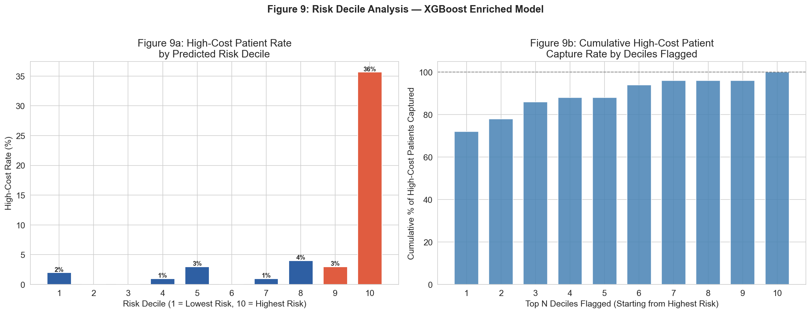
PART B · MODEL RESULTS
7 / 10
How Well Does the Model Perform?
AUC-ROC
AVG PRECISION
0.878
0.592
vs 0.828 baseline
+5 point improvement
vs 0.050 random
12× better than chance
CAPTURE RATE
SPENDING COVERED
72%
56%
Flagging top 10%
of patients
Top decile accounts
for 56% of all costs
Our model beats published benchmarks (Chechulin 2014: AUC 0.78–0.82) and delivers operationally actionable results.

Slide 8
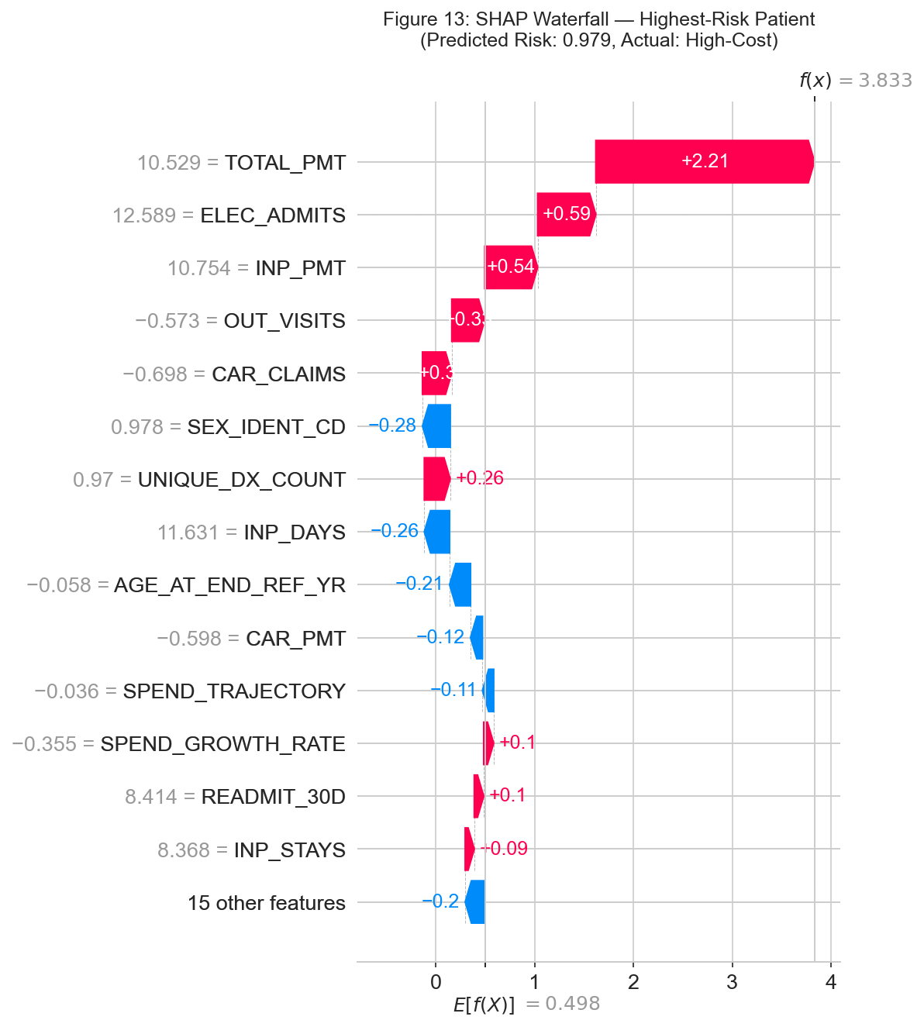
PART B · INTERPRETABILITY & SHAP ANALYSIS
8 / 10
Why Is Each Patient Flagged?
SHAP explains each individual prediction — not just which features matter globally, but which factors drove THIS patient's risk score.
TOP 5 PREDICTORS (Mean |SHAP|)
Total Prior Spending
0.909
Carrier Payments
0.498
Outpatient Visits
0.486
Age
0.425
Spending Growth Rate ★
0.305
When your nurse calls a flagged patient, SHAP tells them exactly why — enabling a targeted, personalized conversation.

Slide 9
PART A · RECOMMENDATIONS & IMPLICATIONS
9 / 10
Three Steps to Deploy This Today
01
Run the Model Each January
Proactive — not reactive
Apply the model to your full enrolled Medicare panel using the prior calendar year's claims. Generate a ranked risk-score list before the care management planning cycle begins.
02
Flag the Top 10%, Not Just Top 5%
500 contacts → 72% captured
On a 5,000-member panel: 500 targeted contacts. Broader net buffers for model uncertainty while capturing 72% of future high-cost patients and 56% of all projected spending.
03
Pair Every Flag With Its SHAP Explanation
Personalized intervention
A patient flagged for high inpatient spending needs a different conversation than one flagged for rising specialist visit frequency. SHAP makes every outreach call smarter.
Preventing even 15% of avoidable hospitalizations among flagged patients generates ROI that substantially exceeds program cost — and for your most vulnerable members, earlier intervention is not just financial, it is clinical.

Slide 10
THE BOTTOM LINE
Flag 10% of your panel.
Capture 72% of next year's
highest-cost patients.
Limitations &
Next Steps
Sample: 3,339 patients, validate on full panel before deployment
Retrain model annually as claims patterns evolve
Using only claims data your ACO already has.
Add calibration correction (Platt scaling) for probability reliability
0.878
72%
56%
Extend to chronic condition sub-groups for precision targeting
AUC-ROC
Capture Rate
Spending Covered

