Slide 1
Obesity Risk Factors Project 4, group 3
Audrey Fermanich
Rachel Le Grand
John Muir
Courtney Toussaint
Luke Wunderlin

Slide 2

Exploring data
Significant cleaning and encoding was necessary to use the data
33 columns with duplicative fields
Incomplete longitudinally, more complete survey questions in odd years with decreased participation seen in even years
Initial rows: 88,629
Source: https://catalog.data.gov/dataset/nutrition-physical-activity-and-obesity-behavioral-risk-factor-surveillance-system

Slide 3
Themes Included in the dataset:
Percent of Adults who achieve:
150 min/wk mod aerobic | 150 min/wk mod aerobic | 300 min/wk mod aerobic |  | No activity
or 75 min/wk vigorous aerobic | or 75 min/wk vigorous aerobic | or 150 min/wk vigorous aerobic
 | & strength 2x/wk |  | Strength 2x/wk
Year data was collected
Percent of adults aged 18 years and older who have an overweight classification
Nutrition (fruit/veg consumption)
Physical activity (see table to right)
Location (by state/territory/capital)
Income level
Age
Race
Gender

Slide 4




Dependencies
PySpark (SparkFiles)
sklearn.model_selection (train_test_split)
sklearn.preprocessing (StandardScaler)
Pandas (scipy.stats)
Matplotlib
TensorFlow

Slide 5

Spark
Read CSV file using Spark
Filtered and cleaned data
Troubleshooting data types
Converted to Pandas Data Frame

Slide 6
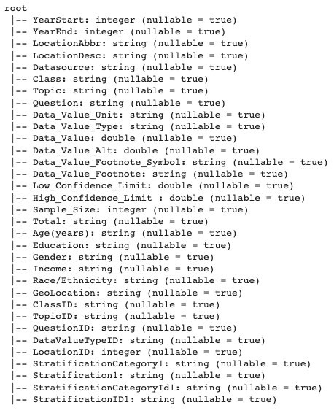
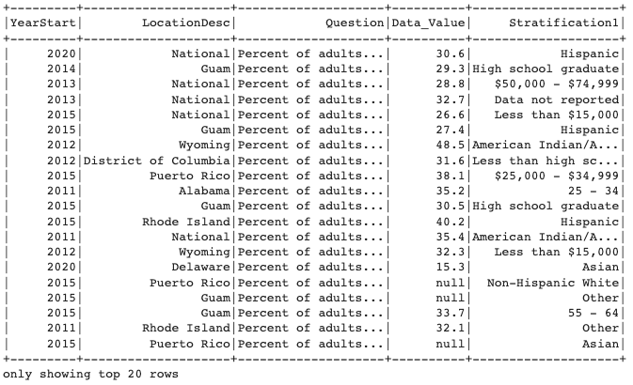
Preprocessing

Slide 7
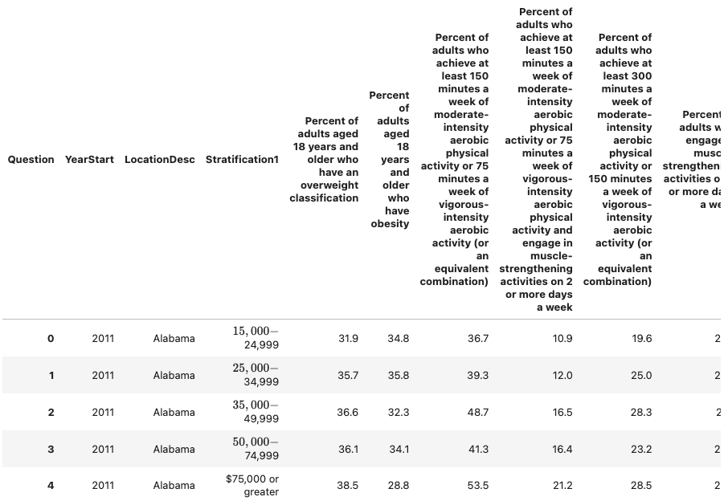
Final data

Slide 8

Included in model
Years 2011, 2013, 2015, 2017, 2019
Overweight classification
Physical activity
Location
Income level
Education
Gender
Race

Slide 9
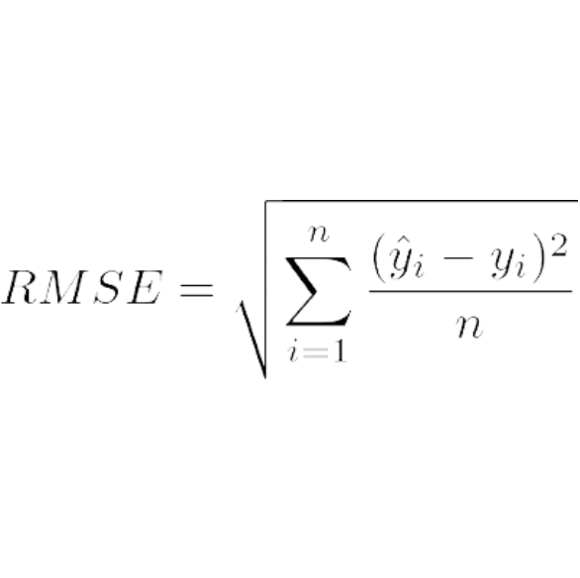
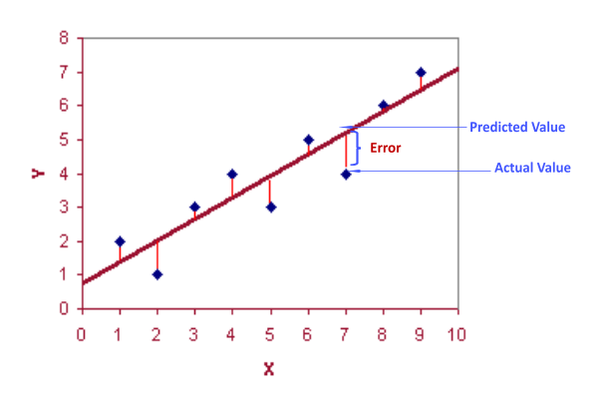
RMSE ()
Root mean square error or root mean square deviation is one of the most commonly used measures for evaluating the quality of predictions. It shows how far predictions fall from measured true values using Euclidean distance.

Slide 10
Optimization process - 3 models
Linear Regression:
Loss = 14.94
R-Squared Value = 0.74
σ = 7.69
RMSE = 3.86
Trimmed features
Random Forest Regressor:
Loss = 12.62
R-Squared Value = 0.76
σ = 7.20
RMSE = 3.55
Trained and Scaled 20% of the data with a random state of 42
Neural Network Regression:
Loss = 8.73
R-Squared Value = 0.83
σ (target) = 7.20
RMSE = 2.95
Decreased features by excluding nutrition values and selected odd numbered years where data was the most robust

Slide 11
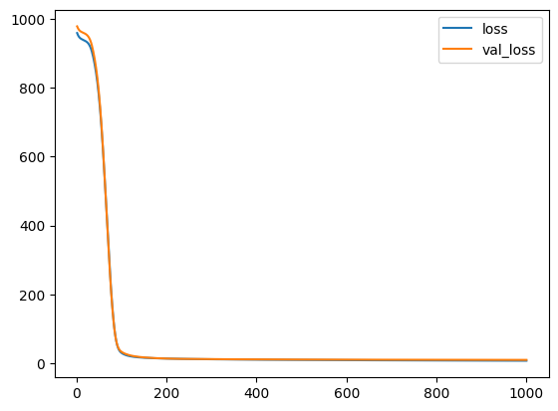
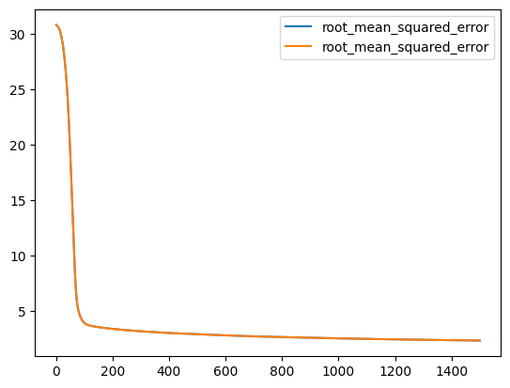
Regression analysis – Neural network (optimized)
R-Squared Value = 0.8312
RMSE = 2.955

Slide 12
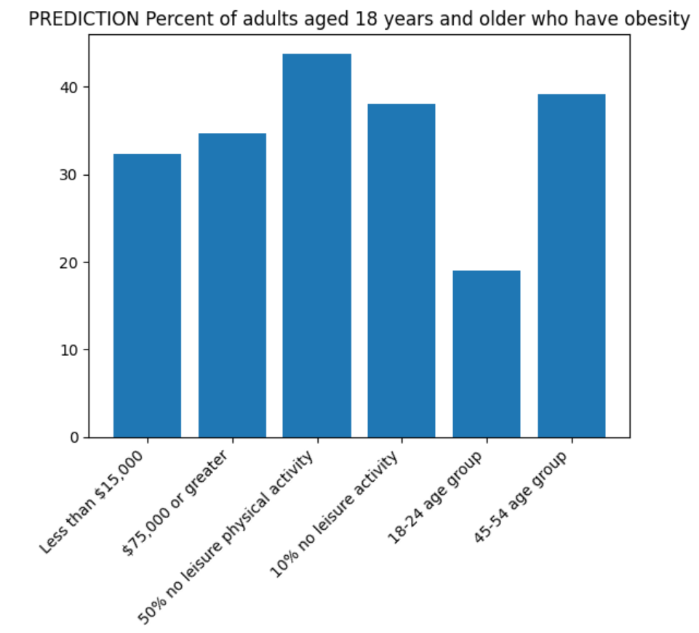
Hypothetical prediction
The model will predict any combination of features and give a percentage of adults who have obesity
Notes:
Luke

Slide 13
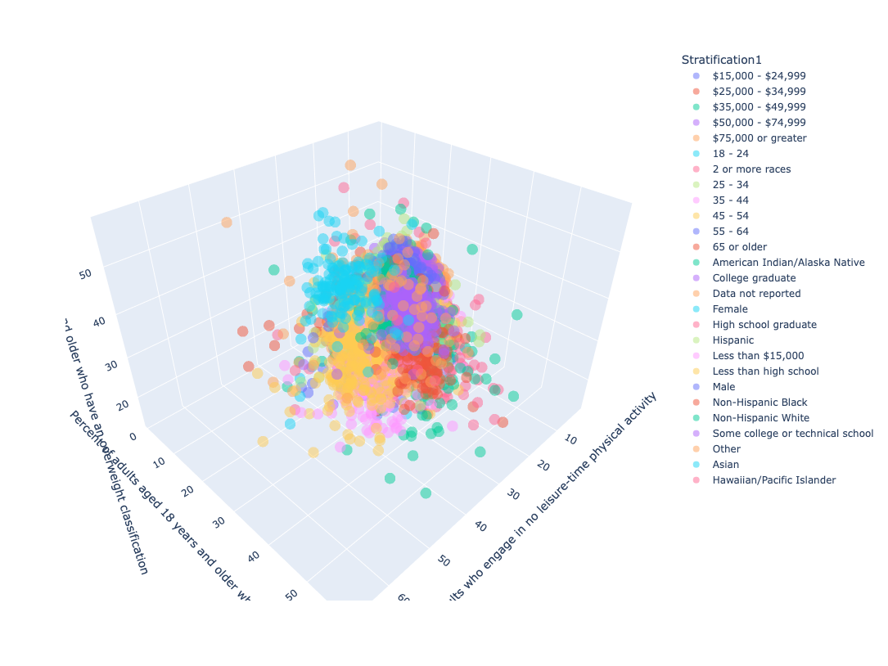
Multidimensional clustering
link

Slide 14
Conclusion
Data included: overweight classification, physical activity, location, income level, education, gender and race.
Factors that were eliminated from the model included years in which less comprehensive data was collected and nutritional attributes (i.e. - inclusion of fruits and vegetables in daily diet).
Regression analysis – neural network optimized model had a R-squared value of 0.8312 and an RMSE of 2.955 with a target y variable standard deviation of 7.1963.
This model was able to predict obesity reasonably well.
Notes:
Luke

Slide 15
questions

