Slide 1

Twin Cities weather trends

Slide 2
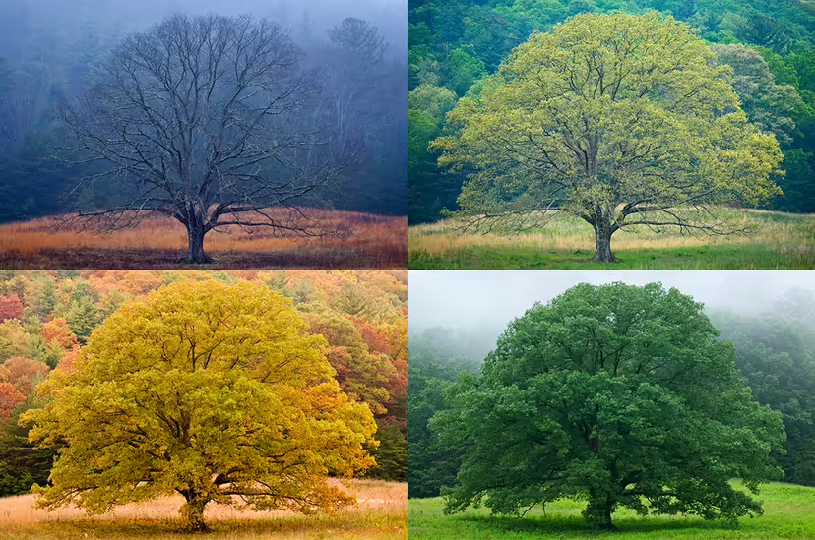
Team Members
Rachel Le Grand
Robert Bentz
Issa Abdulrahman
Alkida Frroku
Notes:
https://science.howstuffworks.com/nature/climate-weather/atmospheric/climate-change-four-seasons-redefine.htm (MICHAEL MELFORD/GETTY IMAGES)

Slide 3

Where we found the data? What we used to clean up and present the data?
https://www.dnr.state.mn.us/climate/twin_cities/listings.html
https://thisancog.github.io/statistics.js/inc/correlation.html#section-regression
EXCEL, SQL, SQLALCHEMY, FLASK API, JAVASCRIPT, HTML, PYTHON

Slide 4
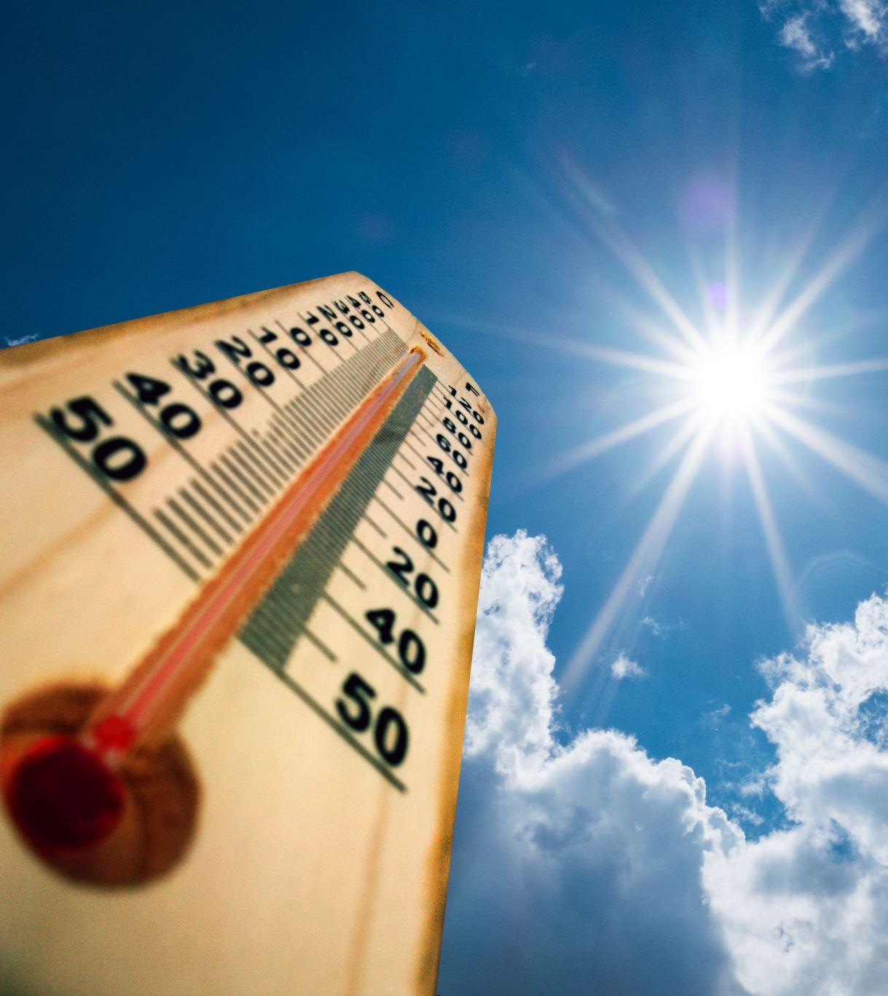
Why do we follow weather?
Observing the daily weather is part of a regular routine for many of us, helping us decide what to wear and which activities we will do each day.
People have attempted to predict the weather informally for millennia and formally since the 19th century.
Notes:
https://www.noaa.gov/education/resource-collections/weather-atmosphere/weather-observations

Slide 5

Why do we follow the weather?
Looking at Twin Cities weather data,
are there any patterns
appearing regarding precipitation?

Slide 6
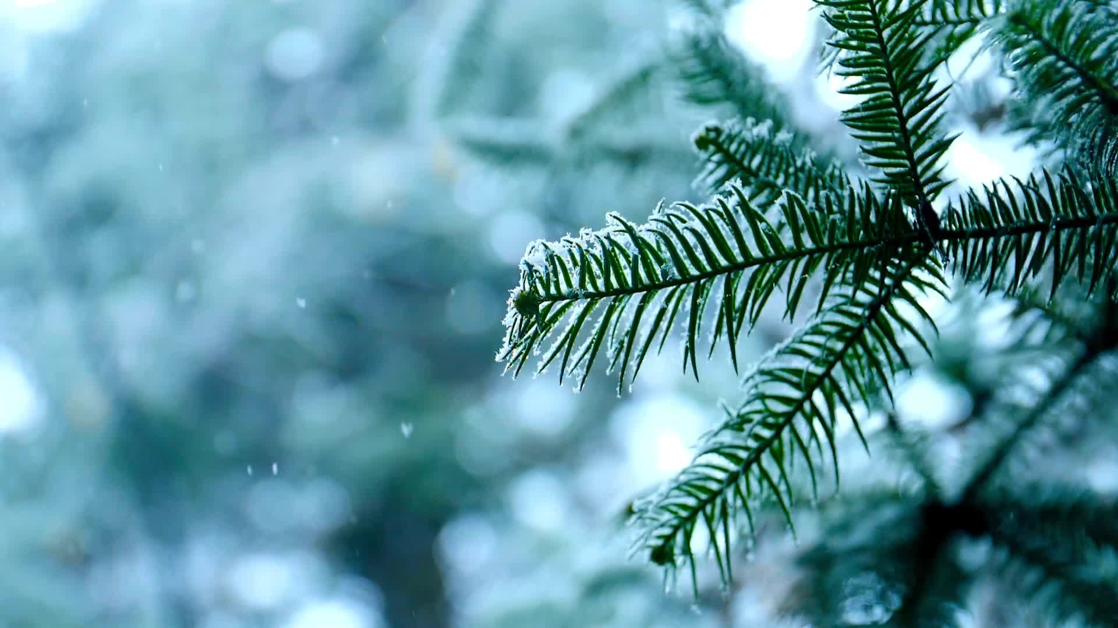
Topics of interest
Seasonal precipitation
Maximum temperatures and
Snowfall in inches
From 1890-2019

Slide 7
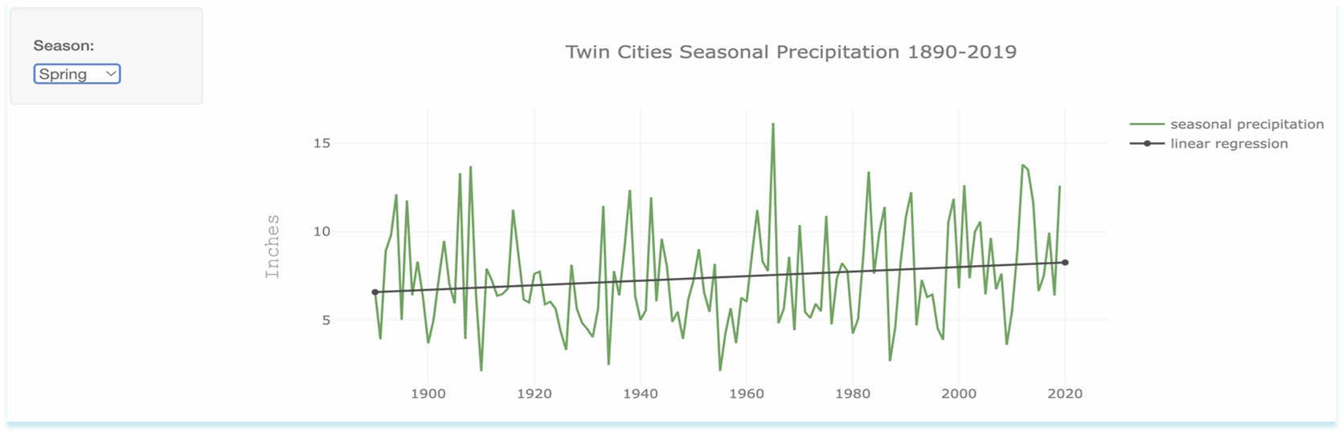
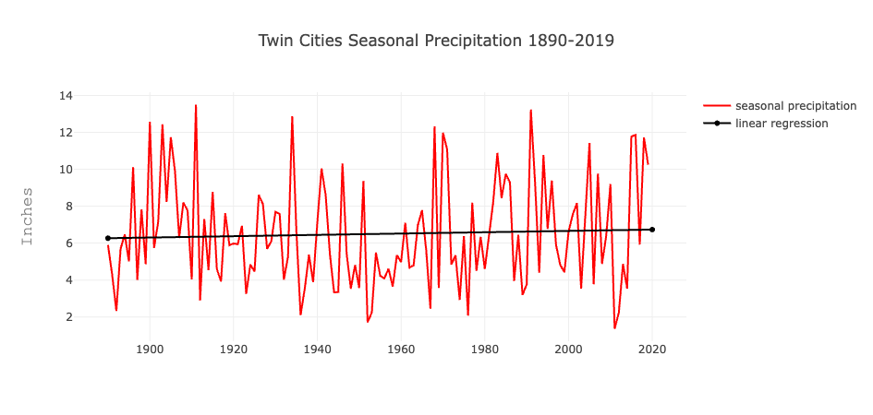
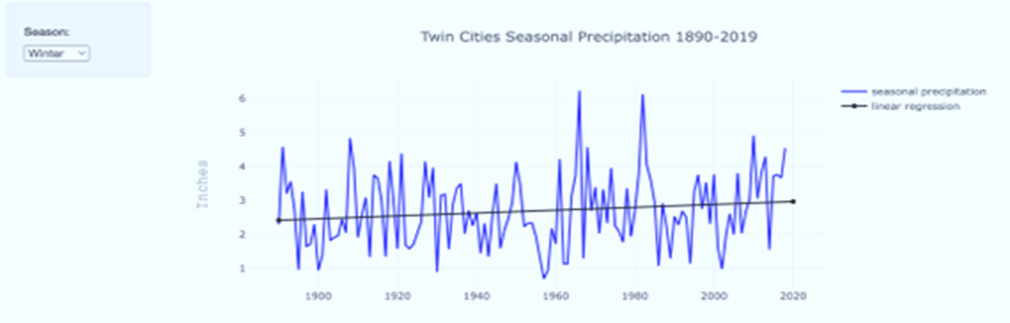
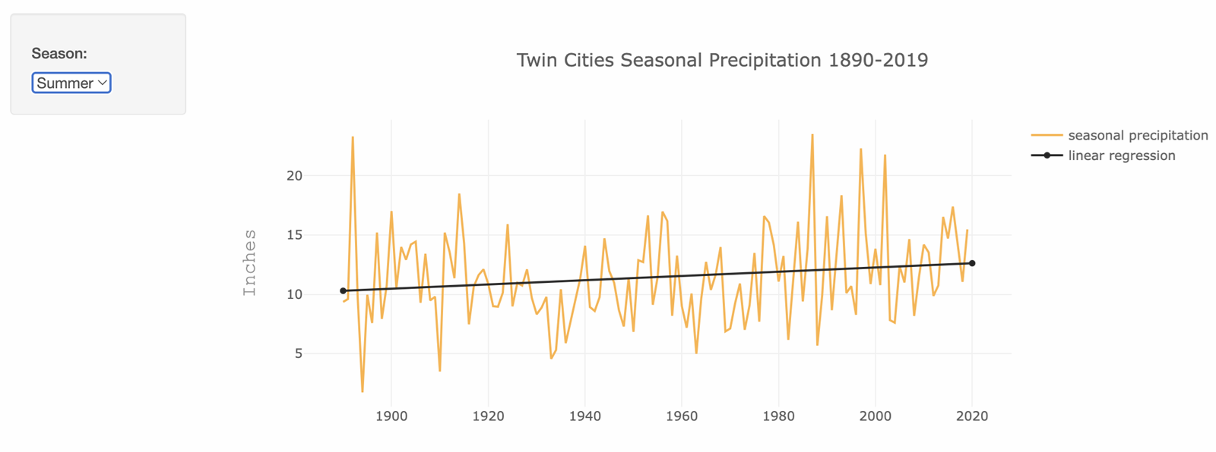

Slide 8

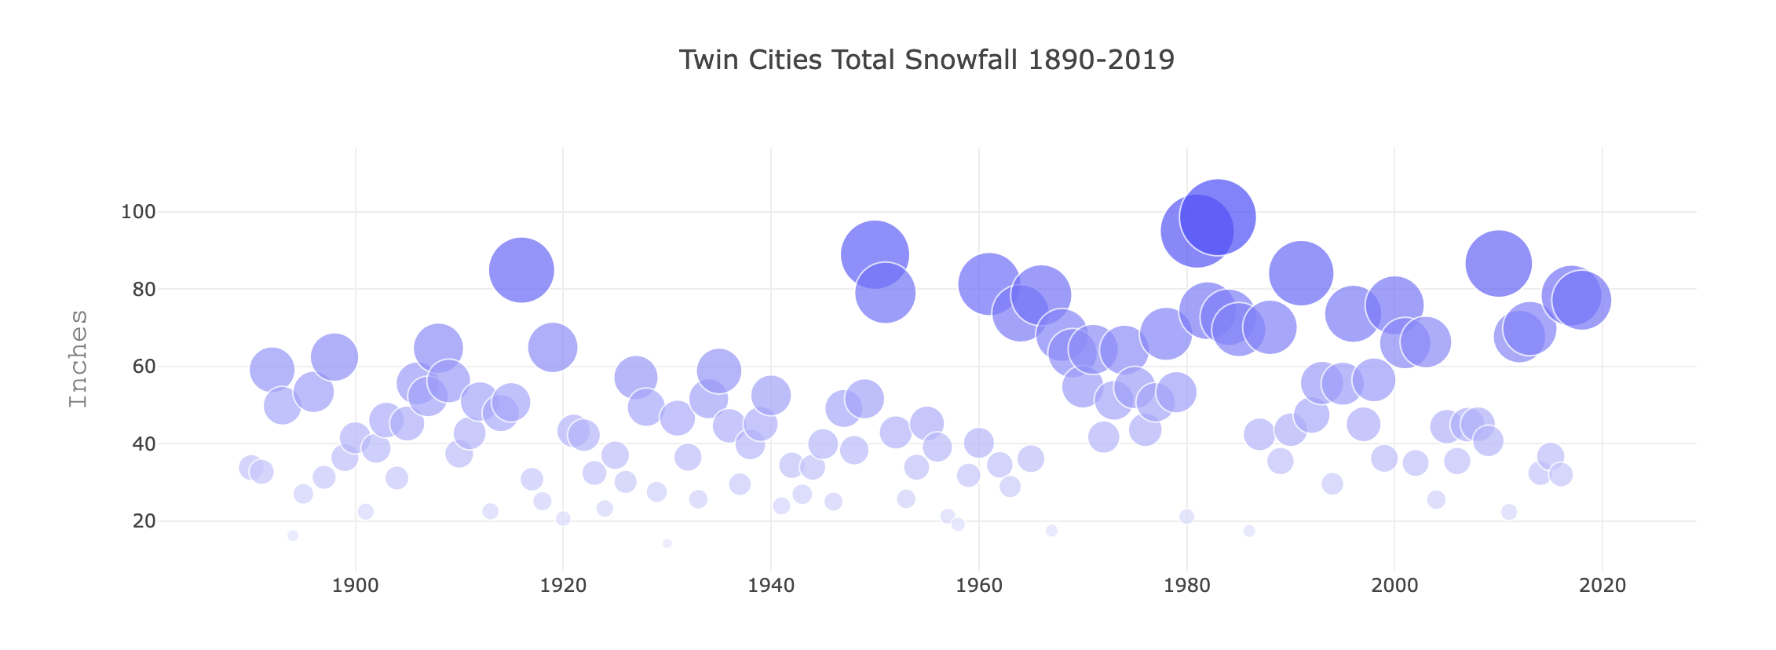
Snowfall in inches throughout the Years
Notes:
https://pixabay.com/photos/snowfall-winter-snow-snowflakes-201496/ (credits for the background picture)

Slide 9

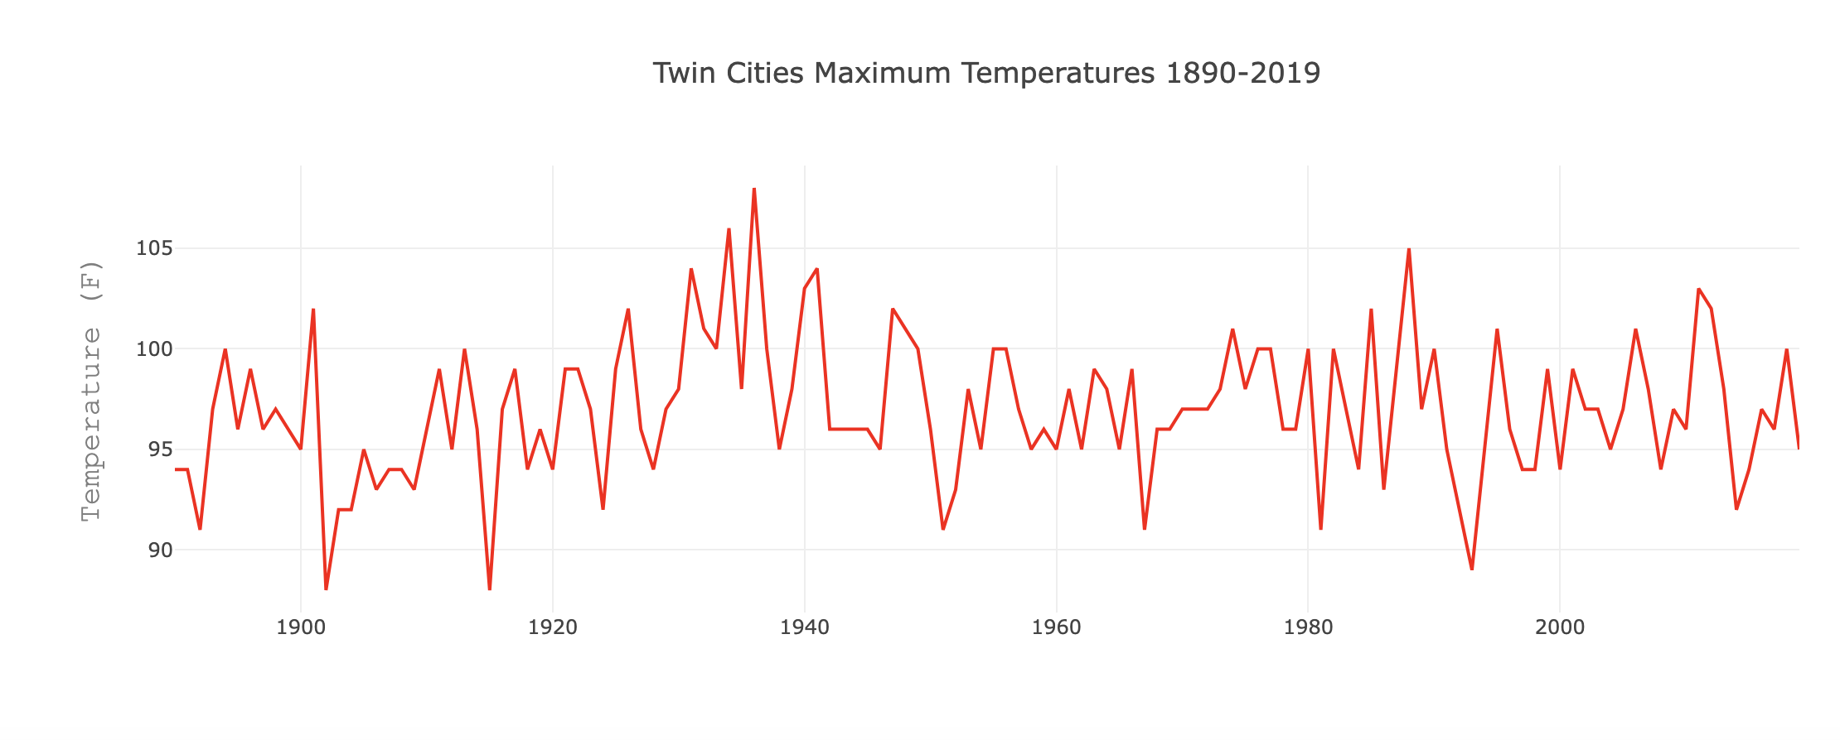
MAX TEMPERATURE SINCE 1890-2019

Slide 10
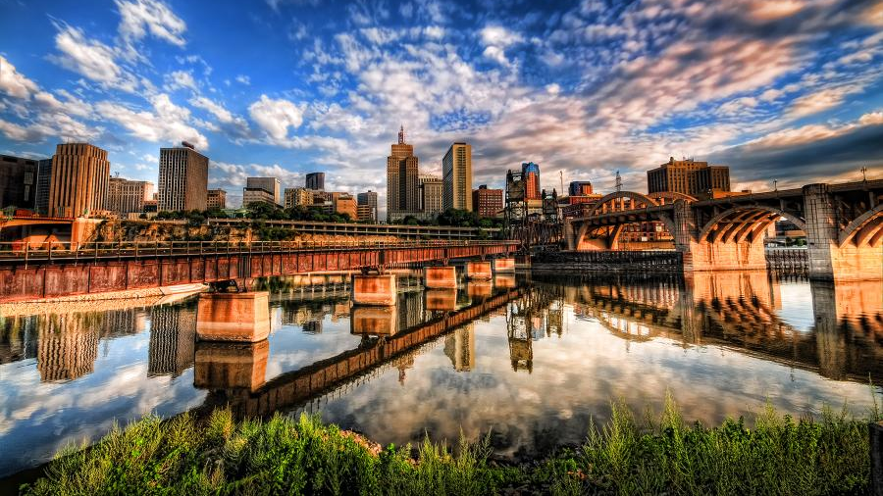
Conclusion
Overall looking at the seasonal trends in Twin Cities we can see that there is not much change, and one can assume that it is a stable and comfortable place to live in, despite the very cold snowy winters.
Notes:
https://www.exploreminnesota.com/article/tour-twin-cities-green-line (picture credits)

Slide 11
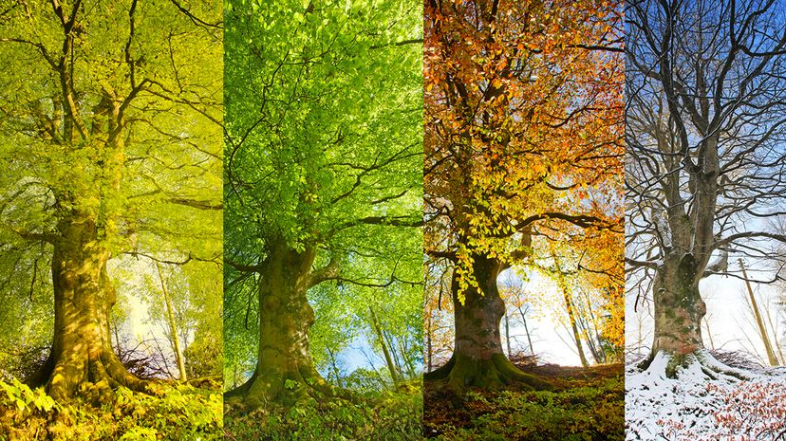
QUESTIONS?
Notes:
https://science.howstuffworks.com/nature/climate-weather/atmospheric/climate-change-four-seasons-redefine.htm picture credits(KATHY COLLINS / GETTY IMAGES)

