Slide 1
MID-TERM PROJECT REVIEW
BIM-Based Construction Progress
Monitoring via Drone Simulation
Synthetic drone point clouds · BIM-registration matching · automated per-element progress scoring
Sagar
September 2026

Slide 2
MOTIVATION
A BIM tells you what SHOULD be built — not what IS
▪ A design BIM encodes intended geometry: every wall, slab, beam and column, exactly as planned.
▪ It says nothing about what has actually been constructed on site.
▪ Manual progress inspection (walkthroughs, photos, spreadsheets) does not scale to large or fast-moving sites.
▪ Research question: can drone-collected point cloud data automatically determine which BIM elements are built, and from that estimate overall project progress?
WHY SIMULATION FIRST
▪ On a real site, the true completion state is never known exactly — you can't separate detection error from matching error from scoring error.
▪ In simulation, the completion state is controlled exactly by construction.
▪ This makes it possible to produce error-vs-completion curves that are impossible to produce on real data — that controllability is the core contribution.
BIM-Based Construction Progress Monitoring — Mid Review
01
2

Slide 3
PIPELINE
End-to-end pipeline, phase by phase
P1
P2
P3
P4
P7
Parse BIM
Ablate
Simulate
Match
Score
IFC → ground-truth
element table
Realistic partial
build states
Raycast drone
point clouds
Register + assign
points to elements
Per-element status
→ progress %
SCOPE DECISION vs. THE ORIGINAL SPEC
▪ Original spec routed through Blender-rendered RGB/depth/index images, then a learned/oracle 2D detector, then 3D fusion and Hungarian matching.
▪ v1 goes straight from BIM to a raycast-simulated point cloud (Open3D), then matches points directly against the known design BIM via ICP registration — a leaner, classical scan-vs-BIM approach (Bosché & Haas 2008/2009) that skips the image pipeline entirely.
BIM-Based Construction Progress Monitoring — Mid Review
02
3

Slide 4
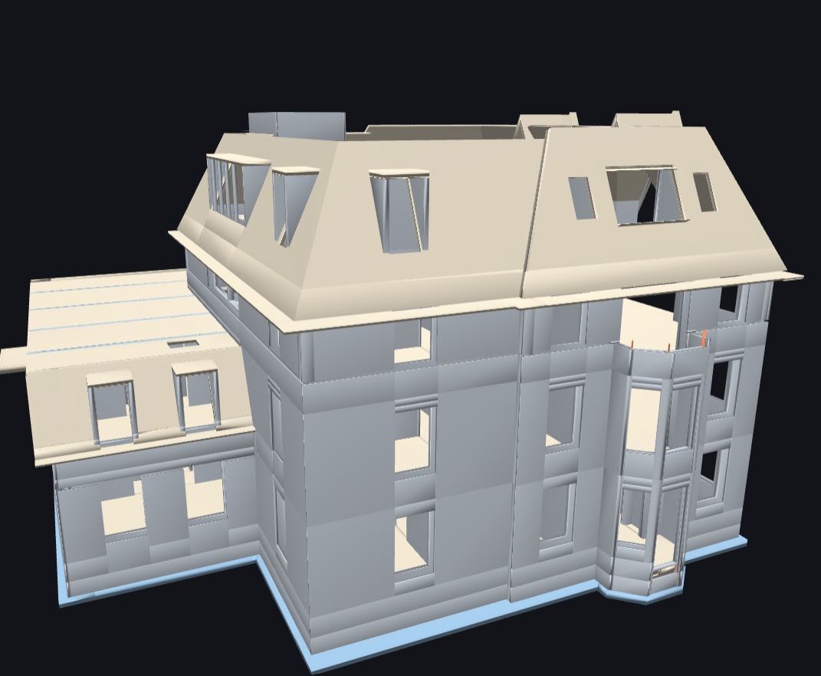
DATASET
Schependomlaan — design BIM as ground truth
IN-SCOPE STRUCTURAL ELEMENTS
879
279
174
23
1,355
Wall
Slab
Beam
Column
Total
▪ Dutch residential project, TU Eindhoven / RAAMAC — IFC2x3 design model from Archicad.
▪ Low-rise residential typology: walls and slabs dominate; columns are sparse (23 total).
- Doors, windows, MEP — out of scope, per spec.
▪ Sanity check: the Synchro-exported weekly as-planned IFCs reassign GlobalIds — 0% overlap with the design IFC's identities.
- → real multi-week ground truth unusable for element identity; fully synthetic staged ablation built instead.
BIM-Based Construction Progress Monitoring — Mid Review
03
4

Slide 5
PHASE 1
Parsing the BIM into a canonical ground-truth table
▪ Per in-scope element, extracted directly from IFC geometry (world coordinates):
- global_id, ifc_type, storey (via spatial containment, not the mm-scaled Elevation attribute)
- centroid, axis-aligned bounding box
- Z-aligned oriented bounding box — PCA in the XY plane, since an AABB alone is a poor descriptor for a wall at 45°
- mesh volume, elevation_bottom (drives build-order sequencing later)
▪ IfcWallStandardCase is already a subtype returned by IfcWall's by_type() — verified 100% overlap, counted once.
▪ Output: data/bim/bim_complete.csv — 1,355 rows, zero NaNs.
BIM-Based Construction Progress Monitoring — Mid Review
04
5

Slide 6
PHASE 2
Generating realistic incomplete build states
MILESTONE MODEL (per storey, bottom-up)
▪ A storey without a milestone (e.g. foundation has no interior walls) simply skips it — stage count falls out of the data, isn't a fixed target.
▪ Within a milestone: elements ordered by (x, y) for a contiguous work front, then 8% of adjacent pairs swapped (seeded) so the boundary isn't razor-sharp.
▪ Partial completion: 50% chance a newly-appearing wall/column is height-clipped to 25–85% of final height — "poured but not finished", not a clean binary.
▪ Cross-checked against the real Planning/XML schedule: confirms bottom-up per-storey sequencing.
▪ Result: 16 real construction stages, foundation → roof envelope, each with a manifest.json ground truth.
1. structure
Columns + beams + slab poured
2. envelope
Exterior walls erected
3. interior
Interior partition walls built
BIM-Based Construction Progress Monitoring — Mid Review
05
6

Slide 7
PHASE 3
Simulating drone point clouds per stage
▪ Open3D raycasting instead of Blender for v1 — a deliberate scoping decision, documented in code.
▪ Camera scheme: exterior drone orbit + per-floor interior walkthrough, Fibonacci-sphere view sampling (avoids grid-aliasing rings a uniform grid would leave).
▪ Only first-hit rays kept — not uniform surface sampling — so the cloud looks like something an actual sensor could produce.
▪ Realism degradations applied per stage:
- sensor noise (Gaussian, fixed σ)
- 15% random point dropout
- per-element pose jitter (as-built deviates slightly from as-designed)
- whole-scene rigid registration-offset jitter (mimics imperfect pre-alignment)
▪ Fixed ground plane + trees shared across all stages, as realistic clutter.
16 STAGES SIMULATED
▪ 00 Foundation — structure
▪ 01 Foundation — envelope
▪ 02–04 Ground floor
▪ 05–07 1st floor
▪ 08–10 2nd floor
▪ 11–13 3rd floor
▪ 14–15 Roof — structure/envelope
BIM-Based Construction Progress Monitoring — Mid Review
06
7

Slide 8
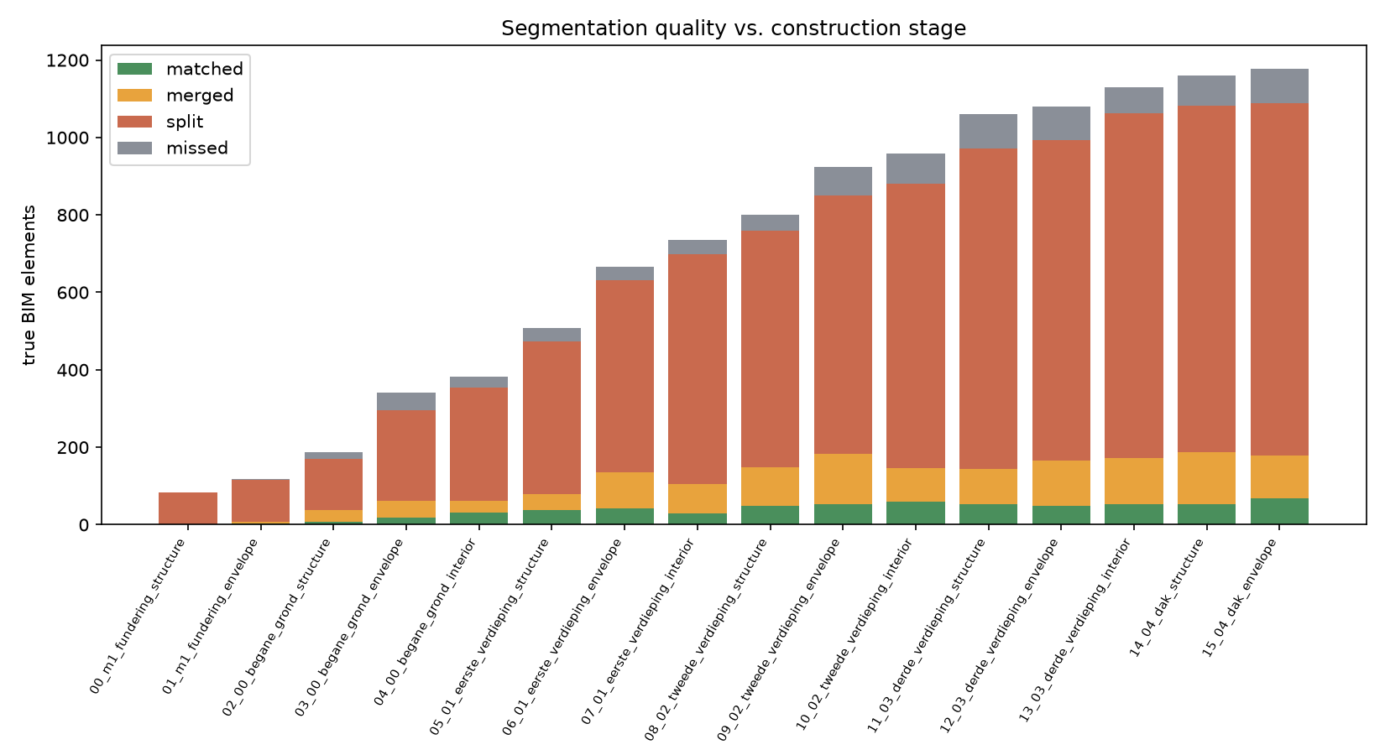
PHASE 4 — FIRST ATTEMPT
Classical geometric segmentation (RANSAC + DBSCAN)
▪ Purely geometric, blind discovery — no BIM knowledge used at this stage:
- iterative RANSAC plane extraction, DBSCAN within each plane to split spatially separate coplanar instances
- normal angle classifies wall vs. slab; residual non-planar points get their own DBSCAN pass, classified by PCA aspect ratio into column / beam / clutter
▪ This is the classical replacement for the spec's image-based detection + 3D localisation phases (P4+P5 combined).
EVAL FINDING
▪ High clutter leakage and element split/merge rates, especially at early and late stages — repetitive, coplanar structures (rows of identical walls) confuse blind clustering.
▪ Motivated the revised, BIM-aware matching approach (next).
BIM-Based Construction Progress Monitoring — Mid Review
07
8

Slide 9
PHASE 4 — REVISED APPROACH
Direct BIM matching via registration
Key insight: the complete design BIM is always known before construction starts — the task is
“which points belong to which known element”, not blind object discovery.
Dense BIM sampling
Every in-scope element's surface sampled once, area-proportional, tagged with its GlobalId — one KD-tree over the whole design, reused unchanged across all 16 stages.
1
ICP registration
Per stage, ICP against the BIM sample cloud undoes the synthetic whole-scene misalignment — coarse-filtered first to keep only points already near some BIM surface, so ground/tree clutter can't drag the alignment off.
2
Margin-gated assignment
Nearest-neighbour query per point with a TIGHT distance threshold (matched to sensor noise, not registration jitter — that's already corrected). Points beyond threshold are unassigned: this alone rejects ground/tree/noise, no separate heuristics needed.
3
Per-element aggregation
Assigned points grouped per GlobalId → point count, centroid, AABB, and height-coverage fraction vs. the element's true height — the completion signal used for scoring.
4
BIM-Based Construction Progress Monitoring — Mid Review
08
9

Slide 10
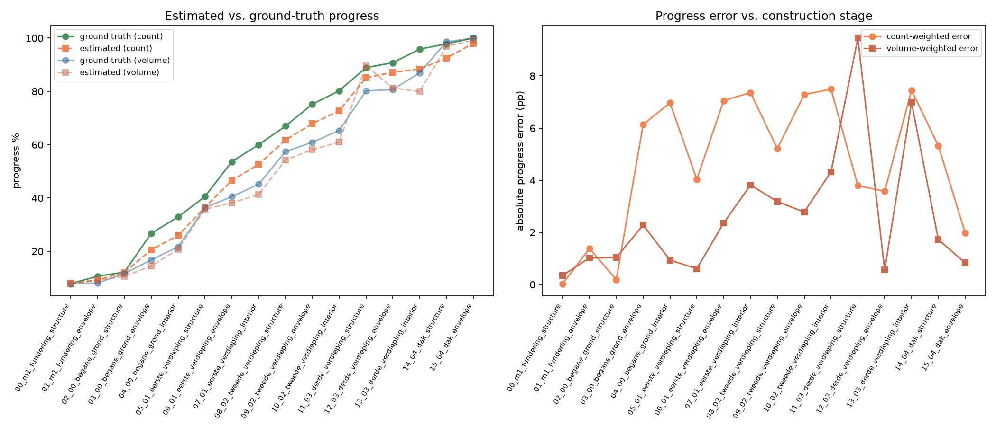
PHASE 7
Per-element status and progress scoring
STATUS RULES (height-coverage based)
completed
height_coverage ≥ 0.5
Cᵢ = 1.0
partial
0.15 ≤ height_coverage < 0.5
Cᵢ = height_coverage
not_started
not detected, but observable
Cᵢ = 0.0
uncertain
never observable, any stage
excluded
▪ “Uncertain” exclusion is the critical rule: an element the drone never observed must not be scored as “not built”.
▪ Measured: 136/1355 elements (10%) are structurally hard-to-observe at every stage — excluded from scoring, not scored as absent.
▪ Progress = Σ(wᵢ·Cᵢ) / Σ(wᵢ) × 100, reported with count weights and volume weights.
BIM-Based Construction Progress Monitoring — Mid Review
09
10

Slide 11
RESULTS
Estimated vs. ground-truth progress, across 16 stages
16
4.7 pp
7.5 pp
1.98 pp
Stages evaluated
Mean abs. progress error
Max error (mid-build)
Error at final stage (roof)
Stage | Est. % | GT % | Error (pp)
00_m1_fundering_structure | 7.9 | 7.9 | 0.03
03_00_begane_grond_envelope | 20.6 | 26.7 | 6.13
07_01_eerste_verdieping_interior | 52.6 | 60.0 | 7.36
11_03_derde_verdieping_structure | 85.1 | 88.9 | 3.79
15_04_dak_envelope | 98.0 | 100.0 | 1.98
BIM-Based Construction Progress Monitoring — Mid Review
10
11

Slide 12
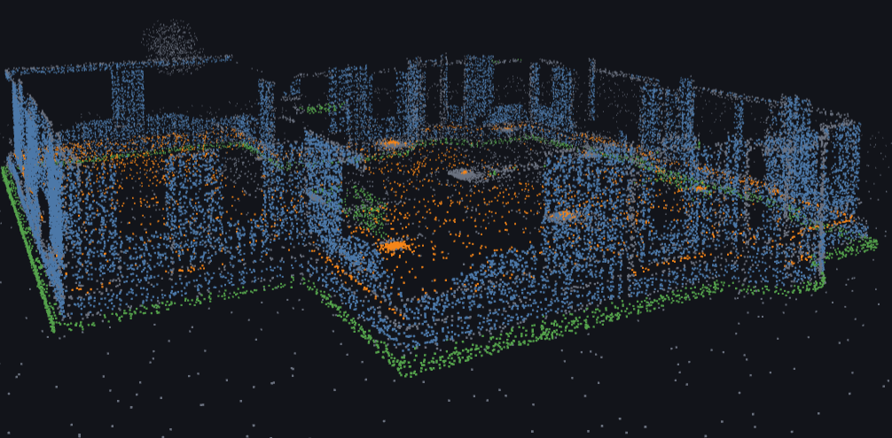
VISUALIZATION
Segmentation-after-registration viewer
▪ A second standalone viewer: every raw scan point coloured by which BIM element class it matched to (wall / slab / beam / column), post-ICP — a direct visual read of segmentation quality, not a separate demo run.
- also supports a per-element “by element” colour toggle, same mechanism shown on the previous slide.
BIM-Based Construction Progress Monitoring — Mid Review
12
13

Slide 13
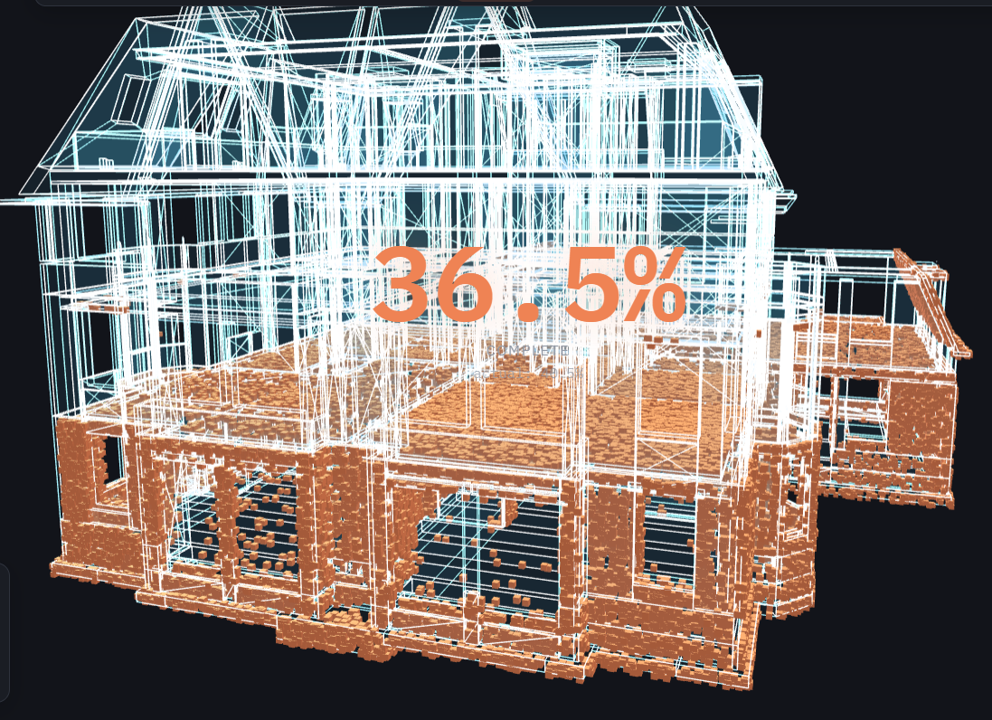
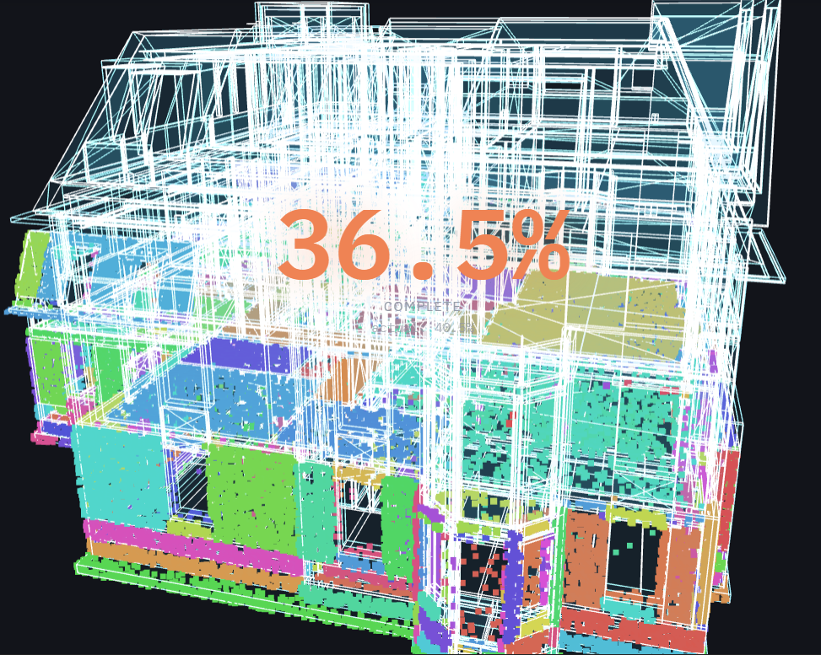
VISUALIZATION
Digital-twin progress overlay viewer
▪ Custom interactive 3D viewer (Three.js): the complete BIM shown as a ghost wireframe, with each stage's confirmed-built points solidified into a voxel cloud, in the same coordinate frame — so intended vs. actual align pixel-for-pixel.
BIM-Based Construction Progress Monitoring — Mid Review
11
12

Slide 14
HONEST LIMITATIONS
What this prototype does not yet show
▪ Sim-to-real appearance gap is entirely bypassed — v1 replaced image-based detection with idealized point-to-BIM geometric matching. No camera-image realism, no clutter/scaffolding/workers modelled visually.
▪ Ablation realism is a crude proxy: binary presence + height-clipping cannot represent every real half-built state (partial pours, rebar-only, etc.).
▪ Single building typology — Schependomlaan is low-rise Dutch residential. Generalisation to other typologies is untested.
▪ Class imbalance: only 23 columns and 174 beams vs. 879 walls — per-class metrics for the rare classes are noisy by nature of the dataset, not the method.
▪ The classical segmentation baseline (Phase 4a) shows blind point-cloud segmentation is genuinely hard on repetitive coplanar structures — this motivates the registration-based approach, but means fully unsupervised detection hasn't been validated at scale.
▪ Comparison against the dataset's real weekly as-planned IFCs was ruled out early (0% GlobalId overlap) — all results here are on synthetic ground truth, not yet cross-checked against real drone data.
BIM-Based Construction Progress Monitoring — Mid Review
13
14

Slide 15
NEXT STEPS
Where this goes next
▪ Phase 9 reality check: register Schependomlaan's real week-28 drone point cloud against the as-planned IFC, run the same scoring pipeline, compare against the dataset's own (non-ground-truth) comparison spreadsheet.
▪ Second building typology, held out entirely, to support a genuine generalisation claim.
▪ Compare camera trajectories (grid / perimeter / waypoint / adaptive) — currently a single fixed exterior-orbit + interior-walkthrough scheme.
▪ Refine the “ever observable” heuristic that drives the uncertain-status exclusion, beyond the current 100%-stage proxy.
▪ Revisit the image-based detection track (YOLOv8-seg on rendered RGB) as an explicit oracle-vs-learned comparison, to quantify the sim-to-real gap this prototype currently sidesteps.
BIM-Based Construction Progress Monitoring — Mid Review
14
15

Slide 16
Thank you
Questions & discussion

