Slide 1
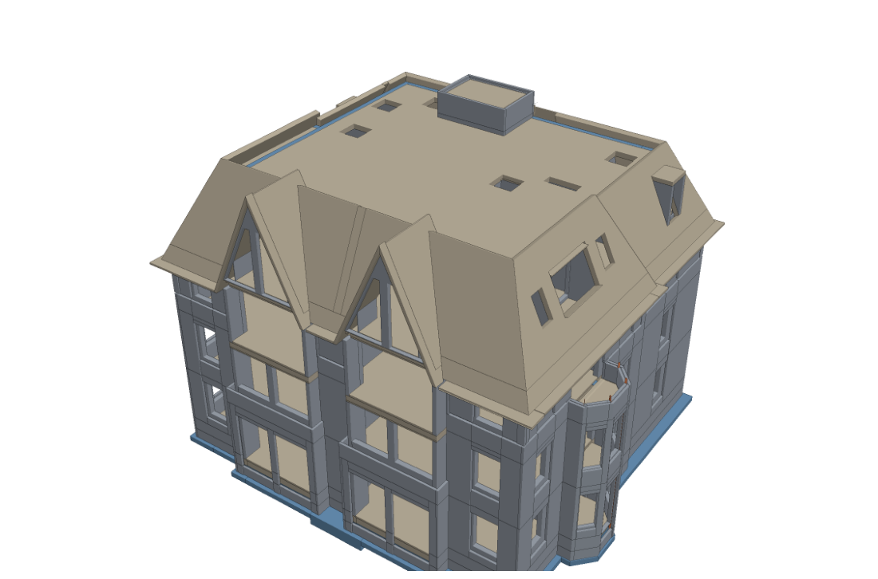
CV5570 | END-TERM PROJECT REVIEW
BIM-Based Construction
Progress Monitoring
via Drone Simulation
From a clean test to a realistic one: what we changed since the mid-term, and what it bought us
Notes:
Welcome. This is the end-term review of our project: monitoring construction progress by comparing scans of a building with its design model. At the mid-term we showed a working pipeline on clean, easy data. Today we show what changed since then: a much more realistic test, a registration method that works when the scan starts metres off, a visibility check, a progress number with a range, and three experiments: colour, AI clutter removal and COLMAP photogrammetry.

Slide 2
What we set out to do
RECAP
A design model says what should be built, not what is built
The design (BIM) says what should be there
1
Every wall, slab, beam and column as planned.
A drone and a scanner see what is there
2
They collect a point cloud: millions of 3D dots on the surfaces.
Compare the two
3
Which elements are built, and how far along is the whole project?
Why simulate? Real sites have no answer key. We un-build a real design into stages, so the true progress is known exactly.
Test building: Schependomlaan, a Dutch apartment block. 1,355 elements, 6 storeys.
BIM-based construction progress monitoring | End-term review
2
Notes:
Recap of the problem. A BIM encodes every wall, slab, beam and column exactly as planned, but says nothing about what exists on site. Checking by hand does not scale. The idea: a drone and a scanner collect a point cloud, we lay it on the design, decide which elements are built, and report one progress number. Real sites have no exact answer key, so we simulate: we take a real design and un-build it into 16 stages. Then we know the true progress and can grade every step of the method.

Slide 3
What changed since the mid-term
Seven things are different, and each one makes the test harder or the method better
AT MID-TERM
NOW
Test scans
Clean ray-cast scan, tiny noise
Realistic sensor: distance noise, holes, stray points
The site
Empty lot with trees
Scaffolding, crane, workers, off-design and late elements
Scan position
Starts almost aligned (centimetres)
Starts metres off and turned, like drone GPS
Alignment
ICP only
Floor-plan search, then ICP, with a warning when unsure
Element not found
Counted as not built
Visibility check: not built, or just not seen?
Result
One progress number
Progress number with a 90% range
Data source
Ray-casting only
Also tested: colour, AI clutter removal, COLMAP photos
BIM-based construction progress monitoring | End-term review
3
Notes:
This is the summary slide for the whole talk. At the mid-term the scans were clean and almost aligned, we used plain ICP, and an element we did not find was simply called not built. Now the scans have realistic noise, the site is busy, the scan starts metres off like drone GPS, the alignment is a new two-step method, we check whether a missing element could even have been seen, and the progress number comes with a range. We also tried three ways of getting better data: colour, AI clutter removal and photogrammetry. The rest of the talk goes through these.

Slide 4
How it works, end to end
Seven steps from the design model to a progress number
1
2
3
NEW
4
IMPROVED
Design model (BIM)
16 stages
Simulated scans
Alignment
Every wall, slab, beam and column as planned.
The design is un-built floor by floor. This is the answer key.
Drone orbit and indoor scans, with realistic noise and a busy site.
Lay the scan on the design: floor-plan search, then ICP.
5
6
NEW
7
NEW
Tried along the way
Colour for alignment
AI clutter removal (DART)
COLMAP point clouds from photos
Match to elements
Visibility check
Progress and range
Each scan point goes to the nearest design element (KD-tree).
Element not found: not built, or just not seen?
Elements add up to a progress %, with a 90% range.
BIM-based construction progress monitoring | End-term review
4
Notes:
Here is the whole pipeline. One: the design model. Two: we un-build it into 16 construction stages; that is our answer key. Three: a simulated drone orbit and indoor scanner produce a point cloud for each stage, now with realistic noise and a busy site. Four: alignment, because the scan starts metres off the design. Five: every scan point is assigned to the nearest design element, using a KD-tree for fast nearest-point lookup. Six: for elements we did not find, we ask whether the cameras could have seen them. Seven: elements become a progress percentage, with a range. The orange and blue tags mark what is new or improved since mid-term.

Slide 5
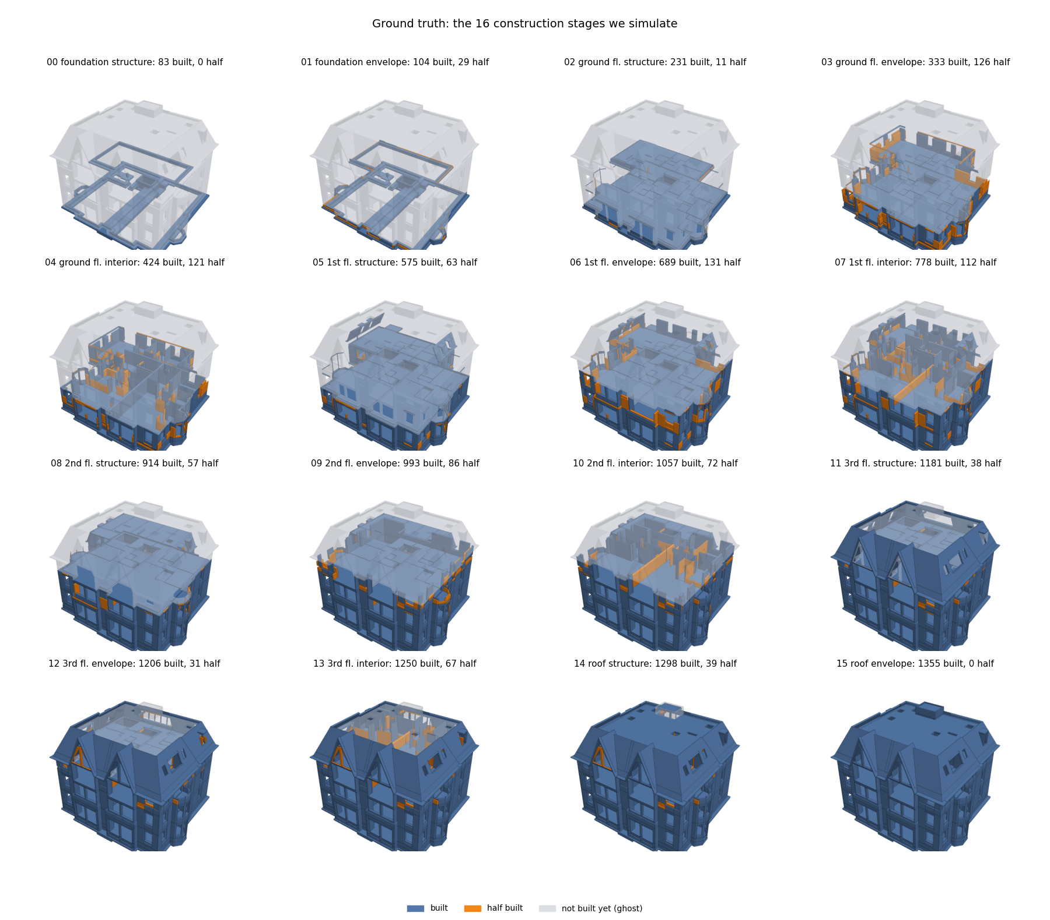
A test world with a known answer
RECAP
We un-build a real design into 16 stages, so every result can be graded exactly
16
1,355
6
stages
elements
storeys
1
Floor by floor
Foundation, then each floor: structure, outer walls, inner walls.
2
Partly built walls
Some walls are cut to a height, as on a real site.
3
An exact answer key
The true status of every element at every stage is stored. Only the grading uses it.
BIM-based construction progress monitoring | End-term review
5
Notes:
The test world. We take the complete design and rebuild it in 16 stages: foundation first, then for each floor the structure, the outer walls and the inner walls. Some walls are only partly built, cut at a height. For every stage we store exactly which elements exist. That gives exact grading for every later step. We never show this answer key to the method itself.

Slide 6
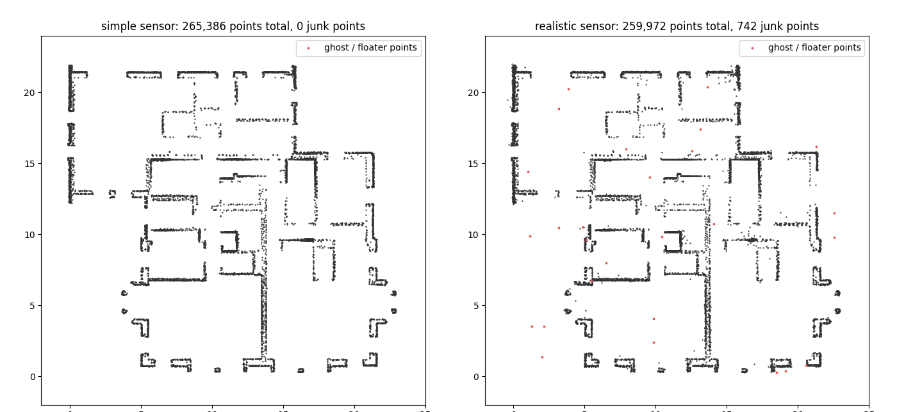
Making the simulation realistic
NEW
Real scans are noisy, start off-position and see a messy site
Realistic sensor
Noise grows with distance and slant. Holes, missing grazing surfaces, stray points.
GPS-sized start offset
The scan begins metres off and turned, like a drone survey.
Camera colour
Sun, shadows, dirt, brick pattern. 6% of elements use a different material.
Top view of a wall slice. Left: simple sensor. Right: realistic sensor, junk points in red.
0.8 → 1.7
2 bugs
Off-design elements
4% of elements are built 4-12 cm away from the design.
average progress error (points). Registration stays within 3 cm.
found and fixed in our own simulator along the way
BIM-based construction progress monitoring | End-term review
6
Notes:
At mid-term the simulated scans were too clean. We made four changes. A realistic sensor: noise that grows with distance and slanted views, holes on textureless surfaces for the photos, surfaces seen at a grazing angle drop out, and stray points at edges. A GPS-sized starting offset: the scan begins metres off and turned. Camera colour with sun, shadows, dirt and brick patterns, and some elements built from a different material than designed. And some elements built a few centimetres off the design. On the picture: the same wall slice with the simple sensor on the left and the realistic one on the right; the red dots are junk points. Along the way we found and fixed two bugs in our own simulator. After these changes the progress error rose from 0.8 to 1.7 points, but registration stayed within 3 cm.

Slide 7
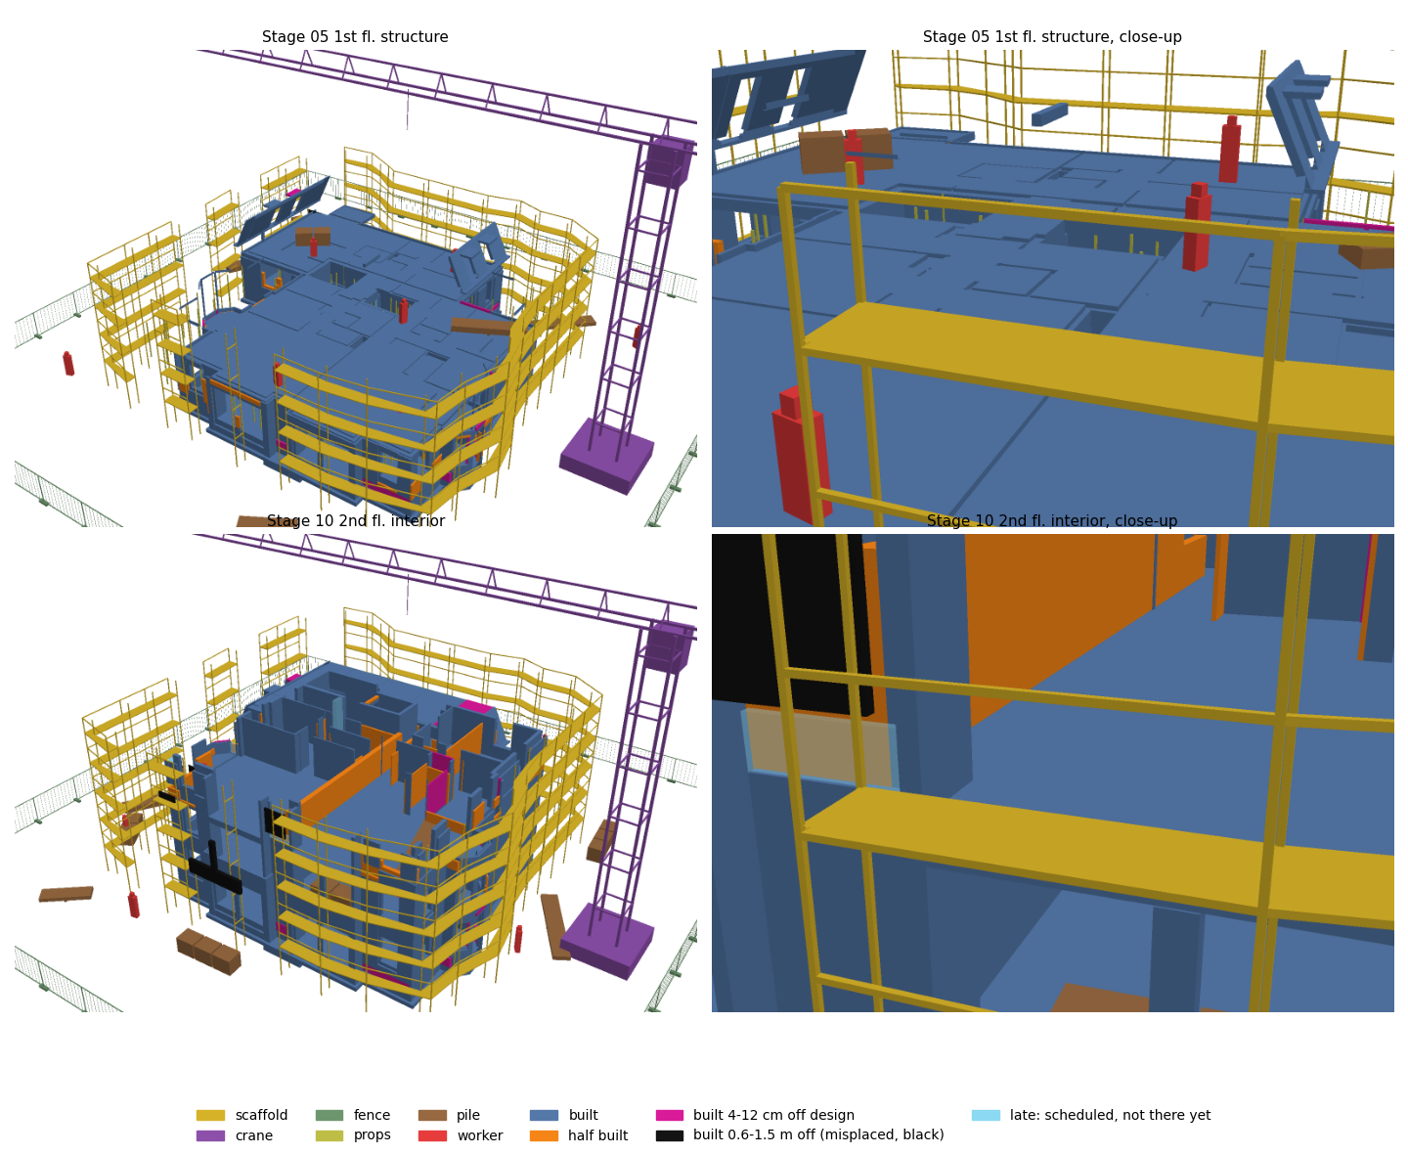
A busy construction site
NEW
None of this is in the design, so the method has to cope with it
Scaffolding, crane, fence
Scaffolding stands 0.3-1.0 m off the walls and is removed at the end.
Props, piles, workers
New ones appear every stage, on the ground and on the floors.
Built off design
4% of elements 4-12 cm off, 1.5% of walls about 1 m off.
Late elements
3% arrive two stages after the schedule says.
1.8 → 2.0
28 of 67
average error (points), registration within 5 cm
false 'built' calls came from scaffolding, workers and piles
BIM-based construction progress monitoring | End-term review
7
Notes:
A real site is not an empty lot. We added scaffolding along the walls, a tower crane, a site fence, shoring props, material piles and workers. We also made the as-built differ from the design: 4% of elements are built 4 to 12 cm off, 3% arrive two stages late, and 1.5% of walls are built about a metre from their place; the ground truth counts those as not built. In the picture: pink elements are slightly off, black ones are about a metre off, and the pale blue ghost is a late element. The cost was small for the progress number, about 1.8 to 2.0 points, and registration stayed within 5 cm. But one weakness showed up: scaffold decks, workers and piles can look like unbuilt elements, and 28 of 67 false 'built' calls came from them.

Slide 8
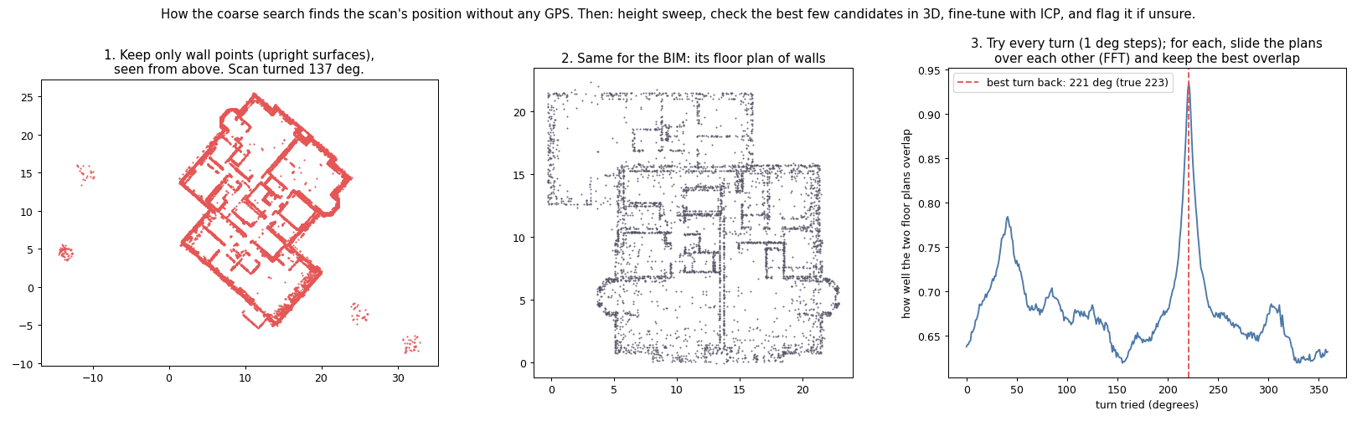
Alignment: why ICP alone failed
IMPROVED
The scan starts metres off, and ICP only works when it starts close
ICP in one minute
For every scan point, find the nearest point on the design. A KD-tree makes that fast.
Shift the scan a little to shrink those distances, then repeat.
0%
1
Level the scan. Use the floors to find which way is up.
2
Search every turn and shift. Compare floor plans of the walls and keep the best overlap.
success for the old ICP when the scan starts metres off, and it never warned
3
Fine-tune with ICP, flag doubt. ICP does the last centimetres. Doubtful results raise a warning.
BIM-based construction progress monitoring | End-term review
8
Notes:
Alignment, or registration, means laying the scan on top of the design. ICP, iterative closest point, is the classic method: for every scan point it finds the nearest point on the model, using a KD-tree so the search is fast; then it moves the scan a little to shrink those distances, and repeats. The catch is that it only finds a nearby answer. If the scan starts metres off or turned, it settles in the wrong place. In our test it was right 0% of the time at GPS-sized offsets. So we added a coarse step before ICP: level the scan using the floors, draw a top-down floor plan of the walls, and try every turn and shift to find where the two floor plans overlap best. Then ICP only has to fine-tune. The method also raises a warning when the answer looks doubtful.

Slide 9
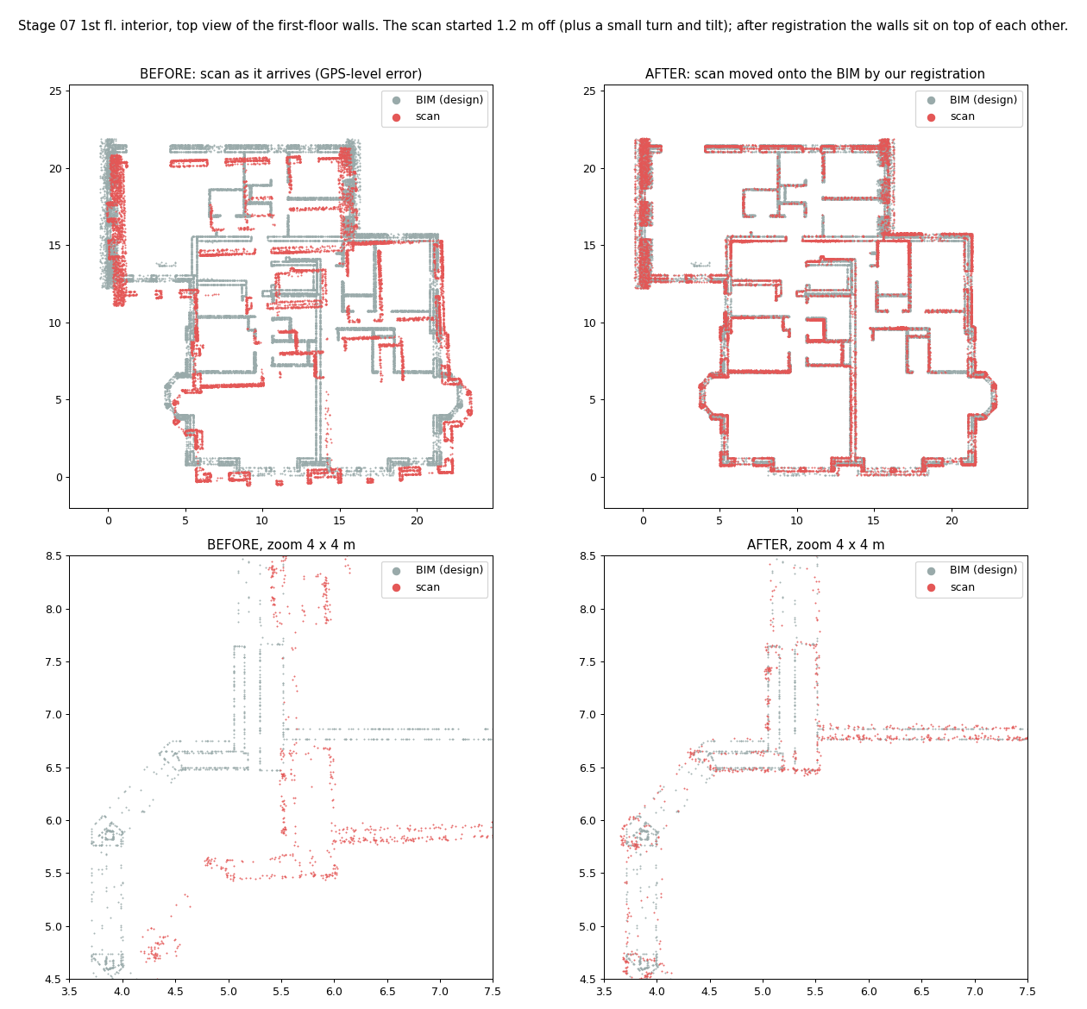
Alignment: from 0% to 98% success
IMPROVED
Random starting offsets: GPS-sized for a drone survey, up to 30 m for an indoor scan without GPS
Success rate (%): scan ends within 5 cm of the right place
0%
98%
1-3 cm
old ICP, and every failure was silent
floor-plan search + ICP
error at every stage in the full run
Failures of the new method: 4 of 170 trials. Two were flagged by the method itself, two were near misses of 7 and 9 cm.
BIM-based construction progress monitoring | End-term review
9
Notes:
Results of the alignment test bench, with 50 random starting offsets per case. The old ICP succeeded 0% of the time, and every failure was silent. Feature matching with RANSAC got 30 to 40%. Our floor-plan search plus ICP got 97 to 98% in both cases, a drone survey with GPS and an indoor scan without. Where it failed it usually flagged the problem itself. In the full pipeline every stage ends up within about 1 to 3 cm. On the left you can see before and after for one stage: the scan in red starts about a metre off, and after alignment it sits on the design in grey.

Slide 10
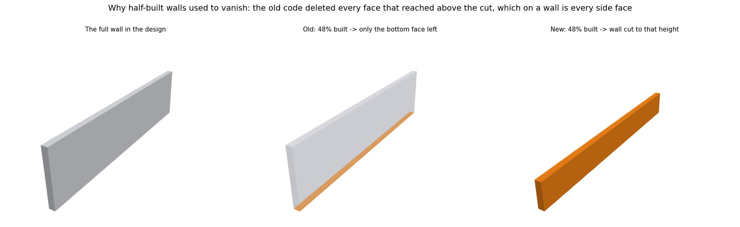
Matching scan points to the design
IMPROVED
The design tells us where every element should be, so we match instead of discovering
1
Tag the design
Sample the design surface densely. Every sample knows its element.
2
Look up fast
A KD-tree finds the nearest design sample for every scan point.
Fix: one wall that is 48% built. Old code kept only its hidden bottom face. New code cuts the wall to the height built.
3
Assign with a margin
A point joins an element if it is within 8 cm and clearly nearer to it than to any other.
4.8 → 2.1
3-8 points
average progress error (points) after this one fix
too low at every stage before the fix: half-built walls were missed
4
Read the height
Enough points means detected. How high they reach tells complete from partly built.
BIM-based construction progress monitoring | End-term review
10
Notes:
After alignment we match. We do not try to discover walls from scratch, because the design already tells us where every element should be. We sample the design surface densely, tag each sample with its element, and put them in a KD-tree. A scan point joins an element if it is within 8 cm and clearly nearer to it than to any other element, by a 4 cm margin. An element with enough points counts as detected, and how high its points reach tells us whether it is complete or only partly built. While doing this we found a bug: our simulator dropped the side faces of half-built walls, so they almost vanished from the scan. Fixing it cut the progress error from 4.8 to 2.1 points.

Slide 11
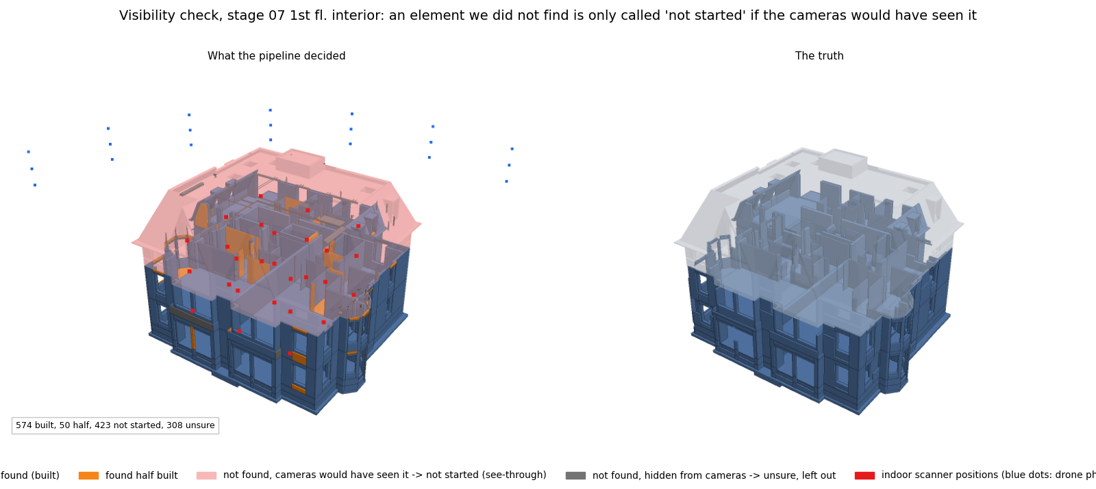
Not built, or just not seen?
NEW
An element with no points is not always an element that is not built
The question we ask
Element not found. If it were built, would the cameras have collected enough points?
Yes: not started.
No: unsure, left out of the progress number.
It uses the estimated alignment and only the elements we found, so it never peeks at the answer.
Stage 7. Pink and see-through: not started. Dark grey: unsure, left out of the count. Truth on the right.
3.2 → 2.0
658 → 327
10% rule: a detection with under 10% of the expected points is thrown out as noise.
average error (points), old final-stage rule vs visibility check
built elements missed, old rule vs visibility check
BIM-based construction progress monitoring | End-term review
11
Notes:
The most important idea we added. If we find no points for an element, there are two explanations: it is not built, or the cameras could not see it. At mid-term we treated both as not built. Now, for every element we did not find, we raycast from the actual camera positions, using the estimated alignment and only the elements we did detect, and ask: if this element were built, would we have collected enough points? If yes it is not started. If not, it is unsure and left out of the progress number. In the picture the pink see-through elements are not started, and the dark grey ones are unsure. We also added a rule: a detection with fewer than 10% of the points we would expect is thrown out, because noisy points near wall junctions were making unbuilt walls look built. On the hardest test the old rule had 658 built elements missed; the visibility check has 327, and the average error went from 3.2 to 2.0 points.

Slide 12
A progress number with a 90% range
NEW
The raw estimate runs low as the building fills up. A learned correction fixes most of it
Error against the true progress (points), by construction stage
2.0 → 0.7
average error (points), raw vs corrected
15 of 16
stages with the truth inside the 90% range (about +/-1.6 points)
How: group elements by their evidence, learn each group's usual bias on one run, apply it to a different run.
Learned on the clean realistic run, tested on the busy site.
BIM-based construction progress monitoring | End-term review
12
Notes:
Instead of one number we now report a progress estimate with a 90% range. The chart shows the error against the truth for each of the 16 stages on the hardest test. The orange line is the raw estimate, which drifts down to minus 5 points late in the job, because built elements hide in places the cameras do not see. The blue line is the corrected estimate and the dashed lines are the 90% range. How: we group elements by their evidence, such as their status, whether they are below or at the construction front, their type, and how many points we found compared with expected. On one run we learn each group's typical bias. Then we apply it to a different run. Here we calibrated on the clean realistic run and tested on the busy site. Mean error went from 2.0 to 0.7 and the truth was inside the range at 15 of 16 stages. For volume-weighted progress the correction helps less, and the range is wider.

Slide 13
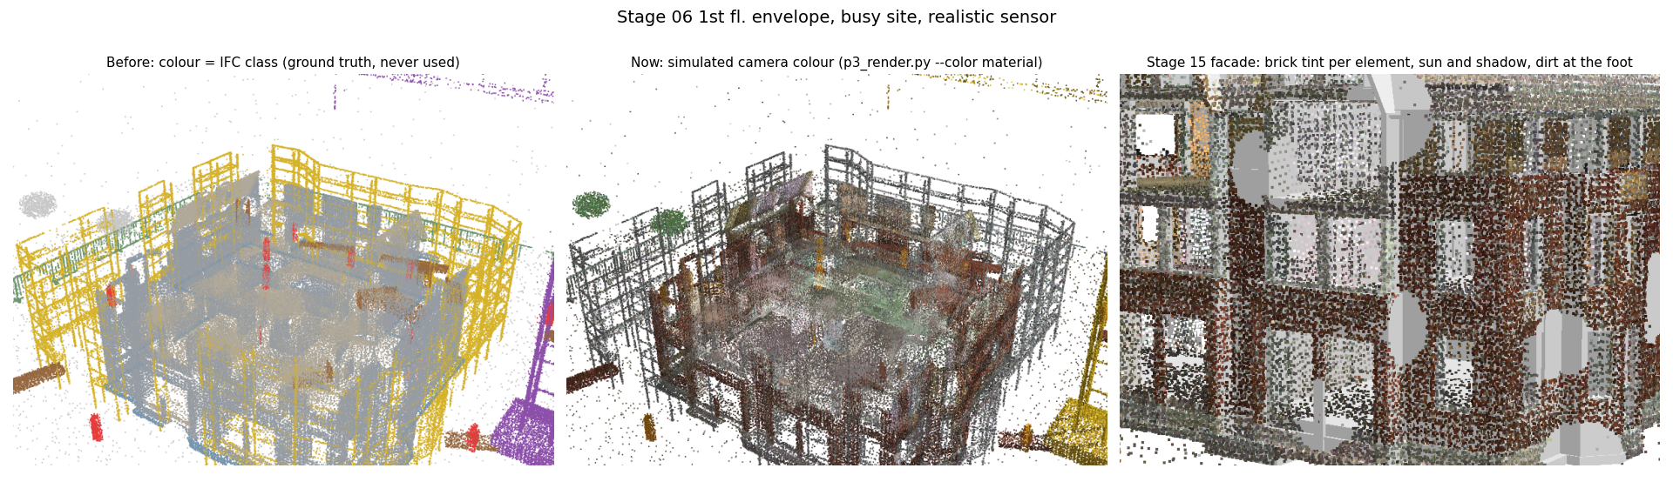
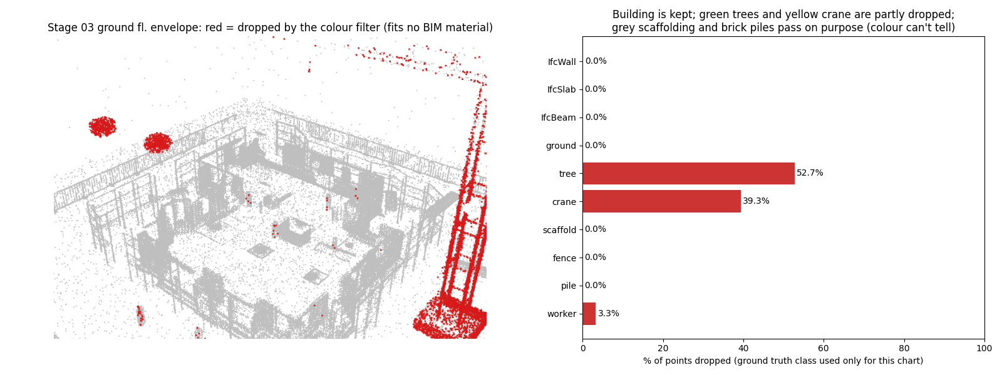
Colour: tried it, kept geometry
EXPERIMENT
Camera colour was tested for alignment and clutter, and geometry still decided
What we did
Gave points a camera colour. Used it to drop clutter and to rank candidate alignments.
What happened
All 12 test cases right, but colour never decided the answer. Full run: 2.1 points against 2.0 without it.
Why
Under changing light, nine of the materials look the same grey. Brick piles look like brick walls.
Decision
Geometry stays the default. Material recognition from texture is on the future list.
Top: scan colours, before and after. Bottom: points dropped by the colour filter (red).
BIM-based construction progress monitoring | End-term review
13
Notes:
Experiment one: colour. We gave every scan point a simulated camera colour, with materials from the design, sun, shadows, dirt, brick patterns, and some elements built from another material, and a material catalogue that is deliberately different from the one used to render. We used colour to drop clutter points and to rank candidate alignments. In the registration test all 12 cases were right with and without colour, and colour never actually decided: the second-best pose was always clearly worse on geometry. In the full pipeline plan_color gave 2.1 points against 2.0 without colour. The reason: once lighting varies, nine of the materials look the same grey, and brick piles look like brick walls. So geometry stays the default. A natural next step is a model that recognises materials from texture patches, which we put on the list of future work.

Slide 14
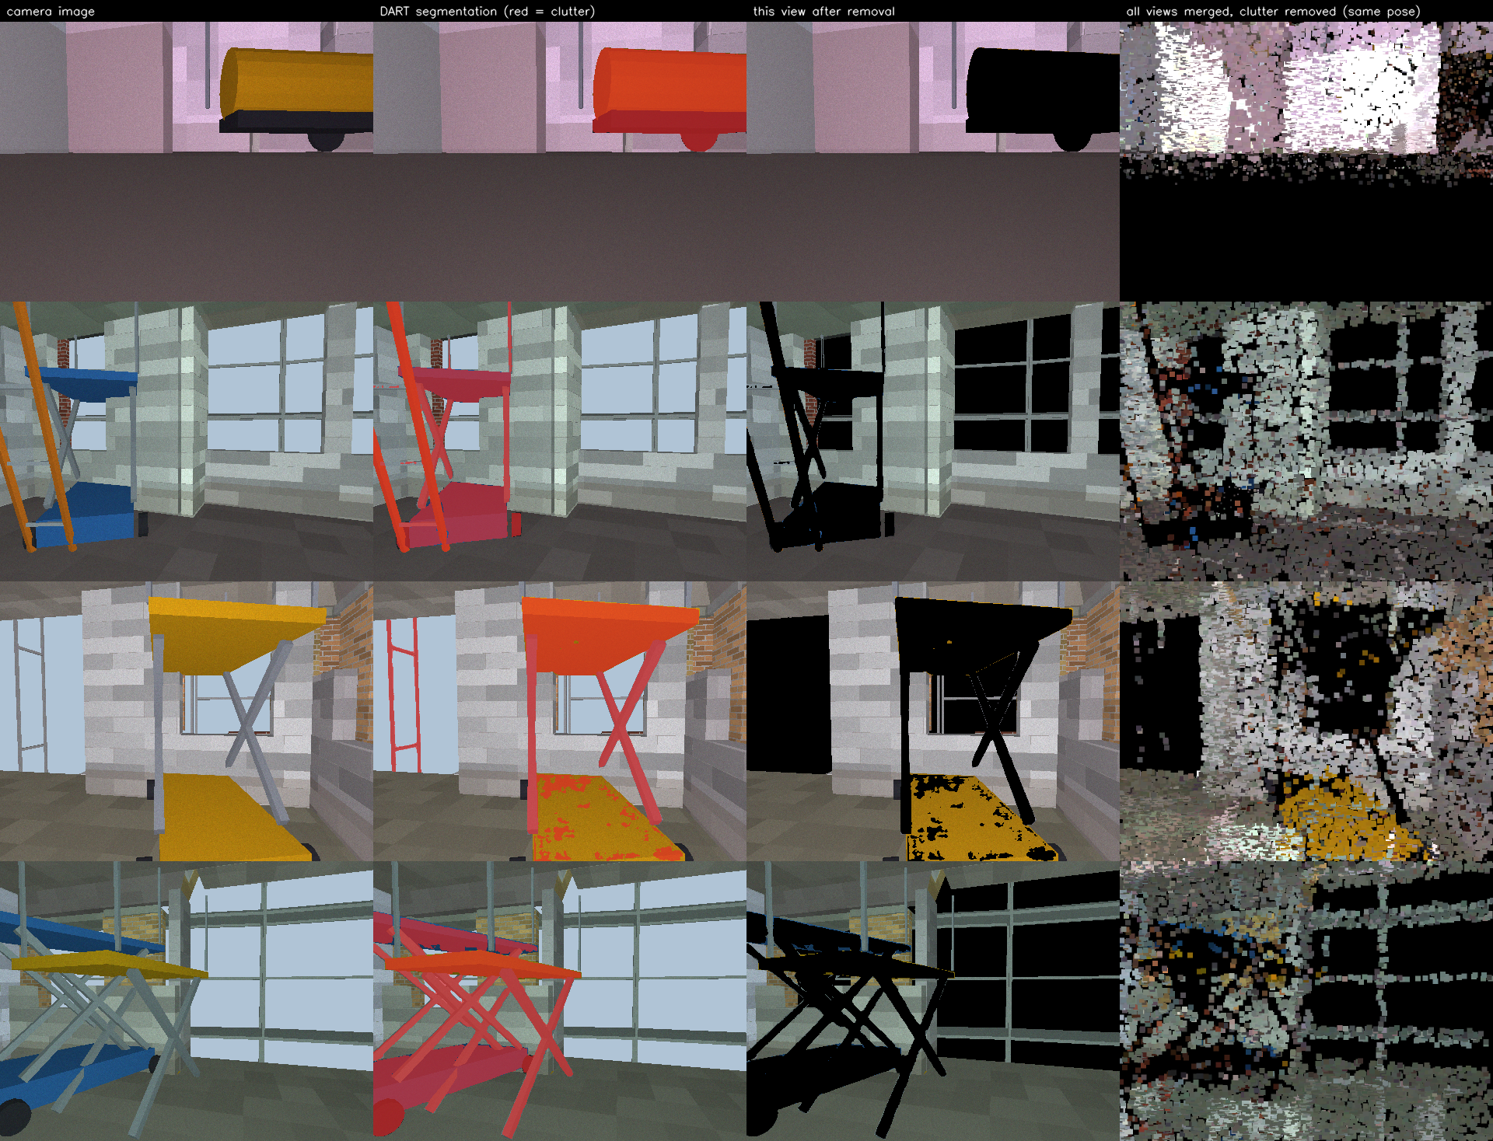
AI clutter removal with DART
EXPERIMENT
An image model labels clutter in camera views so we can remove it from the cloud
DART (built on SAM3) labels each camera image. Points on things it calls clutter are removed.
41%
99.6%
of the clutter points removed
of the structure kept
Progress did not change
About 48% with or without removal, against 85% true. The cloud made only from camera images covers much less of the building.
One stage so far. It needs a GPU, so it ran on another machine.
BIM-based construction progress monitoring | End-term review
14
Notes:
Experiment two: AI clutter removal, done on one stage so far. We added machinery and tools on the built floors, such as a generator, mixer, scissor lift, ladder and barrels. A segmentation model called DART, built on SAM3, looks at simulated camera images and labels what is clutter. In the picture, the columns are: the camera image, DART's labels with clutter in red, the view after removal, and the merged cloud. With the right prompts it removed 41% of the true clutter points and kept 99.6% of the structure. A first attempt with prompts for structure kept only 68% and the estimate collapsed. The progress estimate did not change, about 48% against 85% true, because the cloud made only from camera images covers much less of the building than the scanner cloud. It needs a GPU we do not have on this machine, so it ran elsewhere and stays at one stage for now.

Slide 15
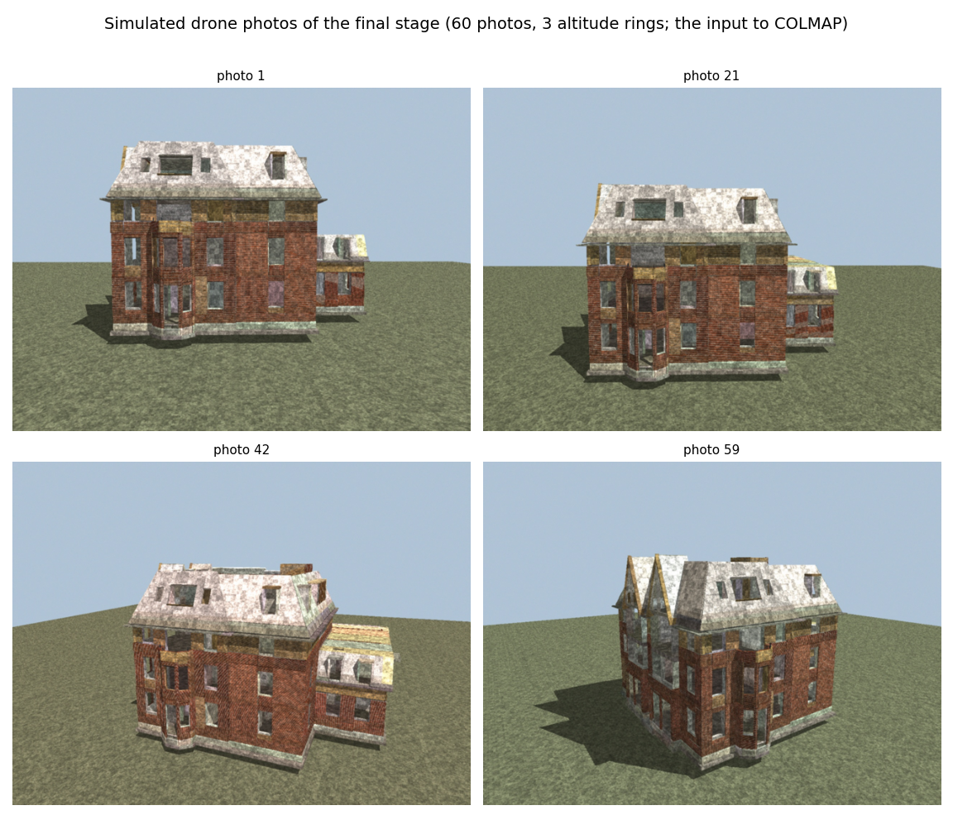
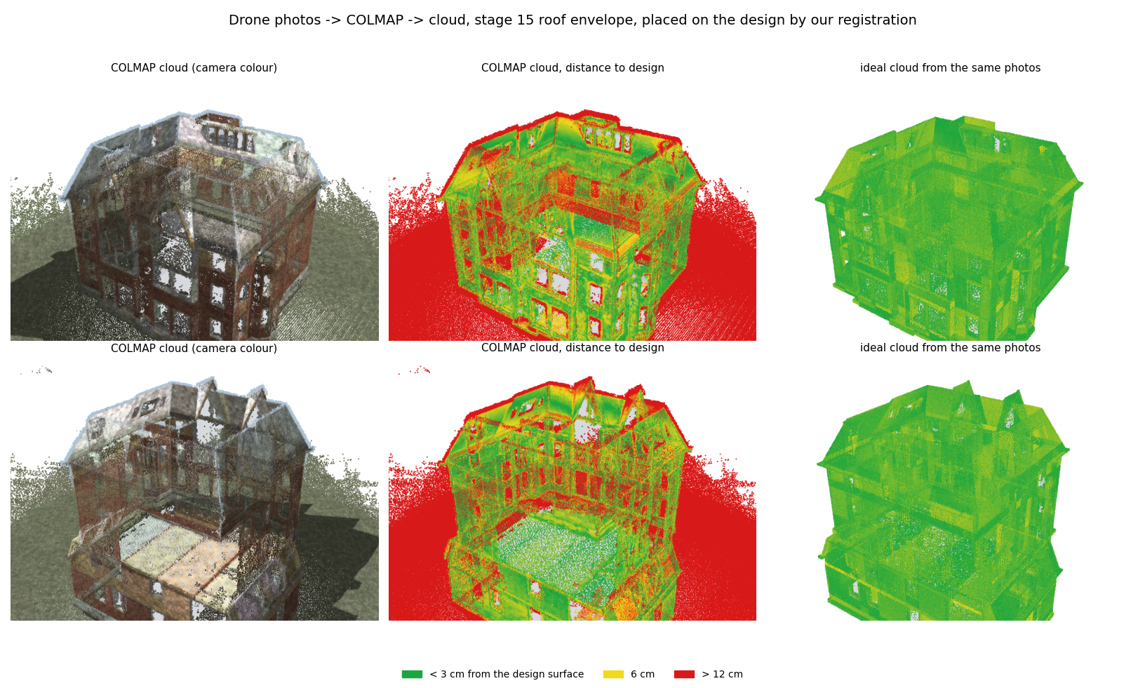
Point clouds from drone photos
NEW
COLMAP builds a 3D cloud from 60 simulated drone photos, like a real survey
Input: 60 photos, 3 altitude rings.
487k
3.7 cm
points
median error
Green: close to the design. Red: far (the ground is not in the design). Right: a perfect cloud from the same photos.
BIM-based construction progress monitoring | End-term review
15
Notes:
Experiment three: photogrammetry with COLMAP. Until now our clouds came straight from raycasting. A real drone survey gives photos, and COLMAP turns photos into a cloud. We rendered 60 drone photos of the final stage, three rings of 20, with material colours, brick pattern, sun and shadows. One lesson: COLMAP matches points between photos, so the surfaces need fine detail that stays fixed on the wall; flat colours gave it nothing to match. COLMAP registered all 60 photos and produced about 487,000 points in 28 minutes on the GPU. Its own scale was nine times off metres, which is realistic, so we move it to the survey frame by fitting the solved camera positions to noisy GPS tags. Measured against the true surface, its median error is 3.7 cm. In the right picture, green points are close to the design. The facades are good, windows are holes, roof edges have stray points, and the ground is red only because it is not part of the design. The right column is a perfect cloud from the same photos.

Slide 16
COLMAP: fine mid-build, weak at the end
NEW
Through our pipeline, photo clouds work mid-construction but lose the finished building
Estimated progress (%) through the same pipeline
5
35
points off, mid-build
points off, finished building
The loss is in the reconstruction
A perfect cloud from the same photos gives 94%, so the drone viewpoints are good enough.
COLMAP leaves holes at windows, adds stray points at roof edges and loses thin parts.
Next: more and closer photos, oblique views, cleaning the cloud.
BIM-based construction progress monitoring | End-term review
16
Notes:
What happens when we put the COLMAP cloud through the same pipeline. Chart: estimated progress for two stages, the first-floor interior and the final stage, with the true progress in grey. Green is our usual raycast cloud with indoor scans, blue is a perfect cloud from the same 60 photos, and orange is COLMAP. At the mid stage COLMAP is five points low. At the finished building it gives 65% against 100% true, with 263 built elements missed. The blue bar tells us why: a perfect cloud from the same photos gives 94%, so the drone viewpoints are good enough; the loss comes from the reconstruction, with holes at windows, stray points at roof edges and lost thin parts. The scale and position were fixed with GPS tags and registration worked on both stages. Next steps are more and closer photos, oblique views and cleaning the cloud. We do not yet know why the finished building does so much worse than the mid stage.

Slide 17
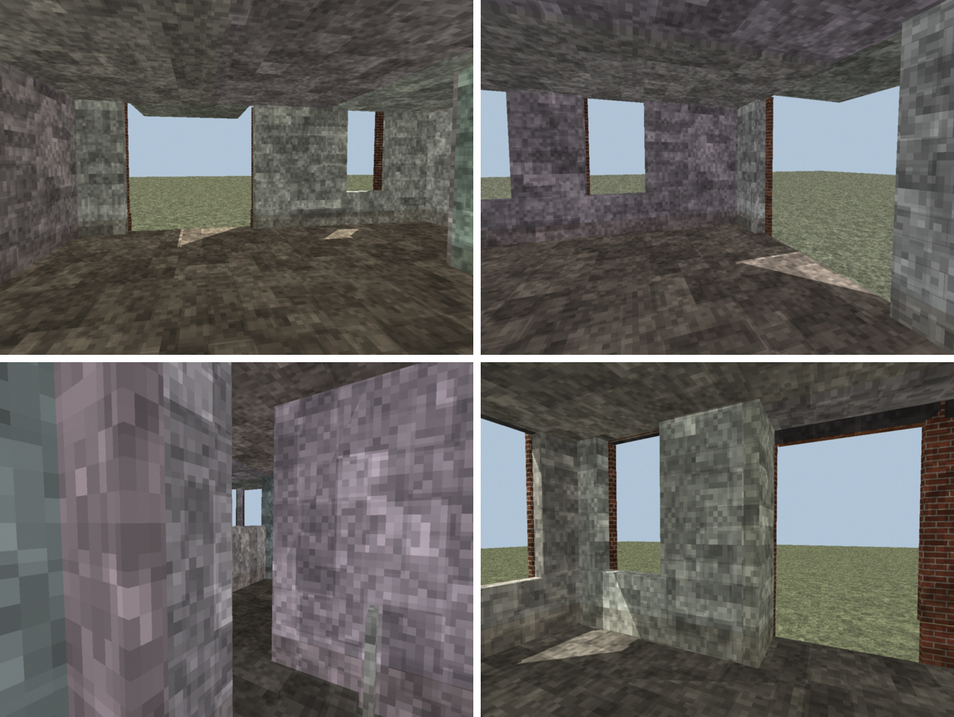
COLMAP indoors: accurate, but hard to link
EXPERIMENT
The same test inside the building: 72 photos of the ground floor
26 of 72
4.6 mm
11.75 m
photos linked into one model
median error where covered
registration error, with no warning
Why it fails
Rooms separated by walls share almost no views, so the photos of one room do not connect to the next.
A cloud of a few look-alike rooms fits several places. Alignment picked a wrong one and our look-alike check stayed just under its threshold.
Next: a continuous walk through the doorways, and a stricter check for small clouds.
Simulated ground-floor photos: 18 standing positions, 4 views each.
BIM-based construction progress monitoring | End-term review
17
Notes:
We also tried the interior, because everything so far used exterior drone photos. We rendered 72 photos on the ground floor: 18 standing positions, four views each. COLMAP split them into two separate models and the larger one used only 26 photos, because rooms separated by walls share almost no views. Where the cloud exists it is very accurate, a median error of 4.6 millimetres. But it covers only a few rooms, and that broke registration: the floor-plan search chose a look-alike place 11.75 metres away, and our own checks did not warn, because the look-alike ratio was 0.85, just under the 0.9 threshold. So the progress estimate from it is meaningless. Two lessons: indoor photo capture needs a continuous walk so the photos stay connected, and registration of small partial clouds needs a stricter safety check. A perfect cloud from the same photos works, 88% against 97% true, but sees only the ground floor.

Slide 18
What each change did
Average progress error over the 16 stages, in points. Lower is better
How the pipeline improved (easy world)
Hardest world: what happens if we remove one piece
Old alignment (ICP)
The 10% noise filter
Error-bar correction
40 points of error
volume error 2.2 vs 6.4 without it
2.0 down to 0.7 points
The scan ends about 3 m off the design and nothing warns. This is why we built a new alignment.
Rejects a detection that got under 10% of the points expected for that element. Without it, false 'built' calls go 68 to 160.
A learned fix for the usual under-count of hidden built elements. It also gives a 90% range. Not shown in the chart: it is added on top.
BIM-based construction progress monitoring | End-term review
18
Notes:
The summary of results. Left chart: how the pipeline improved on the easy world. The first pipeline had 4.8 points of error. The half-built wall fix brought it to 2.1, the visibility check to 1.5, and GPS-sized offsets with the new registration to 0.8, even though that test is much harder. Right chart: on the hardest world (realistic sensor, busy site, late and misplaced elements) we remove one piece at a time and show two measures: the count error, where every element counts equally, and the volume error, where big elements count more. Without the 10 percent noise filter the count error looks fine, 1.6, but the volume error triples, 6.4 against 2.2. With the old rule for unseen elements both errors are worse. The 10 percent filter rejects a detection that got fewer than 10 percent of the points we expected for that element; it stops stray points near an unbuilt wall from making it look built. Bottom boxes: the old ICP alignment is 40 points off with no warning. The error-bar correction is a learned fix for the usual under-count of hidden built elements; it is added on top of the pipeline and brings the average error from 2.0 to 0.7 points, and gives a 90 percent range. As the world gets harder from the simple sensor to the busy site the same pipeline goes from 0.8 to 2.0.

Slide 19
Where it still falls short
The honest list of what the results do not show yet
28 of 67
25%
1 building
Clutter fools matching
Not everything is seen
Simulation only
False 'built' calls on the busy site came from scaffold decks, workers and piles standing where unbuilt elements would be.
About a quarter of elements are never seen by the camera plans, even when built. COLMAP also loses windows and thin parts.
No real survey has been tested yet, and the thresholds were tuned on these runs. A frozen test split is still needed.
Most important next check: freeze a test split, then run the pipeline unchanged on one real survey.
BIM-based construction progress monitoring | End-term review
19
Notes:
Three honest limits. First, clutter still fools the matching: 28 of the 67 false built calls on the busy site came from scaffold decks, workers and material piles that sit where unbuilt elements would be. Second, not everything is seen: about a quarter of the elements are never seen by our camera plans even when built, and COLMAP loses windows and thin parts, with the finished building 35 points off. Third, all of this is simulation: one building, and no real survey has been tested yet. Our thresholds were tuned on these runs, so a frozen test split and a real dataset are the most important next checks.

Slide 20
What comes next
Six directions, in the order we would take them
1
2
3
Real data check
Drone-only flights
Better COLMAP clouds
Run the pipeline unchanged on a real survey. Learn which simulated effects mattered.
Oblique and closer views. A real drone cannot scan indoors.
More photos, a continuous indoor walk, cleaning the cloud.
4
5
6
Material recognition
Merge two scans
Work activities
A model reads material from a texture patch and compares it with the design.
Align two runs of the same building. Colour should help more here.
Formwork, rebar, concrete: more than built or not built.
BIM-based construction progress monitoring | End-term review
20
Notes:
Where this goes next. One: a real data check. Run the pipeline unchanged on a real survey, so we learn which simulated effects mattered. Two: drone-only flights with oblique and closer views, since a real drone cannot scan indoors. Three: better COLMAP clouds, with more photos, cleaning the cloud and a different dense step. Four: recognise materials from texture with a model, and compare against the material the design says. Five: use colour registration to merge two scans of the same building, where colour should help more than against the design. Six: work activities such as formwork, rebar and concrete, not only built or not built.

Slide 21
SUMMARY
A realistic test, and a method that holds up
4.8 → 0.8
2.0
0.7
average error (points) on the easy test, after fixing wall clipping, adding the visibility check and the new alignment
average error on a much harder, realistic site with scaffolding, workers and late elements
with the error-bar correction, and the truth inside the 90% range at 15 of 16 stages
Thank you. Questions?
Notes:
To summarise. On the easy test, the average progress error went from 4.8 to 0.8 points. On a much harder, realistic site the same pipeline has about 2 points of error, and with the error-bar correction about 0.7, with the truth inside the range at 15 of 16 stages. The old ICP would have been 40 points off with no warning. We also tested colour, AI clutter removal and COLMAP photogrammetry, and we know the next steps. Thank you, we are happy to take questions.

