Slide 1
Ness Digital Engineering
Unleashing Your Digital Potential
The Raise Of Bitcoin And Other Cryptocurrencies
17/01/2017

Slide 2
Currency 101

Slide 3
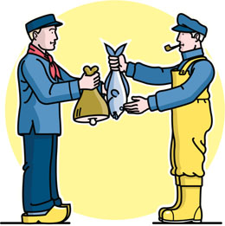
What is currency?
Currency is a medium to exchange value.
Commodity currency
Fiat currency
Digital Currency

Slide 4
Digital Currency:
This is the currency only available in digital form ,not in physical
Digital Currency
Virtual Currency
Crypto Currency

Slide 5
How Bitcoin works?

Slide 11
<Contact Information>

