Slide 1
Ness Digital Engineering
Unleashing Your Digital Potential
The Raise Of Bitcoin And Other Cryptocurrencies
17/01/2017

Slide 2
Agenda of The Day
Introduction of crypto currencies.(Currency 101) - 10mins
Brief Introduction to Bitcoin. – 30 mins
How to buy and sell Bitcoin? – 15 mins
How Bitcoin works? – 30 mins
Risks and Opportunities of using Bitcoin. – 15 mins
Discuss various crypto currencies (litcoin,etc) – 15 mins
What Next…

Slide 3
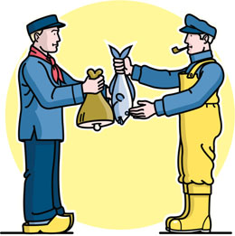
Currency 101
What is currency?
Currency is a medium to exchange value.
Commodity currency
Fiat currency
Digital Currency

Slide 4
Digital Currency: This is the currency only available in digital form. It may backed by a physical currency.
Digital Currency
Virtual Currency
Crypto Currency
Virtual Currency: This special type of digital currency which is created by online community for their use.
Depending on wither we can used out side the community it can be categorized as
Open Virtual Currency
Closed Virtual Currency
Depending who controls the creation and transaction of currency, there are two type of virtual currencies
Centralize virtual currency
Decentralize virtual currency
Crypto currency: Is a kind of digital currency which use cryptography in transaction to protect the privacy and to increase security of the transaction.

Slide 5
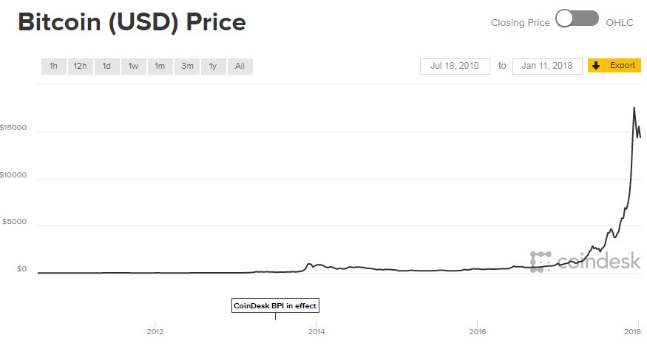
Brief Introduction to Bitcoin.
Bitcoin is a decentralized virtual crypto currency. It coming into being in year 2009 by a anonymous developer Satoshi Nakamoto.
Bitcoin was created using many grounding breaking ideas that will change the way we do financial transaction. One of the idea is trust less consensus which enable bitcoin user do money transaction with out any involvement of a third party intermediary.

Slide 6
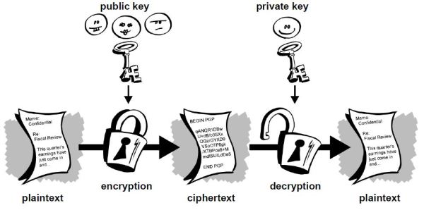
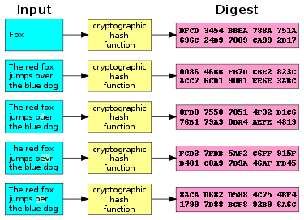
Fundamentals of Cryptography
Public and private key
Hash functions

Slide 7
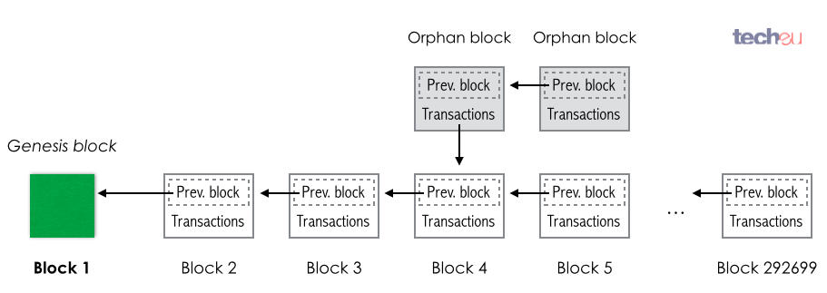
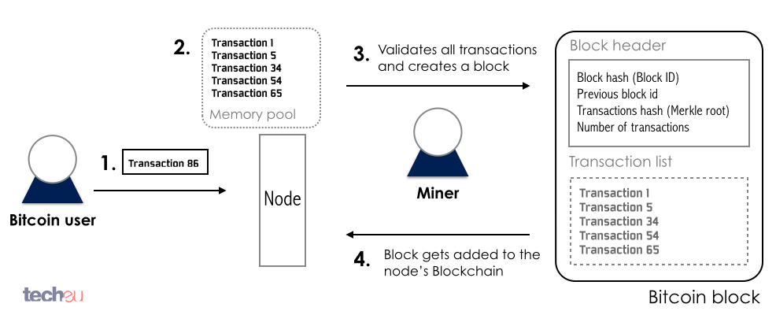
Block Chain Technology

Slide 8
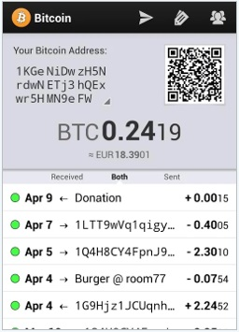
Currency 101

Slide 9
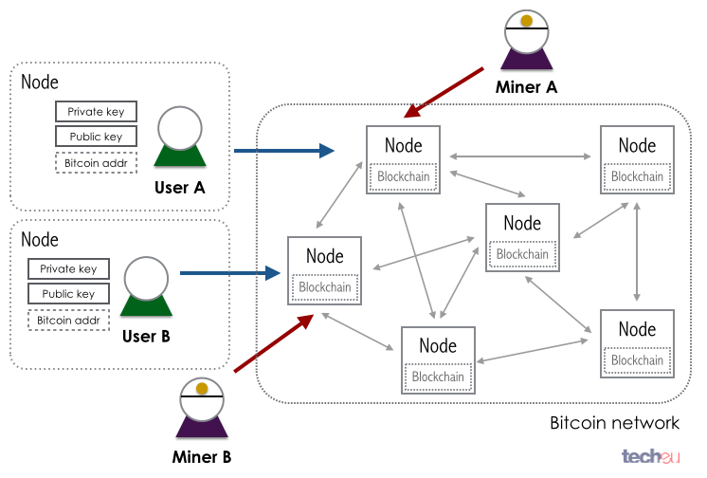
Currency 101

Slide 10

Are you still confused?

Slide 11
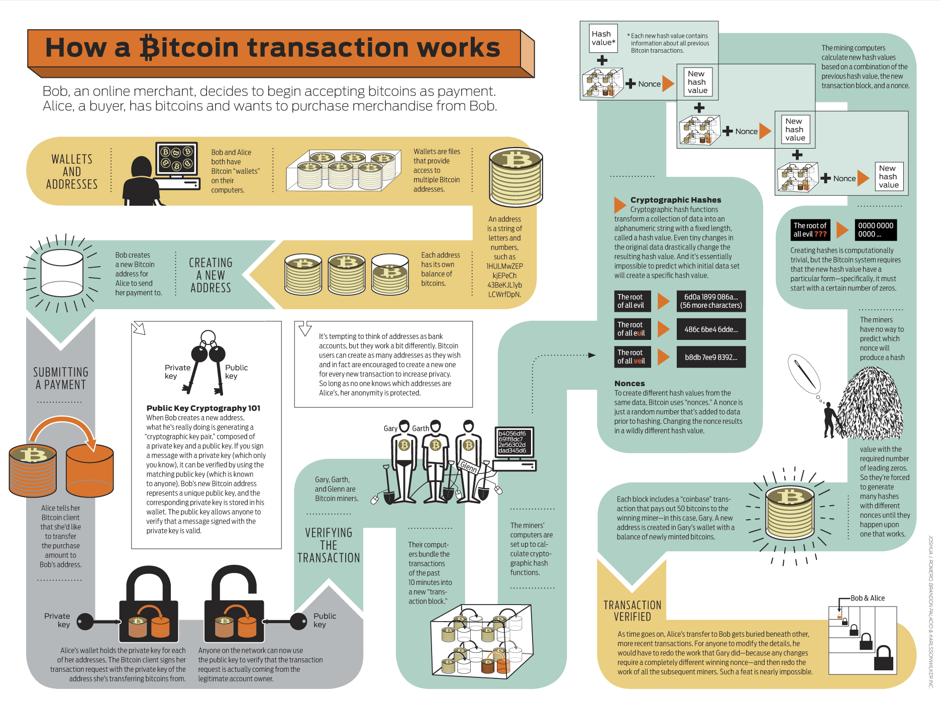
How Bitcoin works?

Slide 12
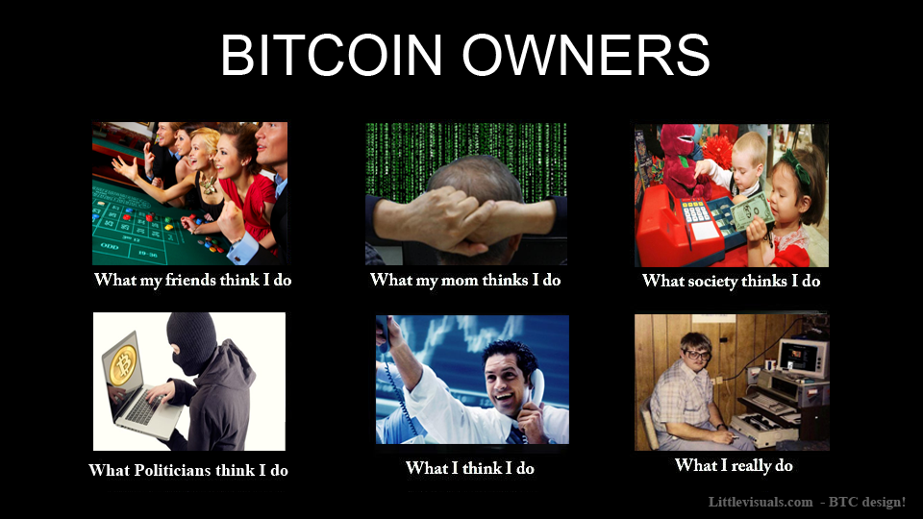
Buy and Sell Bit coins

Slide 13
Continue….
Zepbay
Unocoin
Coinsecure
Hot Wallet:
Most of the web and mobile wallet software services in the Bitcoin market store your private key on your behalf on their servers. They get stored in an encrypted form which only you can decrypt.
Cold Wallet:
Desktop wallets are relatively safe. In such wallets, once you install them on your desktop, you will get your Bitcoin address and private key in a downloadable and importable file.
These importable keys can be made password protected and stored on a memory stick or hard drive.
Paper Wallet

Slide 14
Risks and Opportunities of using bit coin
People are using Bitcoin for speculative trading that makes its value very volatile. Bitcoin is so volatile that it cant be used to by and sell merchandise so it is not fulfilling
The purpose for which it was created.
Opportunities:
Bitcoin still the dominate cryptocurancy in the world.
Every world currency can be exchanged with bitcoin
It is decentralize so no government can interfere so bitcoins is durable as it will not effected by recession of fiat money and no demonetisation fear .
There is limit on how many bitcoin can be in circulation so the currency is deflationary so value of bitcoin will increase overtime so good for investment
In the new
Risks:
Bitcoin is not backed by government or any asset. So if some body steal the bitcoins or some bitcoin exchange take away the user bicoin there is no one to protect buyers
Bitcoin has value because every byers thinks the bit coin going to work and it is subjected to media coverage , if these belefe get shaken then the price of bitcoin will fall sharply
Bitcoin is a threat to govment as goverment loose control over its money so government will try to regulate its use and it will effect the value of bitcoin .

Slide 15
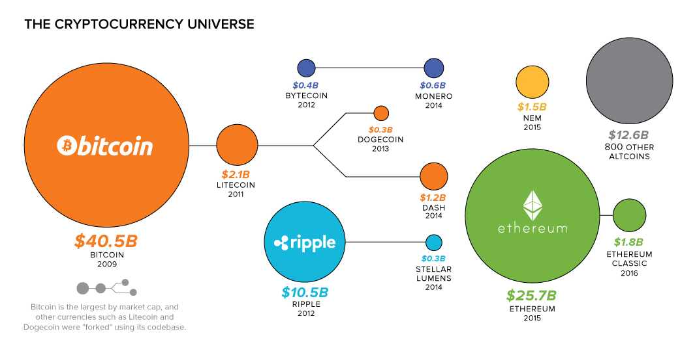
Other Cryptocurecies

Slide 16
<Contact Information>

