Slide 1
Workflow Inference from Process Diagrams
Date: March 31, 2026

Slide 2
Project Overview
• AI-powered extraction of customer journeys from process diagram PDFs
• Converts visual BPMN workflows to structured, machine-readable JSON
• Leverages AWS Bedrock Claude Vision models for intelligent diagram analysis
• Proof-of-concept for automating workflow digitization across enterprise systems
• Targets data scientists and business process engineers for rapid process documentation

Slide 3
Business Problem
• Manual transcription of process diagrams is time-consuming and error-prone
• Legacy workflow documentation trapped in PDF and image formats
• Business Process Management (BPM) systems require structured workflow metadata
• Lack of automated tooling to extract decision logic and branching from diagrams
• Gap between visual process design and executable workflow definitions

Slide 4
Solution Overview
• Two-stage AI extraction pipeline: vision-based node detection + code generation
• Supports BPMN-compliant shapes (tasks, gateways, events) and decision branches
• Automatically detects and skips non-diagram pages in multi-page PDFs
• Outputs validated Mermaid flowcharts and structured JSON workflow definitions
• Reduces hallucination through separation of visual and code generation tasks

Slide 5
Step-Wise Execution Flow
• Stage 1: PDF validation and page classification (diagram vs. text content)
• Stage 2: Extract and enhance workflow images at 300 DPI for LLM clarity
• Stage 3: Vision analysis extracts nodes, arrows, and conditional labels via LLM
• Stage 4: Mermaid flowchart code generation from vision descriptions
• Stage 5: Parse Mermaid and convert to structured JSON workflow format with decision logic

Slide 6
Core Capabilities & Architecture
• Multi-page PDF processing with intelligent diagram detection and validation
• BPMN shape recognition: rectangles (tasks), diamonds (gateways), circles (events)
• Decision gate extraction with conditional branch labels (Yes/No/Success/Fail)
• Loop-back and backward arrow detection for iterative process flows
• JSON output with node metadata, descriptions, and hierarchical workflow structure
• Image enhancement and automatic resizing to meet API constraints (max 8000×8000 px)

Slide 7
Advantages & Business Impact
• Reduces manual workflow documentation effort by 80–90% vs. manual transcription
• Enables rapid process analysis and improvement identification without rework
• Supports compliance and audit workflows requiring documented process flows
• Scales to enterprise multi-page documents with dozens of workflow diagrams
• Two-stage extraction minimizes AI hallucination vs. single-stage approaches
• Open-source compatible; integrates with existing BPM and copilot platforms

Slide 8
Limitations & Known Gaps
• Requires clear, high-quality PDF diagrams; handwritten or very small diagrams may fail
• Supports BPMN and standard flowchart notation only; custom diagramming systems need adaptation
• Depends on AWS Bedrock availability and region constraints (us-west-2)
• API costs scale with document volume and image size; large multi-page batches are expensive
• Complex diagrams with >50 nodes or deeply nested hierarchies may exceed LLM token limits

Slide 9
Risks & Implementation Considerations
• Bedrock model availability and long-term support; consider fallback models (Opus or Haiku)
• Image quality dependency requires controlled input validation and user guidance on PDF standards
• Token consumption and cost control necessary for production scale (token metering recommended)
• Data sensitivity: diagrams sent to AWS; ensure compliance with data residency and privacy policies
• Iterative refinement needed for edge cases (non-standard notations, multi-language labels)

Slide 10
Roadmap & Next Steps
• Integrate with Orch AI team's orchestration platform for workflow automation
• Expand notation support: UML, swimlanes, and custom enterprise diagram formats
• Implement batch processing API and scheduling for enterprise document pipelines
• Add user interface for diagram upload, processing status, and JSON output preview
• Production hardening: error recovery, comprehensive logging, and cost monitoring
• Evaluation of local vision models to reduce cloud dependency and cost

Slide 11
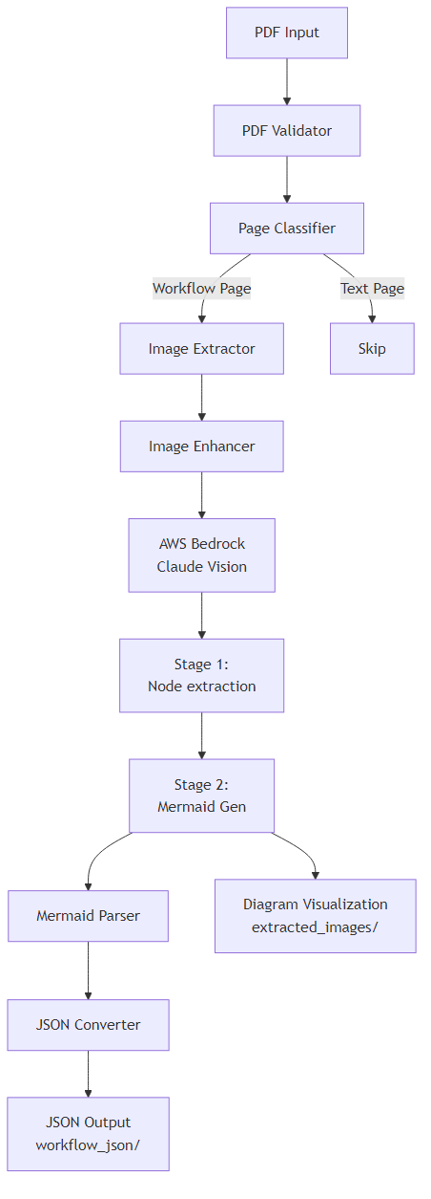
System Architecture Diagram

Slide 12
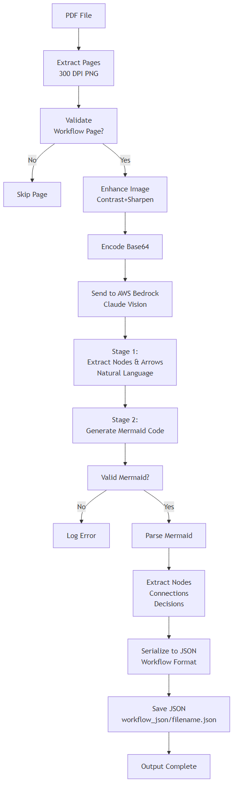
Data Flow Diagram

