Slide 1
AI Workflow Discovery Engine
Date: April 07, 2026

Slide 2
Project Overview
• Analyzes contact center transcripts to discover recurring business workflows automatically.
• Combines large language models with clustering to produce structured process intelligence.
• Targets operations teams, automation architects, and CX optimization stakeholders.
• Converts raw interaction text into normalized task sequences and workflow clusters.
• Supports process mining and orchestration design from real customer conversations.
• Uses a configurable pipeline to adapt to domain-specific intent taxonomies.

Slide 3
Business Problem
• Operational workflow knowledge is buried in large volumes of unstructured call transcripts.
• Manual analysis is expensive, inconsistent, and difficult to scale across intents.
• Different agents describe similar actions using varied language and sequence patterns.
• Without normalization, organizations cannot reliably identify repeatable process paths.
• Process optimization efforts lack evidence from end-to-end customer interaction data.
• Automation opportunities remain hidden without structured workflow discovery outputs.

Slide 4
Solution Overview
• Pipeline extracts workflow tasks from transcripts using intent-aware LLM prompts.
• Task normalization clusters semantically similar actions into representative labels.
• Sequence clustering groups complete workflow paths into common operational patterns.
• Configuration-driven parameters control sampling, thresholds, and output destinations.
• Outputs include Excel, JSON, and serialized artifacts for downstream analytics.
• Design emphasizes privacy-aware extraction and deterministic processing controls.

Slide 5
Detailed Step-Wise Execution Flow
• Load intents and ranked interactions from structured metadata sources.
• Sample transcripts by intent class to build representative processing batches.
• Parse ASR rows into speaker-aware transcript narratives for model input.
• Invoke LLM to infer workflow name, ordered tasks, and supporting analysis.
• Generate embeddings for tasks and cluster them into normalized action groups.
• Cluster normalized sequences and publish representative workflows with frequency counts.

Slide 6
Core Capabilities & Architecture
• Intent-guided extraction aligns detected workflows with business taxonomy context.
• Semantic embedding and hierarchical clustering improve cross-phrase task consistency.
• Representative task and workflow selection uses centroid-based nearest neighbor logic.
• DBCV quality scoring supports evaluation of clustering density and separation.
• Config manager centralizes paths, thresholds, model settings, and runtime parameters.
• Model invocation layer standardizes Bedrock access, retries, and usage telemetry.

Slide 7
Advantages
• Reduces manual effort to discover workflows across large transcript corpora.
• Creates standardized process language from heterogeneous agent conversation styles.
• Improves visibility into frequent customer journey paths and operational bottlenecks.
• Enables data-backed prioritization for automation and orchestration initiatives.
• Supports repeatable experimentation through configurable thresholds and prompts.
• Produces reusable structured outputs for analytics, governance, and reporting.

Slide 8
Limitations
• Extraction quality depends on transcript accuracy and intent metadata completeness.
• LLM responses can vary when conversations are ambiguous or context is incomplete.
• Clustering outcomes are sensitive to distance thresholds and embedding model choice.
• Very large datasets may require batching to manage memory and runtime constraints.
• Some nuanced tasks may be over-merged when semantic similarity is high.
• Current implementation focuses on offline analysis rather than real-time streaming.

Slide 9
Risks & Implementation Considerations
• Cloud model availability and Bedrock rate limits influence throughput predictability.
• Governance is required to monitor token cost and processing efficiency at scale.
• Privacy controls must ensure sensitive details never leak into extracted outputs.
• Quality thresholds should be validated per intent domain before operational rollout.
• Fallback handling is needed for malformed model outputs or empty clusters.
• Versioning of prompts and configs is essential for reproducible discovery results.

Slide 10
Roadmap & Next Steps
• Add interactive controls for threshold tuning and cluster quality exploration.
• Integrate workflow title generation and richer taxonomy-aware labeling.
• Expand evaluation framework with precision and recall benchmarks by intent.
• Introduce human-in-the-loop review for low-confidence workflow inferences.
• Enable incremental and near real-time processing for operational monitoring.
• Package outputs for direct ingestion by orchestration and process mining platforms.

Slide 11
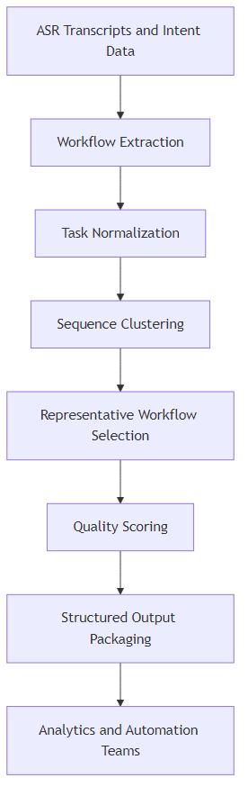
System Architecture Diagram

Slide 12
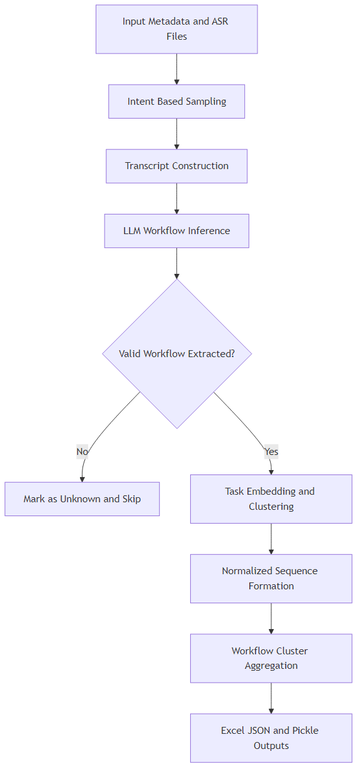
Data Flow Diagram

