Slide 1
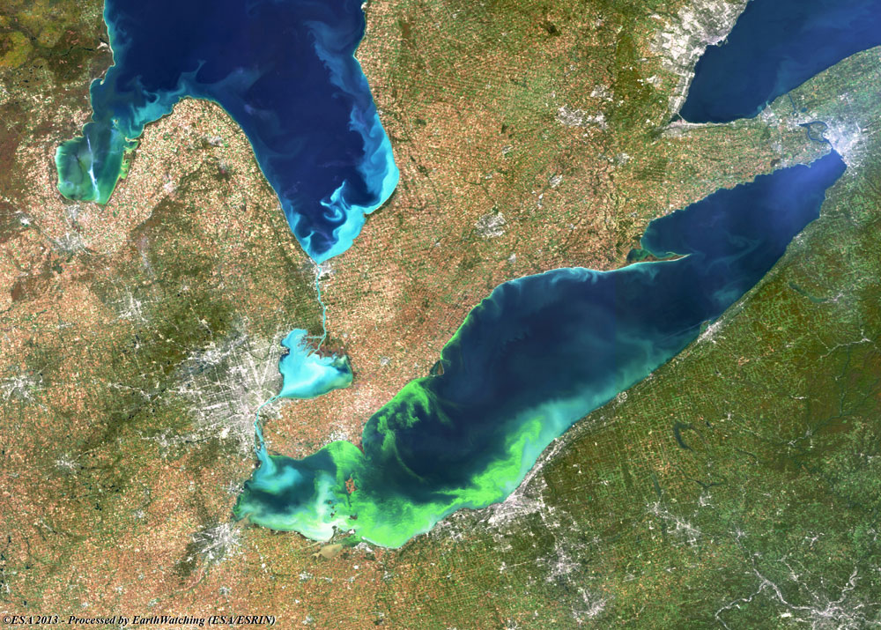
HARMFUL ALGAE BLOOM(HAB)
DETECTION SYSTEM
Gradient Descent
June 24, 2025, Week 3
Dharmik Vara
Daniel
Kruthi Jangam
Karthika Garikapati
Roshan Palem
Sagar

Slide 2
Overview of project Objectives
What problem is the project trying to solve/address?
What are you trying to do?
For whom are you doing this?
Why do they need it?
What is the link to the corresponding challenge?

Slide 3
Technology Stack
Jupyter Notebooks → used for scripting and pipeline control
Earthaccess API → fetch MODIS satellite data
netCDF4 → parse .nc satellite data
pandas → clean and merge ground truth data
pickle → temporarily serialize datacubes (HDF5 planned)
Data Collection
And
Preprocessing

Slide 4
Technology Stack
Scikit-learn → baseline models (Logistic Regression, Ridge)
XGBoost → top-performing tree-based model (94.7%)
TensorFlow / Keras → build CNN + LSTM deep learning model
TimeDistributed + LSTM → capture spatial + temporal patterns
Matplotlib / Seaborn → visualize training progress and metrics
Machine learning
And
Model Development

Slide 5
Technology Stack
Flask → serve model through REST endpoint
Requests → handle frontend → backend communication
Docker (deployed)→ containerised backend
Render / AWS → deployed a scalable API
Backend Inference API

Slide 6
Technology Stack
Streamlit → interactive dashboard UI
streamlit-folium → click-based map selection
Forms → structured user input
Requests → send data to Flask, receive predictions
JSON format → communicate model results (Toxic/Non-Toxic)
Frontend

Slide 7
DATA SOURCE
Sources Considered
⁠HAEDAT: Global HAB event database
HAIS: Harmful Algal Information System
⁠Bloomin' Algae: Additional validation dataset
HABSOS Database (NOAA)
Quality: Karenia brevis cell counts, Lon/Lat coordinates, date
⁠Over 210k labelled HAB events up to 2018, Gulf of Mexico
⁠Access Method: Direct CSV download, processed in our pipeline
Testing Status: Successfully loaded 1,368 events so far
Ground truth data

Slide 8
DATA SOURCE
NASA MODIS-Aqua/Terra
⁠Access Method: EarthAccess API with NASA Earthdata auth (1000 req/hr limit
⁠Available data:
Chlorophyll-a concentration (primary indicator)
Photosynthetically available radiation (PAR)
Different Remote sensing reflectance (Rrs bands: 412, 443, 488, 531, 555nm)
⁠Testing Status: Successfully downloading and processing over 1500 L2 granules
Satellite Remote Sensing Data

Slide 9
DATA SOURCE
⁠30km×30km×5day datacubes around each HAB event
Discard datacubes with less than 60% data coverage
10kb size per datacube
DataCubes

Slide 10
EVALUATION
Model | Accuracy
Logistic Regression | 76.2%
Ridge Classifier | 74.9%
Decision Tree | 91.5%
Random Forest | 92.9%
XGBoost | 94.7%
CNN + LSTM (v1) | 88.4%
CNN + LSTM (v2) | 90.1%
Is Our HAB System Successful?
What Questions Are We Trying to Answer
How Are We Evaluating It?

Slide 11
EVALUATION
Real-World Functionality (System Evaluation)
Comparison to Baselines
User-Centred Success (What Makes It a “Good” System?)
What Does “Success” Look Like?

Slide 12
Current Status
Why This Is an MVP:
Automating the detection of Harmful Algal Blooms (HABs) using satellite data
Offering easy-to-use prediction capability through a web interface
End-to-end integration from data input to model inference and output display

Slide 13
Team Management
TASKS | ASSIGNEE
Data collection and preprocessing | Daniel
Machine learning and Model Training | Dharmik, Kruthi
Backend, Integration Testing | Sagar, Karthika
Frontend | Roshan

Slide 14
Sprint Plan Sprint 3
Sprint 2 | 3/6 - 16/6 (MVP development, basic datacube pipeline,simple classifier)
Sprint 3 | 17/6 - 30/6 (Model training, interim presentation preparation, web interface prototype)
Ground truth processing (HABSOS dataset)
NASA MODIS satellite data integration using EarthAccess
Datacube generation with 30x30km spatial and 5-day temporal span
Baseline ML model trained (using ConvLSTM)
Frontend with Streamlit (manual input form + interactive map)
Flask backend API setup for predictions

Slide 15
Sprint Plan
Sprint 4 : Sprint 4 | 1/7 - 14/7 (higher resolution datacubes, Add data modalities, Retrain model on new datacubes)
Long-Term Plan :
⁠ ⁠Improve backend processing

Slide 16
THANK YOU

