Slide 1


Slide 2
USGS
Active mine plants and operations in 2003
Type, Site, Company, State, County, Lat, Lon
6779 records
http://mrdata.usgs.gov/mineplant/

Slide 3
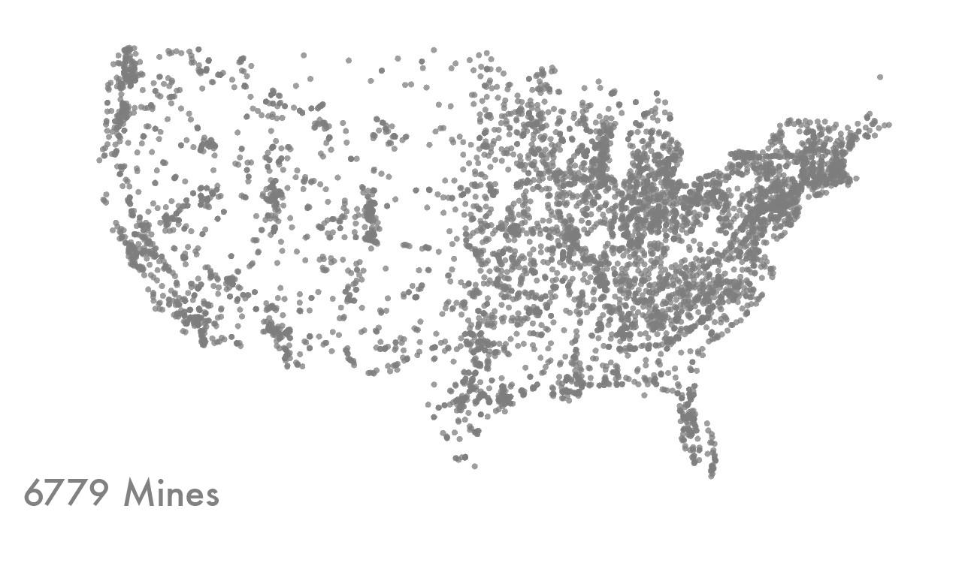

Slide 4
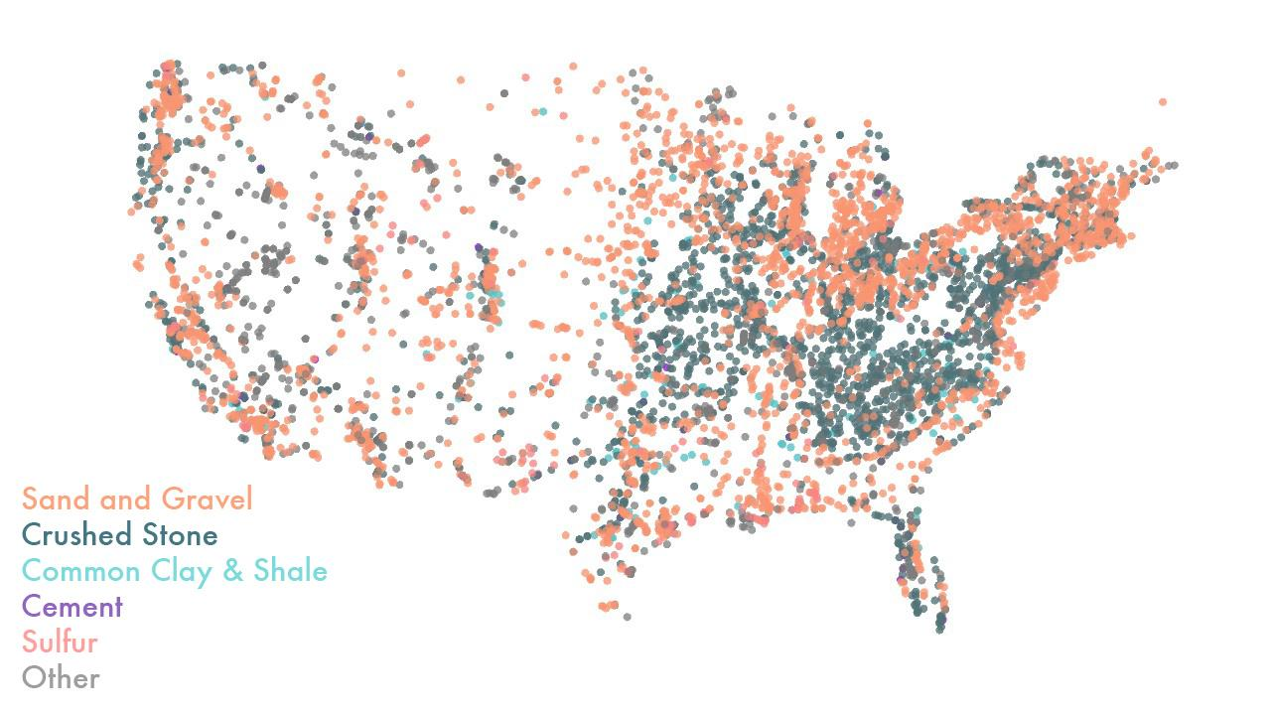

Slide 5
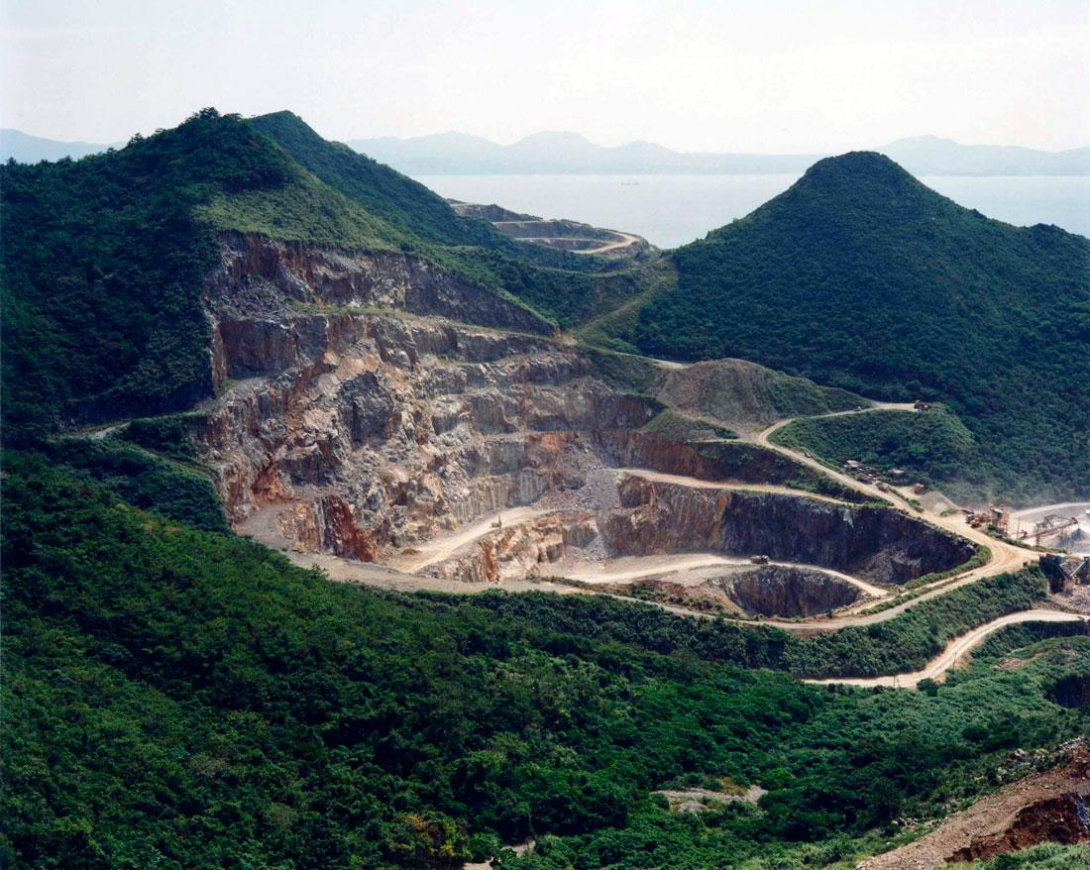

Slide 6
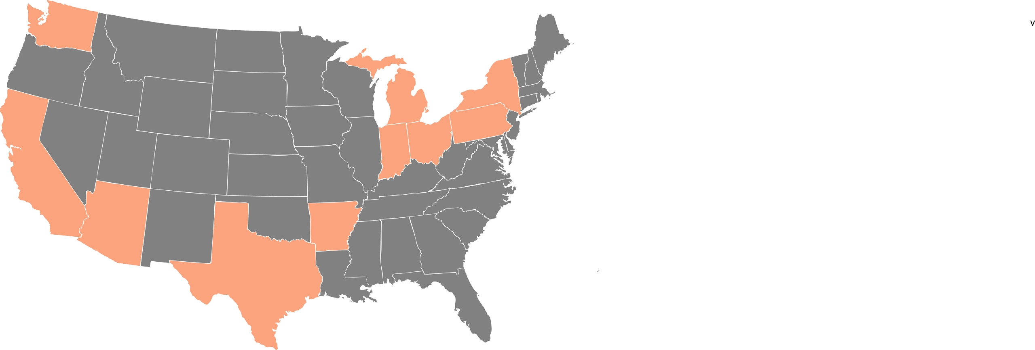

Slide 7


Slide 8
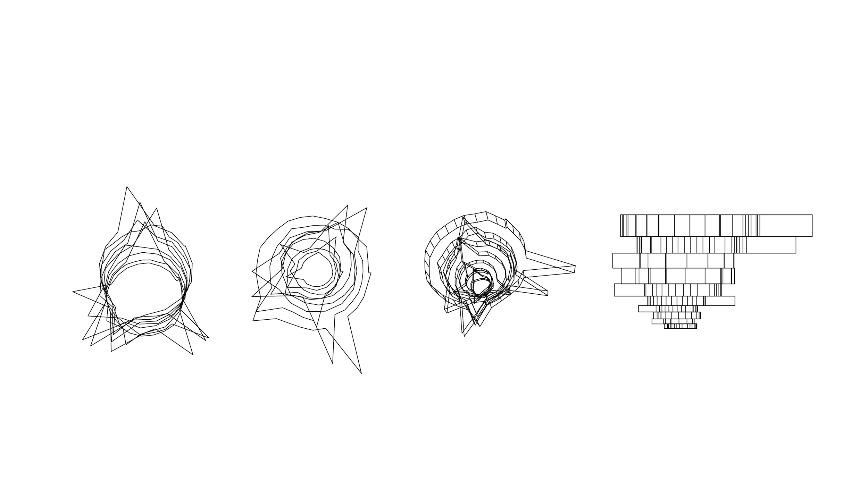

Slide 9
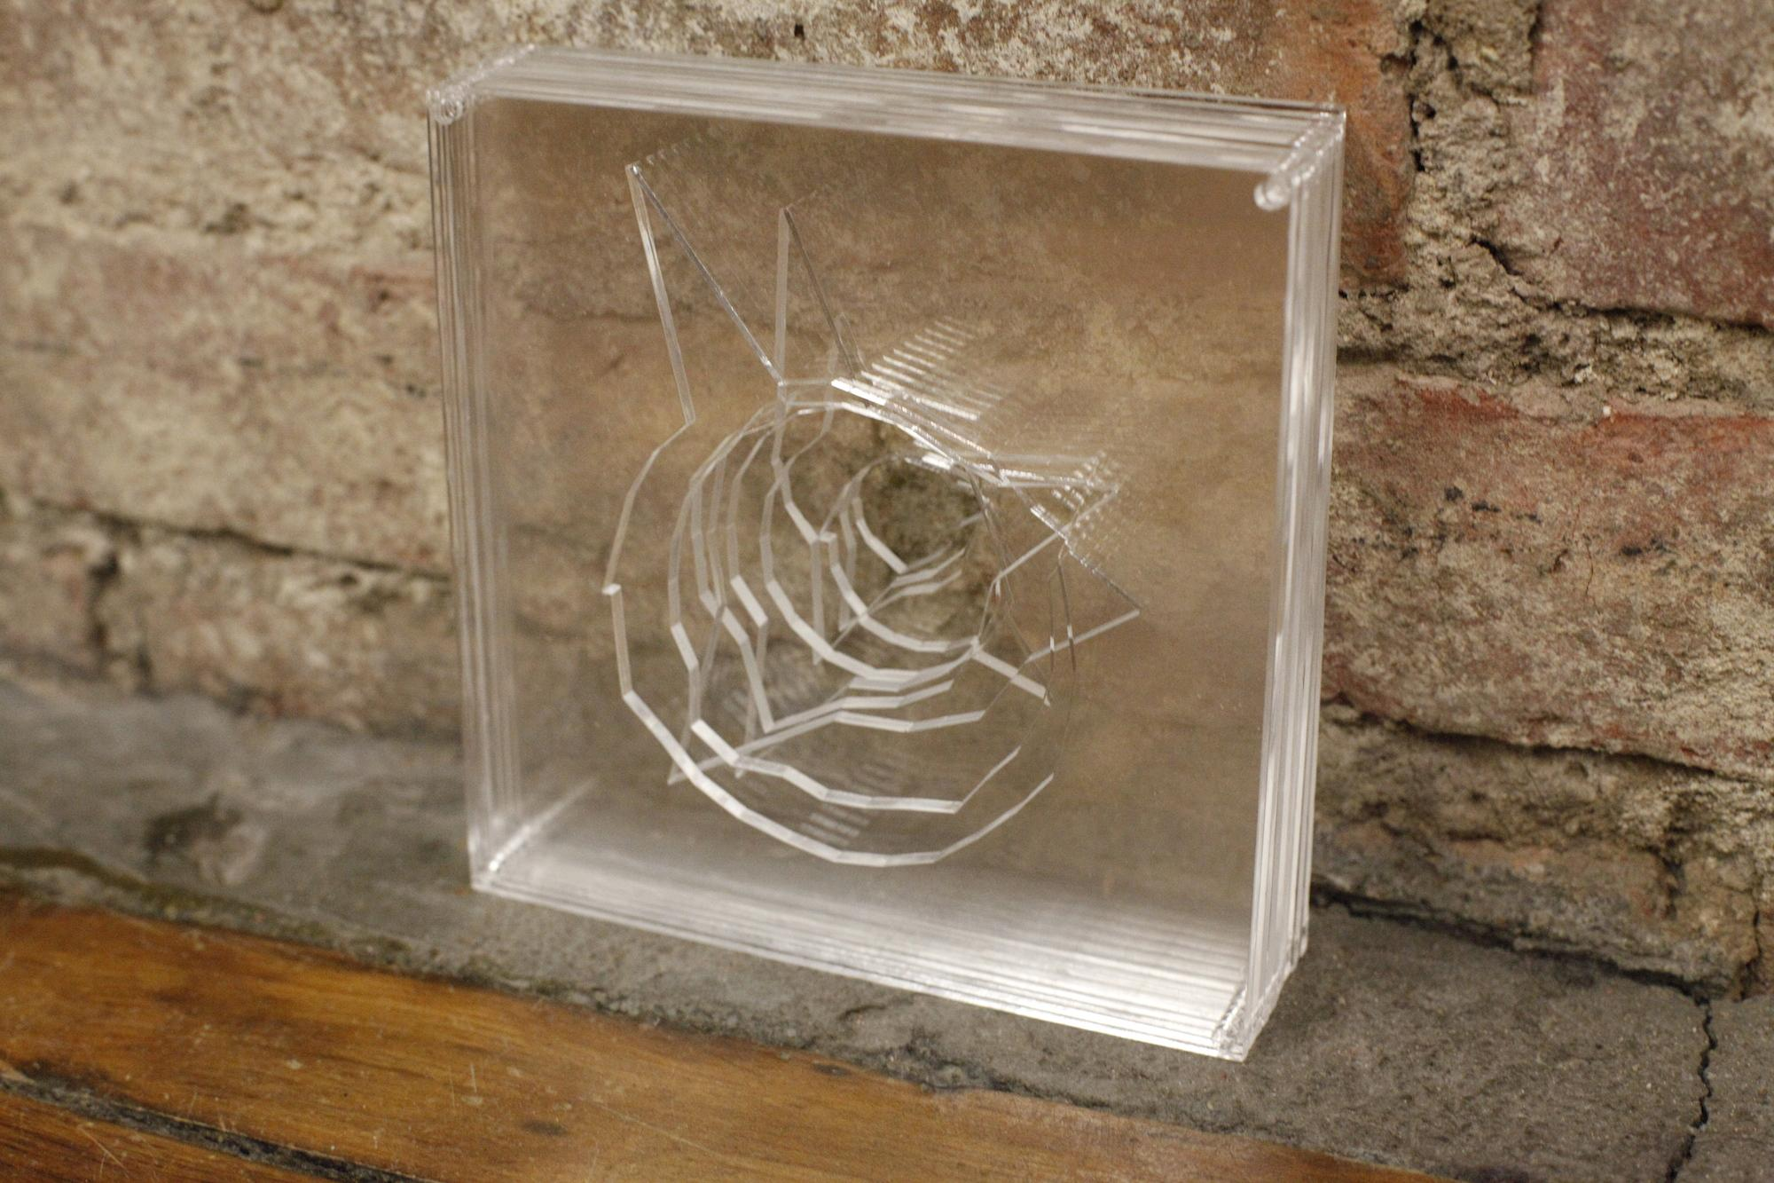

Slide 10


Slide 11
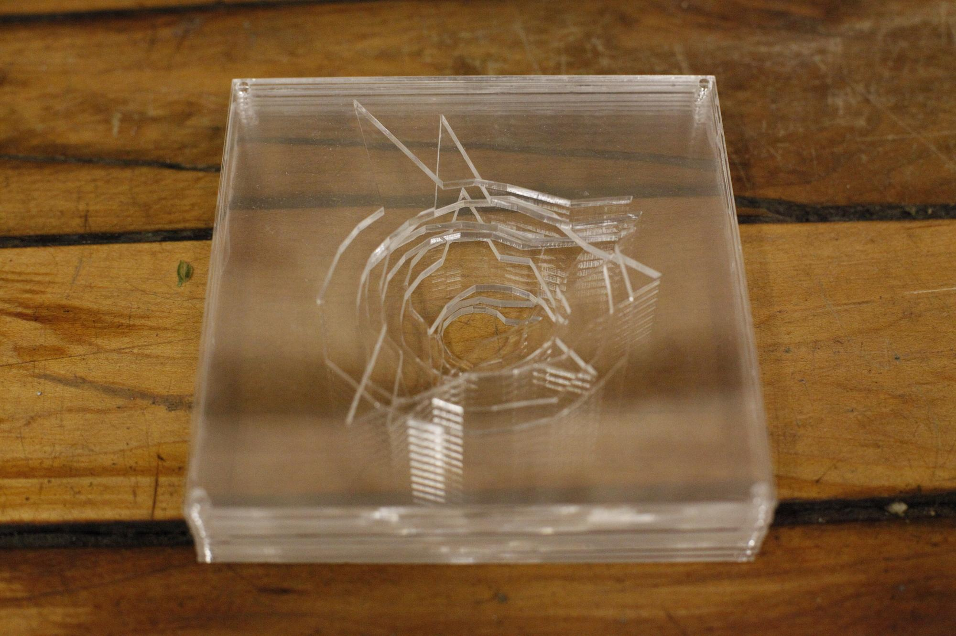

Slide 12
