Slide 1

Convolutional Neural Networks...
Government Polytechnic, Aurangabad
Seminar By:-
Sagar S. Waghmare (156213)
Guided by:-
P. S. Sadafule
(Lecturer in Comp.Engg.)

Slide 2
Contents...
Introduction
History
Layers In CNN
-Convolutional layers
-Subsampling or Max pooling
-Flattening
-Full connected layer (classification)
Features
Application
Applying CNN to real world problem
Advantages \ Disadvantages
Conclusion

Slide 3
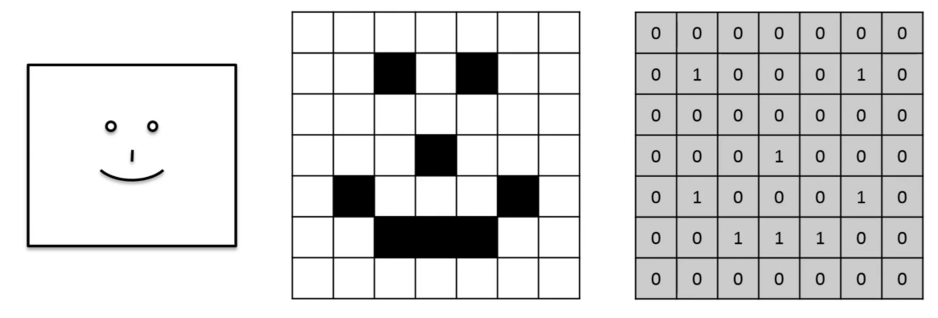
Convolution:-

Slide 4
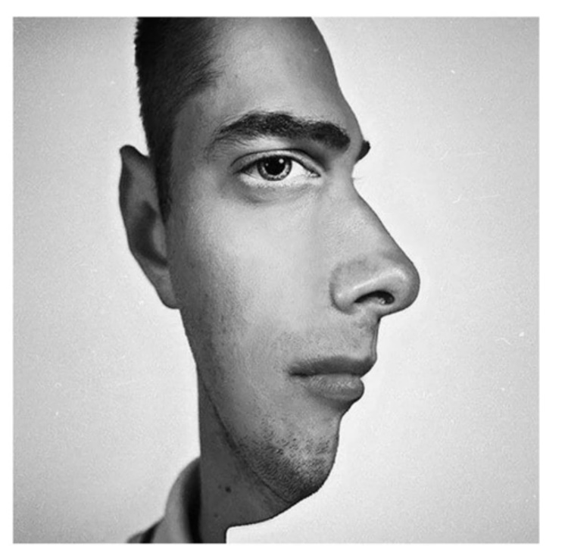
Conv. Neural Network
Feed-forward ANN.
Conv. Nets are inspired
by biological processes
in visual cortex.
It is used in image recognition and handwritten recognition.

Slide 5
Layers In CNN:-
Convolutional layers
Feature Map or filter
Subsampling or Pooling
Flattening
Full connected layer (classification)

Slide 6
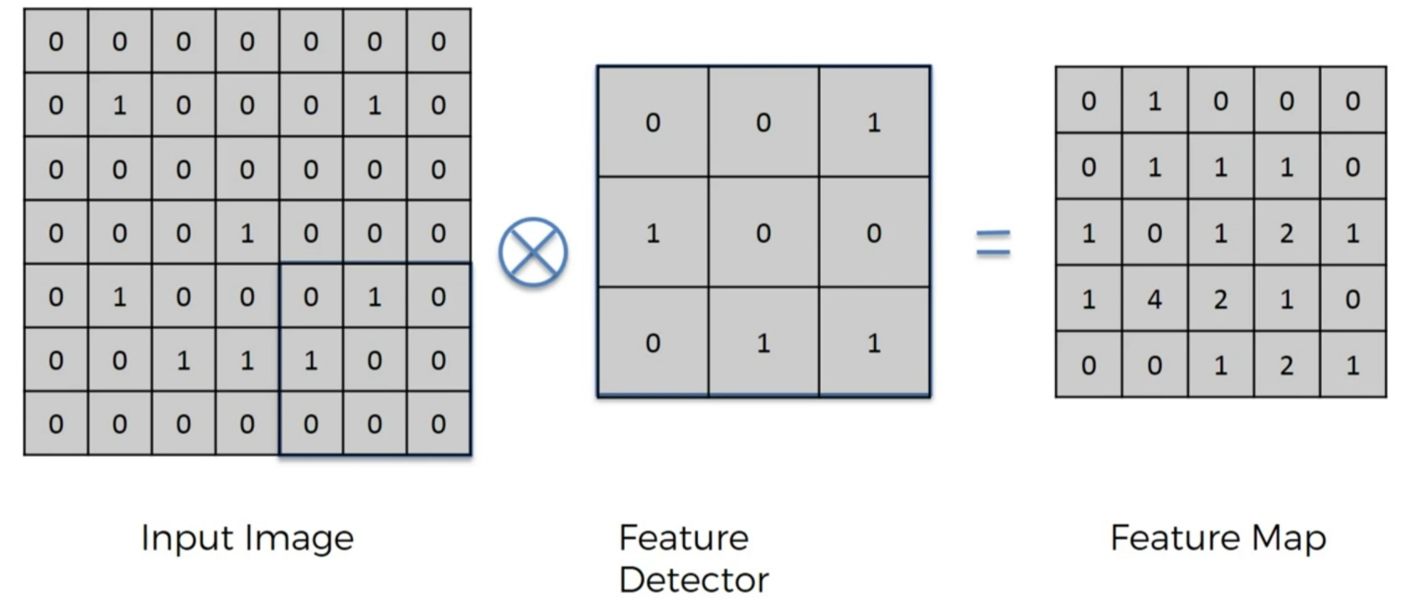
Convolutional layer:-

Slide 7
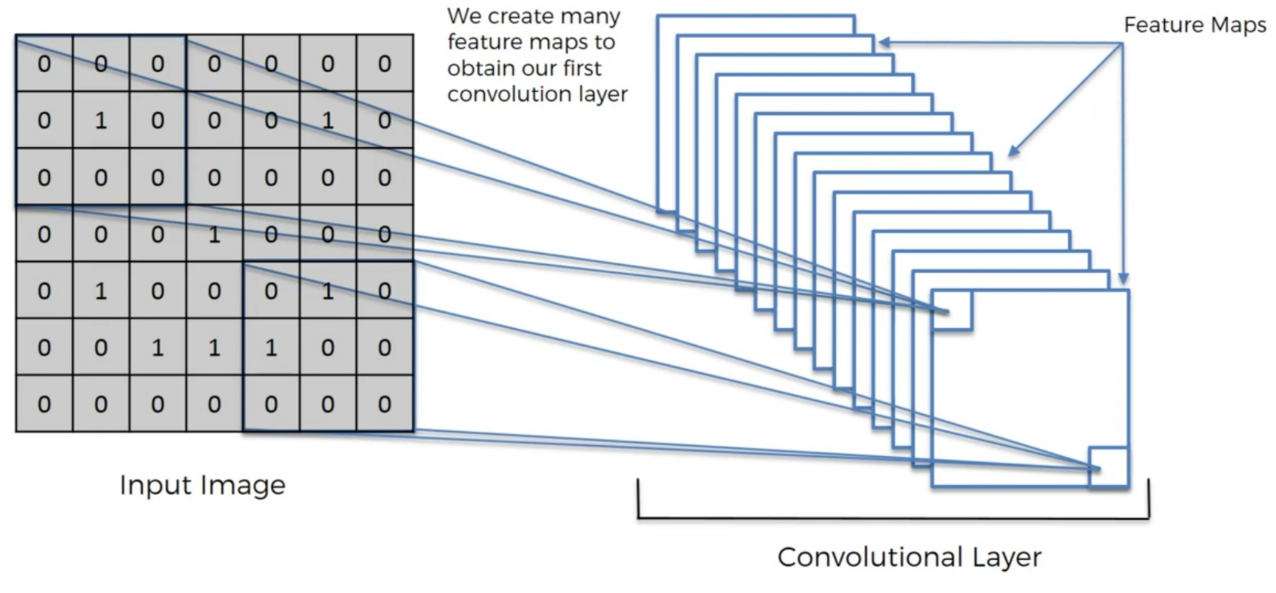
Convolutional layer:-

Slide 8
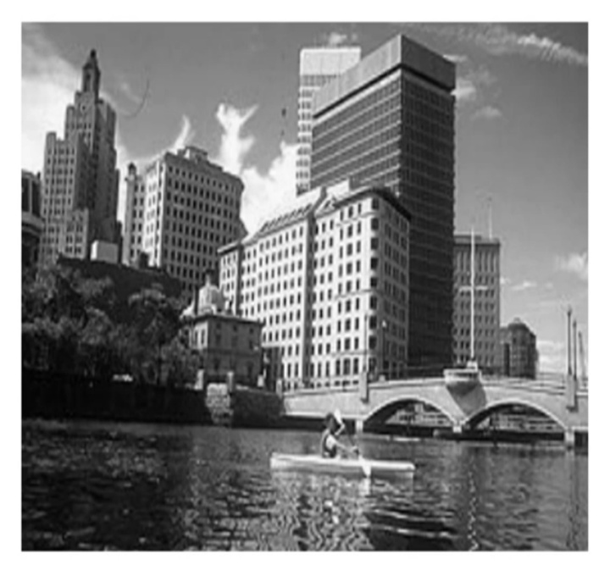
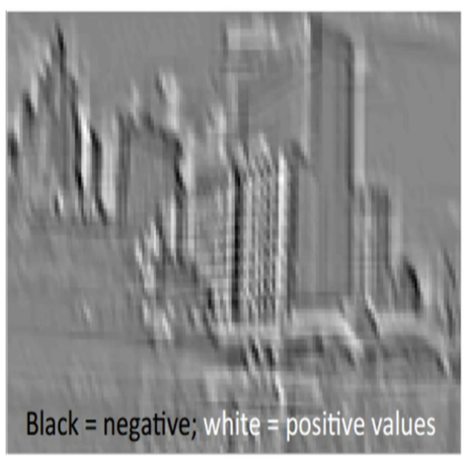
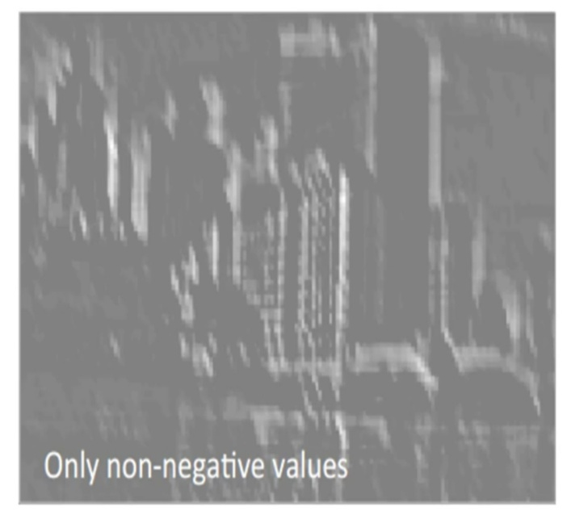
ReLU layer:-
Original image
Linear image
Non linear image

Slide 9
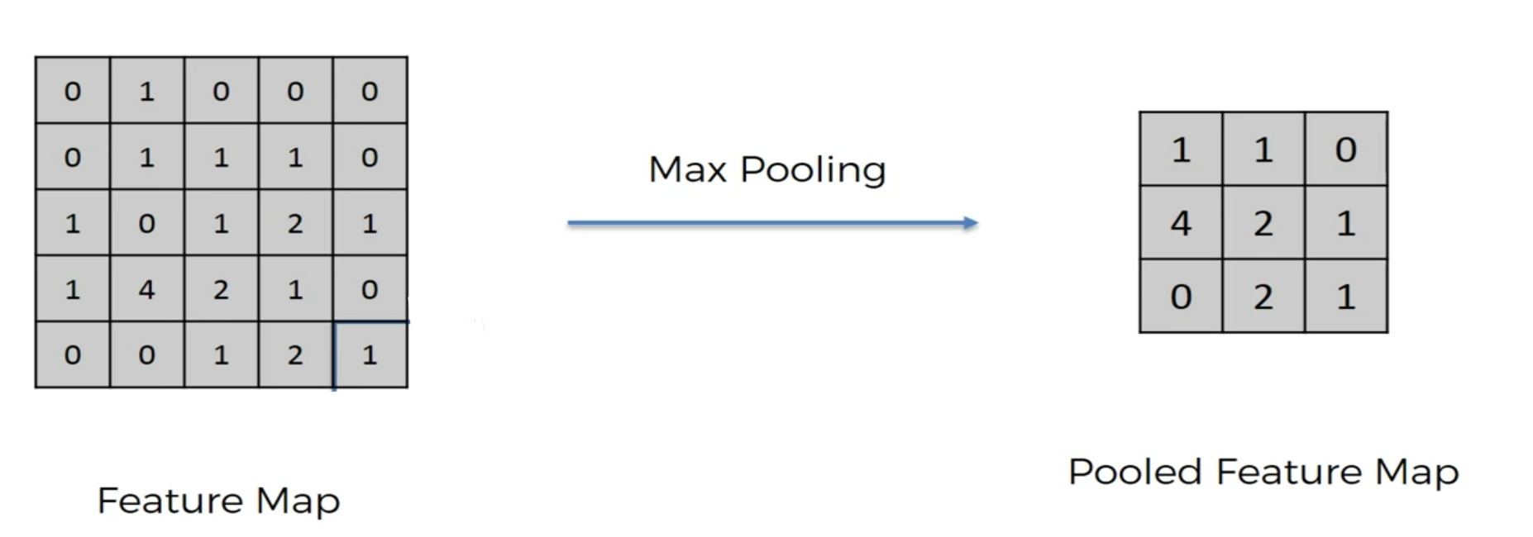
Max pooling layer:-

Slide 10
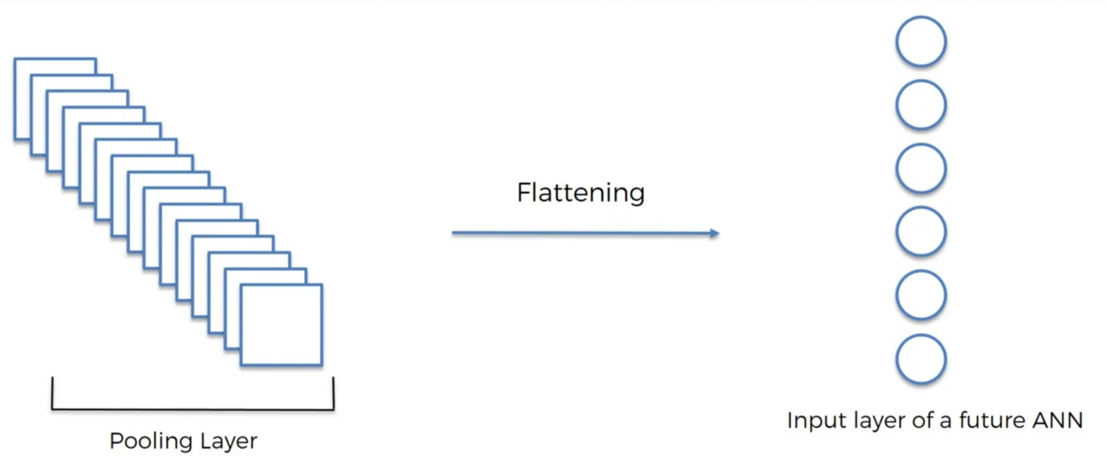
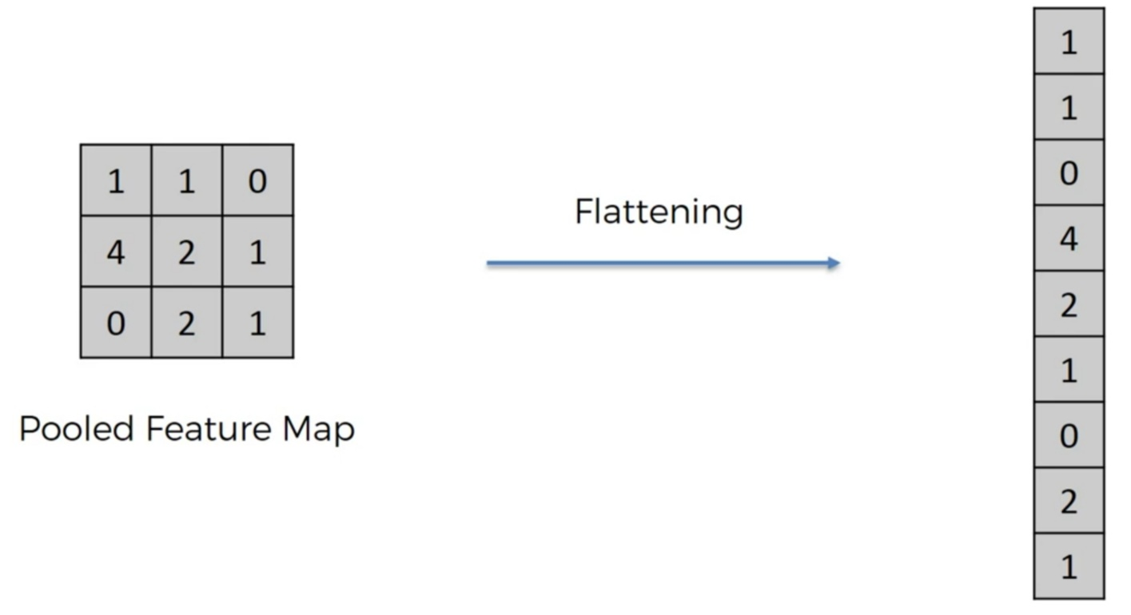
Flattening:-

Slide 11
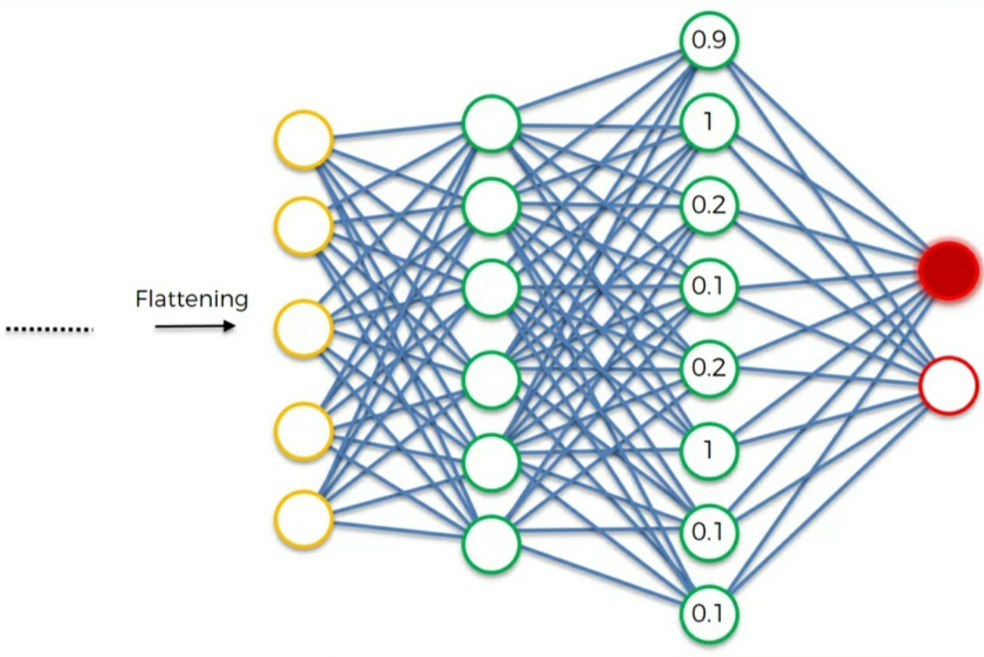
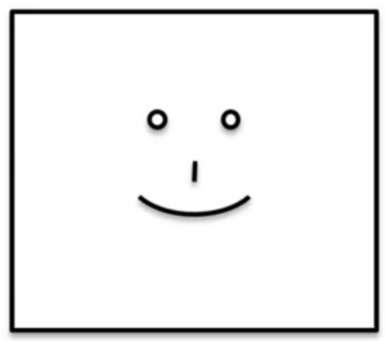
Full-connected layer:-
Happy-0.94%
Sad-0.06%

Slide 12
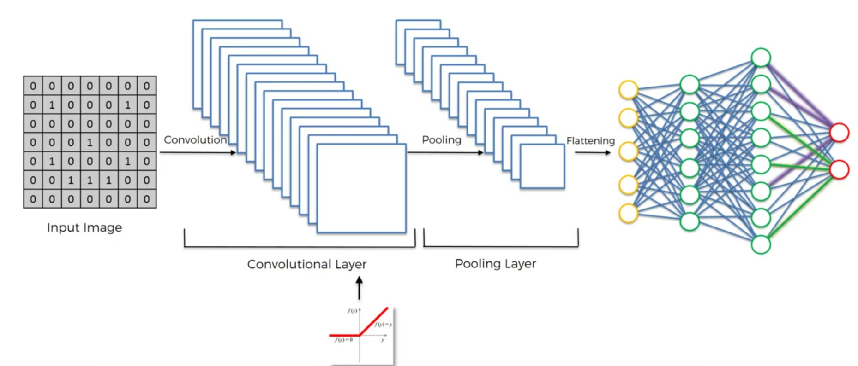
Summary:-

Slide 13
Features:-
A CNN achieves accuracy upto 99.26%.
Consist of 60,000 hand written digits uniformly distributed over 0-9.

Slide 14
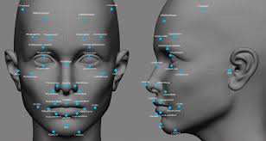
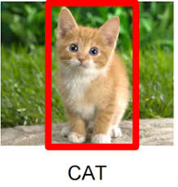
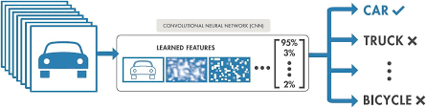
Application:-
Image recognition
Face recognition
Image classification
Self driving cars

Slide 15
Applying CNN to real World problem
Task – detect and characterize cracks and damage in sewer pipe walls.
Task of CNN-
filter raw data
Identify spatial location of cracks
Enable characterization of length, width of damage

Slide 16
Advantage:-
CNN involves less computations.
CNN focuses on limited features only.
We can predict how specific changes in the input will be reflected in the output.

Slide 17
Disadvantage:-
Need a large dataset.
Convolution operation is slightly slower.
CNN completely loss internal data of object.
Checks for component only on basis of stored features.

Slide 18
Conclusion:-
Comparative study with other traditional methods suggest that CNN gives better accuracy and boosts the performance of the system due to unique features like shared weights.
CNN is better than other algorithm for applications pertaining to computer vision and natural language processing because it mitigates most of the traditional problems.

Slide 19
Reference:-
https://deeplearning4j.org
https://www.researchgate.net
https://www.coursera.org
https://towardsdatascience.com
http://scs.ryerson.ca/~aharley/vis/conv/flat.html

Slide 20



