Slide 1
EMAIL TEMPLATE Project – 70 [ Team- 4]
Project Members:
Sagar Nagarale
Sanjana Patil
Vivek Verma
Swapnil Joshi
Vrushabh Rode
Project Mentor: Sreenath sir
Date: 11/10/2021

Slide 2
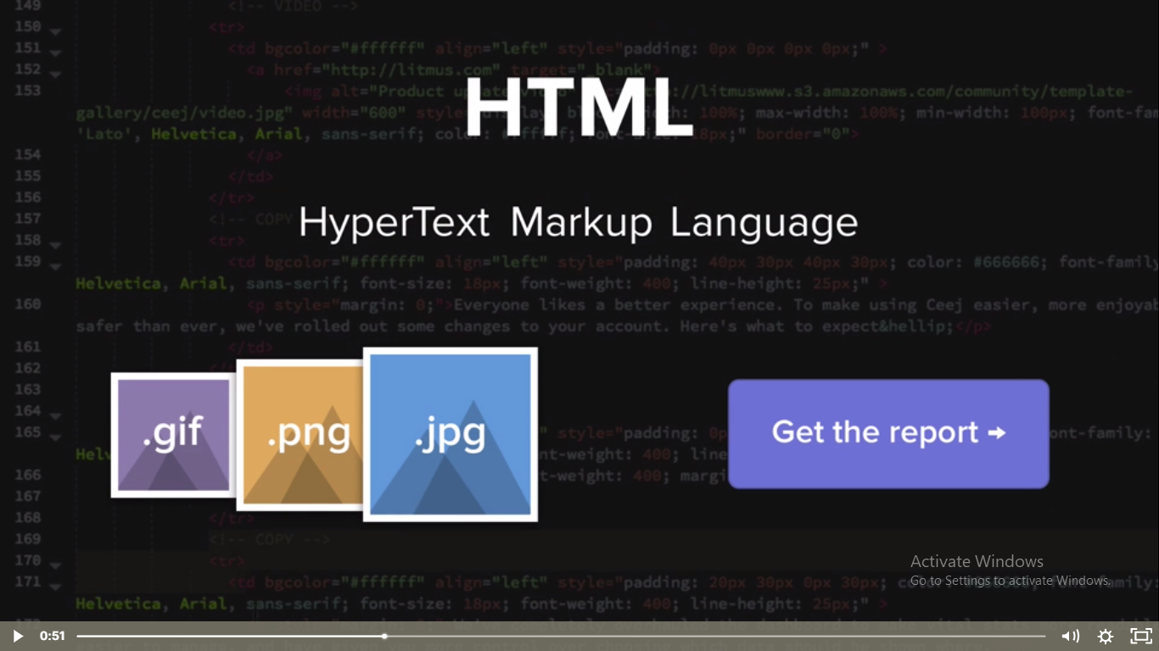
DEFINING A TEMPLATE
An email template is an HTML file composed of reusable code modules, making it as easy as copying and pasting your copy, links, and image URLs to create an email.
BUSINESS OBJECTIVE
To get the nearest email template required by the user based on the key words specified by the user.

Slide 3
WEB SCRAPING DATA
Web scraping of the data from sales intelligence website is done by using Autoscrapper library in python
This website consist lots of information about a collection of 100+ sales email templates and examples that you can use to close more deals.

Slide 4
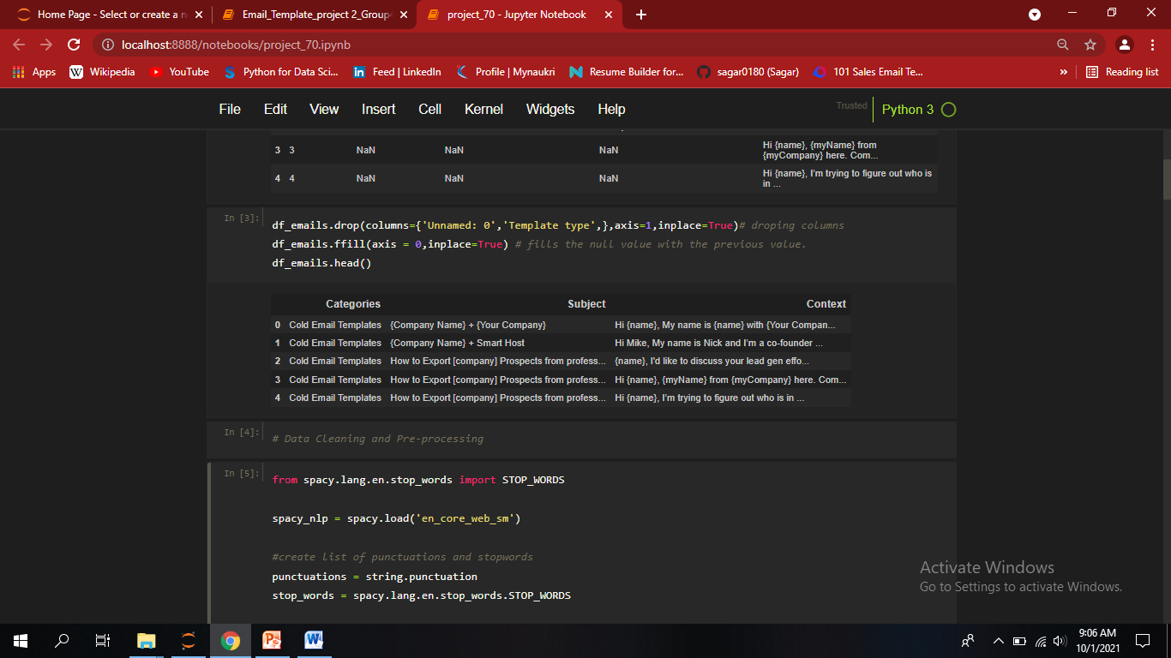
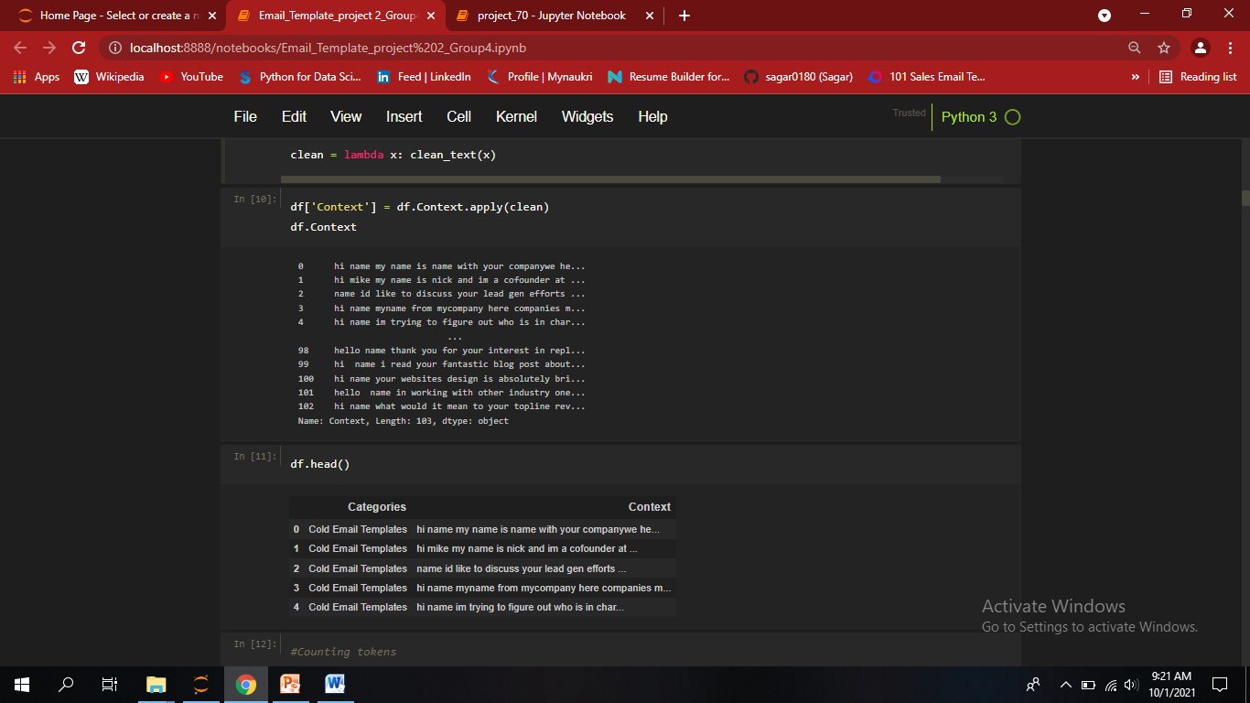
EDA
After dropping some columns and by Using ‘ffill’ method(fills the null value with the previous value.) we get o/p
Data Cleaning and Pre-processing
Make text lowercase, remove punctuation, words containing numbers, stop wards, etc..

Slide 5
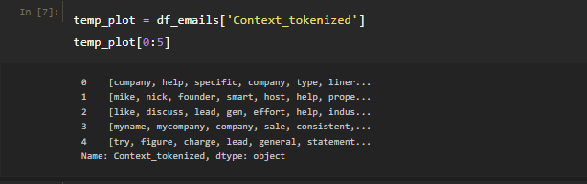
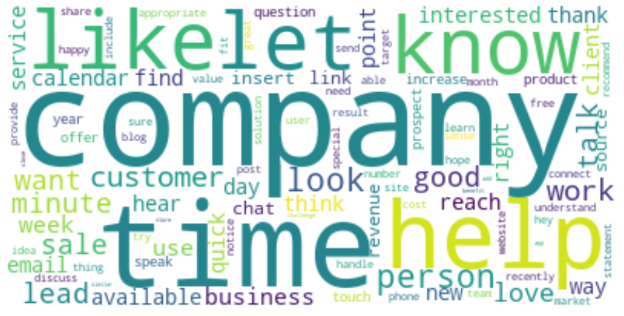
TOKENIZATION
Tokenization is a way of separating a piece of text into smaller units called tokens. Here, tokens can be either words, characters, or sub words.
Hence, tokenization can be broadly classified into 3 types –
word,
character, and
sub word (n-gram characters) tokenization
LEMATIZATION
TF-IDF
Some words might not be stop words but may occur more often in the documents and may be of less importance. Hence these words need to be removed or down-weighted in importance. The TFIDF model takes the text that share a common language and ensures that most common words across the entire corpus don’t show as keywords.

Slide 6
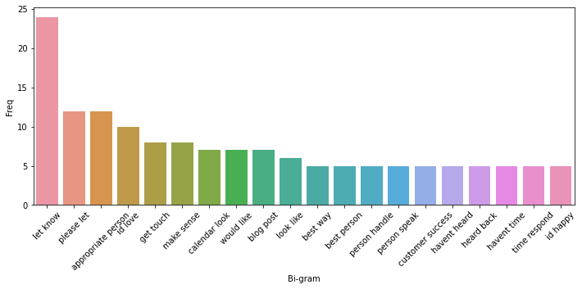
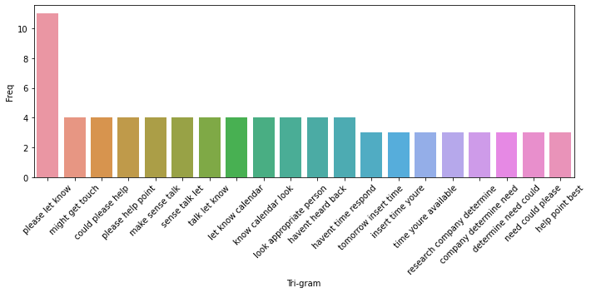
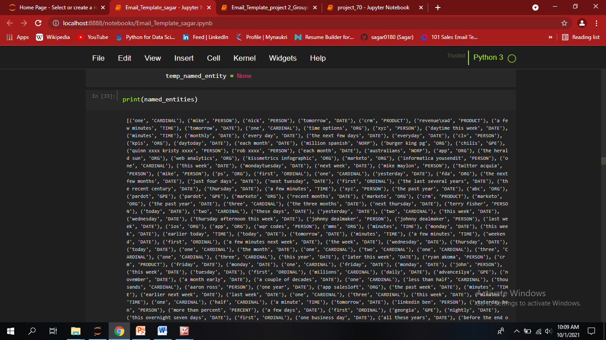
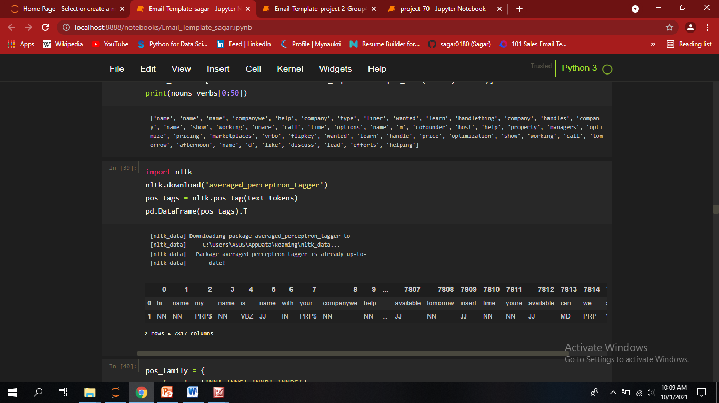
N-gram Analysis
BIGRAM VISUALIZATION
TRIGRAM VISUALIZATION
NAMED ENTITY RECOGNITION
PARTS OF SPEECH TAGGING

Slide 7
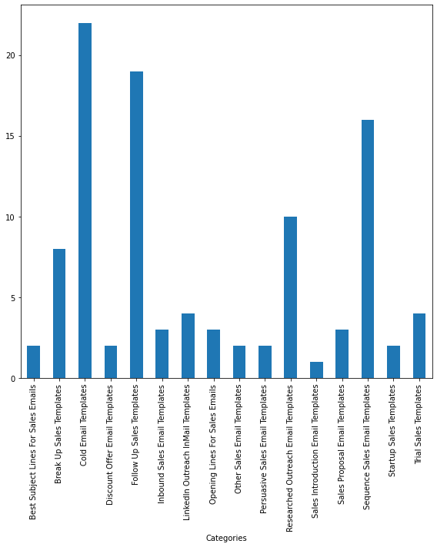
VISUALIZATION OF NUMBER OF MAILS FOR EACH TEMPLATE

Slide 8
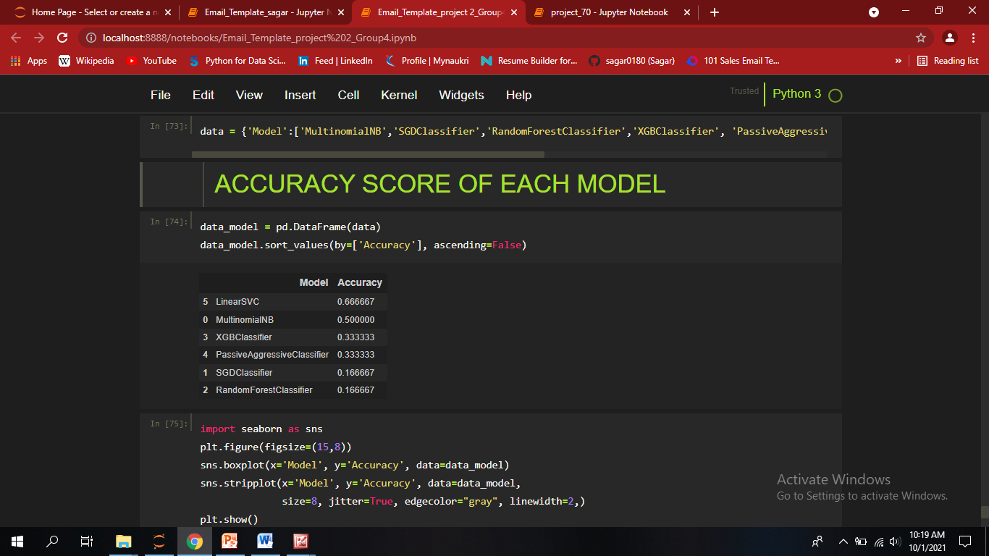
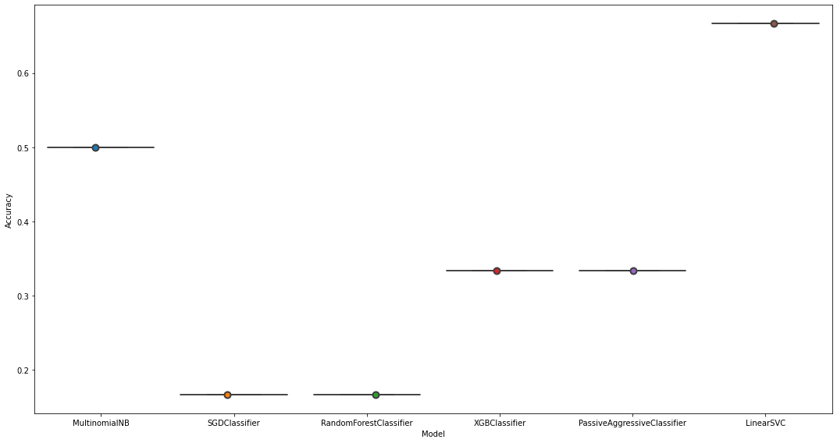
ACCURACY SCORE OF EACH MODEL

Slide 9
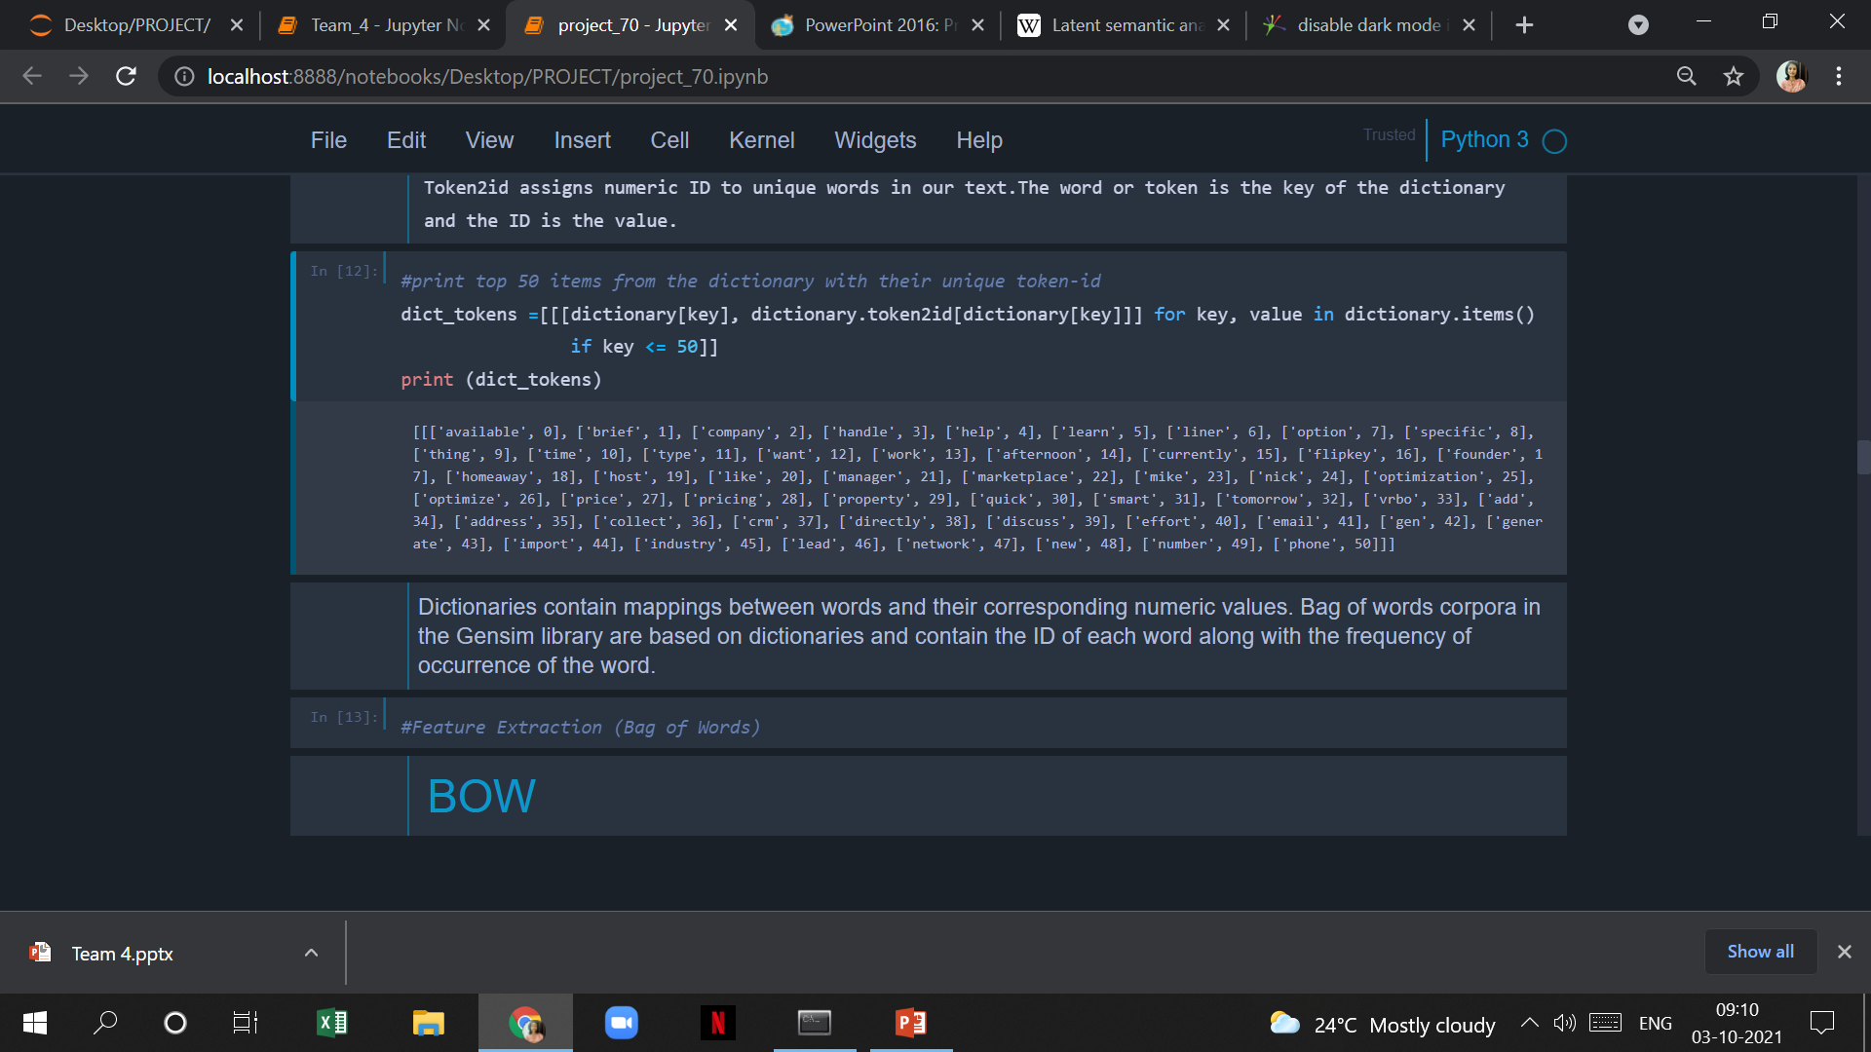
IMPLEMENTATION STEPS OF LSI MODEL
Creating a dictionary
A dictionary is created by the list of words present in our text(also known as tokens). Token2id assigns numeric ID to unique words in our text. The word or token is the key of the dictionary and the ID is the value.

Slide 10
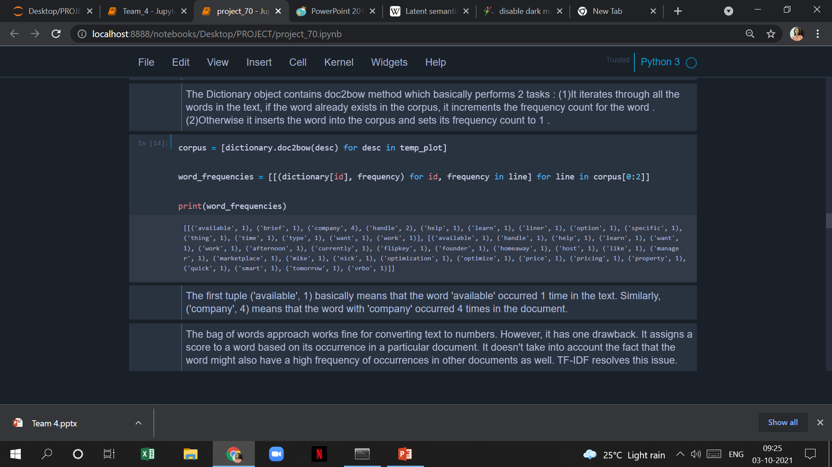
IMPLEMENTING BOW
Bag of Word corpus can be created using the doc2bow( ) function. This function counts the number of occurrences of each distinct word & converts the word to its integer word id.

Slide 11
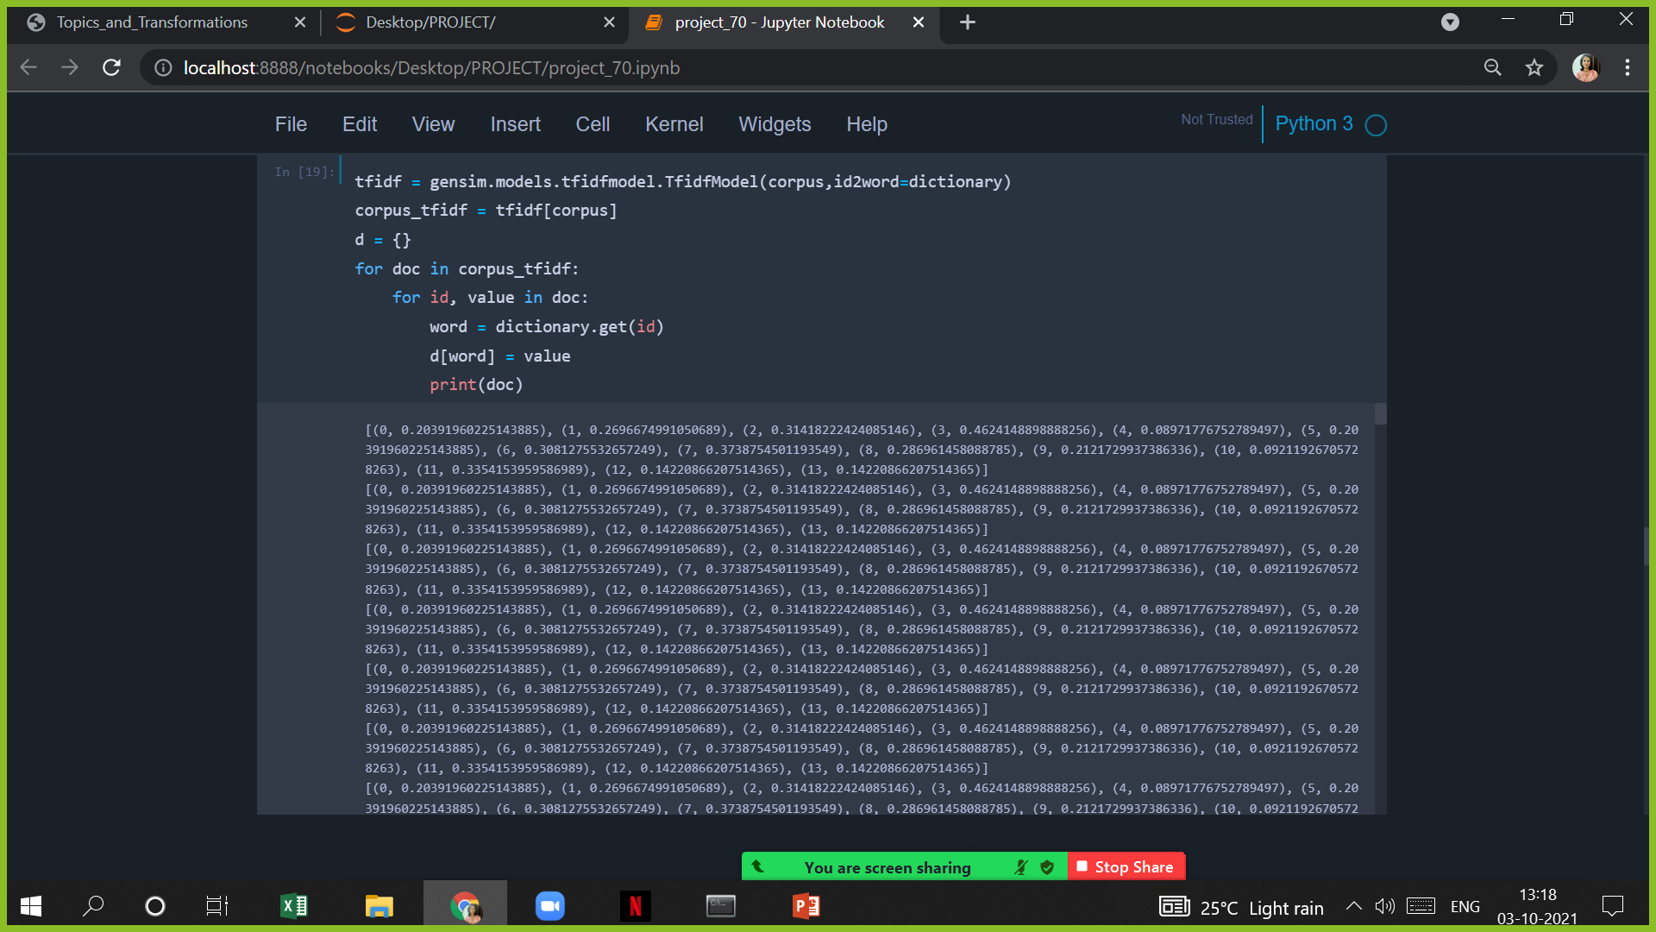
IMPLEMENTING TF-IDF
It gives the TF-IDF scores for all the words present in our corpus .

Slide 12
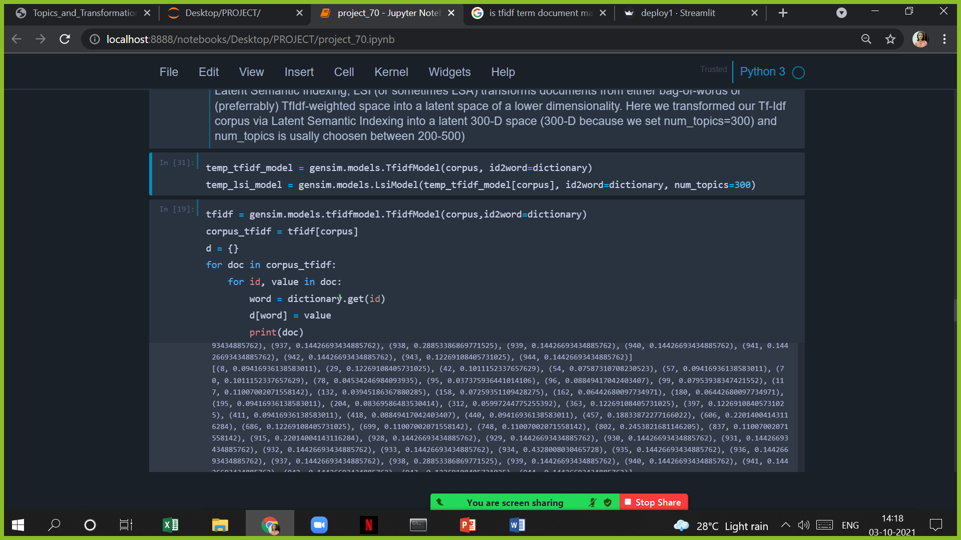
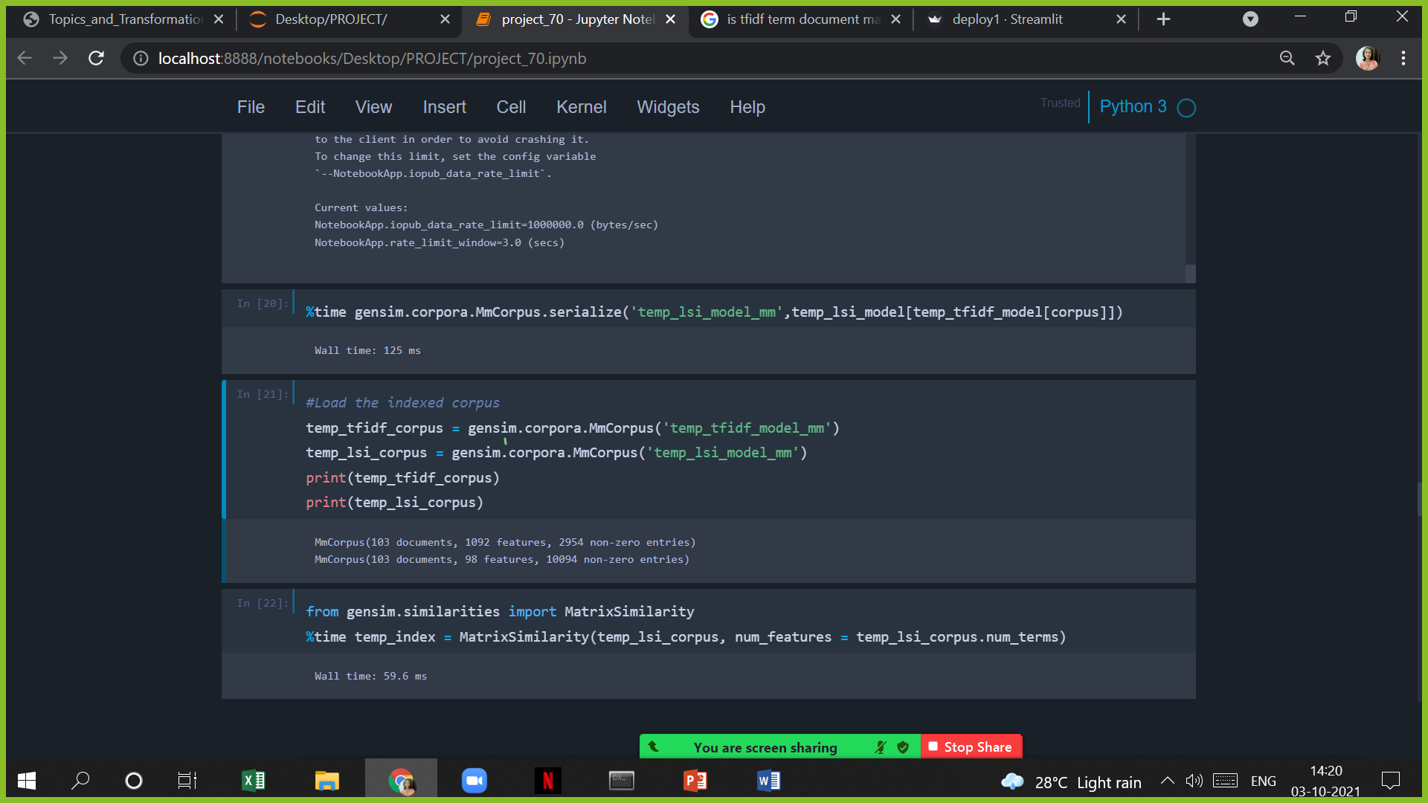
BUILDING LSI MODEL
We transformed our TF-IDF corpus via Latent Semantic Indexing into a latent 300-D space .LSI model builds a Term- Document matrix where rows indicate words and columns represent documents.

Slide 13
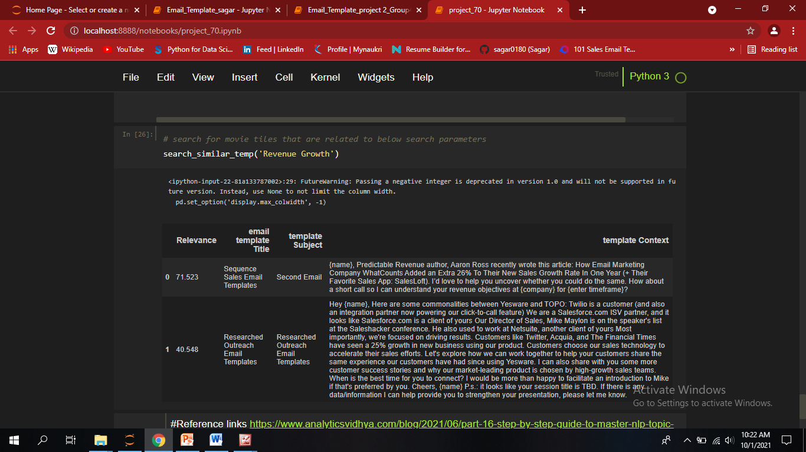
OUTPUT OF LSI
LSI Model Shows Two Most Accurate Email Templates For Keyword Revenue Growth.

Slide 14
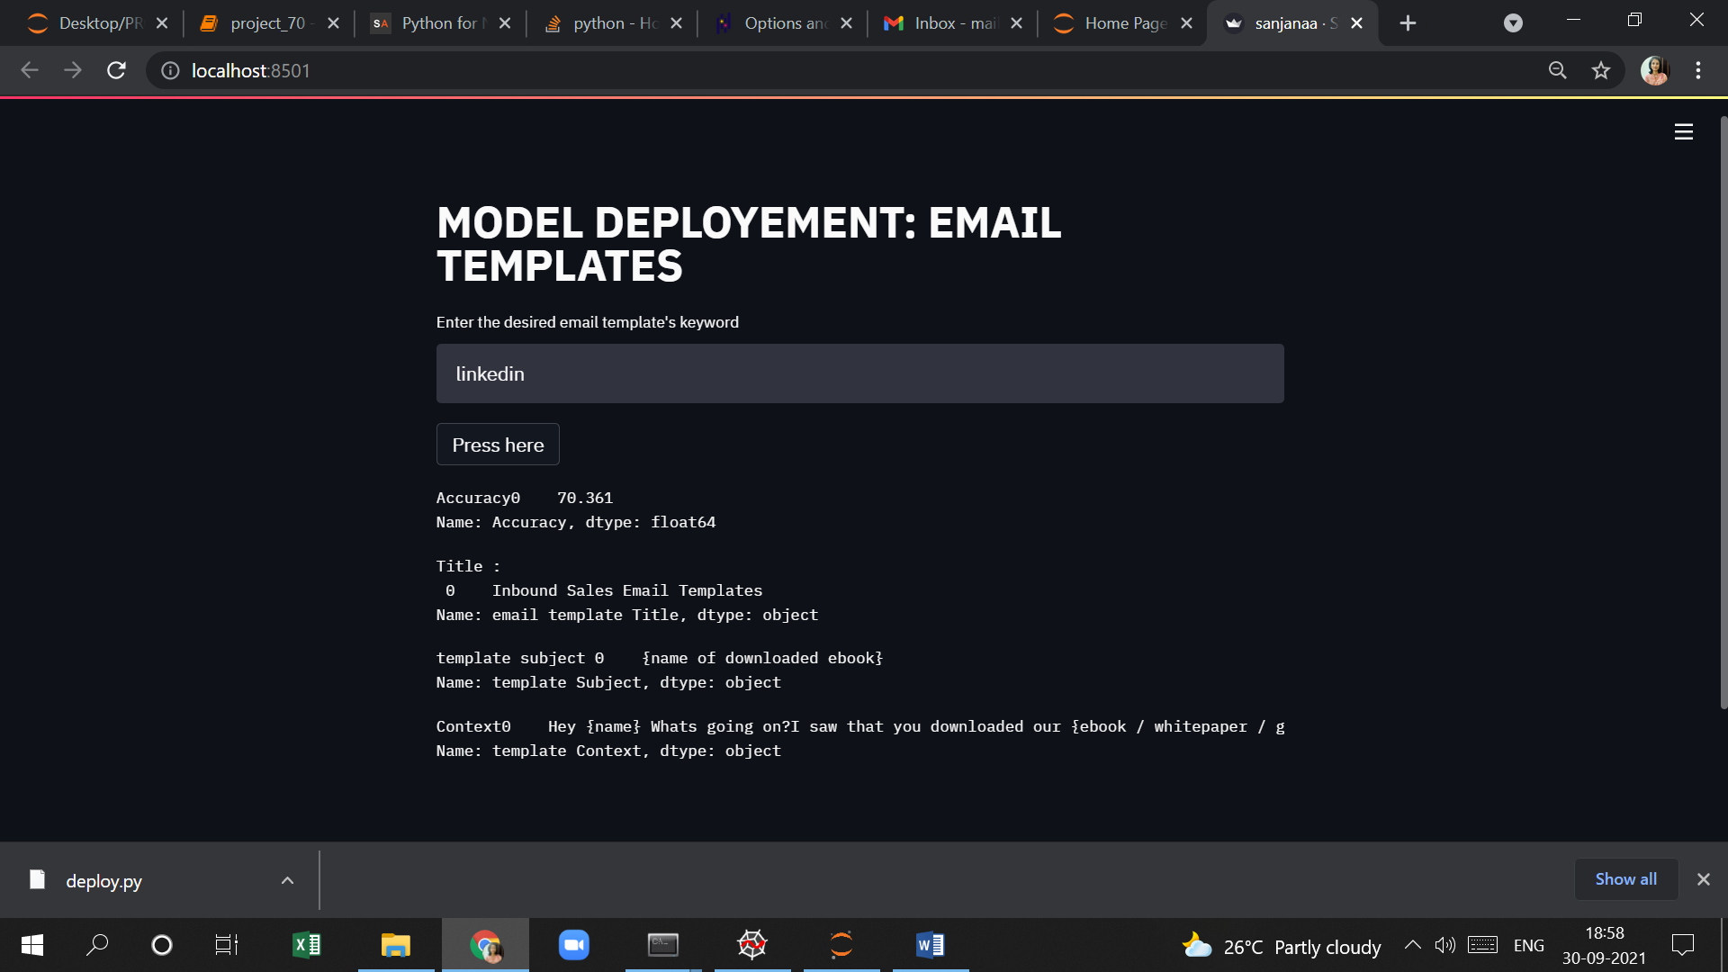
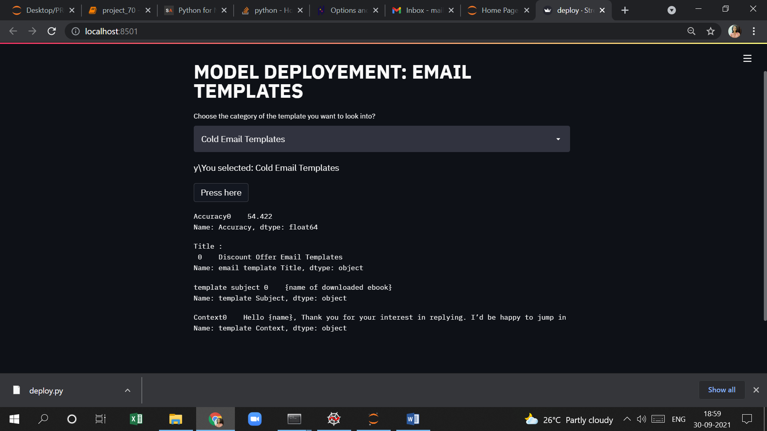
DEPLOYMENT
Deployment using Keyword Search option
Deployment Using Drop down Option

