Slide 1
Final Project-GBH
Aravind J Stalin Babu Lakshmi Tharuni Sivakumar
Sagar Rijhwani Aditya Kale
Aditya Kale

Slide 2
Table of Contents:
01
02
03
US HealthCare vs Other Countries HealthCare
Impact Of Internet Usage On Health outcomes
Conclusion
Notes:
Key Notes:
Table of Contents has been listed to provide an overview of the document's contents and organization.
1. Status Report
Status Reports gives an idea of the overall project report as of September 5th, 2022
2. Current Scenario
Carla Hurricane has made landfall on the Carolina coast on Sep 5, 2022.
The team’s action plan to the situation is presented
3. Risk Assessment
Potential risks are identified and Risk Response matrix is put together
4. Impacts
Impacts due to hurricane are listed and changes in the work schedule is made
5. Schedule & Financial Plan
Updated the cost & Schedule estimation and Gantt chart according to the action plan
6. EV Analysis
Performed Earned Value Analysis to measure the progress of the project

Slide 3
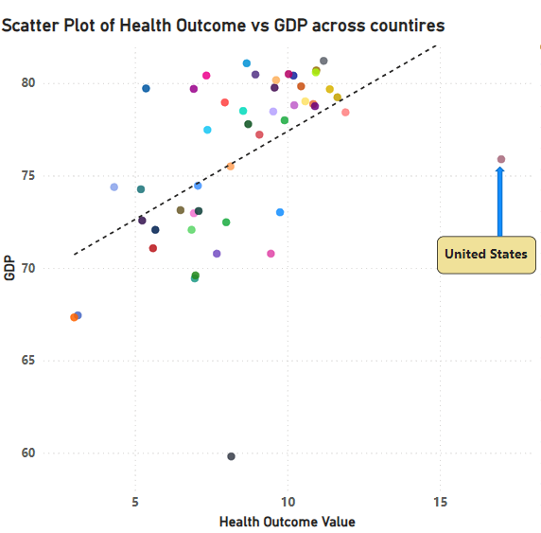
US Healthcare system vs Other Countries Healthcare system
(Considering Life expectancy of Males at Birth)

Slide 4
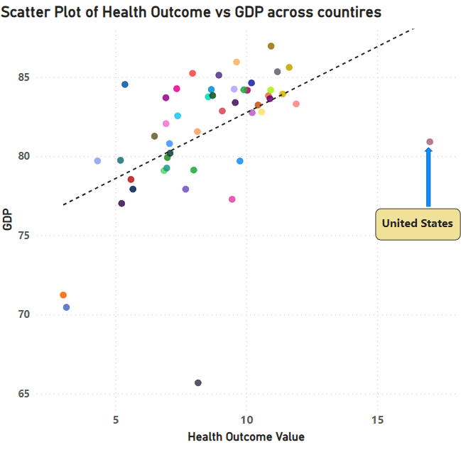
US Healthcare system vs Other Countries Healthcare system
(Considering Life expectancy of Females at Birth)

Slide 5
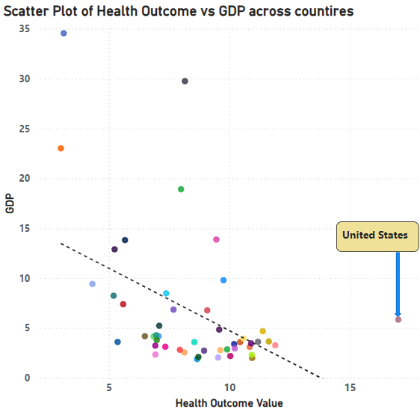
US Healthcare system vs Other Countries Healthcare system
(Considering Infant Mortality)
Visually, the United States is an outlier from other countries. With its GDP, it should ideally have better outcome values for all three metrics: females at birth, males at birth, and infant mortality rate

Slide 6
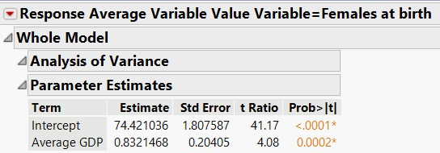
How USA is different from other countries?
(Considering Life expectancy of Females at birth)
The expected Life expectancy of females at birth in the US is approximately 88.57
The actual life expectancy of females at birth in US from the data, averaged over years, is 80.91
The United States has approximately 9.46% lower life expectancy than expected based on its GDP

Slide 7
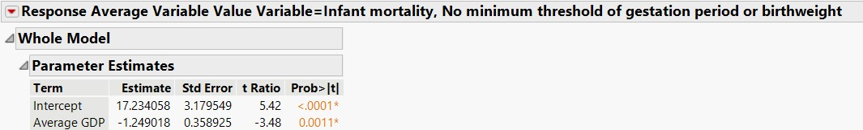
How USA is different from other countries?
(Considering Infant Mortality Rate)
The expected infant mortality rate in the US is calculated to be approximately -4.016. This seemingly negative value suggests that ideally, the US should not just have zero but negative deaths, which is not practically possible.
The actual infant mortality rate in the US from the data is 5.85 averaged over years
The US has 5.85% higher infant mortality than the expected number of 0

Slide 8
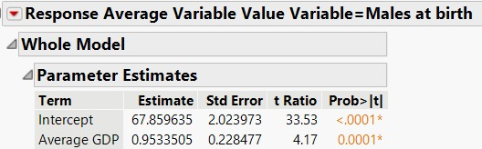
How USA is different from other countries?
(Considering Life expectancy of Males at Birth)
The expected life expectancy of males at birth in the United States is approximately 84
The actual life expectancy of males at birth in US from the data, averaged over years, is 75.88
The US has approximately 10.70% lower life expectancy than expected based on its GDP.

Slide 9
Additional Insights: Health Care Effectiveness Score
The Health Care effectiveness score is a KPI created to compare an outcome across countries. It indicates the efficiency of a country’s healthcare system
Health Care effectiveness score = Normalized Outcome Value / Normalized GDP
Normalized GDP is calculated by ratio of GDP of a country and Maximum GDP among countries. Normalized Outcome value is calculated by ratio of Outcome value of the country and Maximum Outcome value across countries, for a specific outcome.
For Male and Female expectancy, the score is calculated using above equation. For Infant Mortality, the inverse of the equation is performed.

Slide 10
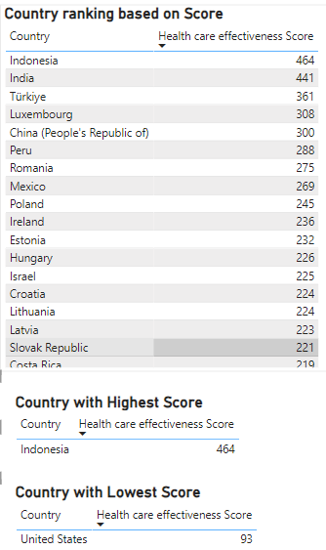
Additional Insights: US HealthCare Vs Other Countries HealthCare
Female life Expectancy
SUMMARY OF SCORES:-
The higher the scores are, better the country is performing, for the outcome.
Maximum score:
Females at birth: Indonesia(464)
Males at birth: Indonesia(469)
Infant mortality rate: Japan(1107)
Minimum score:
Females at birth: USA(93)
Males at birth: USA(93)
Infant mortality rate: India(18)
USA performs least on Life expectancy whereas India performs least on Infant mortality
The rankings are created based on obtained score for different outcomes. The one for Female life expectancy is shown here

Slide 11
Impact Of Internet Usage On Health Outcomes

Slide 12
Survey Data Description
Data Types and Missing Values
The dataset has 6252 entries and data cleaning has been performed on all the columns relevant to our analysis.
Data types for our columns of interest are categorical, which is expected for survey data.
Selected Columns for Analysis:
InternetConnection, ConfidentInternetHealth, Electronic2_HealthInfo, Electronic2_MessageDoc: These variables measure different aspects of internet usage related to health.
ReceiveTelehealthCare, Telehealth_GoodCare: Directly related to health outcomes and satisfaction from telehealth services.
CancerConcernedQuality, LifeHasMeaning, ClearSenseDir, DeepFulfillment, Hopeless, Nervous, Worrying, FeelIsolated, LittleInterest : Measure different aspects of perceived health quality and life satisfaction.
AgeGrpA, Education, RACE_CAT2, HHInc: Demographic variables that we'll control for in the analysis.
Descriptive Statistics
Internet Usage: Variables like InternetConnection and Electronic2_HealthInfo indicate high internet connectivity and usage, which is important for our analysis.
Health Outcomes: Variables like Telehealth_GoodCare show varying levels of satisfaction with telehealth, a direct measure of health outcome satisfaction.
Demographics: Wide range in age, education, race, and income, which will help us control for these factors in our analysis.

Slide 13
Analytical Methods Used
In order to examine how internet use affects health outcomes, two different kinds of regression models will be set up:
Multiple Regression Model: Given our emphasis on internet usage, this model will concentrate on a single health outcome, Telehealth_GoodCare, which is a direct measure of satisfaction with telehealth services.
Multiple Outcomes Regression Model: To examine the relationship between internet usage and other aspects of health and wellbeing, we will integrate a number of health outcome variables (CancerConcernedQuality, Nervous, Hopeless, LifeHasMeaning, ClearSenseDir, and DeepFulfillment) into a more comprehensive model.

Slide 14
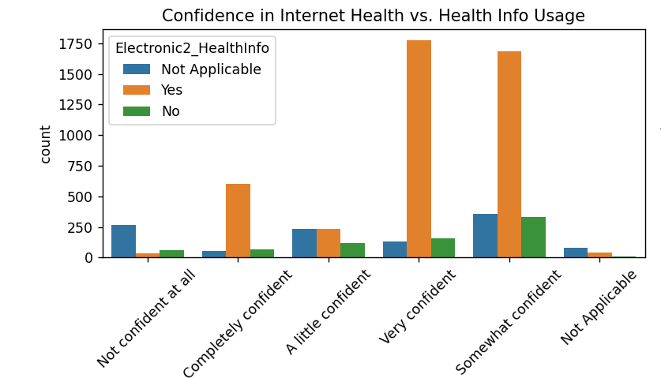
The plot illustrates how confidence in using the internet for health-related information varies with actual usage.
Higher confidence generally correlates with more frequent usage of health information online.

Slide 15
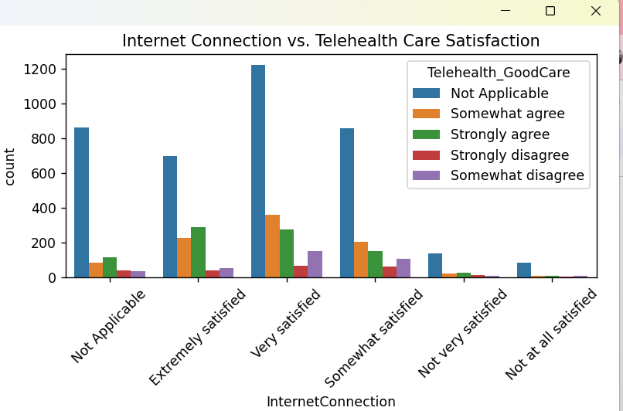
Telehealth Care Satisfaction
The plot shows the relationship between satisfaction with internet connection and satisfaction with telehealth care.
A very satisfied internet connection seems to correlate with higher satisfaction levels in telehealth care, which may indicate a dependency on quality internet for satisfactory telehealth services.

Slide 16
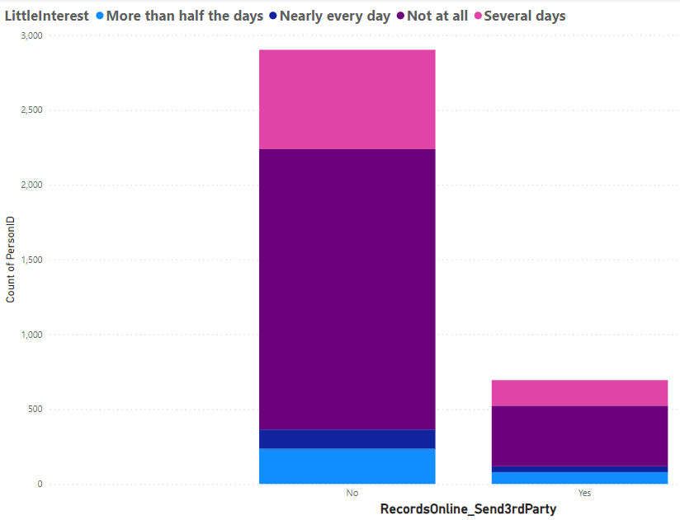
Sharing of Medical Records
A Majority of population are not at all showing little interest if they are found to be not sharing medical records through portal to third parties.
This shows that not sharing medical info. to third parties improves mental health and makes people interested

Slide 17
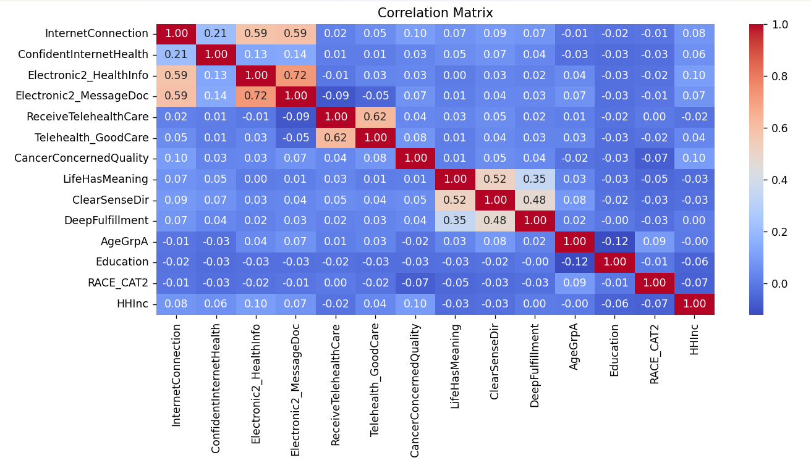
Correlation Matrix
The heatmap provides an overview of how various encoded variables relate to each other.
Significant correlations might indicate relationships worth exploring further through regression analysis.

Slide 18
Logistic Regression : Telehealth_GoodCare
Variables related to internet use and telehealth services show some degree of correlation, suggesting a potential link between how people use the internet for health and their satisfaction with health outcomes .
Therefore we perform Multiple Outcome Regression Model analyses to see how internet usage relates to satisfaction with telehealth services, after controlling for demographics:
Internet Connection: Has a coefficient of -0.0355, significant at the 5% level. This suggests that higher satisfaction with internet connection slightly decreases the odds of being more satisfied with telehealth care.
Confident Internet Health: Not statistically significant, indicating that confidence in using the internet for health information does not significantly affect telehealth satisfaction in this model.
Electronic2_HealthInfo and Electronic2_MessageDoc: Also do not show significant impact, though there's a hint that messaging doctors might slightly increase satisfaction (p-value close to significance).
Receive Telehealth Care: Strong positive coefficient of 0.6432, very significant. This indicates that having telehealth visits strongly increases the satisfaction compared to not having such visits.
Demographics (Age, Education, Race, Income): Mostly non-significant, suggesting that the impact of internet usage on telehealth satisfaction is somewhat consistent across different demographic groups.

Slide 19
Logistic Regression : LifeHasMeaning
Here are the coefficients from the logistic regression model where we dichotomized "LifeHasMeaning" into high and lower categories:
InternetConnection: Coefficient of -0.0467 suggests that higher satisfaction with internet connection slightly reduces the likelihood of reporting high life meaning.
ConfidentInternetHealth: Coefficient of -0.0191 also indicates a minor negative association with reporting high life meaning.
Electronic2_HealthInfo: Coefficient of -0.0925 shows a more pronounced negative effect, suggesting that using the internet for health information is negatively associated with high life meaning.
Electronic2_MessageDoc: Coefficient of -0.0346, similar to other internet use variables, showing a negative association.
AgeGrpA: Coefficient of 0.0365, suggesting that older age groups are slightly more likely to report high life meaning.
Education: Coefficient of -0.0003, indicating nearly no effect from education level on life meaning in this simplified model.
These results suggest a generally negative association between extensive internet use for health-related purposes and perceived life meaning. This could imply that reliance on the internet for health concerns might not translate into a positive subjective well being or satisfaction with life's meaning, possibly reflecting concerns or anxieties about health.

Slide 20
Logistic Regression : Cancer Concerned Quality
This variable provides insights into how concerns about cancer quality are influenced by internet usage, a particularly relevant issue in health communications and public health. Below are the coefficients from the logistic regression model where we categorized "CancerConcernedQuality" into high and lower concern levels:
InternetConnection: Coefficient of -0.0509, indicating a slight negative association with high concern about cancer quality. A better internet connection might reduce anxiety or concerns about cancer quality.
ConfidentInternetHealth: Coefficient of -0.0999, suggesting that greater confidence in using the internet for health information correlates with less concern about cancer quality.
Electronic2_HealthInfo: Coefficient of 0.5975, showing a strong positive association. This implies that individuals who frequently use the internet for health information might be more concerned about cancer quality, possibly due to increased awareness or exposure to information about cancer.
Electronic2_MessageDoc: Coefficient of 0.1785, indicating that messaging doctors online is associated with increased concern about cancer quality, which might reflect more engagement with health issues.
AgeGrpA: Coefficient of 0.0787, suggesting that older age groups tend to be more concerned about cancer quality.
Education: Coefficient of 0.0558, indicating that higher education levels are associated with increased concern about cancer quality, possibly due to greater health literacy.
The results suggest that active internet usage, particularly looking up health information, correlates with increased concern about cancer quality. This might be driven by greater access to and consumption of health-related content, which could heighten awareness and potentially anxiety about health issues like cancer.

Slide 21
Logistic Regression : Deep Fulfillment
This variable reflects a person's sense of fulfillment in life, potentially influenced by their health information behavior online.
Below are the coefficients from the logistic regression model where we categorized "DeepFulfillment" into high and lower fulfillment levels:
Internet Connection: Coefficient of -0.0505, suggesting a slight negative association with high deep fulfillment. This indicates that better internet connection might not necessarily correlate with greater life fulfillment.
Confident Internet Health: Coefficient of 0.0440, showing a slight positive association. Greater confidence in using the internet for health information could slightly increase feelings of deep fulfillment.
Electronic2_HealthInfo: Coefficient of 0.0636, indicating a small positive effect. Engaging with health information online might marginally contribute to feelings of deep fulfillment.
Electronic2_MessageDoc: Coefficient of 0.0264, suggesting a modest positive link between messaging doctors and deep fulfillment, possibly due to better healthcare communication.
AgeGrpA: Coefficient of 0.1920, showing a strong positive association. Older age groups tend to report higher deep fulfillment, which may reflect more contentment or satisfaction with life as age increases.
Education: Coefficient of 0.0104, indicating a very minor effect from higher education levels on deep fulfillment.
These results hint that while the direct impacts of internet usage on deep fulfillment are relatively minor, the role of age is significant, suggesting deeper fulfillment among older adults. The positive associations with internet-based health interactions might reflect benefits from increased access to health information and better communication with healthcare providers.

Slide 22
Logistic Regression : Clear Sense Dir
This variable is another aspect that can greatly influence an individual's life quality and overall well-being.
Below are the coefficients from the logistic regression model where we categorized "ClearSenseDir" into high and lower sense of direction levels:
Internet Connection: Coefficient of -0.0301, indicating a slight negative association with a clear sense of direction. This suggests that better internet connection might slightly detract from a clear sense of direction.
Confident Internet Health: Coefficient of 0.0250, showing a minor positive relationship. Greater confidence in using the internet for health information correlates with a slightly clearer sense of direction.
Electronic2_HealthInfo: Coefficient of -0.0060, suggesting a negligible negative effect. Using the internet for health information does not significantly affect one's sense of direction.
Electronic2_MessageDoc: Coefficient of -0.0147, indicating a minor negative association. Messaging doctors online may slightly reduce the sense of clear direction, potentially reflecting more complex health interactions that could lead to uncertainty.
AgeGrpA: Coefficient of 0.2583, showing a strong positive association. Older age groups tend to have a clearer sense of direction, possibly reflecting life experience and settled lifestyles.
Education: Coefficient of 0.0134, indicating a small positive effect. Higher education levels contribute slightly to a clearer sense of direction.
The results suggest that while the direct impacts of internet usage on a clear sense of direction are generally minor, age is a significant factor, with older adults reporting a clearer sense of direction. The internet's role seems mixed, with slight negative impacts from connectivity and communication but minor positive contributions from increased confidence in using internet health resources.

Slide 23
Logistic Regression :Hopeless
"Hopeless", variable measures feelings of hopelessness and can be a significant indicator of mental health status.
Below are the coefficients from the logistic regression model where we categorized "Hopeless" into frequently feeling hopeless versus rarely:
InternetConnection: Coefficient of -0.0111, indicating a very slight negative association with feelings of hopelessness. Better internet connectivity might slightly reduce feelings of hopelessness.
ConfidentInternetHealth: Coefficient of 0.0605, suggesting a moderate positive association. Greater confidence in using the internet for health information correlates with slightly increased feelings of hopelessness.
Electronic2_HealthInfo: Coefficient of 0.0480, showing a moderate positive effect. Using the internet for health information might slightly increase feelings of hopelessness.
Electronic2_MessageDoc: Coefficient of 0.0399, indicating a slight positive link between messaging doctors online and feelings of hopelessness, perhaps reflecting more engagement with health issues that could be worrisome.
AgeGrpA: Coefficient of 0.2041, showing a strong positive association. Older age groups tend to report higher feelings of hopelessness, which could be influenced by a variety of life and health factors.
Education: Coefficient of 0.0165, indicating a minor positive effect. Higher education levels are slightly associated with increased feelings of hopelessness, potentially due to greater awareness of health and life challenges.
These results indicate that while the direct impact of internet usage on feelings of hopelessness is generally modest, it tends to be slightly positive, suggesting that increased engagement with health information online might correlate with more frequent feelings of hopelessness. This could reflect the anxiety-inducing effect of accessing extensive health information.

Slide 24
Logistic Regression : AverageSleepNight
Since sleep hours are typically numeric, we categorized this into 'adequate sleep' versus 'inadequate sleep' for simplicity. We considered less than 7 hours as inadequate and 7 or more as adequate, based on common health recommendations.
The coefficients indicate how various factors are associated with the likelihood of getting adequate sleep (7 or more hours):
InternetConnection : Has Coefficient of -0.011079 which is slight negative coefficient suggesting that better internet connection might slightly reduce the likelihood of getting adequate sleep.
ConfidentInternetHealth: Has Coefficient of 0.060548 which is a positive coefficient indicating that higher confidence in using the internet for health information correlates with a greater likelihood of adequate sleep.
Electronic2_HealthInfo & Electronic2_MessageDoc: Has Coefficient of 0.047957 and 0.039920 which are both positive coefficients, suggesting that engaging with health information and messaging doctors online might be associated with better sleep habits.
AgeGrpA & Education: Has Coefficient of 0.204078 and 0.016487, both showing positive associations, indicating that older age groups and higher education levels are correlated with a higher likelihood of getting adequate sleep.
These results suggest complex interactions between internet use and sleep, with certain aspects of online engagement possibly supporting better sleep patterns.

Slide 25
Summary of Findings
Cancer Concerned Quality
Active internet usage, particularly the search for health-related information, is associated with increased concerns about cancer quality. This correlation likely stems from greater access to health information, which while increasing awareness, may also amplify anxiety about health issues such as cancer.
Life Has Meaning
There is a generally negative association between extensive internet use for health purposes and perceived life meaning. The reliance on the internet for health information might not enhance subjective well-being or life satisfaction, potentially reflecting the anxieties or concerns generated by such information.
Deep Fulfillment
The direct impacts of internet usage on deep fulfillment are minor. However, age plays a significant role, with older adults experiencing deeper fulfillment. Positive associations may be due to improved access to health information and enhanced communication with healthcare providers, beneficial for older adults.
Clear Sense of Direction
Internet usage has minor direct impacts on having a clear sense of direction, with age being a significant factor. Older adults report a clearer sense of direction. The internet's role is mixed, with slight negative impacts from connectivity issues possibly offset by positive effects from increased confidence in using online health resources.
Hopelessness
The impact of internet usage on feelings of hopelessness is modestly positive, suggesting that increased engagement with online health information correlates with more frequent feelings of hopelessness. This could indicate that accessing extensive health information is anxiety-inducing.

Slide 26
Conclusion
Internet usage, particularly the search for and engagement with health information online, has complex effects on health outcomes. While it can enhance knowledge and awareness, it also appears to heighten concerns and anxiety related to health issues. Age is a significant moderator in how internet use affects well-being, with older adults often seeing some benefits in terms of fulfillment and clarity, potentially due to different usage patterns or perspectives on the information found online. The findings underscore the need for careful consideration of how internet resources are utilized for health-related purposes and highlight the importance of managing the psychological impacts of such engagements.

Slide 27
THANK YOU

