Slide 1


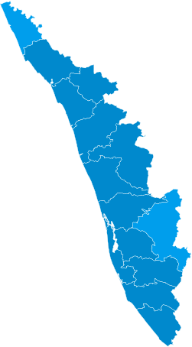
Kerala's E-Waste Landscape
Navigating hazardous waste streams, urban mining potential, and the path to a circular economy (FY 2025-26).
Kerala State Pollution Control Board

Slide 2


The Paradox of Digital Waste
The Hazard
The Opportunity
38,395.84 Metric Tonnes of e-waste generated annually statewide. Rapid growth driven by high smartphone penetration and IT-dense urban markets.
75.83% Material Recovery rate achieved by authorized recyclers. A high-yield secondary supply of critical minerals and rare earth elements (REEs).
Data Source: FY 2025-26 Report

Slide 3
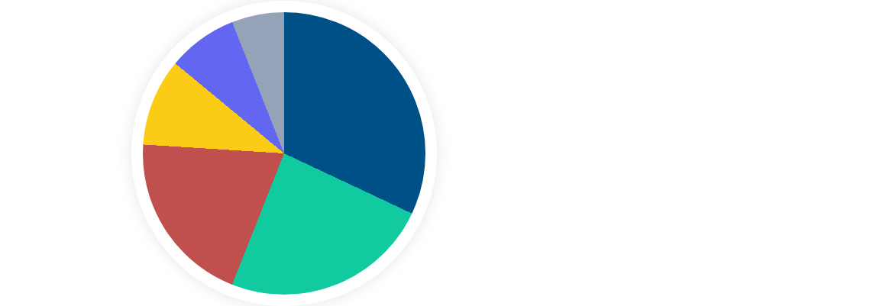
E-Waste Composition Profile
IT & Telecom (32.0%)
Consumer Electronics (24.0%)
Large & Small Equipment (20.0%)
Batteries (10.0%)
Lighting Equipment (8.0%)
Others (6.0%)

Slide 4
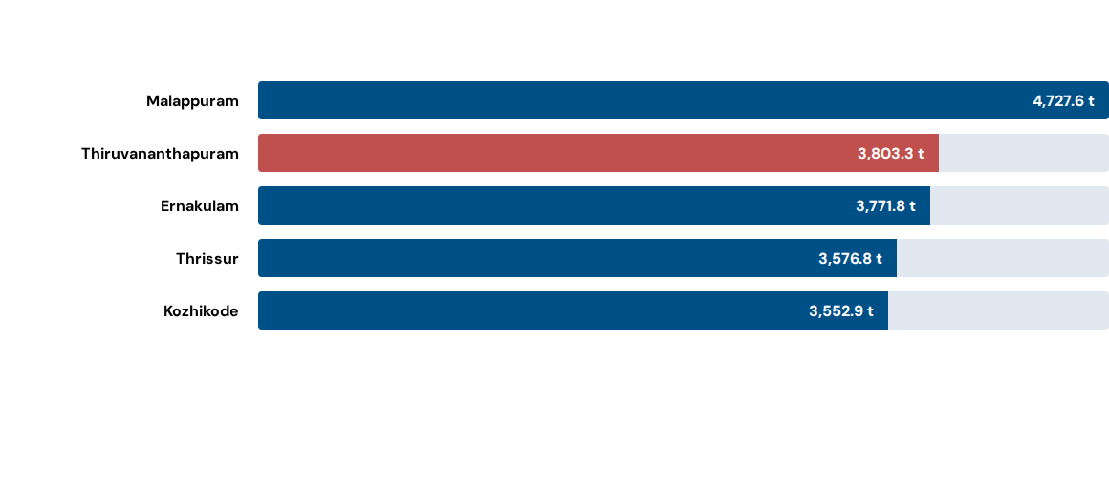
Top Generating Districts
Average state-wide per-capita generation: 1.15 kg / year.

Slide 5


Collection Infrastructure
Decentralized Model: Haritha Karma Sena door-to-door drives are the primary collection channel.
EPR Framework: Registered collection centers work in coordination with Clean Kerala Company Ltd (CKCL).
Efficiency Gap: Achievement stands at 62.6% against a 100% benchmark target.

Slide 6
The Material Adequacy Gap
22.4%
Structural Shortfall: Current authorized recycling capacity (8,600 t/yr) covers less than a quarter of statewide generation.
Actual processed throughput accounts for only 15.29% of total state generation, leaving massive volumes undocumented.
CAPACITY COVERAGE

Slide 7
Compliance Tracker
Metric | Status / Value | % Achievement
Producer Compliance | 8 out of 10 Registered Entities | 80.0%
Inspection Efficiency | 8 out of 9 Planned Inspections | 88.9%
Environmental Hotspots Monitored | 5 out of 6 Identified Sites | 83.3%
Penalty/Show-Cause Resolution | 0 out of 2 Issued Proceedings | 0.0%

Slide 8


Informal Sector Hotspots
Hotspot Integration: 6 sites identified, but only 1 (16.7%) is fully formalized. The majority (50%) remain "Partially Formalized."
36.07%
Worker Registration Rate
The majority of the estimated 305 workers remain outside formal health and safety safeguards.

Slide 9


Environmental & Human Toll
Exceedance Flags:
Ernakulam (Site 1): Soil and Water exceed limits for Lead (Pb) and Cadmium (Cd).
Kozhikode (Site 3): Water exceeds safe limits for Mercury (Hg).
60% of monitored sites recorded toxic levels exceeding prescribed environmental safety limits.

Slide 10
The Awareness Disconnect
Achievement of 30.0% against benchmark targets. Outreach remains the weakest functional category.
6 Programs
(Actual)
20 Programs
(Target)

Slide 11


Roadmap to Transformation
1. Formalize
2. Infrastructure
3. Enforce
Complete formalization of Malappuram and Kozhikode clusters; register 100% of informal workers.
Expand capacity to 20,000 t/yr; fast-track authorized dismantling units in southern districts.
Resolve all outstanding penalty proceedings and scale quarterly district-wise awareness drives.

Slide 12


Questions?
Toward an Environmentally Sound Kerala
KERALA STATE POLLUTION CONTROL BOARD
www.keralapcb.nic.in

Slide 13




Image Sources
https://upload.wikimedia.org/wikipedia/commons/thumb/8/8b/Language_Map_of_Kerala_%282011_Census%29.svg/250px-Language_Map_of_Kerala_%282011_Census%29.svg.png?utm_source=en.wikipedia.org&utm_campaign=parser&utm_content=thumbnail
Source: en.wikipedia.org
https://media.istockphoto.com/id/1254440706/vector/e-waste-garbage-icon-old-discarded-electronic-waste-to-recycling-symbol-ecology-concept.jpg?s=612x612&w=0&k=20&c=zE96Hdx55nLyLK2jrFWtDm74rEcmg0nRSjj3Wqa6xoU=
Source: www.istockphoto.com
https://png.pngtree.com/png-clipart/20250812/original/pngtree-artificial-intelligence-brain-with-integrated-circuitry-components-and-glowing-lights-isolated-png-image_21726604.png
Source: pngtree.com
https://lookaside.fbsbx.com/lookaside/crawler/media/?media_id=932485019642493
Source: www.facebook.com

