Slide 1


E-Waste Buyback & Recycling
"If it can be reused, we buy it. If it can be repaired, we refurbish it. If it can't be reused, we connect you to responsible recycling."

Slide 2

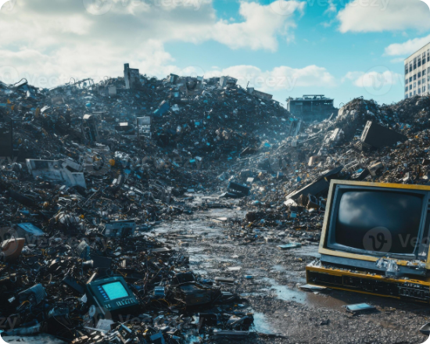
The Problem Statement
Massive Waste Generation: Huge volumes of electronic waste are generated from old phones, laptops, and chargers daily.
Lack of Valuation: People are largely unaware of the actual resale value of their aging devices.
Premature Disposal: Usable electronics are often discarded instead of being repaired or reused.
Inaccessible Recycling: Users struggle to find reliable, authorized recycling facilities nearby.
Environmental Hazard: Improper disposal significantly increases environmental pollution and toxicity.

Slide 3
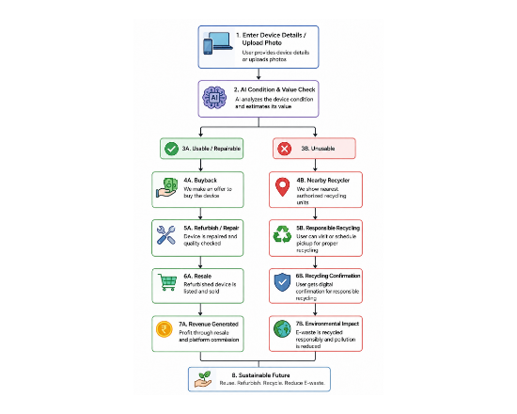
Our Solution & Process
A unified platform providing buyback, refurbishment, and authorized recycling services.
AI-Based Valuation: Instant, accurate pricing based on device condition.
Doorstep Pickup: Hassle-free logistics directly from the user.
Refurbish & Resale: Restoring usable devices for the circular economy.
Recycler Network: Built-in locator for the nearest authorized recycling units.
Impact Tracking: Digital recycling confirmation and environmental tracking.

Slide 4



Business Model & Roadmap
Execution Timeline
Expected Revenue Streams
Month 1: Market research & strategic planning.
Resale Margins: Profit from buying, refurbishing, and selling.
Month 2–3: Minimum Viable Product (MVP) development.
Platform Commissions: 5–15% fee on facilitated transactions.
Month 3–4: AI valuation system integration.
Recycling Fees: Recycler partnership and processing fees.
Month 4–5: Finalize recycler & refurbisher partnerships.
B2B Contracts: Corporate e-waste management services.
Month 6: Pilot launch in target zones.
Logistics: Premium doorstep pickup charges.
Month 7–12: System optimization & market expansion.
Target: ₹30–40 Lakh Revenue in Year 1

Slide 5

Image Sources
https://static.vecteezy.com/system/resources/previews/053/913/474/large_2x/piles-of-electronic-waste-fill-a-landfill-site-under-a-cloudy-sky-at-midday-photo.jpeg
Source: www.vecteezy.com

