Slide 1
B.Tech 8th Semester Final Year Project
Speech Emotion Recognition
Using Deep Learning
Sagar S. Maddi (12215121 – ECE B6)
Kasagani Charan Kumar (12215095 – ECE B5)
Mentor: Dr. Vrinda Gupta | Dept. of Electronics & Communication Engineering
National Institute of Technology, Kurukshetra — May 2026
CNN-LSTM · RAVDESS + TESS + EMO-DB · Gradio Web App · 89.7% Accuracy

Slide 2
Project Overview & Motivation
1 / 10
Motivation
What We Built
Speech carries emotion beyond literal words — pitch, energy, and spectral cues encode affect.
Applications: mental health monitoring, call-center analytics, adaptive e-learning, empathetic virtual assistants.
Existing open-source SER systems lack augmentation, multi-dataset training, and accessible demos.
This project closes those gaps with a complete, reproducible, deployable pipeline.
184-dim feature vector: MFCC, Chroma, Mel Spectrogram, ZCR, RMS, Spectral Centroid, Rolloff
4× data augmentation: ~5,131 → 20,524 samples (time-stretch, pitch-shift, noise)
3 architectures trained & compared: LSTM, CNN-LSTM, Transformer Encoder
Best model: CNN-LSTM — 89.7% test accuracy (vs 70.3% baseline)
Gradio web app — real-time demo with waveform, Mel spectrogram, confidence charts
NIT Kurukshetra | ECE Dept. | B.Tech 8th Sem FYP 2025–26 | Dr. Vrinda Gupta

Slide 3
Datasets & Feature Extraction
2 / 10
Datasets Used — Combined Multi-Speaker Corpus
Dataset | Speakers | Language | Clips (used)
RAVDESS | 24 (12M+12F) | English | ~4,390
TESS | 2 (Female) | English | ~741
EMO-DB | 10 (5M+5F) | German | ~454
TOTAL | 36 speakers | Multi | ~5,131 → 20,524 (4×aug)
Feature Extraction Pipeline — 184-Dimensional Vector
Feature | What it captures | Status
MFCC (40-dim) | Vocal tract shape — primary emotion cue | Baseline
Chroma STFT (12-dim) | Harmonic / pitch class energy | Baseline
Mel Spectrogram (128-dim) | Freq–time energy map — richest single feature | Baseline
ZCR, RMS, Centroid, Rolloff (4-dim) | Loudness, brightness, voicing (NEW) | NEW ✓
NIT Kurukshetra | ECE Dept. | B.Tech 8th Sem FYP 2025–26 | Dr. Vrinda Gupta

Slide 4
Data Augmentation & Model Architectures
3 / 10
Data Augmentation (4× Pipeline)
CNN-LSTM Architecture
Time Stretching ×1.1 — simulates fast speech delivery
Pitch Shifting +2 semitones — cross-gender voice variation
Gaussian Noise (σ=0.005, ~20 dB SNR) — real-world mic conditions
Result: 5,131 → 20,524 samples — same label, 4× variety
Input (184 × 1)
▼
Conv1D (64 filters, k=5) + BatchNorm + MaxPool
▼
Conv1D (128 filters, k=3) + BatchNorm + MaxPool
▼
Model Comparison
LSTM (64 units) + Dropout 0.4
Model | Params | Accuracy
LSTM Baseline | ~120K | 70.3%
CNN-LSTM Hybrid ★ | ~80K | 89.7%
Transformer Encoder | ~171K | Early stopped
▼
Dense (64, ReLU) + Dropout 0.3
▼
Dense (4, Softmax) → Emotion class
NIT Kurukshetra | ECE Dept. | B.Tech 8th Sem FYP 2025–26 | Dr. Vrinda Gupta

Slide 5
Results & Per-Class Performance
4 / 10
89.7%
+19.4 pp
0.87–0.91
CNN-LSTM Test Accuracy
Gain over LSTM baseline (70.3%)
Per-class F1 Range
Per-Class Performance — CNN-LSTM Model
Emotion | Precision | Recall | F1-Score | Samples
Angry | 0.93 | 0.89 | 0.91 | 766
Happy | 0.93 | 0.83 | 0.88 | 763
Neutral | 0.89 | 0.93 | 0.91 | 1,808
Sad | 0.85 | 0.89 | 0.87 | 768
Weighted Avg | 0.90 | 0.90 | 0.90 | 4,105
NIT Kurukshetra | ECE Dept. | B.Tech 8th Sem FYP 2025–26 | Dr. Vrinda Gupta

Slide 6
System Architecture & Workflow
5 / 10
Raw Audio Input
→
Preprocessing
→
Data Augmentation
→
Feature Extraction
→
CNN-LSTM Model
→
Emotion Output
WAV / Mic
Resample → 16 kHz
4× expansion
184-dim vector
89.7% accuracy
Happy / Angry
Neutral / Sad
Gradio Web Application — Real-Time Inference Flow
1. Upload / Record
2. Feature Extract
3. CNN-LSTM Inference
4. Waveform + Mel Plot
5. Confidence Chart
WAV audio file or live mic
184-dim vector in real time
Softmax probability output
RMS energy overlay
All 4 emotion scores
Tech Stack: Python 3.11 · TensorFlow 2.16 / Keras · librosa 0.11 · NumPy · scikit-learn · Gradio 6.14 · Matplotlib
Training config: 100 epochs max | Early stopping (patience=10) | Batch=32 | Adam lr=1e-3 | ReduceLROnPlateau | 80/20 stratified split
NIT Kurukshetra | ECE Dept. | B.Tech 8th Sem FYP 2025–26 | Dr. Vrinda Gupta

Slide 7
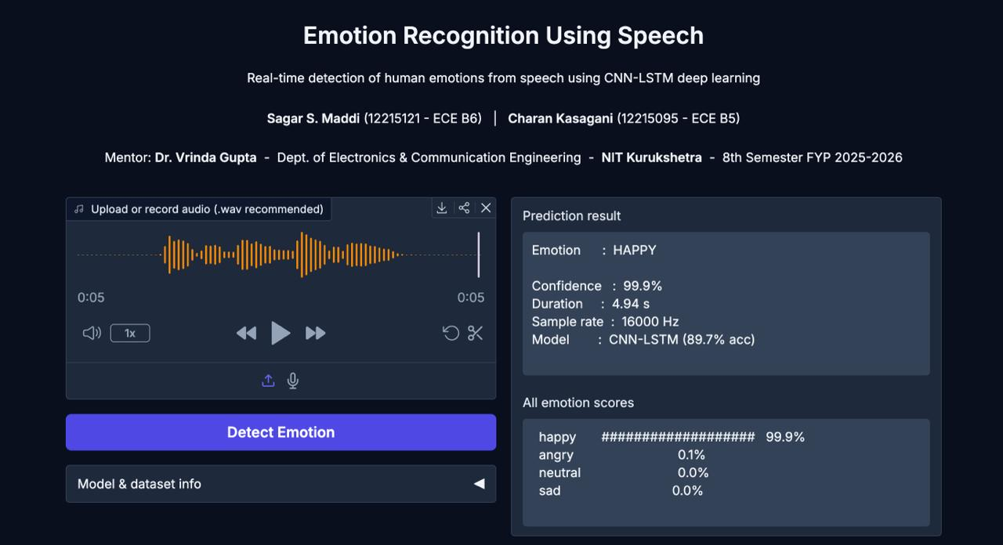
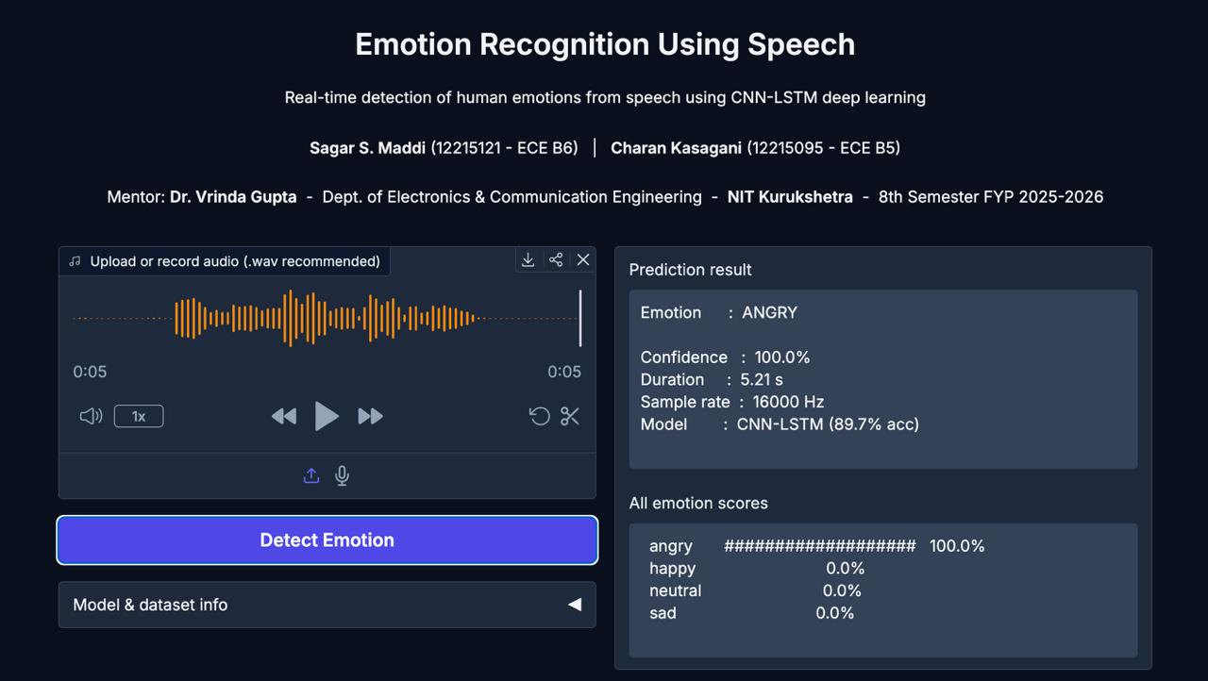
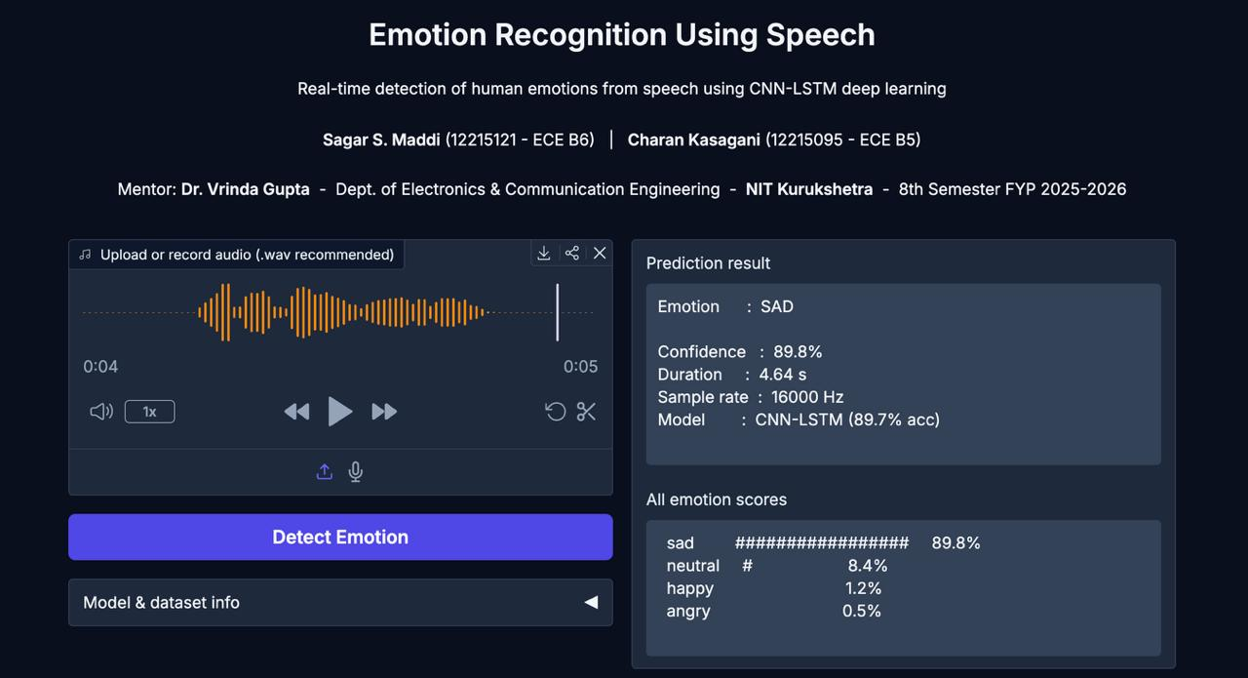
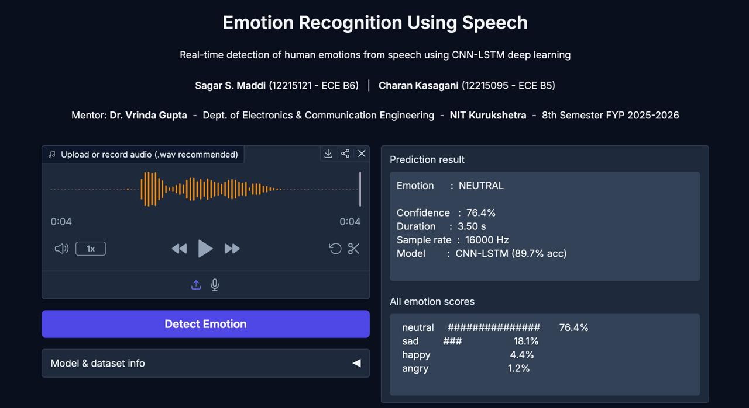
Gradio Web App — Prediction Interface Screenshots
6 / 10
Each screenshot shows: Detected Emotion · Confidence Score · Audio Metadata · All Emotion Scores
Fig 10.1 — HAPPY (99.9%)
Fig 10.3 — ANGRY (100.0%)
NIT Kurukshetra | ECE Dept. | B.Tech 8th Sem FYP 2025–26 | Dr. Vrinda Gupta
Fig 10.5 — SAD (89.8%)
Fig 10.7 — NEUTRAL (76.4%)

Slide 8
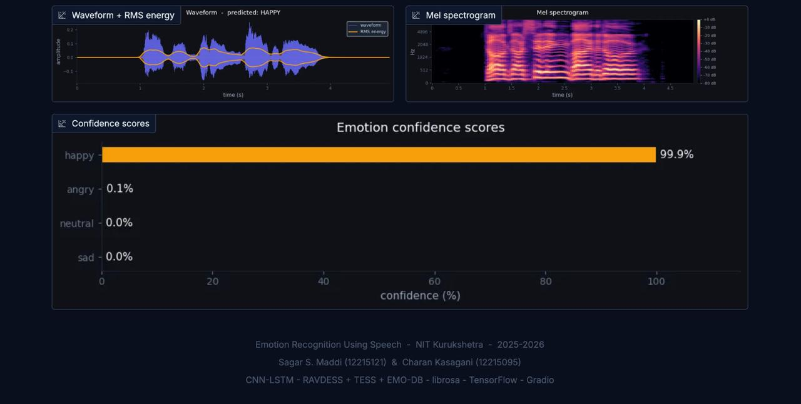
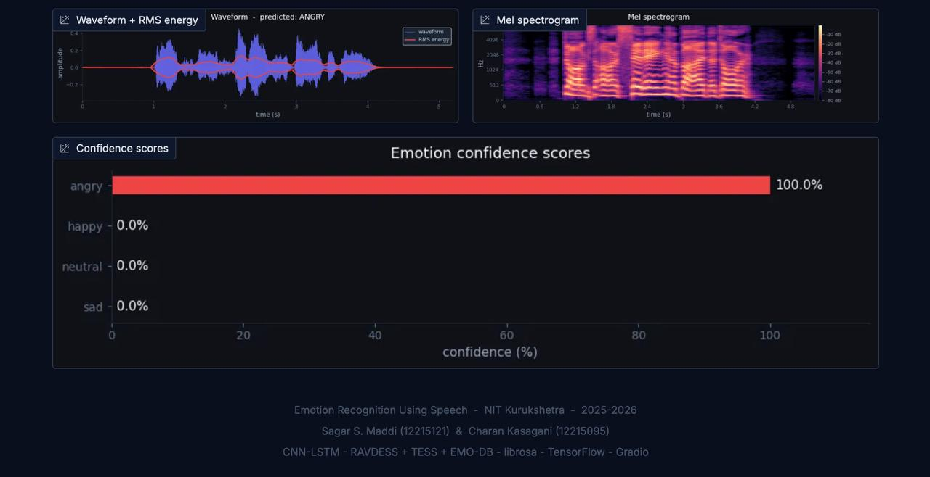
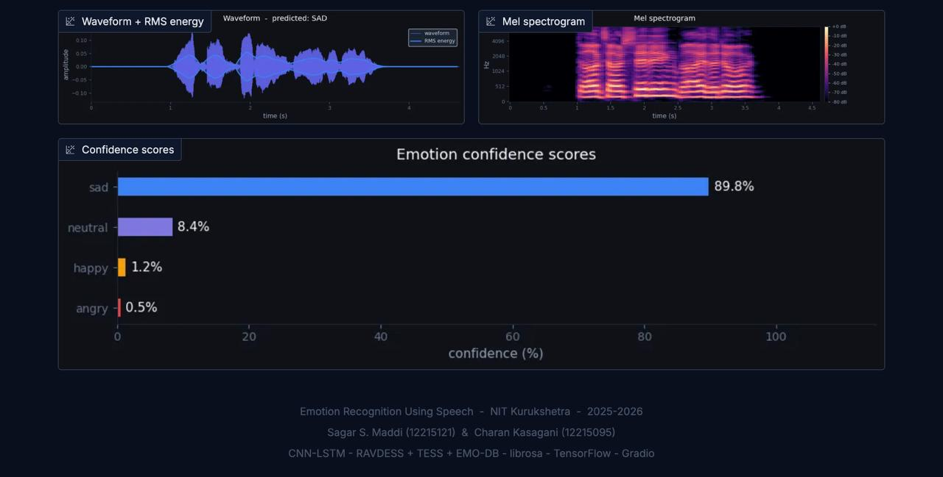
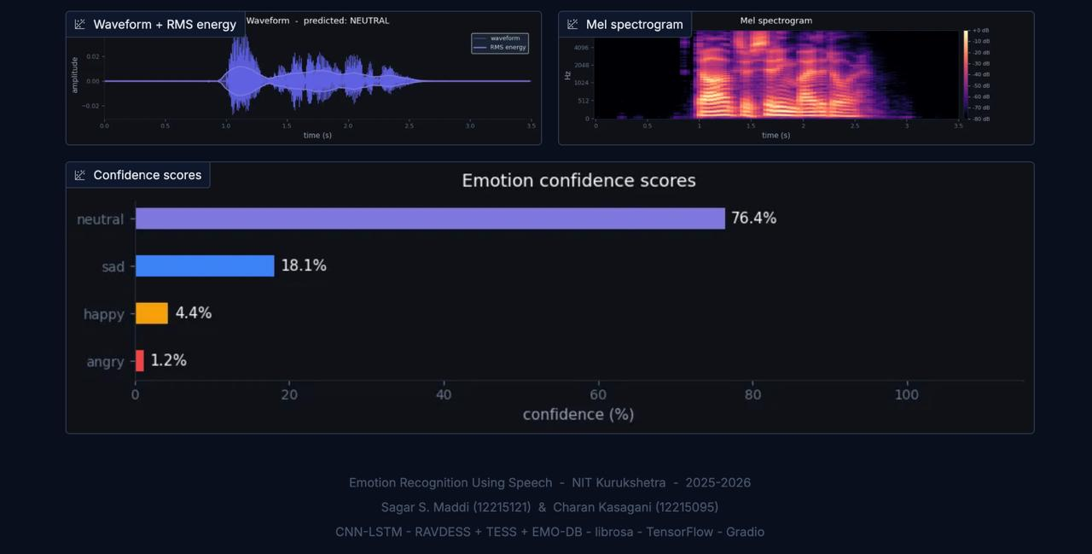
Gradio Web App — Waveform + Mel Spectrogram & Confidence Charts
7 / 10
Top row: Waveform + RMS Energy overlay + Mel Spectrogram · Bottom row: Emotion Confidence Bar Charts
Fig 10.2 — HAPPY Waveform + Mel
Fig 10.4 — ANGRY Waveform + Mel
NIT Kurukshetra | ECE Dept. | B.Tech 8th Sem FYP 2025–26 | Dr. Vrinda Gupta
Fig 10.6 — SAD Confidence Scores
Fig 10.8 — NEUTRAL Confidence Scores

Slide 9
Comparison with Prior Work | Advantages & Limitations
8 / 10
Comparison with Prior Work
Method / Author | Dataset | Accuracy | Aug.
SVM + MFCC (2011) | EMO-DB | 77.4% | No
DNN + MFCC (2017) | IEMOCAP | 64.7% | No
CNN-LSTM (2019) | RAVDESS | 70.1% | No
x4nth055 LSTM (2019) | RAVDESS+TESS | 77.2% | No
This Work — CNN-LSTM ★ | RAVDESS+TESS+EMO-DB | 89.7% | 4×
Advantages
Limitations & Future Scope
Multi-dataset: speaker diversity across RAVDESS, TESS, EMO-DB
4× augmentation cuts overfitting without extra data collection
CNN-LSTM +19.4 pp over LSTM baseline; all F1 ≥ 0.87
Runs on standard consumer laptop — no specialized hardware
Only 4 emotion classes; expand to 7-8 (Fear, Disgust, Surprise)
Transformer Encoder training was stopped early due to hardware limits
File-level only; no streaming/frame-level real-time inference yet
Future: Wav2Vec2 embeddings, Hugging Face cloud deployment, edge TFLite
NIT Kurukshetra | ECE Dept. | B.Tech 8th Sem FYP 2025–26 | Dr. Vrinda Gupta

Slide 10
Conclusion
End-to-end SER pipeline: raw audio → 184-dim features → CNN-LSTM → real-time Gradio demo
CNN-LSTM achieves 89.7% accuracy — 19.4 pp above LSTM baseline; macro F1 = 0.89
Multi-dataset training (36 speakers) + 4× augmentation → robust, generalizable model
No specialized hardware required — runs fully on consumer MacBook with Metal GPU
Interactive Gradio app provides accessible, real-time emotion detection from any browser
🔗 Live Demo: https://095706ea257921b090.gradio.live/
📁 GitHub: https://github.com/sagar141202/8th_sem_project
Mentor: Dr. Vrinda Gupta | Dept. of ECE, NIT Kurukshetra
Thank You

