Slide 1

Weather forecast gui application
SUBMITED BY
NAME:AKASH MAHATO
ROLL:2104006
DEPARTMENT OF COMPUTER SCIENCE AND ENGINEERING
GITA, BHUBANESWAR,ODISHA

Slide 2
content
Introduction​
Technology Used
Working Structure
​Applications
Snapshot
​Conclusion
Reference

Slide 3
Introduction
Weather Forecast GUI application is Graphical User Interface application developed for getting the current weather conditions of a particular place as well as the seven days forecasted weather.
It also contains a digital clock and time zone identifier.
It makes the use of the python tkinter module for the development of the interface and other modules and packages to get the weather with the help of a open weather rest api.

Slide 4
TECHNOLOGY USED
Software used: IDLE (Python 3.10 64 bit)
Modules and Packages used: 1)tkinter module
2)geopy module
3)timezonefinder module
4)datetime module
5)pytz package
6)PIL(Python imaging library)
REST API Used:openweathermap.org

Slide 5
Working structure
The working of the Weather GUI Application can be explained in 6 simple steps:-
Step-1:Taking the name of the place as input using the python tkinter entry object.
Step-2:Calculate the latitude and longitude of the place using the geopy module and nominatim.
Step-3:find out the time zone using the timezonefinder module.
Step-4:Use the latitude and longitude in api link to get data from openweather api using the requests module.
Sep-5:We can import data like temperature ,climate ,wind speed ,pressure, cloud, humidity and many more from the ouptput of the api.
Step-6:Use the datetime module to get the day name.

Slide 6
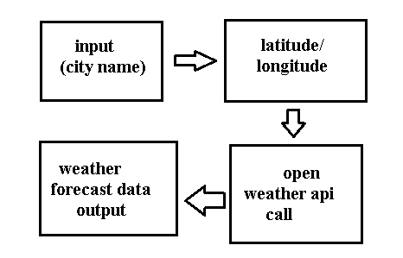
WORK FLOW

Slide 7
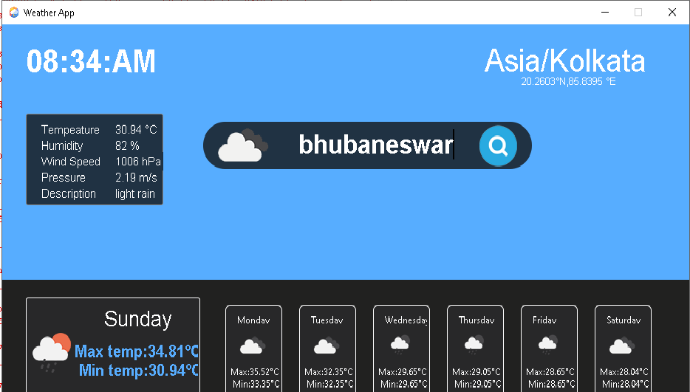
snapshot

Slide 8
APPLICATIONS
Severe weather alerts and advisories which the national weather services issues in case of hazardous weather.
Air and Maritime traffic control for regulations of the routes.
Agriculture and private sector for their profit and production.
Utility companies like water, electricity and gas.

Slide 9
conclusion
Weather forecast GUI application is a simple fast and accurate level application that make use of open weather api to get the data of the current and forecast weather. Making of the project evolves great understanding of the python Tkinter module and several other modules being used in the project.
It helped us to get an understanding of what is an api how they work and how its efficient utilization can help us to make a weather forecast GUI application.
Weather APIs are used in a wide range of applications such as online news outlets providing local weather reports, travel websites showing an overview of the current conditions in each destination country, home automation systems monitoring temperature trends for more efficient energy use, and smartphone apps helping people plan their outdoor activities according to the most recent forecast.

Slide 10
reference
GeeksforGeeks-A computer science portal for geeks
StackOverflow.com
Wikipedia
Openweathermap.org
docs.python.org
pipy.org
W3schools

Slide 11
THANK YOU

