Slide 1
Websockets

Slide 2
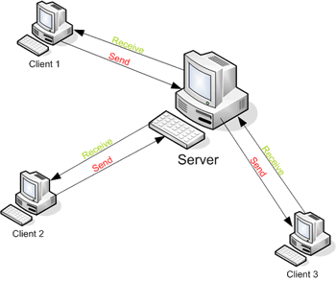
Client - Server - Real time ?
Response could be stale by the time the browser renders the page.
How to get up to date information ?
Refresh the page ?
Notes:
Web applications were originally developed around a client/server model, where the Web client is always the initiator of transactions, requesting data from the server. Thus, there was no mechanism for the server to independently send, or push, data to the client without the client first making a request.
This paradigm went unchallenged for a number of years but with the introduction of AJAX around 2005 many people started to explore the possibilities of making connections between a client and server bidirectional.

Slide 3
Options ?
Polling
Long Polling
Streaming

Slide 4
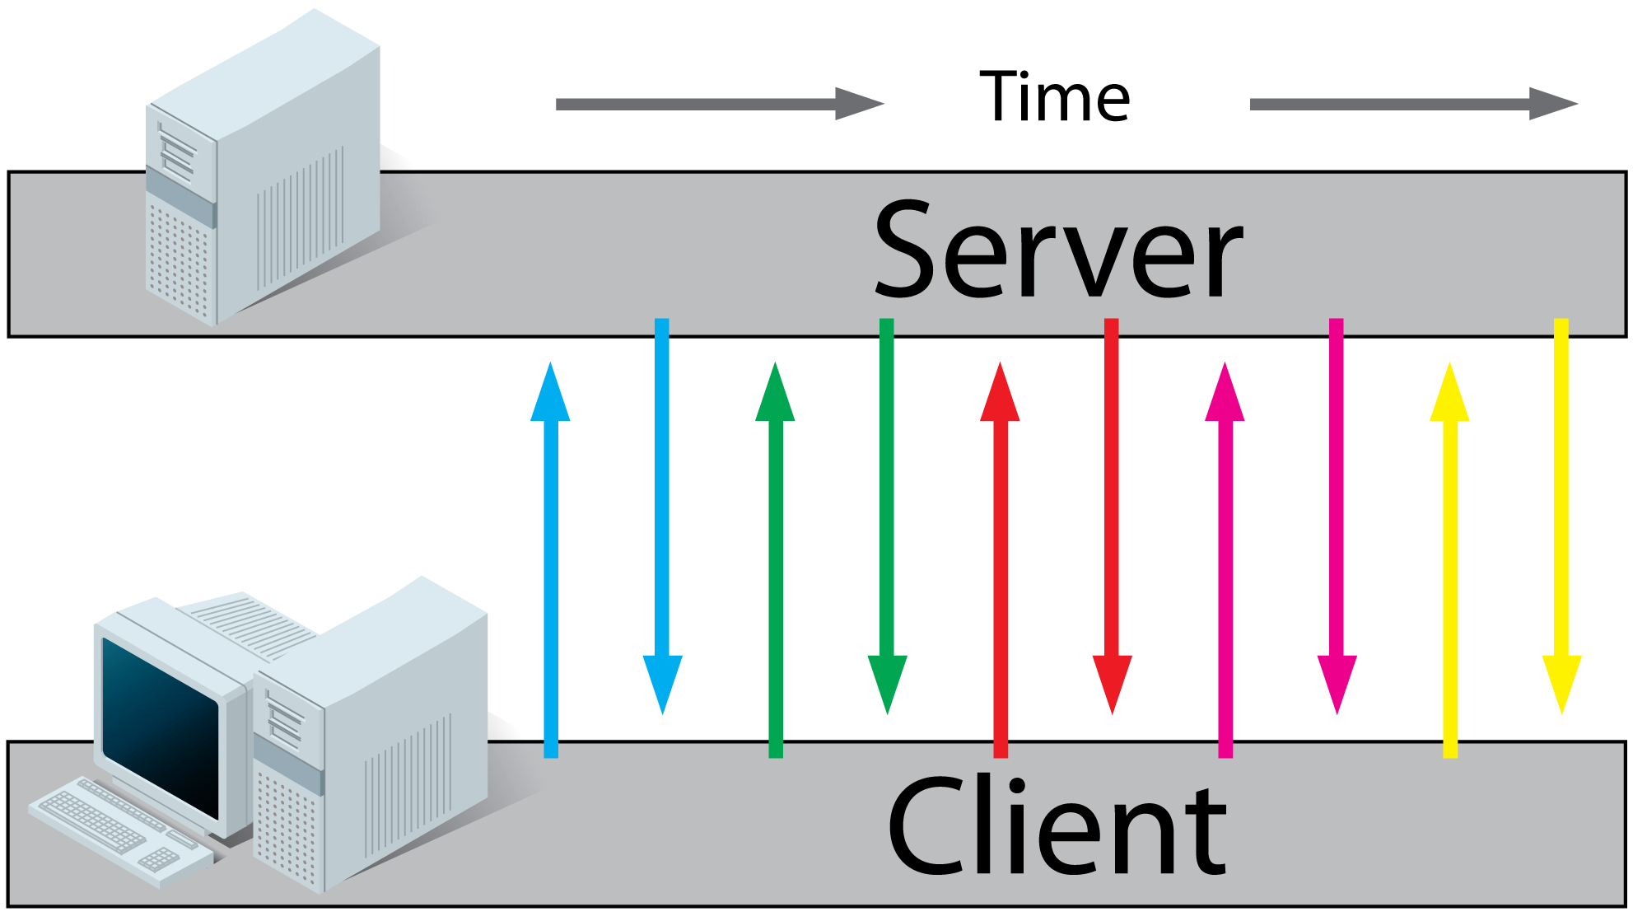
HTTP Polling
Client browser sends http requests at regular intervals and receives the response.
Some of the responses to client can be empty.
For example, checking score of a game.
Good if the exact interval of the message delivery is known but Real time data is unpredictable

Slide 5
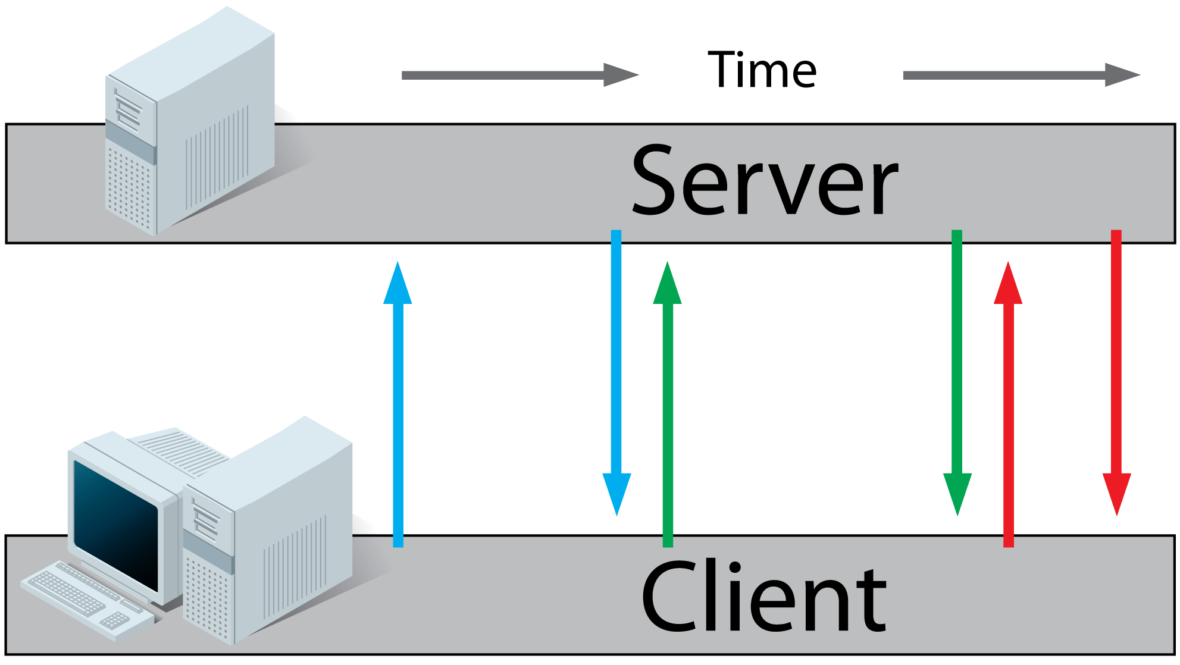
HTTP Long Polling
The server holds the request open until new data is available.
Once available, the server responds and sends the new information.
When the client receives the new information, it immediately sends another request, and the operation is repeated.
Notes:
o

Slide 6
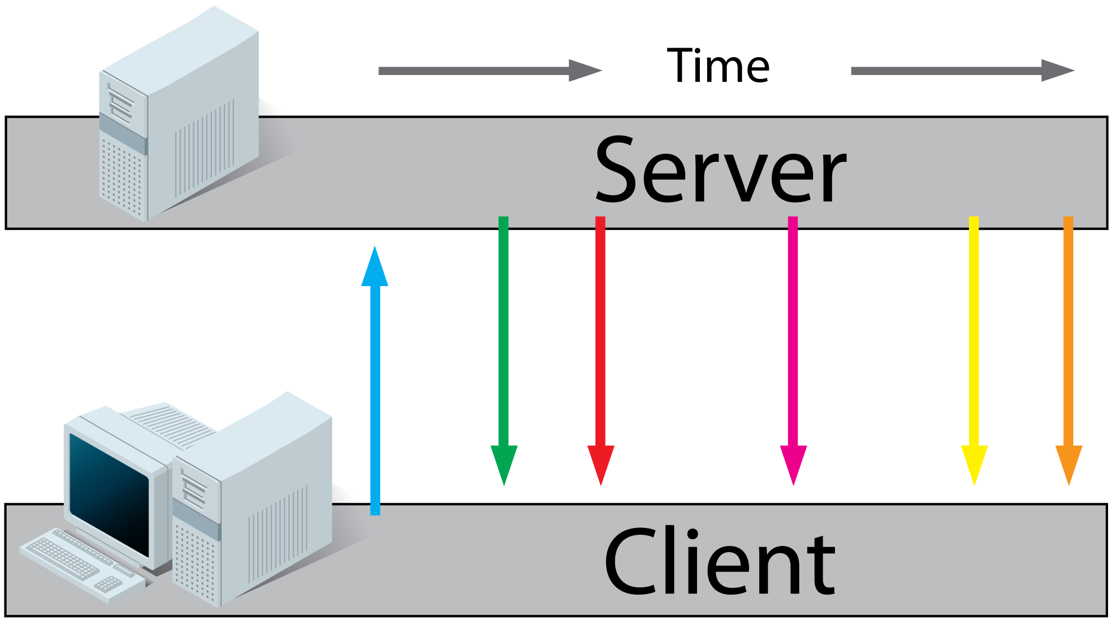
HTTP Streaming
Connection is not closed.
a variety of techniques (multipart/chunked response) that allow the server to send more than one response to a single client request.
The W3C is standardizing this as Server-Sent Events using a text/event-stream MIME type. The browser API (which is fairly similar to the WebSocket API) is called the EventSource API.

Slide 7
HTTP overhead
All of these methods for providing real time data involves empty, or multiple responses containing duplicates data and cause huge amount of network overhead and introduce latency.

Slide 8
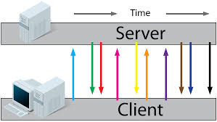
Websockets
Mechanism for web application that needs two way communication.
WebSocket connections are bi-directional, full-duplex and long-lived.
The client and server may send messages at any time and must handle message receipt asynchronously.

Slide 9
How websocket connection is established ?
Client
Server
1
1. Client sends HTTP GET request to url with connection:upgrade header
2
3
2. If the server supports the WebSocket protocol, it agrees to the upgrade and communicates this through an Upgrade header in the response.
3. Now that the handshake is complete the initial HTTP connection is replaced by a WebSocket connection that uses the same underlying TCP/IP connection. At this point either party can starting sending data.

Slide 10
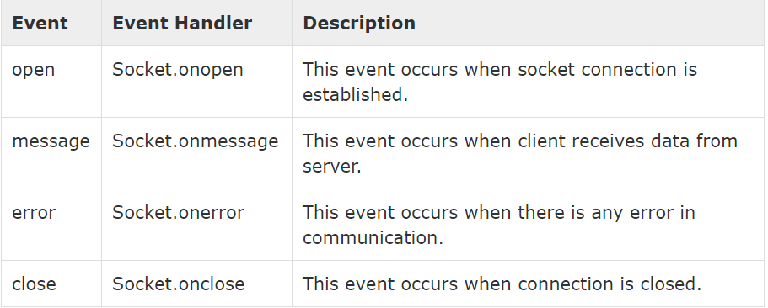
Websocket events

Slide 11
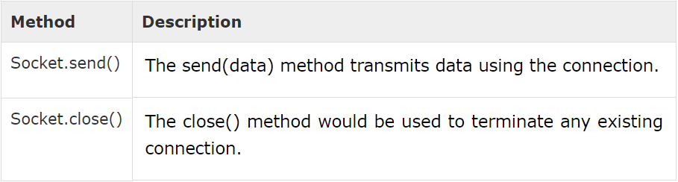
Websocket Methods
URI Formats:
ws-URI = "ws:" "//" host [ ":" port ] path [ "?" query ] default(80)
wss-URI = "wss:" "//" host [ ":" port ] path [ "?" query ] default(443)

Slide 12
Issues
All browser doesn’t support websocket protocol.
Applications
Chat application: Video and audio conferencing applications
Multi-player online gaming
Social feeds
Simultaneous file sharing

