Slide 1
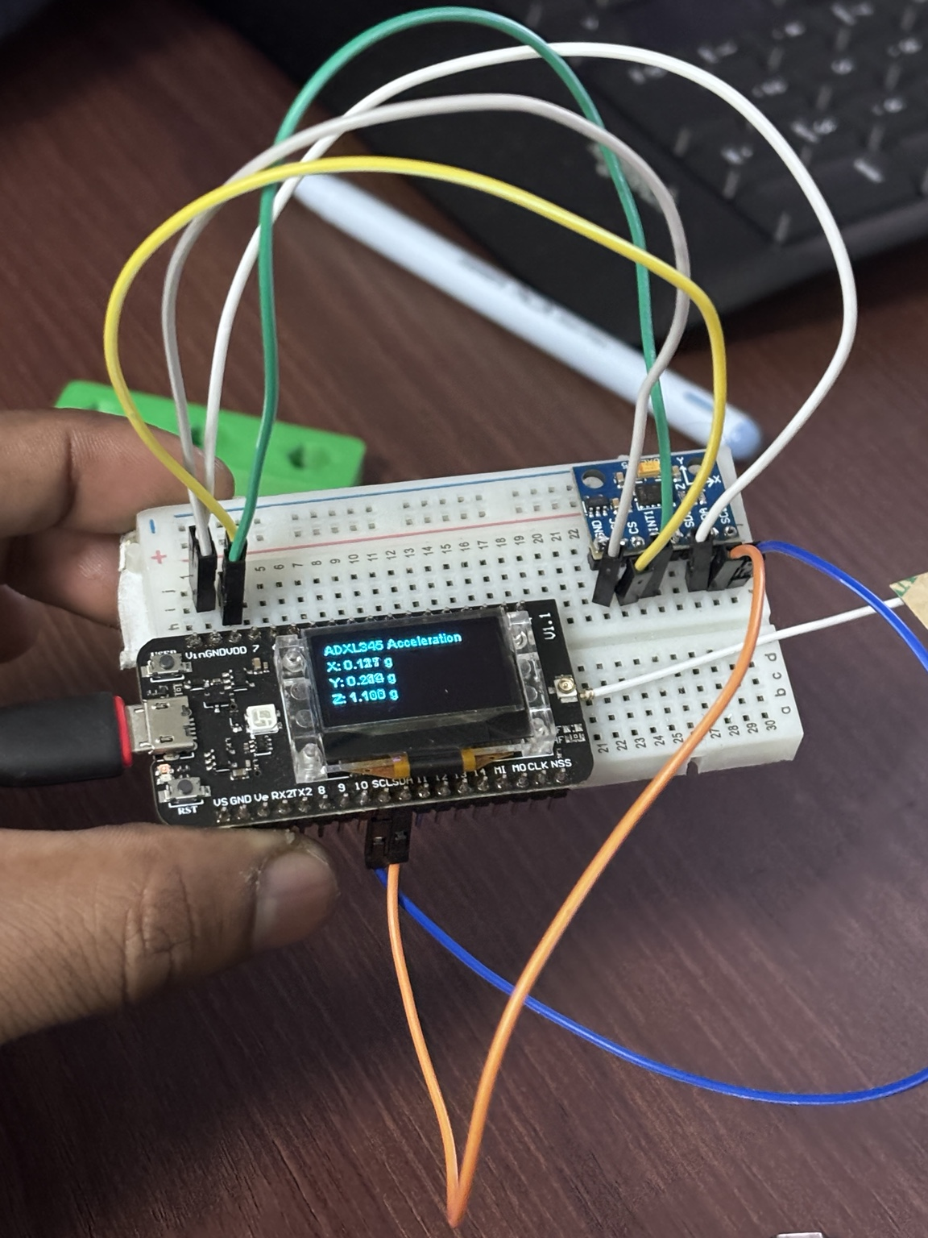
VEHICLE
TRACKING DEVICE
BTP PROGRESS REVIEW
Campus e-rickshaw fleet
IIT Roorkee
Sagar Baruah and Ponting
24 October 2026
01
Notes:
Prototype photo supplied by the user: IMG_0092.jpeg. Scope: progress review of campus vehicle tracking BTP.

Slide 2
THE CAMPUS USE CASE
Where is the vehicle?
How fast is it moving?
Build a vehicle node that combines GPS location and speed
with acceleration data for a campus fleet dashboard.
Longer-term goal: use fleet visibility to study route coverage
and support better e-rickshaw availability.
02
Notes:
Project context supplied in the conversation: campus e-rickshaw tracking using CubeCell, LoRa and a basic dashboard. Route optimisation is a project goal, not a demonstrated result.

Slide 3
PROGRESS AT A GLANCE
WORKING
ADXL345 sensor acquisition
Live X / Y / Z on OLED and Serial
DEMONSTRATED
Acceleration visualization
Laptop demo supplied with this update
EARLIER PROGRESS
Tracking node + basic dashboard
Previously reported project baseline
NEXT
GPS speed + combined telemetry
Outdoor validation and integration pending
03
Notes:
Current verified evidence: user says the pasted ADXL345 sketch works; photo shows OLED readings; supplied video shows a 3D acceleration visualization. Earlier tracking/dashboard status comes from the project discussion, not new field measurements. GPS sketch was provided but no GPS test result has been supplied.

Slide 4
SENSOR FIRMWARE
25 Hz
100 ms
Configured sensor output rate
OLED / Serial refresh interval
ADXL345 over I²C
Device ID check at 0x53 / 0x1D
Full-resolution mode, ±2 g range
Six-byte XYZ register read
Signed 16-bit axis conversion
Read-failure message on OLED
Current loop reads about 10 samples/s. Vehicle-event logging needs a faster acquisition loop.
04
Notes:
Source: user-supplied working Arduino code. BW_RATE 0x08 configures 25 Hz. DATA_FORMAT 0x08 selects full resolution with ±2 g. Loop gating uses 100 ms. Scale used by code: 0.0039 g/LSB. Current acquisition and display share the same loop.

Slide 5
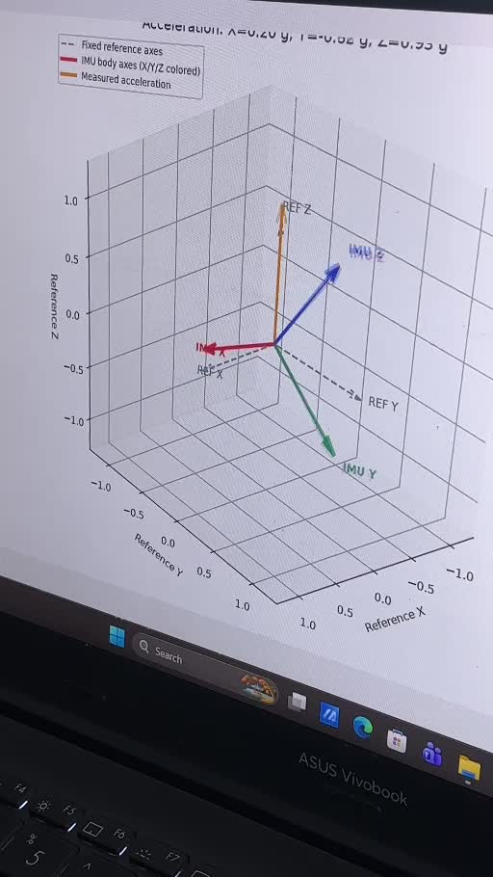
ACCELERATION DEMO
3D VECTOR VIEW
The supplied demo shows
measured acceleration against
reference axes.
This provides a visual check of
axis response when the board moves.
Next: record stationary bias and
repeat controlled orientation tests.
05
Notes:
Source: IMG_0093.mp4, duration approximately 9.77 s. Slide uses a still at 4 s. The display shows an acceleration vector and reference/body axis labels. An accelerometer alone does not validate full 3D orientation or yaw. Calibration accuracy is not established by this video.

Slide 6
GPS SPEED TRACKING
LIVE SPEED IN km/h
Read GPS speed alongside location
Display speed and satellite status on the OLED
Show unavailable data when the fix becomes stale
IMPLEMENTATION STATUS
Initial sketch prepared. Outdoor GPS lock, speed accuracy
and operation with the ADXL345 still need testing.
06
Notes:
GPS speed was requested by the user in this conversation. An AIR530Z-based sketch was supplied, but it has not been compiled or hardware-tested here. Board GPS revision and library compatibility must be confirmed during integration. No measured speed result is claimed.

Slide 7
SYSTEM INTEGRATION
VEHICLE NODE
FLEET BACKEND
GPS position + speed
ADXL345 acceleration
Local OLED feedback
LoRa telemetry receiver
Timestamped vehicle records
Fleet dashboard
Next packet: vehicle ID, timestamp, latitude, longitude,
speed, acceleration and GPS validity.
Combined sensor transmission and dashboard display remain integration tasks.
07
Notes:
Intended integration based on the project brief. Current ADXL345 code only prints locally and updates the OLED. It does not transmit LoRa packets or update a backend. No mesh capability is claimed: LoRa telemetry topology and any custom mesh are separate future design decisions.

Slide 8
NEXT MILESTONES
01
Validate GPS speed
Outdoor lock, stationary drift and comparison with a reference
02
Combine the firmware
Keep GPS parsing continuous and separate sensor sampling from display
03
Connect fleet telemetry
Transmit valid sensor packets and display them on the dashboard
04
Run vehicle trials
Check radio coverage, packet loss and power consumption
08
Notes:
Planned work, no completion dates committed. Before accident-related features, assess sensor range, sampling rate, calibration and false positives under real vehicle vibration. Current ±2 g configuration and 10 Hz reading loop are a bench baseline, not a validated crash detector.

