Slide 1



PG Diploma in ML
#LifeKoKaroLift
1

Slide 2




Course : PG Diploma in ML
Lecture On : Live Session
on Data Story Telling
Instructor : Siddhesh Gunjal
EdEditit MaMastesterr tetexxtt stystyleless
2

Slide 3







Why Storytelling is essential
What is Storytelling ?
Different Methods to create stories
Agenda
Types of dataset & appropriate charts
Storytelling during Predictive Model building
Demonstration on 1st Dataset Demonstration on 2nd Dataset Q & A

Slide 4


Slide 5
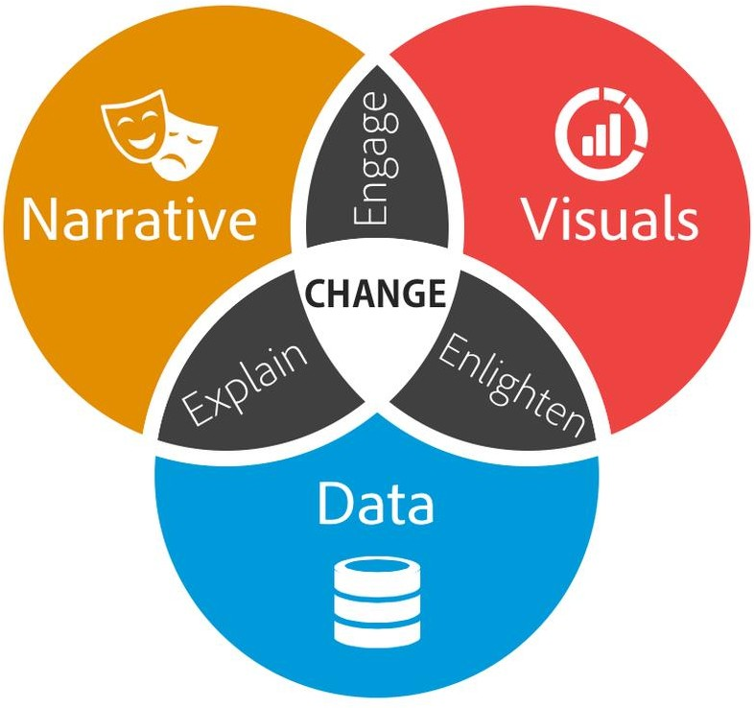

What is Data Storytelling?
Data visualization expert Stephen Few said, “Numbers have an important story to tell. They rely on you to give them a clear and convincing voice”
Data storytelling is a structured approach for communicating data insights, and it involves a combination of three key elements: data, visuals, and narrative.

Slide 6
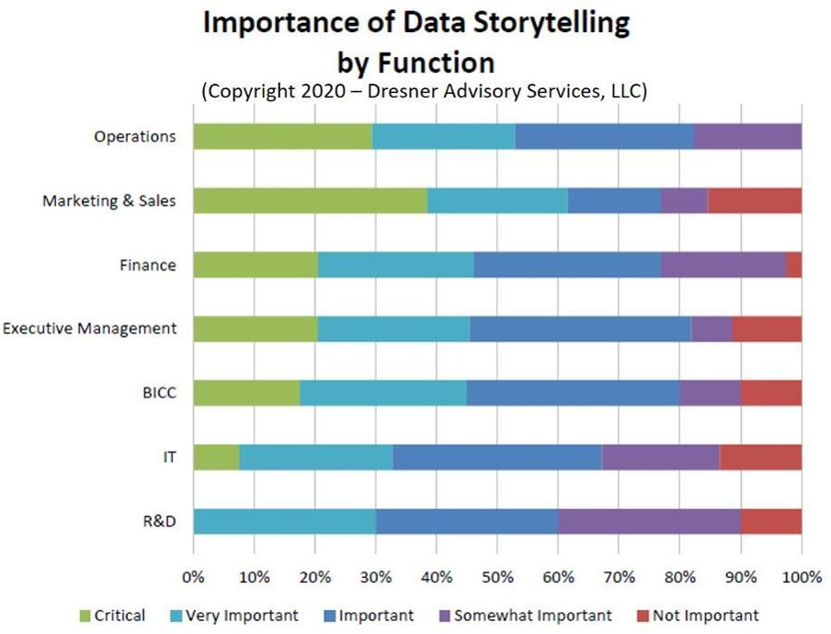

Why Storytelling is essential ?
Memorability- A study by Stanford professor Chip Heath found 63% could remember stories, but only 5% could remember a single statistic. People hear statistics, but they feel stories
Persuasiveness
Engagement

Slide 7
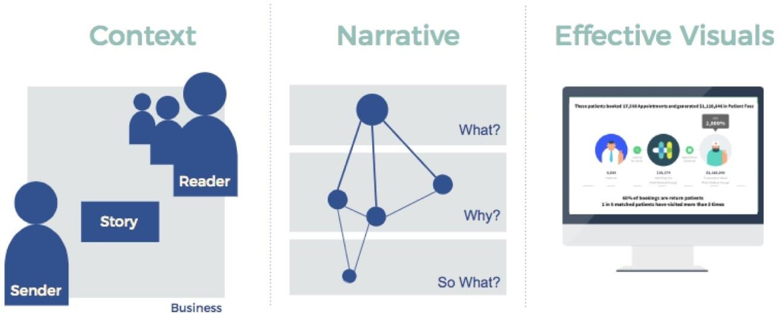
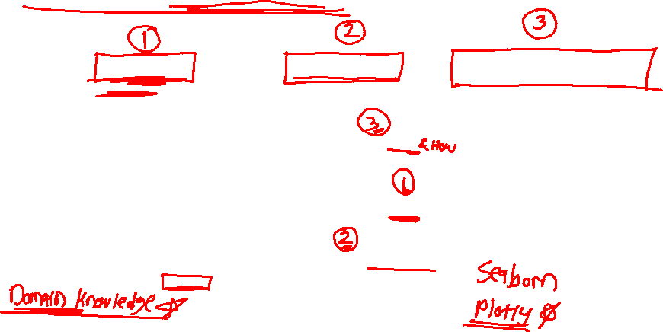
Flow of Storytelling

Slide 8
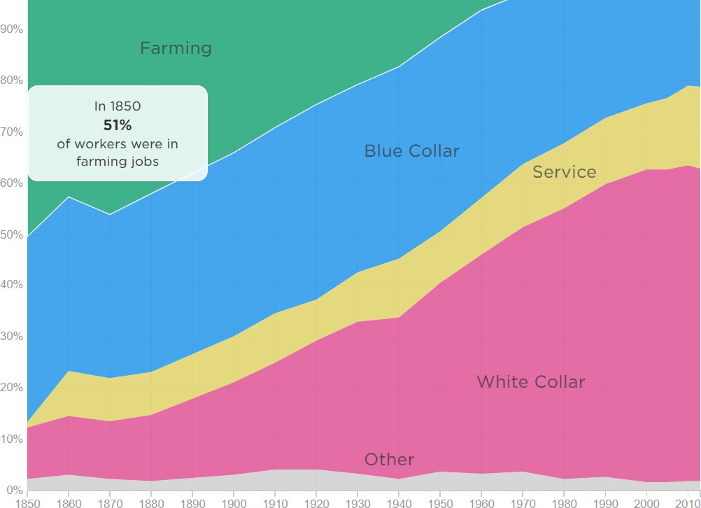

How Machines Destroy (And Create!) Jobs

Slide 9
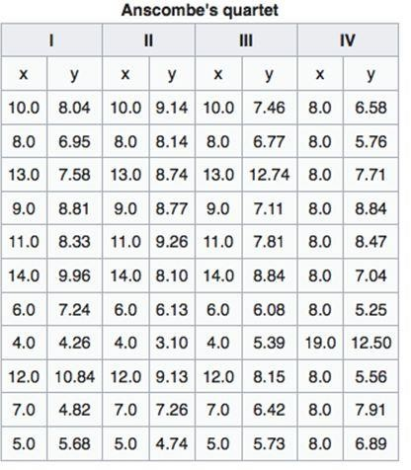

Slide 10
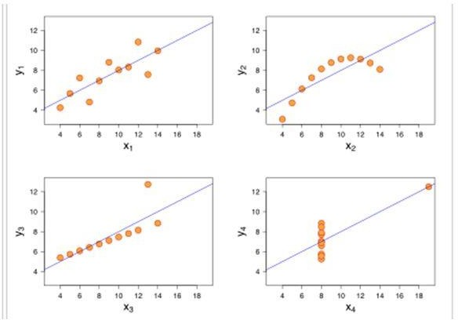


Slide 11
Different Methods to create stories

Slide 12

Scripting down your ideas and flow before you start
structuring your story is very essential
Aristotle’s classic five-point plan that helps deliver strong impacts is:
1.Begin with Pen-Paper Approach
Deliver a story or statement that arouses the
audience’s interest.
Pose a problem or question that has to be solved or
answered.
Offer a solution to the problem you raised.
Describe specific benefits for adopting the course
of action set forth in your solution.
State a call to action.

Slide 13

2.Dig deeper to identify the Ultimate purpose of your story
Identify closely, what the idea of your story
is. Ask yourself, “What am I really giving
with this story?” .What you’re displaying is the idea of a better decision making or analytics.

Slide 14
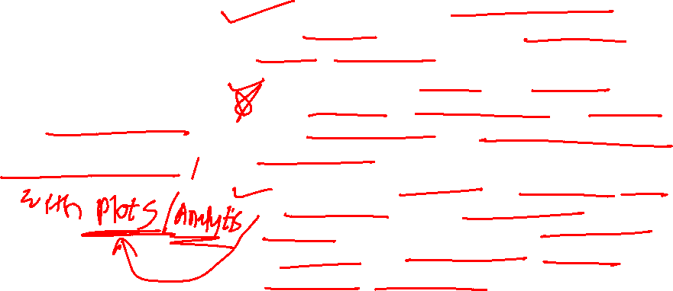
Create a list of all the key points you want your audience to know about your story, visual, or analysis.
Categorize the list until you are left with only three major message points. This group of three will provide the verbal road map for your story.
Under each of your three key messages, add supporting evidence to enhance the narrative. These could include some or all of the following: personal stories, facts, examples, analogies etc.
3.Design a Road Map

Slide 15

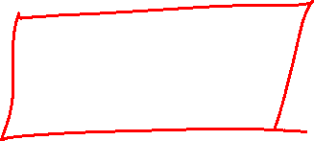
Types of Data and Suitable Charts

Slide 16
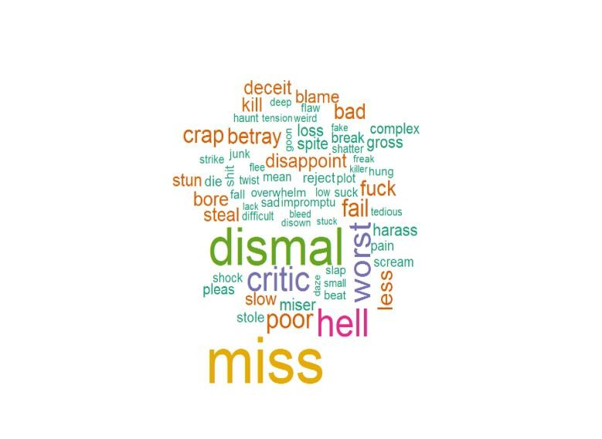
1. Textual Data
One of the best-suited visualizations for textual data is the WordCloud. The wordcloud brings the more frequent ones to the center and enlarges them, giving us a clear picture of what the general idea of the text depicts.

Slide 17
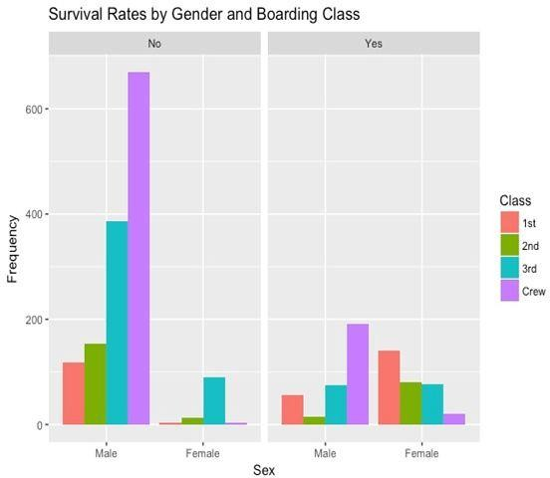
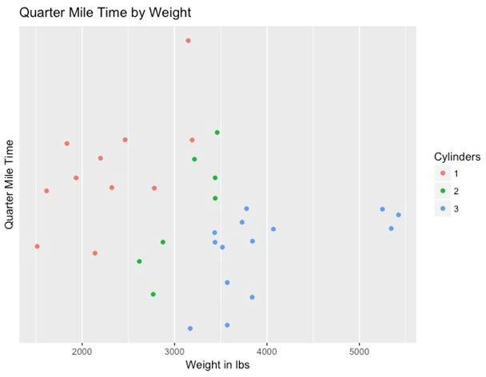
2. Dataset consist of Continuous & Categorial Data

Slide 18
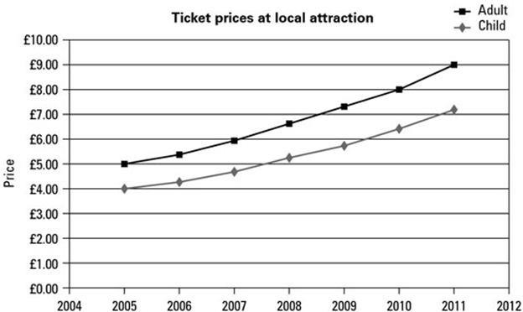

3. Numerical Dataset

Slide 19
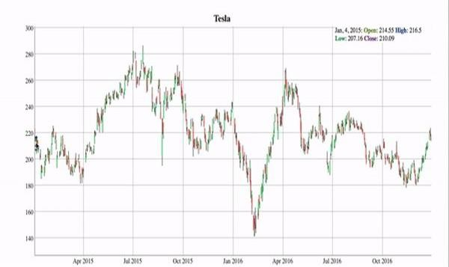

4. Time Series Dataset

Slide 20
Storytelling during the steps of predictive modeling

Slide 21
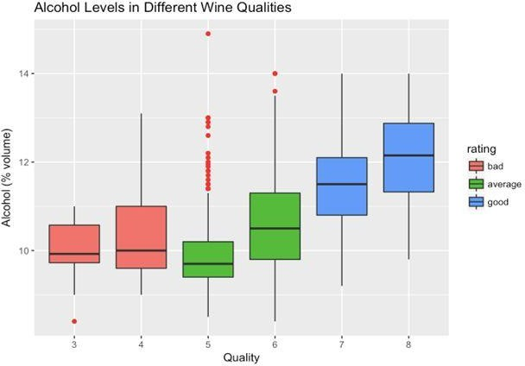
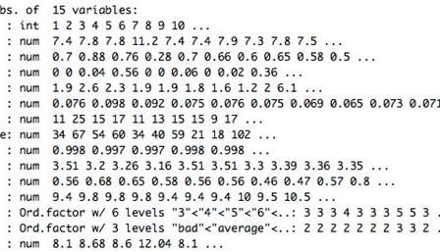
Let’s consider a dataset on Wine Quality
Data Exploration

Slide 22
Demo 1 & 2

Slide 23
Thank You!
#LifeKoKaroLift
24

