Slide 1

NASA SPACE APPS CHALLENGE 2026
FieldShift
Crop-rotation choices with climate context and clear limits
FIELD SHIFT: ADAPTING FARMS WITH NASA DATA
TEAM FIELDSHIFT
Illustrative visual. Not NASA data or a field measurement.
FIELD SHIFT / 01
Notes:
Project title and challenge: NASA Space Apps Challenge 2026, Field Shift: Adapting Farms with NASA Data. Left image is a FieldShift illustrative project asset, not a measurement or NASA dataset.

Slide 2
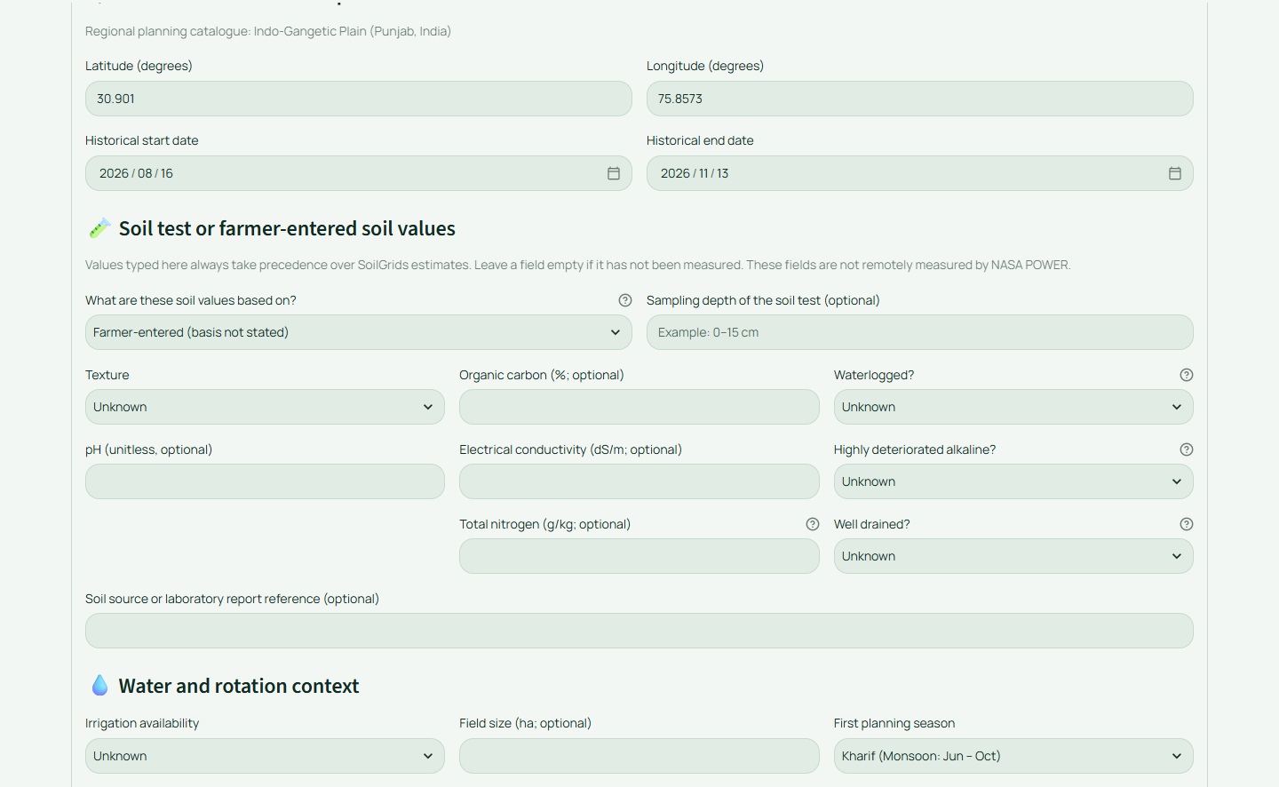
Start with the field, not the algorithm
A farmer enters the local facts they know.
Soil details
Irrigation limits
Previous crops
Priorities
Missing soil values remain unknown. They are never replaced with a favourable guess.
FIELD SHIFT / 02
Notes:
Source: FieldShift Farm Profile. Screenshot captured from the live FieldShift application on 2026-11-14. The location and values shown are illustrative.

Slide 3
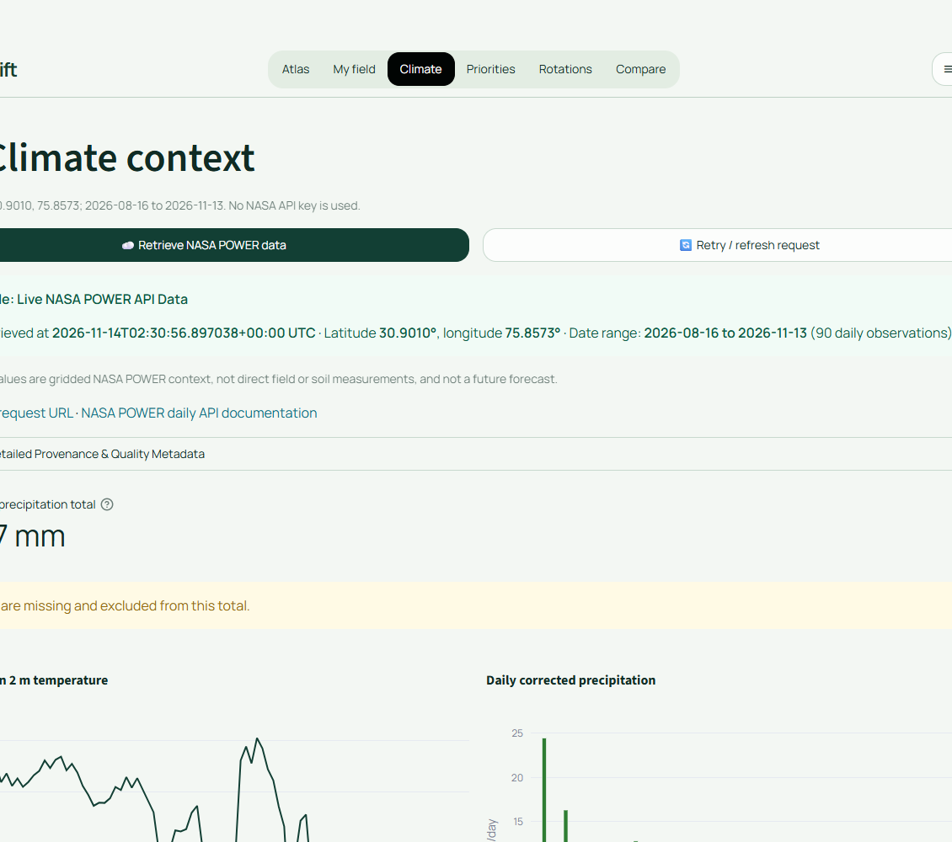
Climate data with provenance
Historical NASA POWER context arrives with the source, date range, units, request URL, and coverage warning.
Live data, not a decorative label
The application separates retrieved observations from calculated indicators and farmer inputs.
Gridded climate context does not measure soil chemistry or forecast a farm's future.
FIELD SHIFT / 03
Notes:
Primary data source: NASA POWER Daily API, https://power.larc.nasa.gov/docs/services/api/temporal/daily/. Screenshot captured from the live FieldShift application on 2026-11-14. Retrieved values are gridded climate context, not field measurements.

Slide 4
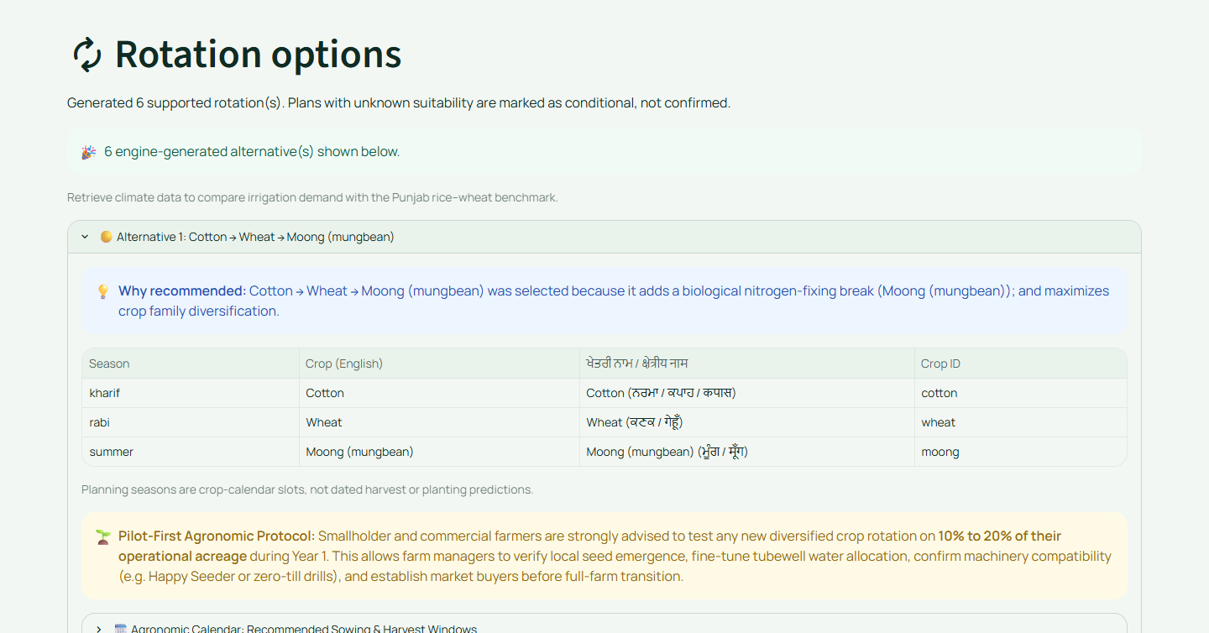
Rotation options need reasons
The engine searches documented crop relationships across several planning seasons.
Known hard rules stay hard.
The tool will not call a sequence feasible when it breaks a documented rotation or pest restriction.
One combined score never hides the separate checks, trade-offs, or missing inputs.
FIELD SHIFT / 04
Notes:
Sources: FieldShift crop catalogue, documented rotation rules, and docs/ROTATION_ENGINE.md. Screenshot captured from the live FieldShift application on 2026-11-14. The displayed plan is a prototype output, not a guarantee of outcome.

Slide 5
FieldShift keeps uncertainty in the decision
Unknown soil data
Hard rotation rules
is visible to the farmer and the engine
are checked before a plan appears
Farmer priorities
Sources and limits
change the comparison, not the evidence
stay beside the recommendation
That makes FieldShift a planning conversation, not an opaque crop recommendation.
FIELD SHIFT / 05
Notes:
Sources: docs/AGRONOMIC_ASSUMPTIONS.md, docs/ROTATION_ENGINE.md, docs/SCENARIOS_AND_UNCERTAINTY.md, and docs/KNOWN_LIMITATIONS.md.

Slide 6
Stress-test the assumptions
Dry
Hot
Less irrigation
Each scenario makes a clear hypothetical change to the historical context.
The farmer can compare how water suitability, climate suitability, feasibility, and trade-offs respond.
These views are stress tests. They do not forecast the next season.
Data coverage · Model limits · Scenario uncertainty
FIELD SHIFT / 06
Notes:
Source: docs/SCENARIOS_AND_UNCERTAINTY.md. Scenario transformations are hypothetical sensitivity tests, not weather or climate forecasts.

Slide 7
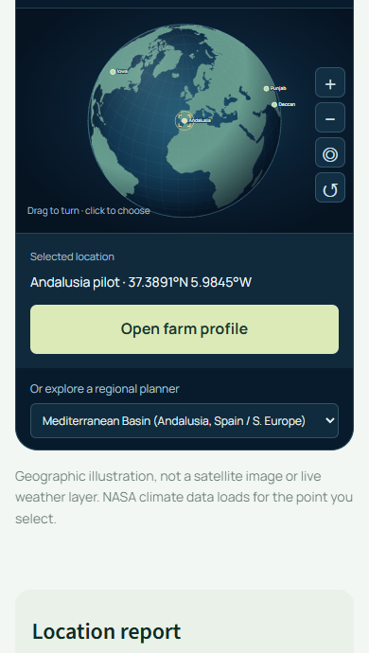
A transparent planning tool
FieldShift brings NASA climate context, farmer knowledge, and documented crop rules into one clear workflow.
It helps farmers ask better questions before making a choice with local expertise.
fieldshift-nasa.streamlit.app
Open app / Data sources / Methods
FIELD SHIFT / 07
Notes:
Live project: https://fieldshift-nasa.streamlit.app/. Source and complete references: https://github.com/sagar25446-prog/Nasa-Hacakathon. Screenshot captured from the FieldShift application. FieldShift is a decision-support prototype; farmers retain the final decision with local expertise.

