Slide 1
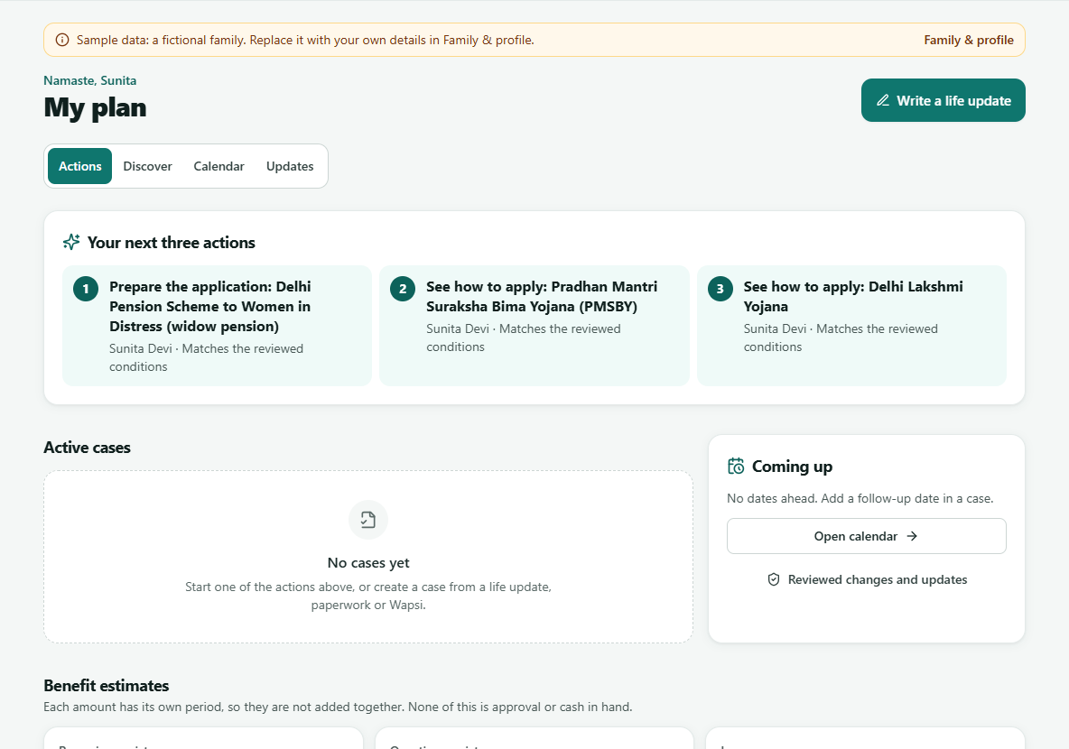
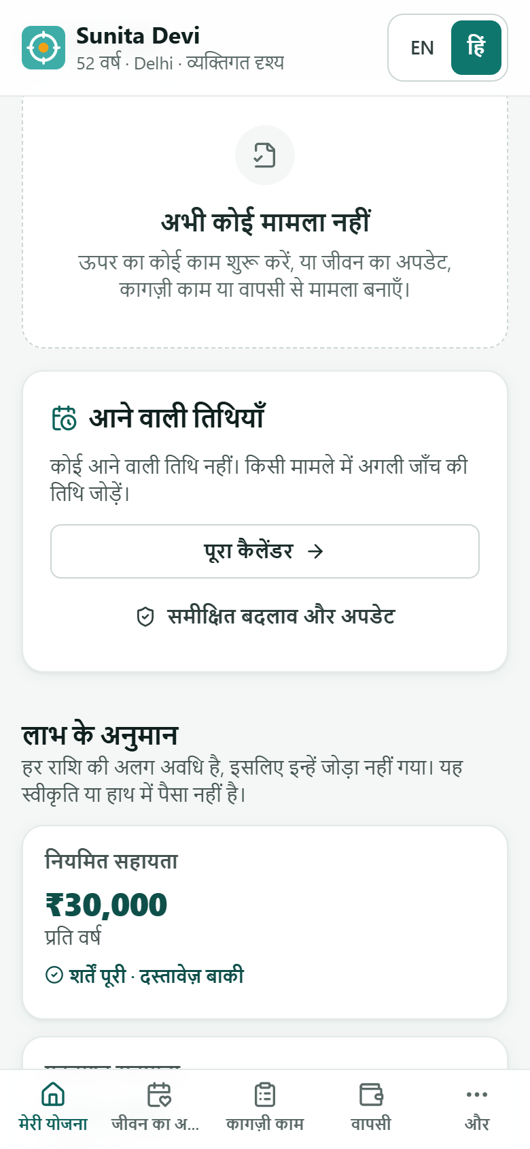

JAAGRUK
HackIIITD '26 · Esya · Final submission
जागरूक Janta's AI Agent for Government Rights, Updates & Knowledge
Every rupee your family is owed — found, proven, claimed.
A Hindi/English app that checks each entitlement against official rules with a Z3 solver, turns life changes into ready-to-act cases, and prepares unclaimed-money recovery on the live government web through TinyFish.
Z3-checked eligibility
6 TinyFish products
Live .gov.in portals
हिन्दी + English
THE TEAM
₹1.04 lakh cr
unclaimed in India
AA
Ayush Awasthi
SN
Saif Nasim
SH
Sagar Hundia
AI/ML & agents
Backend & TinyFish
Frontend & UI/UX

Slide 2






Families miss money and benefits they are already owed
01 · PROBLEM STATEMENT
UNCLAIMED IN INDIA
5,000+
SUNITA, 52, DELHI · HUSBAND DIED LAST MONTH
Rules are scattered
government schemes — citizens must search many department websites and guidelines to check eligibility
Each scheme has its own age, income and residence rules, in legal English across portals and PDFs.
₹1.04
lakh crore
Money is hidden
MeitY · myScheme
Each unclaimed-money portal covers one asset type, with its own form, login, OTP or CAPTCHA.
74%
Finder ≠ payer
UDGAM, MITRA and IEPF find a record — the bank, AMC or company actually pays.
Bank deposits ₹78k cr
Insurance ₹14k cr
of PM-JAY households surveyed did not know how to claim a benefit they already had
Deadlines move
Dividends ₹9k cr
Mutual funds ₹3k cr
Her daughter's scholarship renewal changes on boards nobody watches.
Source: PIB, Dec 2025
Haqdarshak survey, 6 states
People claim when someone helps: ₹5,777 cr went back to 22.95 lakh claimants in three months of help camps (PIB, Mar 2026). Portals list information — nobody watches, matches, verifies and acts for one family.

Slide 3
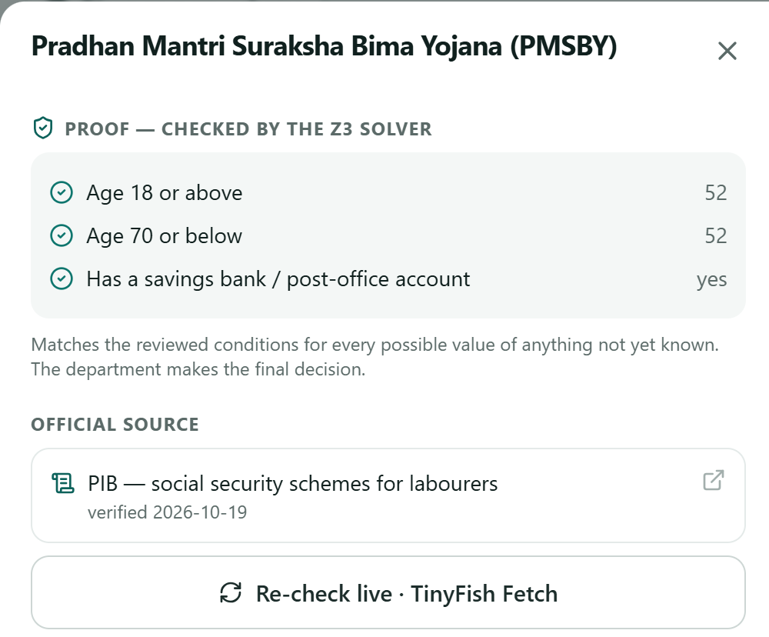

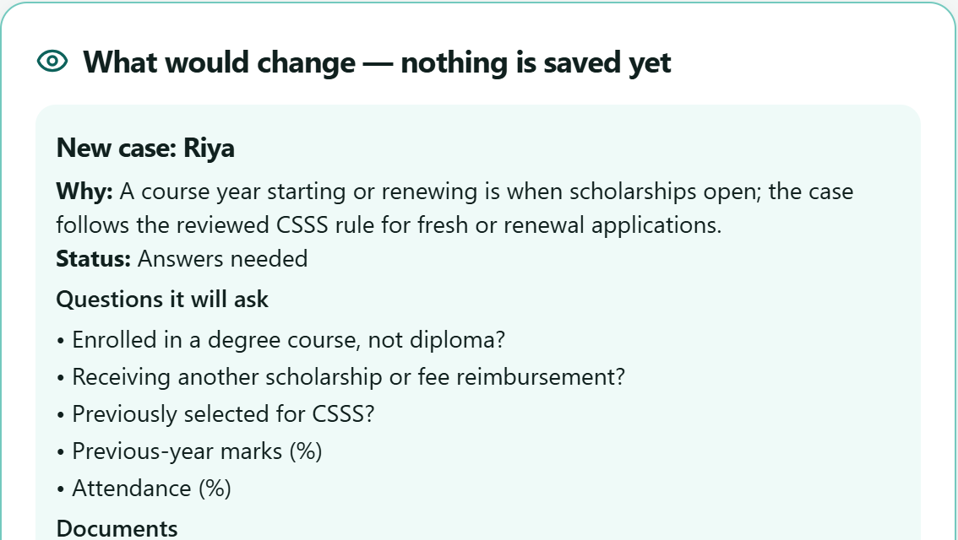

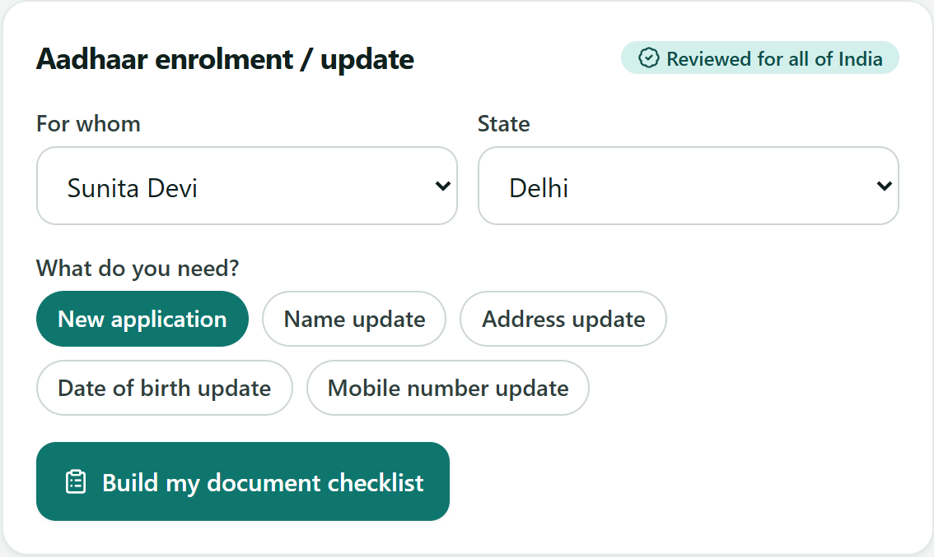

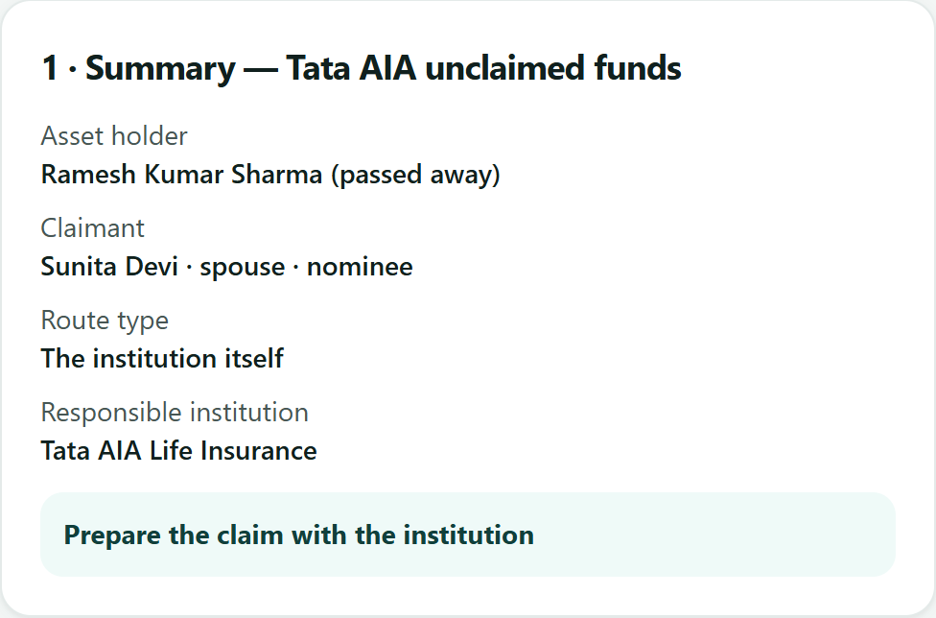





Find, check, prepare — and the family approves every step
02 · SOLUTION STATEMENT
One phone-first app for an Indian family's schemes, scholarships, exams, insurance and its own unclaimed money.
My plan
Life update
Next 3 actions + benefit estimates by type
“Why?”: Z3 checks every clause, with source and date
“Re-check live” reads today's page (TinyFish Fetch)
Write or say: “Riya got into second year”
Preview the new case, questions, documents — nothing saved yet
Apply refused if plan or rules changed
Paperwork
Wapsi
Minimum checklist for this person, service and state
From reviewed official routes — no invented lists
Anything else: TinyFish Search finds .gov.in guidance
Case first: holder, claimant, relation, claim capacity
Automated check (LIC, Tata AIA) or official site for OTP/CAPTCHA
Claim prepared with the institution that pays
Reasons, not guesses
Nothing submitted for you
Never sees an OTP or password
हिन्दी + English, voice

Slide 4





























A light, testable stack built for the live government web
03 · TECH STACK
Frontend
React 18
component UI
TypeScript
typed end to end
Vite
fast build, lazy screens
Tailwind CSS
48 px touch targets
Installable PWA
हिन्दी / English, voice
Backend
Python 3.12
typed services
FastAPI
REST + SSE job streams
Job ledger
restart-safe jobs
SQLite (WAL)
call log, helper links
FTS5
1,135-scheme search
Reasoning & ML
Z3 SMT solver
three-valued proofs
z3.Optimize
fewest docs to unlock
Name matcher
fuzzy + phonetic
Exam forecaster
circular statistics
Claude
optional: cited answers
Web layer
TinyFish Agent
run-sse, schemas
TinyFish Browser
CDP + Playwright
Fetch + Search
free public reads
Monitor
+ Research, cited
India exit proxy
for blocked portals
QUALITY
pytest · 103 offline tests
Frontend tests
Live adapter qualification
Recorded replay offline
Error boundary + self-heal
Why this stack: rules are data, a solver proves each answer, every web call is logged — and the whole app runs offline on recorded real runs.

Slide 5








One rules registry, one job ledger, one TinyFish harness
04 · SYSTEM DESIGN & ARCHITECTURE
CLIENT
API
SERVICES
WEB LAYER
Citizen or CSC
FastAPI
Rules registry → Z3
TinyFish harness
Phone or desktop, Hindi or English, voice input
My plan · Life update · Paperwork · Wapsi · Ask · Under the hood; private responses no-store
One rules_version for plan, cases, Discover, Ask
Plan → run → verify → self-heal → hand-off; every call logged, public reads replayable
Recovery cases
React PWA
Bound to case, holder, route; strict outcomes
Job ledger + SSE
Official web
Workspace, cases and journal stay in this browser; lazy screens, error boundary
Idempotent starts, cancel, live progress; “uncertain” after a restart
Updates + Discover
.gov.in · myScheme · NSP · LIC · Tata AIA · notice boards (India exit IP)
Notice boards, deadlines, 1,135 scheme pages
SQLite (WAL) TinyFish call log · job ledger · 24-hour helper links behind a hashed token · reviewed rule changes · no IDs, passwords or OTPs stored

Slide 6







All six TinyFish products, behind a harness that never guesses
05 · TINYFISH INTEGRATION
Agent · run-sse
Search
THE HARNESS — EVERY CALL
Tata AIA check · second opinion
Discover · paperwork · new schemes
1
Plan pick the qualified playbook or agent
5 steps · 66 s · ≈ $0.08
≈ 1 s · free
2
Run India exit IP, hard caps 180 s / 30 steps
Browser · CDP
TinyFish
harness
every call logged
Monitor
LIC playbook · myScheme pages
Always-on board watching
3
Verify read the portal's own result area
LIC in 38.6 s · ≈ $0.002
private webhook · operator-enabled
4
Self-heal one bounded fallback, only before submit
Fetch
Research
Updates scan · re-check · deadlines
Ask → live research, cited
5
Hand-off OTP / CAPTCHA → citizen on the official site
all boards in one call · free
cited .gov.in answers
STRICT OUTCOMES — EVERY CHECK ENDS IN ONE OF THESE
Possible record
No match
Citizen step
Missing input
Unavailable
Failed
Uncertain
Cancelled
CAPTCHA, outages and timeouts never become “no match”. A record is never treated as ownership, and amounts are never summed.

Slide 7



What the live government web taught us — and how we prove it
06 · RESEARCH & VALIDATION
Portal | What we found live | What we changed
LIC | The default network returned proxy_error | Every TinyFish browser and agent exits from India
SBI Life | Agent said “COMPLETED, not found” — it had hit a CAPTCHA | Blocked ≠ no match; the citizen completes it on the official site
IEPF / MCA | Search moved behind a login; an uncapped agent ran 83 steps | Hard caps on every run; official-site route
Delhi widow pension | Official text: income “less than ₹1,00,000” | Extractor fixed; Z3 proves our rule matches the live page
Agent outputs | found: true alongside “Found 0 unclaimed amounts” | Strict portal-specific reader + a test from the recorded case
103
backend tests pass offline — recovery, jobs, rules registry, eligibility, life updates
2 / 2
automated Wapsi adapters live-qualified on 25 Oct 2026 — LIC 38.6 s, Tata AIA 66 s
0.979
Research sources: PIB (Dec 2025, Mar 2026) · MeitY myScheme · Haqdarshak PM-JAY survey · RBI UDGAM · official portal pages read with TinyFish
name-matcher F1 on synthetic Indic name pairs; exact matching finds only 14% of true variants
Live tests use only a fictional identity (“Jaagrukdemo Testcase”). They show how portals behaved on the day — not a paid claim.

Slide 8





Cheap to run, clear to earn from, ready to scale
07 · IMPACT, BUSINESS MODEL & ROADMAP
WHAT A CHECK COSTS
WHAT'S NEXT
≈ $0.002
≈ $0.08
₹0
Every state's schemes through the same reviewed-rules pipeline
LIC playbook check on a TinyFish Browser
Tata AIA check with the TinyFish Agent
Search, Fetch and Research reads
Bhashini voice and more Indian languages
BUSINESS MODEL
CSC / NGO console
₹199 per centre a month
Year-2 projection ≈ ₹2.9 cr
conservative · ₹ crore a year
More banks and insurers as live-qualified adapters (IRDAI Bima Bharosa list)
CSCs already earn ₹30 per scholarship application; 1% of 5.16 lakh CSCs ≈ ₹1.23 cr a year
CSC operator mode: one operator serves a whole village
Banks & insurers
1% of a settled claim, capped at ₹500
SQLite → Postgres, jobs → a queue: drop-in upgrades
Paid only after a claim settles; the citizen pays nothing for recovery

Slide 9

Thank you
JAAGRUK जागरूक
Every rupee your family is owed — found, proven, claimed.
Ayush Awasthi · Saif Nasim · Sagar Hundia
4
destinations: My plan, Life update, Paperwork, Wapsi
6
TinyFish products on live .gov.in portals
103
automated tests, plus live adapter qualification
Run it: python run.py · offline: python run.py --replay · evidence: docs/VALIDATION.md

