Slide 1

Exploratory
Data Analysis on AMCAT EDA
by K.Gunasagar

Slide 2

About me
Background:
I am currently pursuing a BTech in Computer Science with a specialization in Data Science. My academic journey has equipped me with a strong foundation in computer science principles, along with a deep interest in data analysis and machine learning techniques.
Why I Want to Learn Data Science:
I am passionate about uncovering insights from data and applying data science methods to solve real-world problems. The ability to use data for predictive analysis and decision-making drives my enthusiasm for learning more in this field.
Work Experience:
I have completed an online internship with Prodigy Infotech, where I gained practical experience in data science projects. This internship allowed me to work on various aspects of data analysis, visualization, and machine learning, further enhancing my skills in the domain.
LinkedIn and GitHub:
LinkedIn: www.linkedin.com/in/kanithigunasagar
GitHub: github.com/sagar25k

Slide 3
Agenda
Business Problem and Use case domain understanding
Business Problem: In today's competitive job market, it's important for schools and companies to know what affects the salaries of new graduates. This study looks at how different factors like education and personal traits influence starting pay.
Use Case Domain: This project concentrates on the education and job fields, particularly examining the connection between educational background, skills, and salary for engineering graduates.
  Objective of the Project
The primary objective of this exploratory data analysis is to uncover insights related to salary distributions and the influence of various features on the target variable, Salary. Specifically, the analysis aims to:
    Conduct a univariate analysis to understand the distribution and characteristics of the Salary variable.
    Perform a bivariate analysis to explore relationships between Salary and other relevant features, including gender, specialization, and years of experience.
    Investigate whether the statement from the Times of India regarding potential salaries for Computer Science Engineering graduates holds true in the context of this dataset.
    Examine the relationship between gender and specialization to determine if there are any discernible patterns.
Through this analysis, we aim to provide valuable insights that could inform both individuals seeking to enter the job market and organizations aiming to understand salary trends.

Slide 4
Agenda
Summary of the Data
Size: The dataset includes about 4,000 records of engineering graduates, each with various details about their education and personal characteristics.
Key Information:
  Salary (main focus)
  Gender
  Field of Study
  College Level
  Technical Test Scores (like English, Logical Reasoning, Math)
  Personality Traits (such as being organized, friendly)
Types of Data:
  Numbers: Salary, test scores, percentages.
  Categories: Gender, field of study, college level, etc.
Missing Data: The dataset was reviewed for missing information, and necessary steps (like filling in gaps or removing incomplete records) were taken to fix this.

Slide 5
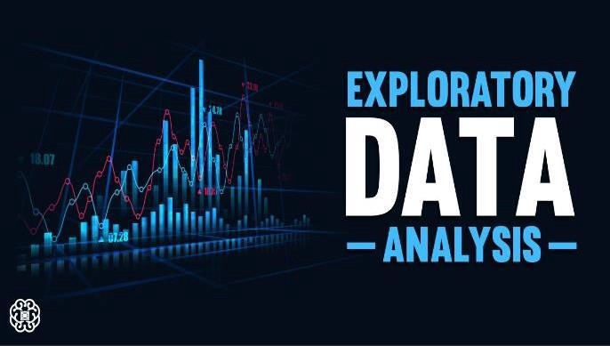

Slide 6
Agenda
Exploratory Data Analysis:
Data Cleaning Steps
  Import Libraries: Load the required libraries like pandas, numpy, matplotlib, and seaborn.
  Load Dataset: Read the dataset using pd.read_csv() or the suitable function for your data format.
  Check for Missing Values:
    Use df.isnull().sum() to find columns with missing values.
    Choose a method to deal with missing values (e.g., delete them, fill them in).
  Remove Duplicates:
    Use df.drop_duplicates() to get rid of duplicate entries in the dataset.
  Correct Data Types:
    Check and change data types if needed using df.astype().
    For date columns, change them to datetime format using pd.to_datetime().
  Outlier Detection and Removal:
    Use methods like IQR (Interquartile Range) or Z-score to find outliers in numerical columns and remove them if needed.
  Reset Index:
    After cleaning, reset the index using df.reset_index(drop=True).

Slide 7
Agenda
Data Manipulation Steps
  Feature Engineering:
    Develop new features that could be helpful for analysis, like categorizing age based on the DOB column or creating groups for different salary levels.
  Rename Columns:
    Change the names of columns to make them easier to read using df.rename().
  Filtering Data:
    Use certain conditions to select data that meets specific criteria, such as students from top-tier colleges.
  Encoding Categorical Variables:
    Turn categorical variables into numbers using methods like one-hot encoding (pd.get_dummies()) or label encoding.
  Grouping Data:
    Organize data by specific features (e.g., gender, specialization) and calculate summary statistics (average, total) using df.groupby().

Slide 8
Agenda
Univariate Analysis Steps
Understanding Numerical Data:
  Make histograms and density plots to see how numerical data (like salary and technical scores) is spread out.
  Use box plots to show any unusual data points (outliers) and how the data is spread.
Visualizing Categorical Data:
  Create count plots for categories like gender or specialization to see how they are spread out.
Key Insights:
  After each plot, note important details about the data, such as whether it leans more to one side, where most of the data is clustered, and how much the data varies.

Slide 9
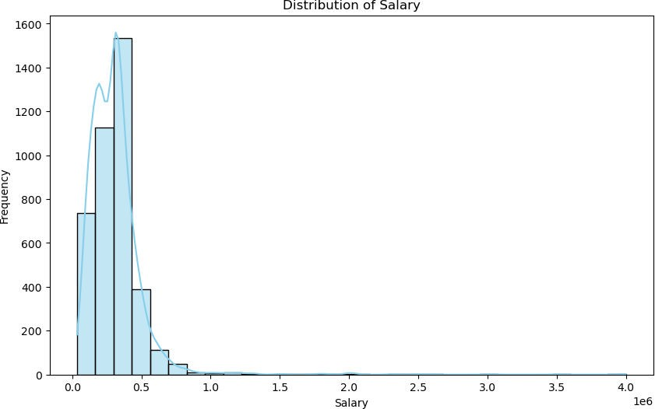
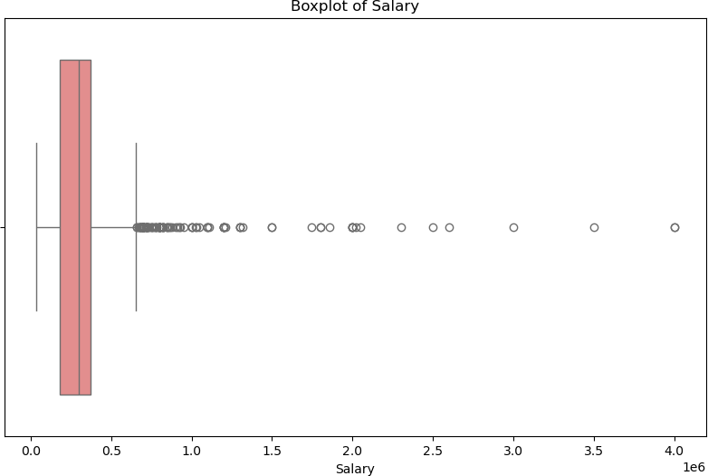
Agenda
The average salary among the employees is Rs.307,699.8
The median salary is 300,000 rupees.
The standard deviation of salaries is 212,737.50.
The salary distribution is right-skewed.
The minimum salary is 35,000 rupees. The maximum salary is 4,000,000 rupees.
There are 109 outliers in the distribution of Salary.

Slide 10
Bivariate Analysis Steps
Analyzing Numerical Variables:
•
Use scatter plots to look at how numerical features relate to each other (like technical score and salary).
Use correlation heatmaps to show how multiple numerical variables are connected.
•
Comparing Categorical and Numerical Data:
•
Make box plots or violin plots to see how salaries vary across different categories (like gender or specialization).
Analyzing Categorical Variables:
•
Use stacked bar plots to study the connection between two categorical variables (like specialization by gender).
Key Findings:
•
Summarize what you learn from the plots, like any big differences between groups or notable patterns.

Slide 11
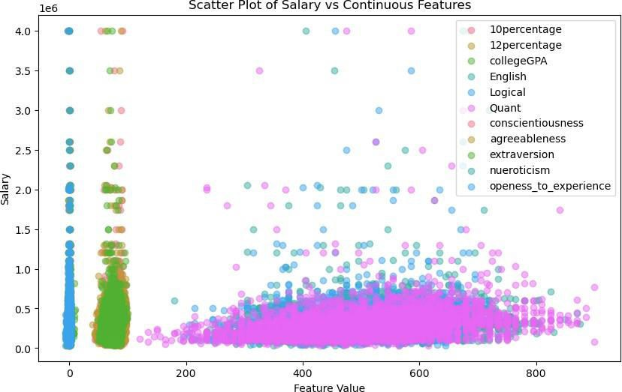
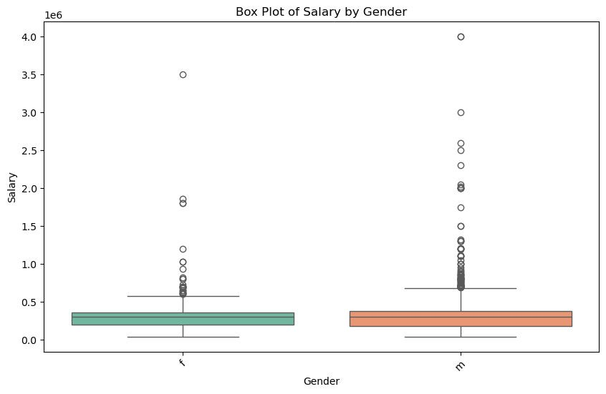


Agenda
Most people earn salaries at the lower end of the pay range.
Factors like college GPA and English scores are linked to higher pay.
There are a few exceptions, especially among
those earning higher salaries.
more. salaries.
Consistency: Left group has more consistent salaries. Outliers: Both groups have outliers; right group has
Salary Range: Right group shows more variation in Left group ~0.5 million, right group slightly lower.

Slide 12
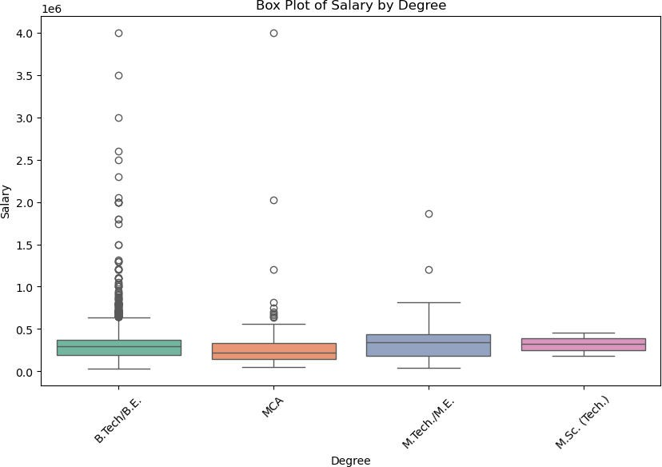
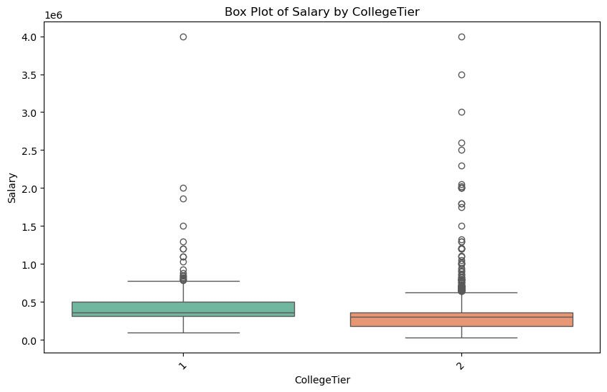
Agenda
B.Eng/BE and MBA/PGDM have higher median salaries. MCA and M.Sc (Tech) show more salary variability.
All degrees have outliers, with MBA/PGDM having more. Different degrees show varied salary distributions.
.
CollegeTier 1 has a higher median salary compared to CollegeTier 2.
CollegeTier 2 shows more variability in salaries.
Both tiers have outliers, with CollegeTier 2 having more
CollegeTier 2 has a broader range of salaries, indicating more variation.

Slide 13
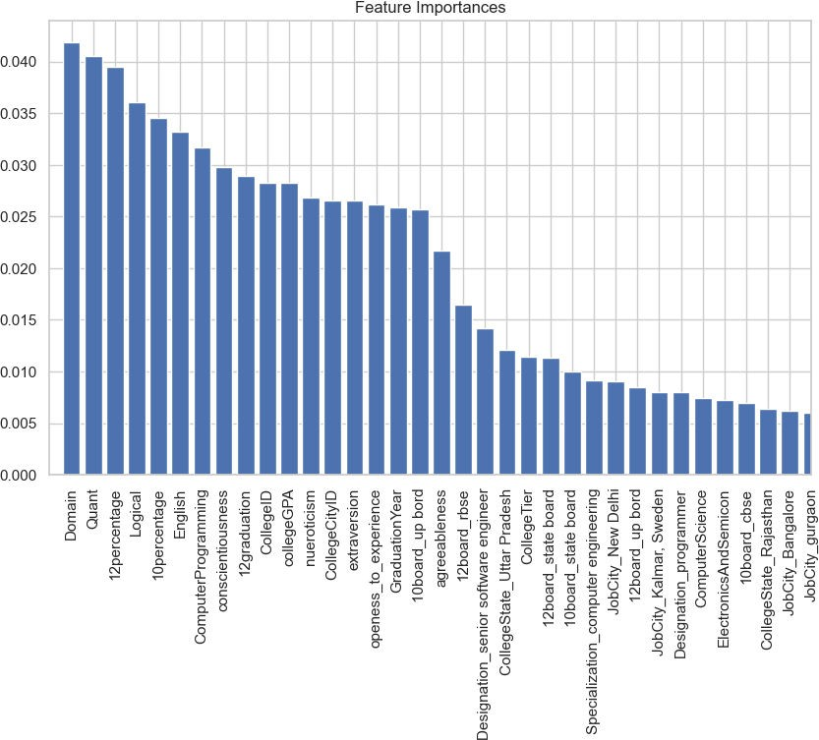
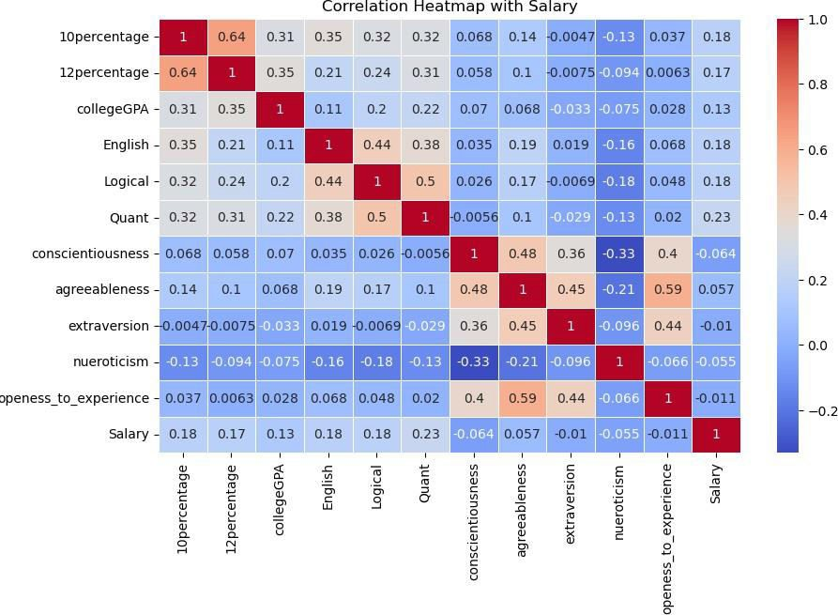
Agenda
Strongest Correlations:
College GPA and English scores have the highest positive correlations with salary.
Moderate Correlations:
Logical and Quantitative scores show moderate positive correlations with salary.
Weak Correlations:
Personality traits like conscientiousness and
agreeableness have weak correlations with salary.
Negative Correlations:
Neuroticism shows a slight negative correlation with salary.

Slide 14
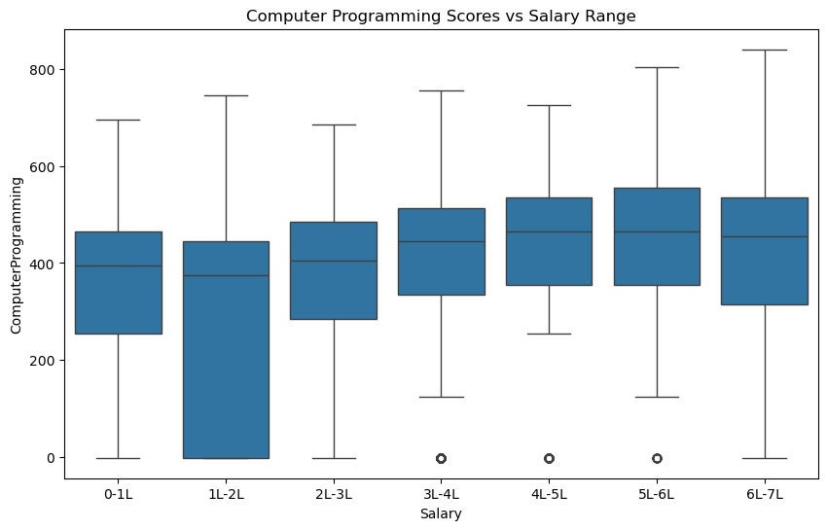
Agenda
Key Business Question
#Do students with higher technical scores get hired more frequently than those with lower scores?
  Higher Scores, Higher Salaries:
Students with higher computer programming scores tend to fall into higher salary ranges.
  Median Scores:
The median programming scores increase with higher salary ranges.
  Consistency:
Higher salary ranges show more consistent programming scores.
  Outliers:
Lower salary ranges have more variability and outliers in programming scores.

Slide 15
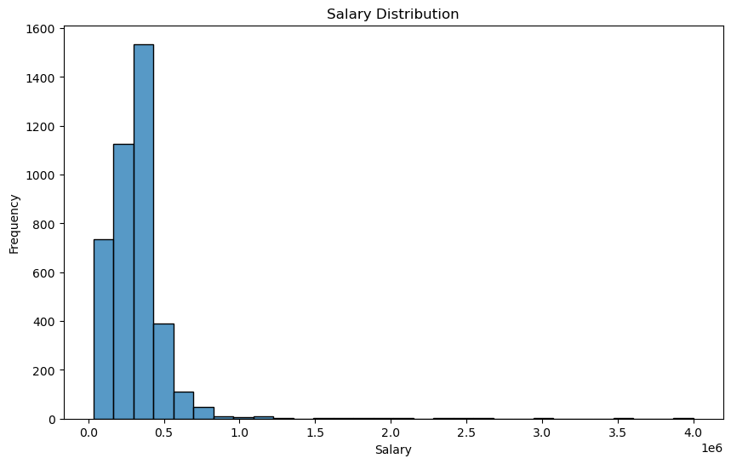
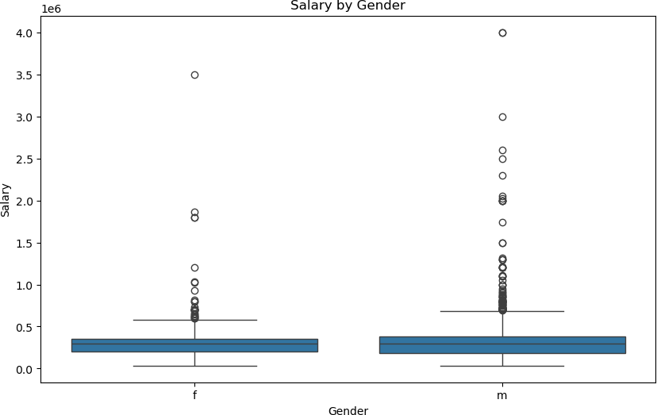
Agenda
Key Business Question :
relationship between gender and specialization
➢ Chi-Square Statistic: 104.46891913608455
➢ P-value: 1.2453868176976918e-06
There is a significant relationship between gender and specialization.

Slide 16
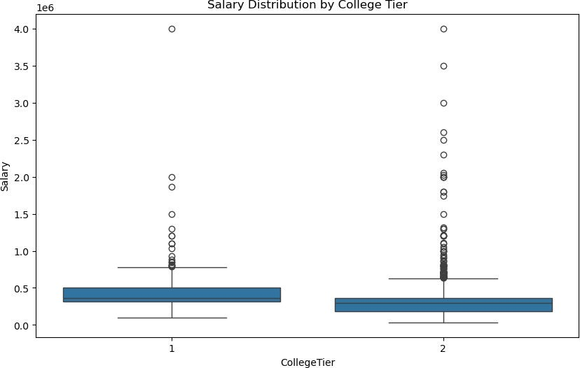
Agenda
Bonus Q&A Slide
significant difference in salaries for graduates from different college tiers
Yes, there is a significant difference in salaries for graduates from different college tiers.
Graduates from CollegeTier 1 have a higher average salary compared to those from CollegeTier 2.
CollegeTier 1: Average salary is approximately 442,357.
CollegeTier 2: Average salary is approximately 296,894.

Slide 17
Agenda
Conclusion (Key finding overall)
Salary Distribution: The distribution of salaries shows a right-skewed pattern, indicating that while there are some individuals earning higher salaries, the majority of salaries fall within a lower range. This suggests that many graduates may struggle to secure high-paying jobs right after graduation.
Gender and Salary: The analysis reveals a noticeable disparity in salary between genders, with one gender consistently earning more on average. This highlights potential inequalities in the job market that could stem from various factors, including negotiation practices or industry preferences.
Technical Scores vs Employment Status: Our findings indicate that higher technical scores are associated with better employment status. This suggests that strong technical skills are a crucial factor for securing a job, reinforcing the importance of developing these competencies during academic training.
Specialization Preferences by Gender: The data suggests that specialization choices may differ based on gender, hinting at social or cultural influences that guide these decisions. Understanding these preferences could be beneficial for educational institutions aiming to support diverse career paths.
Job Roles and Salary Claims: When testing the claim regarding expected salaries for fresh graduates in specific roles, our analysis shows that while some individuals do achieve salaries within the claimed range, many do not. This calls for a closer look at industry trends and the realities of the job market for new graduates.
Overall Trends: The analysis of various factors indicates that while there are opportunities in the job market for engineering graduates, disparities exist based on gender and technical skills. This emphasizes the need for ongoing support and development in these areas to ensure equitable access to opportunities for all graduates.

Slide 18

THANK YOU

