Slide 1
*args and **kwargs
It is not necessary to write *args or **kwargs. It is just a convention.
The * (asterisk) is necessary.
You could also use *var and **vars.

Slide 2


*args
*args: It accepts any extra non-keyworded arguments that are passed through actual parameters of the function.
Allows you to pass variable number of arguments through function
Syntax : use ‘*’ before a variable name.

Slide 3
**kwargs
It allows us to pass the variable length of keyworded arguments to the function.
Syntax: use ‘**’ before a variable name.
Imagine a dictionary as keyworded arguments.
X = {‘company’ : ‘Consultadd’, ‘training’ : ‘Python’}

Slide 4
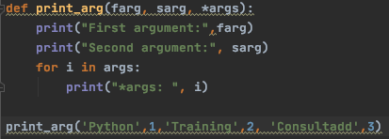
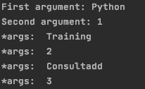
Example *args

Slide 5
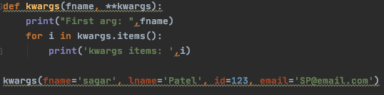
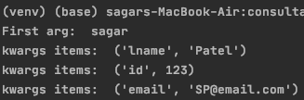
Example **kwargs

Slide 6
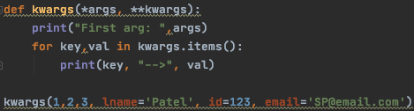

*args, **kwargs example

