Slide 1


AI reinvention made real
Accenture Innovation Challenge 2026
Notes:
DigitalTwin.ai — Round 1 concept deck, Accenture Innovation Challenge 2026, problem statement 4. Team HipHipHooray.

Slide 2


Team details
TEAM NAME: HipHipHooray
Sagar Sahu (Team Leader)
Priyansh Goyal
College: IIT Kharagpur
Stream: Ocean Engineering and Naval Architecture
Year of graduation: 2027
College: IIT Kharagpur
Stream: Electronics and Communication
Year of graduation: 2027
DigitalTwin.ai · see the constraint · predict the defect · estimate the unseen
Notes:
Two members, both IIT Kharagpur, graduating 2027.

Slide 3
The Problem Statement
A modern line is instrumented for utilisation. Utilisation does not tell you what is costing you cars.
A bottleneck ripples downstream — and never stays put
We jammed one station, let cars pile up, repaired it, then ran it at twice every other station's speed. Output: 106 cars either way — the queue just moved downstream. The constraint also moves on its own: about six times per shift, up to 25, with no fault injected at all. An hour saved at a non-bottleneck is a mirage (Goldratt, 1984).
106 = 106
cars out — repaired, or twice as fast
speeding up a non-constraint bought nothing
1
An early defect can go uncaught for dozens of vehicles
A tool can drift out of calibration long before anyone notices — the part looks fine, the station reports no fault. Under sensor drift, 11,631 of 11,826 defective joints in our data passed as OK, because the reading the controller trusts was the thing that had failed.
11,631 / 11,826
defective joints passed as OK
98% escape rate · v3 process telemetry
2
Many real stations have little or no sensor data
Manual stations and legacy equipment routinely expose no usable signal. Guessing is dangerous: bracketing a silent station between its neighbours' timestamps alone overstates its true work time by 53% — 88.8 s measured against 58.0 s true — because it also counts the waiting its neighbours caused.
88.8 s → 58.0 s
raw occupancy vs true work time
a 53% overstatement if you trust the bracket alone
3
Why it matters: unplanned downtime in automotive runs above $2M per hour (Senseye/Siemens) — and the line supervisor deciding what to fix next has minutes, not hours.
Notes:
Three problems, taken straight from PS4's own wording. Each is demonstrated with a measured result rather than asserted. 106 = 106 is the hook: repairing the jammed station restored output; running it at double speed added nothing, because it was no longer the constraint.

Slide 4
Proposed Solution
A closed-loop AI twin that ranks stations by what a fix is worth — not by how busy they look. It runs on signals the line already emits.
Line
OPC-UA · MTConnect
Event spine
five event types, one clock
Twin
replay + paired counterfactual
Ranked call
cars gained, not % busy
Supervisor
confirms or overrides
◀ closed loop, responsibly — a person confirms each change, then the twin re-reads the line
1
Bottleneck formation
answers #1
2
Defect prediction
answers #2
3
No-sensor stations
answers #3
1 Each station carries a working / blocked / starved state — measured where a PLC tag exists, estimated where it doesn't.
2 The constraint runs busy while the station behind it blocks and the one ahead starves. That signature locates it, not raw busyness.
3 Rank by processing time ÷ uptime, then pull only that station's full history.
4 Buffer fill-rates flag the next constraint before it forms — 60% of warnings are followed by a real block.
1 Track always-on signals per station — torque, current, cycle time — with running statistics that cost almost nothing.
2 Combine into one health score; stay silent unless it drifts from that station's own healthy baseline.
3 Classify why before acting: a worn tool needs servicing, a drifted sensor needs only recalibrating.
4 Get that wrong and you either pass 11,631 bad joints or scrap 700–960 good ones.
1 Bracket a silent station between the two timestamps we do have, minus an estimated transit-time distribution — never a fixed number.
2 Cross-check the neighbours: an empty upstream buffer means it was waiting, not working.
3 Several dark in a row? Locate the culprit from arrival delays on each side, the way an earthquake is placed.
4 Every estimate ships a confidence score; a fully opaque section gets a costed sensor recommendation.
46% / 58% top-1 / top-2 vs 35% / 48% for utilisation ranking · 958 scored line-blocks
median warning 421–1,322 vehicles before scrap · bearing faults flagged separately
cuts a 53% bracketing overstatement down to the true work time
Every station also publishes how well it is known.
What was measured, what was inferred, and how confident the twin is on each one — so a supervisor can see where the model is guessing before acting on it.
ILLUSTRATIVE · observability record format
2 of 10 signals measured, 6 inferred
confidence 0.81 — act, but verify on site
MODEL stations, buffers, routing, processing-time distributions, failures and repair, genealogy per unit
SKIP 3D geometry, robot kinematics, welding / paint physics, closed-loop write-back to line control
Notes:
Three pipelines, one per problem, tagged 'answers #1/#2/#3' so the mapping to the previous slide is explicit. Everything runs on signals the plant already emits. The twin advises; a person confirms; it never writes to line control.

Slide 5
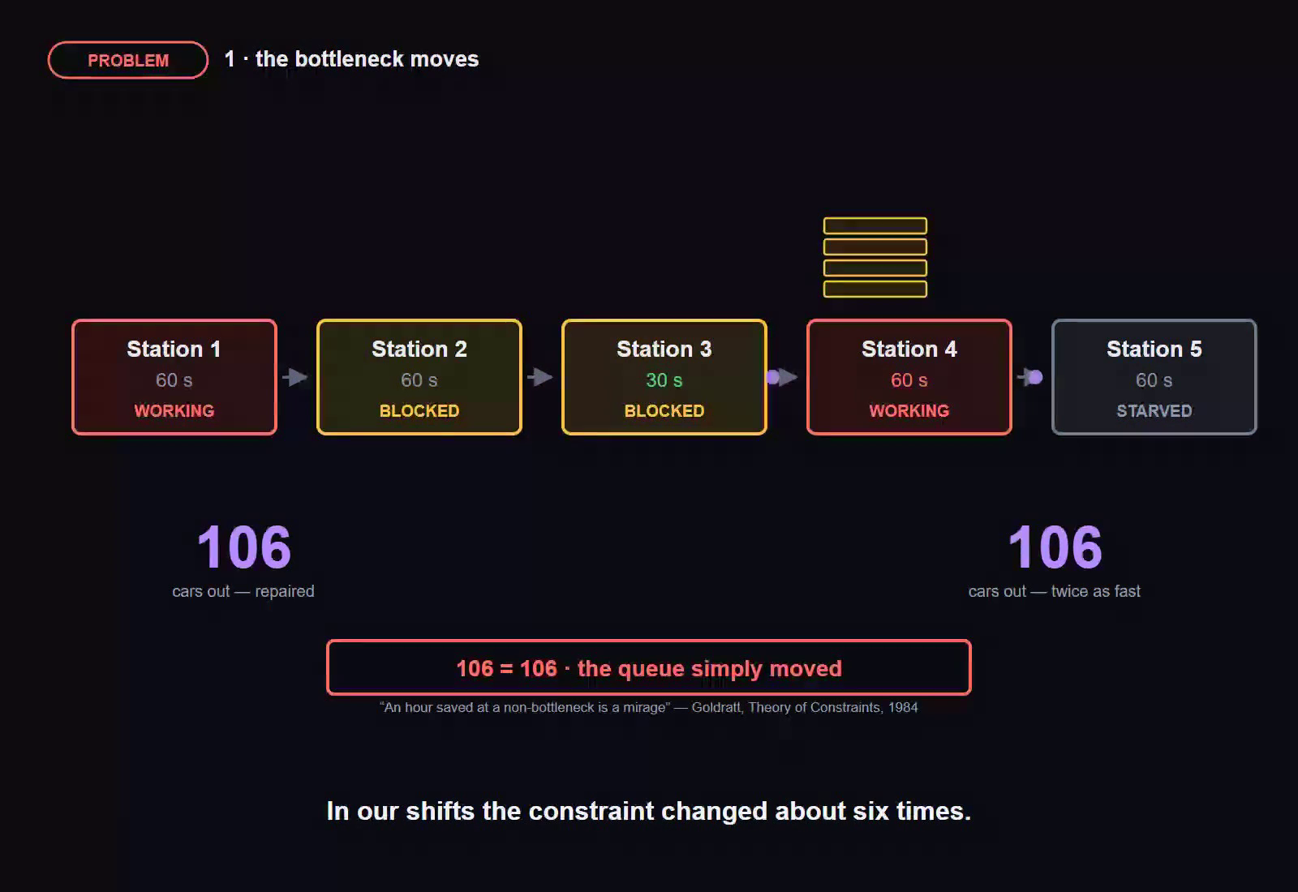
Video
Two minutes fifty-three: three problems, three solutions, and the loop that closes them.
Watch the demo
▶ Watch the video on Google Drive
https://drive.google.com/file/d/1U0qsM3jGvBVVtscg6wikxxGiOH4cvRs0/view?usp=sharing
2:53 · narrated · captions on screen
What the video covers
0:00 Team introduction.
0:03 The line — twenty stations, and the signals a plant already emits.
0:12 Problem 1 → Solution 1 · the bottleneck moves; read the blocked / starved signature.
0:57 Problem 2 → Solution 2 · the sensor is what drifted; watch the health score.
1:37 Problem 3 → Solution 3 · dark stations; bracket, then correct the bias.
2:19 The closed loop · ranked call, and a person confirms every change.
Everything shown is reproducible.
We built the plant as well as the twin, so ground truth is known and held in files the detectors never read. Every figure on these slides comes from committed code run against that truth; industry figures are cited as ranges, and negative results are reported at the same prominence as positive ones.
Backing material: a pipeline design document and an evidence file, each carrying per-claim provenance. Here is the drive link of those files: https://drive.google.com/drive/folders/1wY7A9GcMkgCSGwxs4Z9mUg2iX4wXhhoC?usp=sharing
BUILT & MEASURED three detection pipelines, a 20-station plant simulator, 162 runs, held-out calibration DESIGNED, NOT YET BUILT genealogy containment, failure-mode classifier
TESTED AND FAILED drift-based overtake risk called 70–100% confidence but was right 5.9% of the time. We report it rather than hide it.
Notes:
Video is embedded and also linked. Provenance: we built the plant as well as the twin, so ground truth is known and held in files the detectors never read. Negative results are shown, not hidden.

Slide 6
Thank you
DigitalTwin.ai · Team HipHipHooray
Every figure on these slides is produced by committed code against ground truth the detectors never read.
Notes:
Close.

