Slide 1
Book2
File created on: 10/2/2024 6:06:42 AM

Slide 2
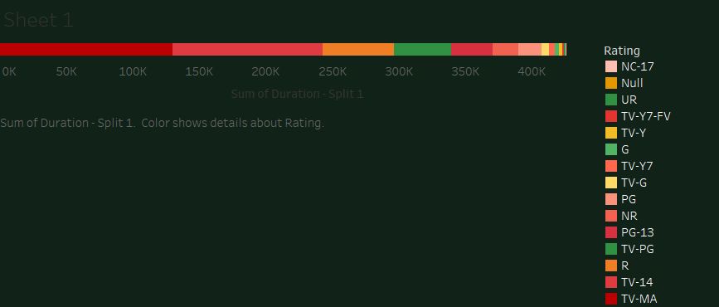

Slide 3
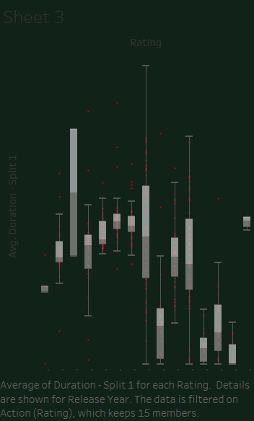

Slide 4
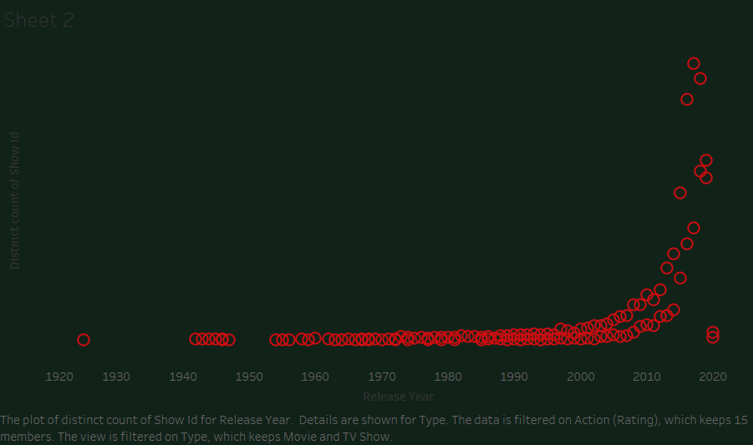

Slide 5
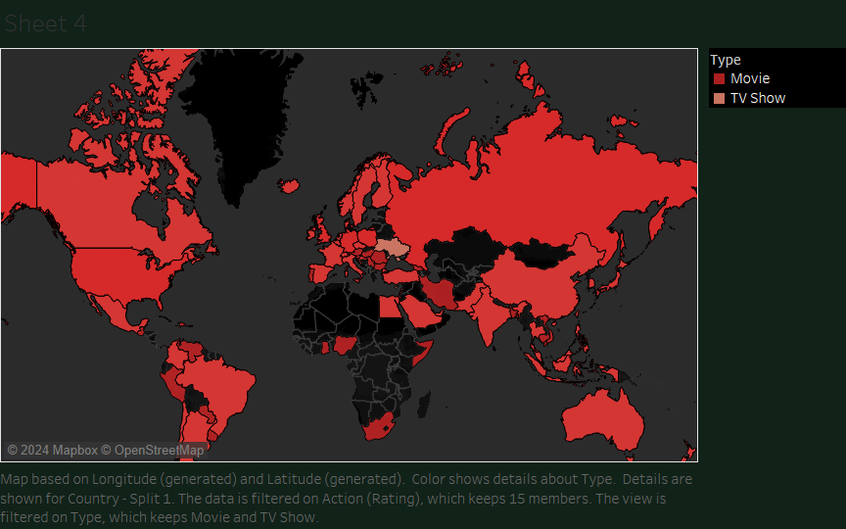

Slide 6
