Slide 1

Presentation on Network layer ATTACK (TNET)

Slide 2

INTRODUCTION
As the world now has been fully involved in digitalization from every aspect which means every work is done through working over the internet.
Maintaining the network security has been very challenging. As many users are getting involved into technology, equally the cyberpunks seek chances to get into the system in order to exploit and gain access to the devices to acquire sensitive data.

Slide 3

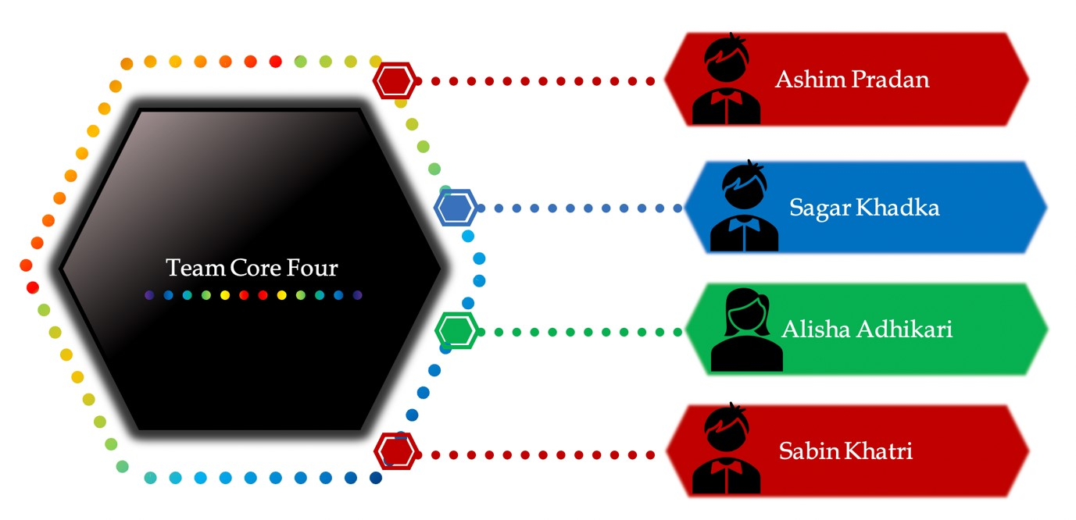
Core 4 member

Slide 4
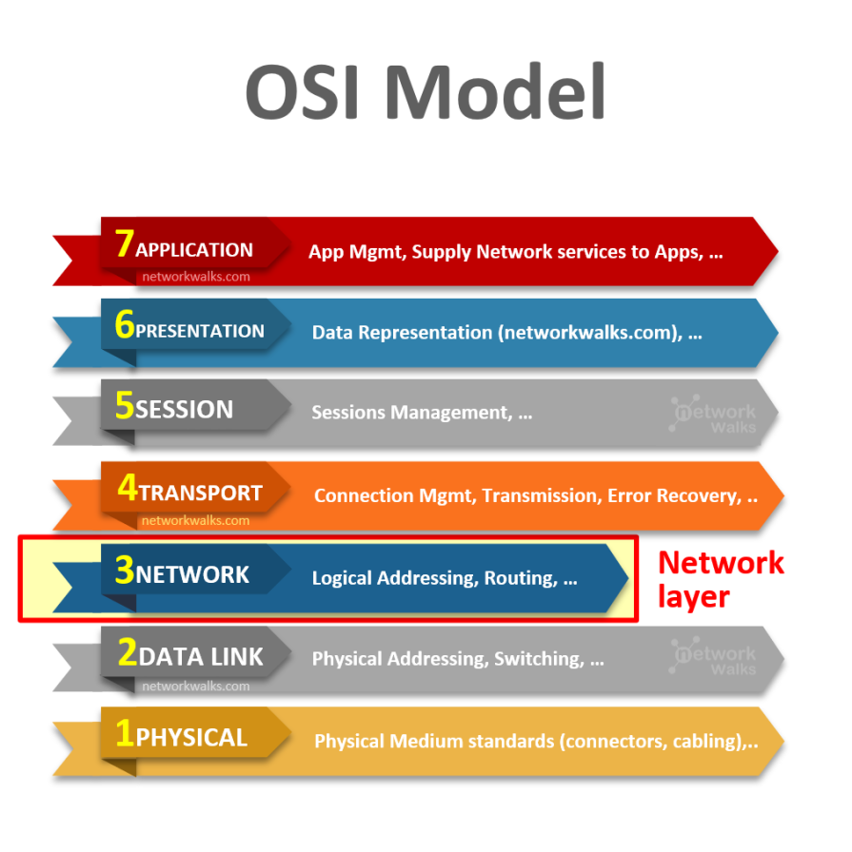
NETWORK LAYER
Host to Host( Source to Destination) delivery.
Uses Logical Address(IP Address)
Uses Router as main device.
Routing (RIP, OSPF)
Fragmentation
-

Slide 5

MISSION, VISION AND AIM
Implement possible attack on layer 3 device.
Secure the layer3 devices from every possible attack.
Provide an eyesight to the security expert where the layer3 device weakness is occurred

Slide 6

Attack performed
Ip spoffing
Rip Attack
DDOS Attack
EIGRP Attack
ICMP Flood Attack
POD Attack

Slide 7

POSSIBLE SOLUTION
Authentication implementation
Proper Engineering
Avoid neglence
Securing premises

Slide 8

ETHICAL AND LEGAL CONSIDERATION
Law has divided hackers in three types.
White hat hacker
Black hat hacker
Gray hat hacker

Slide 9

TOOLS AND TECHNOLOGY
Kali LInux
GNS3
Python
Pycharm

Slide 10
Thank you

