Slide 1

SMART INDIA HACKATHON 2026
StormLife Nowcast
Problem Statement ID – SIH26084
Problem Statement Title- Convective Scale Nowcasting for Thunderstorms, Hail & Cloudbursts (0–6 hr)
Theme- Disaster Management
PS Category- Software
Team ID- 167858
Team Name – THE FEVICONS
Notes:
StormLife Nowcast: satellite-first nowcasting of deep convection for SIH26084. Research prototype, validated on real, held-out storm days. Fill Team ID and registered Team Name before export.

Slide 2
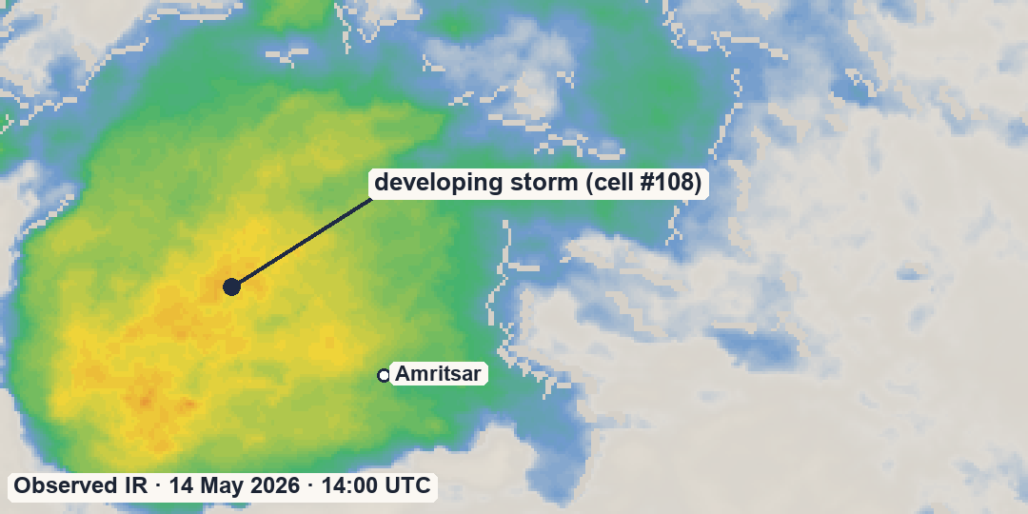
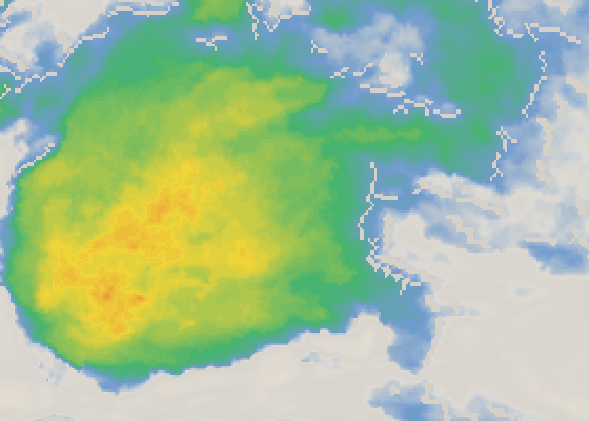
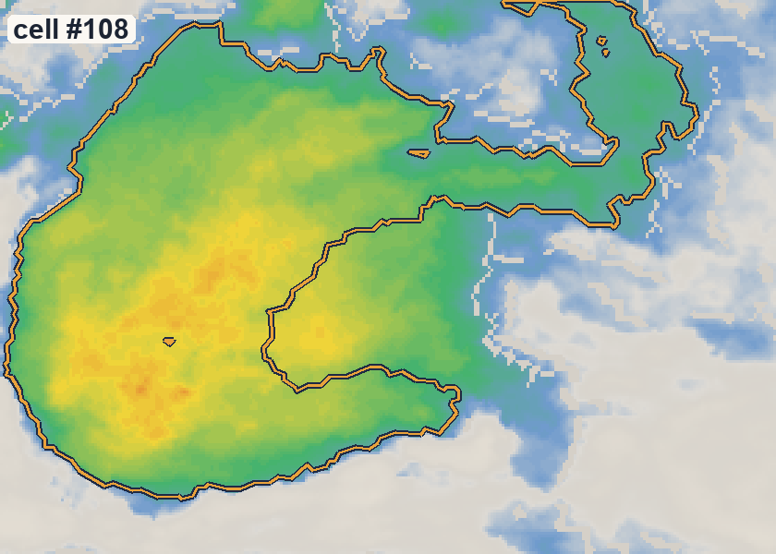
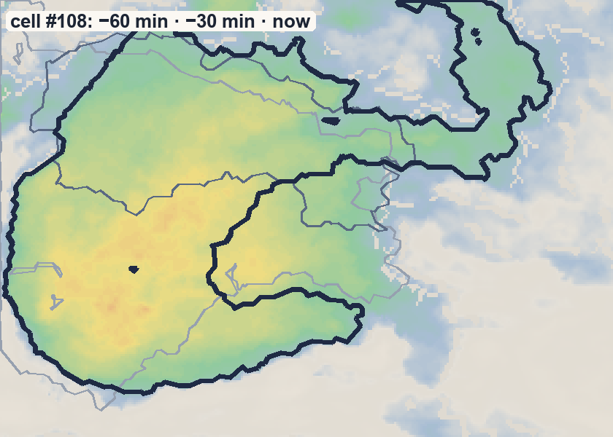
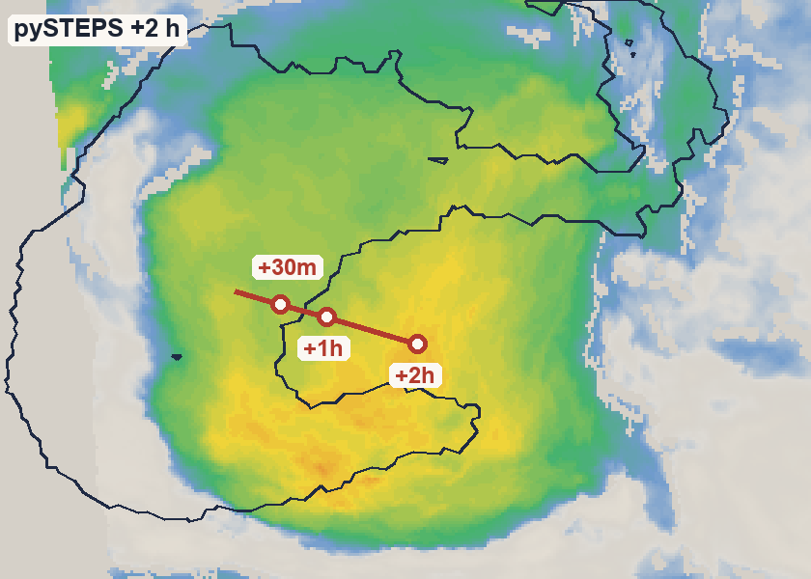
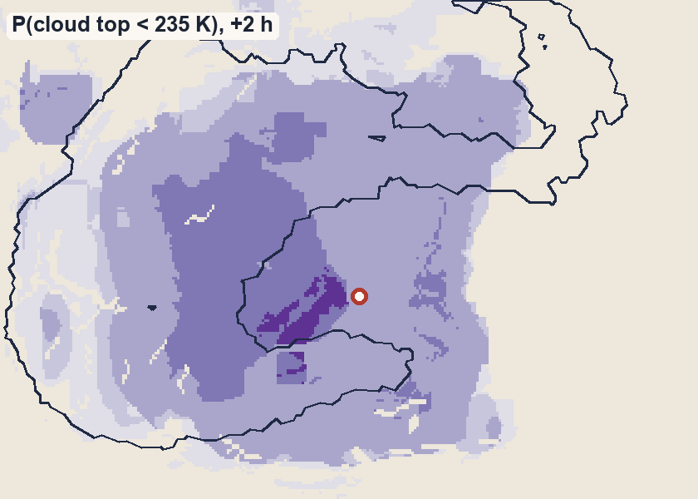
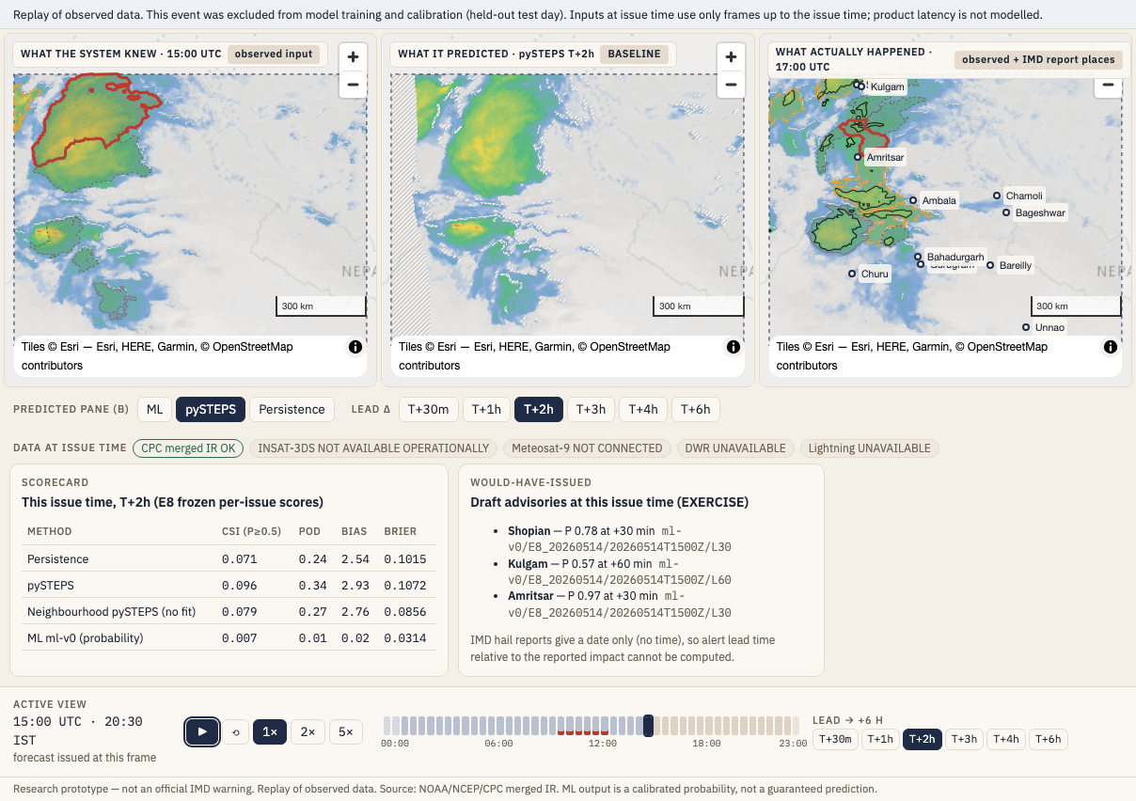
IDEA TITLE
THE FEVICONS
StormLife Nowcast: satellite → storm cell → a forecast you can check. Convective-scale nowcasting, 0–6 h: how far can it be trusted?
▸ HOW IT ADDRESSES THE PROBLEM
▸ DETAILED EXPLANATION OF THE PROPOSED SOLUTION
WHAT WE SEE TODAY
WHAT STORMLIFE ADDS satellite nowcasting of one real storm cell (#108, 14 May 2026)
30 min
→ 6 h
1 SATELLITE IR
2 DETECT
3 TRACK
4 FORECAST
5 PROBABILITY + SKILL
6 REPLAY / DECIDE
every 30 min
cold cell < 245 K
same cell, by area overlap
storm movement, 30 min – 6 h
calibrated, validated
knew · predicted · happened
2 km grid
target: deep
convection,
cloud top < 235 K
VALIDATED SKILL SHOWN BESIDE EVERY FORECAST
3 held-out storm days, pooled
BSS 0.27
ML probability skill at +2 h (no-fit ref. 0.02)
to ≈ 4 h
best probability skill of the 4 methods tested
1 h
yes/no maps: no gain over pySTEPS beyond 1 h
? Where will it move?
? Will it intensify?
? How far can we trust the forecast?
Thunderstorms, hail and cloudbursts grow from deep convection within hours · no open, live radar or lightning feed in India
▸ INNOVATION AND UNIQUENESS OF THE SOLUTION
1
Real storm days only
No simulated radar, lightning or metrics; days fixed before scoring
2
Baseline-first
Every result vs persistence and pySTEPS; negative results reported
3
Calibrated probability
Reliability and validated skill shown with each forecast
4
Audited and frozen
Tracking audited before use; 386 evidence files hash-locked
RESEARCH PROTOTYPE · real satellite data, held-out storm days · hazard-specific (hail, lightning, rain) skill not claimed · not live · not an official IMD warning
Notes:
Left: this is what a forecaster sees today, the real satellite IR image of 14 May 2026 at 14:00 UTC. It shows where the storm is, but not where it will go, whether it will grow, or how far to trust a forecast. Right: StormLife takes that same storm cell (#108) through the pipeline: detect it, track it, forecast it 30 min to 6 h ahead, give a calibrated probability of deep convection, and show the validated skill beside it. Every panel is rendered from our frozen replay data. The skill numbers come from 3 held-out storm days. As a yes/no map, ML is not better than pySTEPS beyond 1 h, and we say so. This is a replay prototype, not a live system.

Slide 3
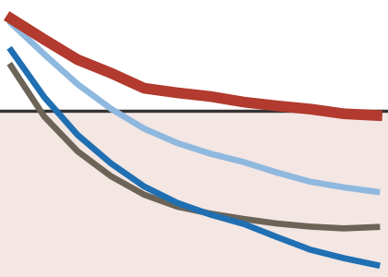
TECHNICAL APPROACH
THE FEVICONS
▸ TECHNOLOGIES & TOOLS
▸ METHODOLOGY AND PROCESS: HOW STORMLIFE WORKS
▸ WORKING PROTOTYPE: WHAT IT PRODUCES
1
DATA &
SCIENCE
2
STORM
INTELLIGENCE
1
REAL SATELLITE DATA What goes in: pictures of cloud-top temperature
NOAA/NCEP/CPC merged IR · 4 km · 30-minute frames · 3 held-out storm days
STORM CELL
cell #108, 14 May 2026
Python
NumPy
pandas
xarray
SciPy
OpenCV
scikit-image
custom overlap tracking
optical flow
TRACK + MOTION
where it has been and is heading
2
QC + PREPROCESSING Clean every frame and put it on one map
Decode · quality control · cloud-top temperature (BT) · 2 km grid
30 MIN – 6 H FORECAST
where it may be next
Satellite processing & numerical analysis
Detect, track & characterize storm cells
3
STORM INTELLIGENCE Find the storms and follow them
Cold cells < 245 K (deep convection) · area-overlap tracking · optical-flow motion
CALIBRATED PROBABILITY
how likely is deep convection?
VALIDATED SKILL
how far to trust it
3
FORECAST &
VALIDATION
4
PRODUCT
4
FORECAST ENGINE Estimate what happens next, 30 min – 6 h
STORMLIFE DASHBOARD
9-screen replay prototype
pySTEPS
scikit-learn
isotonic calibration
pytest
React
TypeScript
Vite
MapLibre GL
Persistence
baseline: assume no change
pySTEPS advection
move storms along their motion
ML probability
how likely is deep convection? (calibrated)
STORMLIFE RESEARCH PROTOTYPE · replay, not live
Replay situation map
0–6 h forecast
5
VALIDATION Did the forecast actually work?
CSI · FSS · Brier skill · reliability · held-out storm days · same pixels · replay
Historical replay
Model performance
Forecast, calibrate & verify
Interactive replay & decision-support dashboard
Data health
Exercise alert (CAP)
Real satellite data → audited storm intelligence → forecast + calibrated probability → validated decision support
Notes:
Left: the tools, grouped by the stage they power. Centre: how StormLife works. Real satellite frames come in, are cleaned and put on one 2 km grid; cold cloud cells (deep convection) are found and followed; three methods estimate the next 30 minutes to 6 hours; and every method is scored on held-out storm days. Right: what it produces, shown with real images from 14 May 2026, ending in the 9-screen replay prototype. It is a research prototype running on replayed data, not a live system.

Slide 4
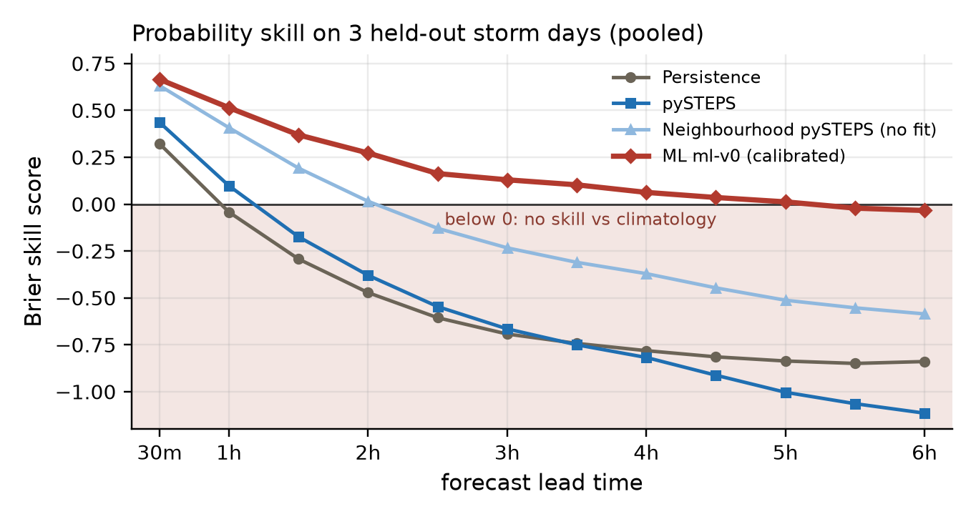
FEASIBILITY AND VIABILITY
THE FEVICONS
BUILT
MEASURED
VERIFIED
CLEAR LIMITS
NEXT VALIDATION
▸ ANALYSIS OF THE FEASIBILITY OF THE IDEA: EVIDENCE AT A GLANCE
25 days
600 real satellite files
3 storm days
held out: E8 · E10 · E11
9 screens
working replay prototype
84 tests pass
incl. 2 browser tests
386 files
evidence hash-frozen
▸ WHAT THE TESTING SHOWED: 3 HELD-OUT STORM DAYS, POOLED, SAME PIXELS
3 / 3
pySTEPS beats persistence
at every tested lead, 30 min – 6 h
≈ 2 h
Useful baseline skill
FSS 40 km useful to ~90 min (persistence) / ~120 min (pySTEPS)
≈ 4 h
ML probability skill
BSS 0.27 at 2 h (no-fit ref. 0.02) · calibration error 0.002–0.004
1 h
LIMIT
LIMIT: no yes/no gain
ML does not improve binary yes/no maps over pySTEPS beyond 1 h
▸ POTENTIAL CHALLENGES AND RISKS → STRATEGIES FOR OVERCOMING THESE CHALLENGES: VIABILITY ROADMAP
BUILT NOW
NEXT (not built)
FUTURE (not built)
Research prototype · real satellite data
3 held-out storm days · IR-only replay
More seasons + regions
Forward-time validation
Independent radar / lightning verification
INSAT-3DS / Meteosat, 15-min+
Radar / lightning truth
Live pipeline + initiation score
Limits today: 3 held-out days (May 2026, NW India) · ML tested backward in time · single IR, 30-min · parallax not verified · no radar/lightning truth · replay, not live
Notes:
Built, measured, verified, clear limits, next validation. Top: what exists today. Centre: the frozen Brier skill chart from three held-out storm days and four findings; the red card is the limit we state openly: ML does not improve yes/no maps over pySTEPS beyond 1 hour. Bottom: only the first stage is built; next and future stages are not built. Limits: 3 held-out days in May 2026 over NW India, ML tested backward in time, single IR channel at 30 minutes, parallax not verified, no radar or lightning truth, replay not live.

Slide 5



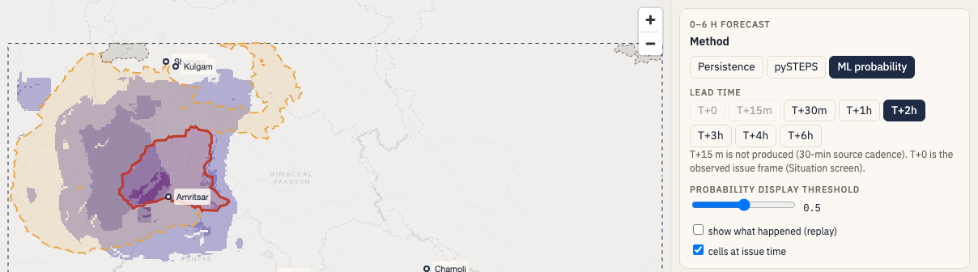
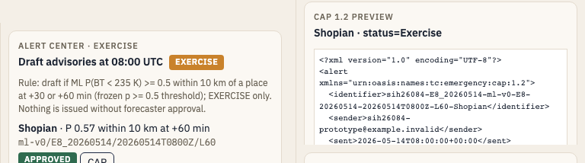
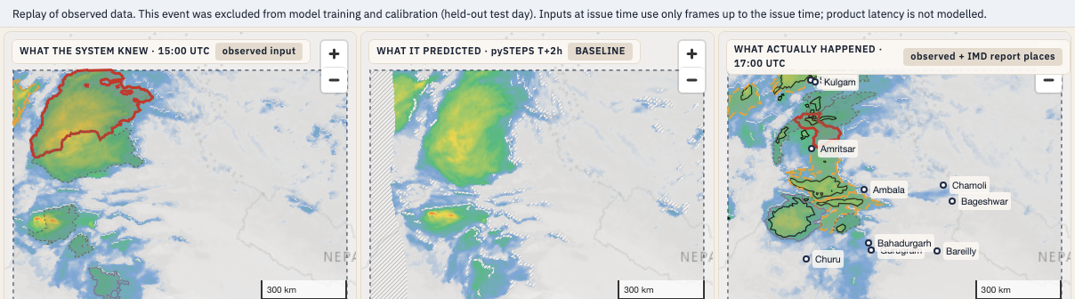
IMPACT AND BENEFITS
THE FEVICONS
One storm signal → three decision users
▸ POTENTIAL IMPACT ON THE TARGET AUDIENCE
STORMLIFE: storm • forecast • skill • replay
FORECASTER
IMD / NCMRWF
DISTRICT DISASTER OFFICIAL
district level
RESEARCHER / EVALUATOR
research
EXERCISE / NOT OPERATIONAL
“Where is convection developing?”
“Where should attention be focused?”
“Did the system predict what happened?”
SEES
Storm location + motion + forecast skill
SEES
Probability + forecast track + replay
SEES
Replay + held-out events + baseline comparison
DECISION
Compare forecast methods and focus attention
DECISION
Prioritize areas for exercise / advisory review
DECISION
Evaluate model skill, limitations and reproducibility
▸ BENEFITS OF THE SOLUTION (SOCIAL, ECONOMIC, ENVIRONMENTAL, ETC.)
SOCIAL
Potential earlier awareness of deep convection
ECONOMIC
Open-data + open-source prototype
ENVIRONMENTAL
Satellite-first; no new sensing hardware
TRUST
Traceable metrics + visible limitations
Research prototype • replay of real satellite data • not operational • exercise alerts only
Notes:
One storm signal, three decision users. StormLife provides the storm, the forecast, its validated skill and the replay. The forecaster uses it to see where convection is developing and compare forecast methods. The district official uses the probability and track to prioritise areas for review; advisories are exercise drafts only and nothing is operational. The researcher replays held-out storm days to check whether the system predicted what happened, against the same baselines. Each screenshot is the real prototype screen. No live alerts, deployment or savings are claimed.

Slide 6
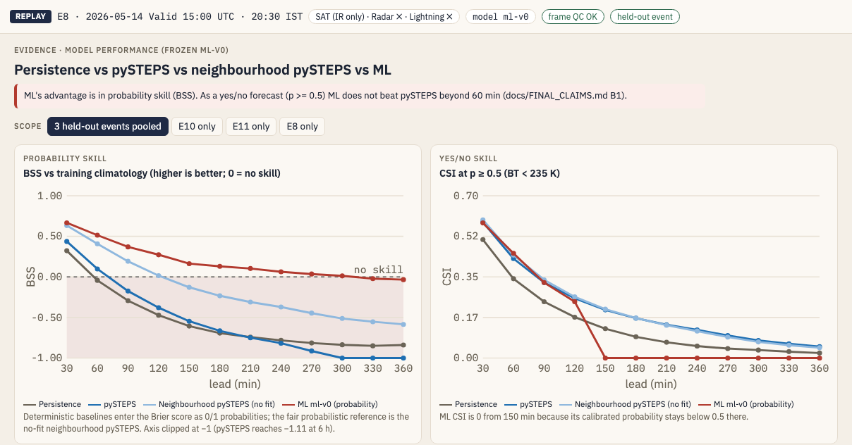

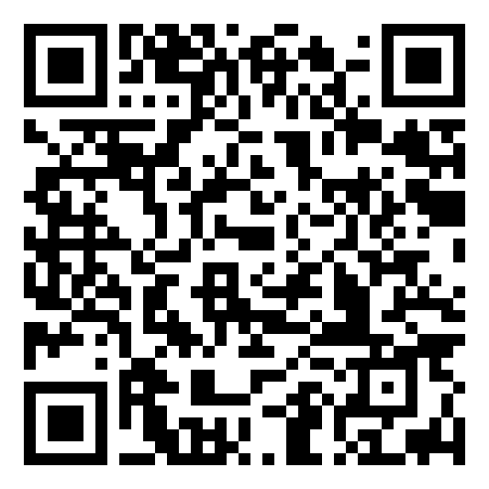
RESEARCH AND REFERENCES
THE FEVICONS
Research question → StormLife contribution → verified prototype → data sources → methods & reproducibility
▸ EXISTING APPROACHES
▸ OUR RESEARCH QUESTION
▸ VERIFIED PROTOTYPE
RADAR
cell tracking, e.g. MeteoSwiss TRT; IMD radar nowcasts
LIGHTNING
flash data in severe-storm guidance
WHAT CAN ACTUALLY BE VERIFIED FROM OPEN GEOSTATIONARY IR ALONE?
NWP
model environment, e.g. in NOAA ProbSevere v3
SATELLITE PRODUCTS
storm objects + phases, e.g. NWCSAF RDT
Operational and research systems already provide storm detection, tracking and severe-weather guidance.
STORMLIFE CONTRIBUTION
SATELLITE-FIRST
open geostationary IR only
BASELINE-FIRST
vs persistence + pySTEPS
DATA / ACCESS CONSTRAINT
Indian open-data access and latency constrain reproducible, independent validation.
• IMD radar raw data: licence or research request
• INSAT via MOSDAC: general users get data after ~3 days
• Lightning networks: restricted research access
• IMD AWS/ARG portal: closed to the public (May 2025)
CALIBRATED PROBABILITY
reliability shown
AUDITED TRACKING
ID switches 21 % → 0.4 %
3 held-out storm days • reproducible replay • validated metrics • evidence frozen
StormLife complements existing operational systems; it does not replace them.
Research prototype · real-event replay · held-out validation
REAL-EVENT REPLAY
knew · predicted · happened
TRACEABLE EVIDENCE
every number → hashed file
+ EXPLICIT LIMITATIONS 3 days · single IR · no radar/lightning truth
▸ DETAILS / LINKS OF THE REFERENCE AND RESEARCH WORK: DATA SOURCES USED
▸ METHODS & REPRODUCIBILITY
IMD
Govt.
of India
India Meteorological Department
Used for: hail-report dates to select storm days (context, not verification truth)
Hail-storm report (PDF) · mausam.imd.gov.in
NOAA
NCEP
CPC
NOAA / NCEP Climate Prediction Center
Used for: Globally Merged IR: all satellite inputs + truth · ~4 km · 30-min
Merged IR page · Full-res IR · Archive used
pySTEPS → pySTEPS official repo
external open-source: advection baseline + FSS
STORMLIFE REPOSITORY → [REPOSITORY URL]
GitHub: our code · replay pipeline · validation · evidence
DEMO / REPLAY → Demo video [VIDEO LINK]
short demo of the verified prototype
Notes:
Existing radar, lightning, NWP and satellite systems already provide storm guidance; StormLife complements them. In India, open access and latency constrain independent validation, so our question was what can be verified from open geostationary IR alone. Our contribution answers it: satellite-first, baseline-first, calibrated probability, audited tracking, real-event replay, traceable evidence and explicit limitations. The two primary data sources are IMD (hail-report dates, for event selection) and NOAA/NCEP/CPC (Globally Merged IR, all satellite data). References: pySTEPS, Pulkkinen et al., GMD 12, 4185 (2019); tobac, Heikenfeld et al., GMD 12, 4551 (2019) and v1.5, GMD 17, 5309 (2024); TITAN, Dixon & Wiener (1993); FSS, Roberts & Lean (2008); ProbSevere v3, Cintineo et al., Wea. Forecasting 39(12) (2024). Links: https://mausam.imd.gov.in/newdelhi/mcdata/hailstorm_report.pdf ; https://www.cpc.ncep.noaa.gov/products/global_precip/html/wpage.merged_IR.shtml ; https://www.cpc.ncep.noaa.gov/products/global_precip/html/wpage.full_res.shtml ; https://ftp.cpc.ncep.noaa.gov/precip/global_full_res_IR/

