Slide 1
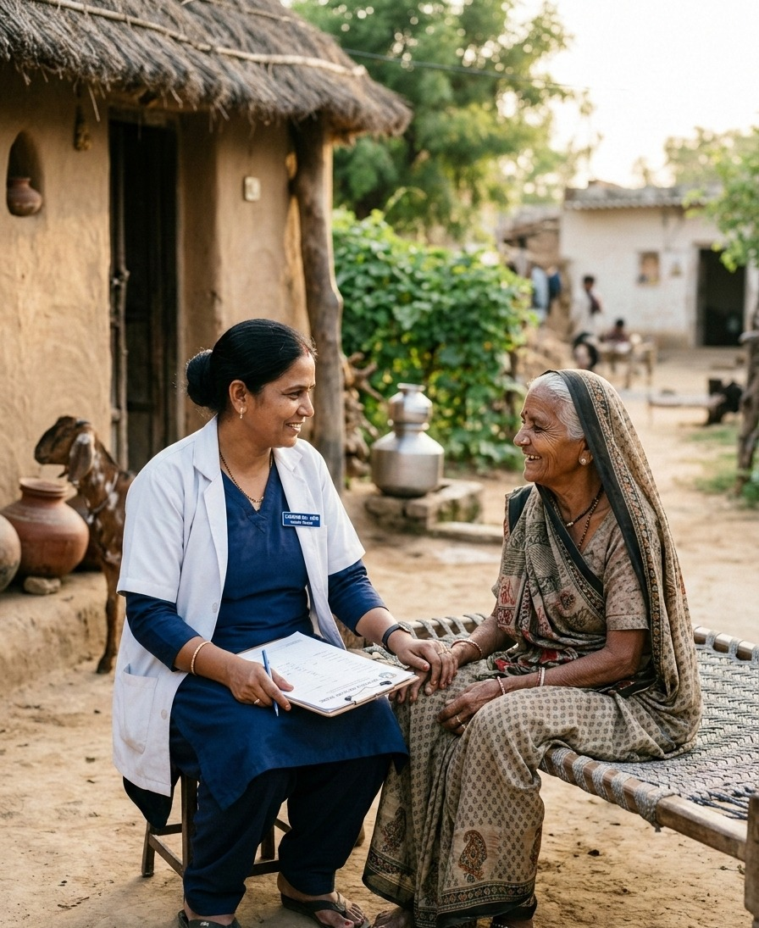





HACKATHON CONCEPT · HEALTHCARE FOR EVERY INDIVIDUAL
CAREBRIDGE
Bridging the gap between care prescribed and care completed.
TEAM MISSIONARY
IIT Guwahati
Proposed concept — not a deployed or clinically validated system.
Notes:
CareBridge is a proposed concept, not a deployed or clinically validated system. The competition name and theme are submission context supplied by the team, not independently verified competition facts. Risk in this proposal concerns failure to complete a care step, not medical deterioration.

Slide 2

02 — THE IDEA IN ONE LINE
Refer → Help → Confirm
01
02
03
Refer
Help
Confirm
The doctor's referral is recorded.
The worker asks what is holding it up and responds to the reason.
Confirm arrival and the next step.
CAREBRIDGE helps a worker ask what is holding up a referral, respond to the reason and confirm the next step.

Slide 3






03 — THE GAP
A referral made. What happens next?
THE GAP
?
?
Doctor
Referral
Worker check
Hospital
Treatment
Follow-up
Refers Ravi
Asks what's needed
Confirms arrival
KEY QUESTIONS TO ASK
He may need help, not another reminder.
Was it clear? · Could it wait?
Cost, location, transport, or service access?
The real problem is understanding what is preventing the next step.
No arrival confirmation? Ask first — it does not mean Ravi missed the visit.
Notes:
The concern is continuity, not a claim that rural healthcare is entirely broken. A journey can break between any two steps. Missing records are not proof that care did not happen; patient or facility confirmation is needed.

Slide 4



04 — HOW CAREBRIDGE HELPS
Don't stop at the referral.
Referral recorded → arrival unconfirmed → worker checks with Ravi. Ask why. Help. Confirm arrival.
01
02
03
04
05
06
Record referral
Ask the patient
Understand the barrier
Help with the reason
Confirm arrival
Track the next step
The worker helps.
The facility confirms.
Asks why and helps with the reason.
Confirms arrival, so the next step can be tracked.
Simple checks flag unconfirmed referrals for review.
Notes:
The proposed MVP uses simple checks, not a trained prediction model. Missing confirmation prompts a check with the patient or facility; it is not proof of a missed visit.

Slide 5


05 — TRANSPORT: ONE SYNTHETIC EXAMPLE
Ravi needs a ride.
SYNTHETIC EXAMPLE
Ravi needs a hospital visit.
Ravi
Arrival is unconfirmed.
Synthetic example
Worker asks Ravi.
“I have no ride.”
Ravi says: “I have no ride.”
Worker helps arrange travel.
Hospital confirms arrival.
Doctor refers Ravi → worker checks → helps with travel
Track the next step.
Notes:
This is a synthetic illustrative case and a prototype interface, not evidence of a deployed product. The seven-day deadline is doctor-assigned for the example, not medical guidance. A completed step continues the timeline. An unconfirmed or delayed step triggers a barrier check and ASHA/ANM alert, followed by human intervention and facility confirmation. Unconfirmed arrival alone does not prove nonattendance.

Slide 6
06 — CAREBRIDGE · PROTOTYPE
Checked. Helped. Confirmed.
CareBridge · Worker
Facility screen
Ravi
✓ Checked
Cardiology referral · Ravi
Cardiology referral · Referral recorded
Please note
Arrival unconfirmed
Hospital confirmed
Prototype interface.
Synthetic illustrative case — not evidence of a deployed product.
Unconfirmed arrival alone does not prove nonattendance.
“I have no ride.”
Arrival confirmed
Worker helps arrange travel
Arrival confirmed ✓
Track next step
Hospital confirmed. Track next step.
Notes:
This is a synthetic illustrative case and a prototype interface, not evidence of a deployed product. The seven-day deadline is doctor-assigned for the example, not medical guidance. A completed step continues the timeline. An unconfirmed or delayed step triggers a barrier check and ASHA/ANM alert, followed by human intervention and facility confirmation. Unconfirmed arrival alone does not prove nonattendance.

Slide 7



07 — WHY USE AI?
AI reads and listens. People decide.
No AI diagnosis or prescribing. The doctor decides care.
01
Referral slip → Clear details
Responsible by design
Reads the doctor's referral. AI pulls out the hospital and due date. The worker checks them.
No AI diagnosis
No AI prescribing
The doctor decides care
Workers verify AI outputs
Human confirmation is required
Simple checks flag unconfirmed referrals
No trained prediction in the MVP
02
Local-language voice → Reason
Summarizes the reported reason. AI summarizes what the patient says: unclear instructions, cost or another barrier. The worker confirms.
03
Reason → Suggested help
Suggests practical next steps. The worker checks and acts. AI never decides clinical urgency. Unclear input? Ask a person.
Workers verify. Doctors decide.
Notes:
These are proposed AI tasks: read a referral slip, understand local-language voice, and suggest practical help. Workers verify the details and approve help. Doctors retain all clinical decisions. Simple rules flag unconfirmed referrals; the MVP does not use trained prediction.

Slide 8
08 — MORE THAN A REMINDER
“Go to hospital” isn't enough.
Identify the barrier
Help with the next step
What is holding up the next step?
Ask why → match the help
Didn't understand?
Explain the doctor's instruction
Thought it could wait?
Check understanding
Cost?
Discuss available support
No transport?
Coordinate travel
Unsure where to go?
Clarify where to go
Service unavailable?
Check service with facility/doctor
Ask why
Match the help
Confirm
Worker confirms and acts. No funding promised. Then confirm arrival and the next step.

Slide 9



09 — BUILD SMALL. TEST WITH CARE.
Start with one referral.
01
Record referral
02
Ask why
03
Match help
04
Confirm next step
Build
Practical
Test first
Pilot metrics
Worker app + facility screen + secure database. AI reads slips and voice messages; simple checks flag referrals.
Local-language voice, low-cost Android, no patient app. Save offline; sync and use AI when connected.
Synthetic records, then an approved pilot at one primary health centre.
Not results — what we would measure
Confirmed hospital arrivals
Time from referral to arrival
Reasons reported and worker time
Before real use: consent, minimum data, restricted access, secure storage and human review. No pilot results or partnerships claimed.
Notes:
All stack choices are proposed, not existing integrations or production capabilities. Offline support means capture and queued synchronization, not cloud AI operating without connectivity. Pilot outcomes would be measured, with no promised impact percentages. Expansion follows validation: one PHC, then a PHC network, then district and wider network. No current partnerships or integrations are claimed.

Slide 10

CAREBRIDGE · PROPOSED CONCEPT
“A patient shouldn't disappear from the healthcare system just because the next step is difficult.”
Bridging the gap between care prescribed and care completed.
CARE CONTINUUM FLOW
01
02
03
04
05
Referral
Ask
Help
Confirm
Next Step
We don't replace the doctor. We help the worker support the patient.
Empowering community health teams to ensure follow-through without clinical overhead.
CAREBRIDGE
Team Missionary — IIT Guwahati
Notes:
This closing statement describes the purpose of the proposed system, not an achieved or guaranteed clinical outcome. CareBridge keeps clinical authority with doctors and operational intervention with frontline workers.

