Slide 1
cement compressive strength prediction
wireframe diagram

Slide 2

Homepage

Slide 3
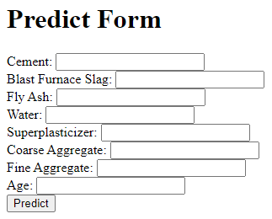
Prediction page

Slide 4
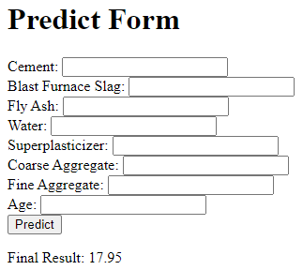
Results

