Slide 1
Insurance premium prediction
wireframe diagram

Slide 2
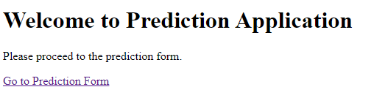
Homepage

Slide 3
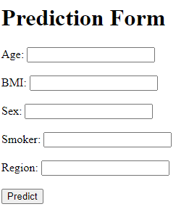
Prediction page

Slide 4
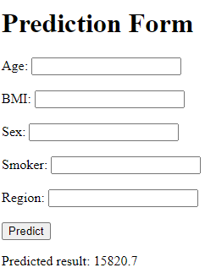
Results

