Slide 1
School Management System
Project Team:
Gautam Giri
Kiran Sing Katuwal
Kisan Tamang
Sagar Lama

Slide 2
Introduction

Slide 3
Introduction
Background
Manal
Paper
Tedious
Time consuming
Existing Software are hard to use

Slide 4
Introduction
Objective
Speed up the billing process
View student details
Generate receipt
View pending bills

Slide 5
Introduction
Problem Statement
Manual
No Data Backup
Unproductive
Time consuming

Slide 6
Introduction
Rationale
Digitalization
Save Time
Save Cost
Ease up the billing process

Slide 7
Literature Review
Background
Accessed by almost 74% population of the world
Came into existence in late 385 BC
Have not been much major change operations of schools
Some major improvements in the methods of teaching
Notes:
Education sector accessed by almost 74% population of the world, is one of the oldest and densest sectors in human history. The school management system is expected to come into existence in late 385 BC, specifically in ancient India, ancient China, ancient Greece, and ancient Rome. However, the curriculum of schools is updated every decade but there have not been much major change operations of schools. In contrast, there have been some major improvements in the methods of teaching. This change was brought by YouTube and many Ed-Tech startups as they have digitalized the learning process. So this system is commonly used from ancient time in school that’s why we choose this system.

Slide 8
Literature Review
Significance
Record Filing
Record of payments
Generate Receipt

Slide 9
Literature Review
Drawbacks of existing System
Slow
Difficult to use
Expensive

Slide 10
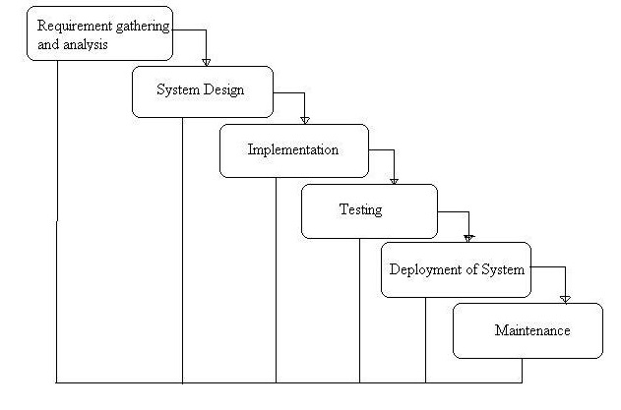
Methodology
Waterfall model

Slide 11
Methodology
Waterfall Model
Requirement Gathering and Analysis Phase
Design Phase
Implement Phase
Test Phase
Deploy Phase
Maintenance Phase

Slide 12
Design
Tools And Techniques
MS Visio
Project 2016
IDE
SQL workbench
Java JDK

Slide 13
Design
Mockups
Admin Login
Username
Password
Login
Exit

