Slide 1



z
Bank Loan Data Analysis
-By Group 5

Slide 2
z
Project Overview
Analyzed Bank Loan data to identify key business insights.
Performed data cleaning and preprocessing to prepare the datasets.
Used MySQL to analyze data and calculate 5 key KPIs.
Created dashboards using Excel, Power BI, and Tableau.
Used charts, KPIs, and filters to visualize important loan trends.
Generated data-driven insights to support better decision-making.

Slide 3
z
Problem Statement
Bank loan datasets contain large amounts of raw and unstructured information, making analysis difficult.
It is challenging to identify loan performance and customer-related trends from raw data.
Manual analysis of loan applications, funding, payments, and verification status can be time-consuming and inefficient.
There is a need to calculate important Key Performance Indicators (KPIs) for effective loan analysis.
A centralized and interactive dashboard is required to visualize data and identify meaningful patterns.

Slide 4
z
Data Cleaning and Preparation
Factors | Description
Missing Values | Checked the datasets for missing values and handled them appropriately.
Duplicate Removal | Identified and removed duplicate records to maintain data accuracy.
Data Formatting | Standardized data types, formats, and values for consistent analysis.
Unnecessary Data Removal | Removed irrelevant and unnecessary columns from the datasets
Data Transformation | Created required calculated and helper columns for KPI analysis.

Slide 5
z
KPIs
Year-wise Loan Amount Status
Grade and Sub-Grade-wise Revolving Balance
Total Payment by Verification Status
State-wise and Month-wise Loan Status
Home Ownership vs Last Payment Date

Slide 6
z
KPI 1 - Year-wise Loan Amount Status
Displays the total loan amount for each year.
Categorizes the loan amount based on loan status.
Helps compare loan performance across different years.
Identifies increases or decreases in loan amounts over time.
Shows which loan status contributes more to the total loan amount.
Helps understand yearly lending patterns and trends.

Slide 7
z
KPI 2 - Grade and Sub-Grade-wise Revolving Balance
Shows the total revolving balance for each loan grade.
Analyzes revolving balance across different sub-grades.
Helps compare the revolving balance between loan grades.
Identifies grades and sub-grades with higher revolving balances.
Helps understand the credit utilization pattern of borrowers.
Provides insights into the distribution of revolving balances across loan categories.

Slide 8
z
KPI 3 - Total Payment by Verification Status
Shows the total payment amount based on verification status.
Compares payments between Verified and Not Verified loans.
Helps understand the payment distribution by verification category.
Identifies which verification category has a higher total payment.
Provides insights into the relationship between loan verification and payments.
Visualized using a pie chart for easy comparison.

Slide 9
z
KPI 4 - State-wise and Month-wise Loan Status
Shows the loan status across different states.
Analyzes the monthly distribution of loan status.
Helps identify states with higher or lower loan activity.
Highlights monthly trends in loan status.
Allows comparison of loan performance across states and months.
Provides insights into regional and time-based loan patterns.

Slide 10
z
KPI 5 - Home Ownership vs Last Payment Date
Shows the last payment date for different home ownership categories.
Compares repayment activity among home ownership types
Helps identify payment patterns across different ownership categories
Shows how repayment activity changes over time.
Helps understand the relationship between home ownership and loan repayment.
Provides insights into customer repayment behavior.

Slide 11
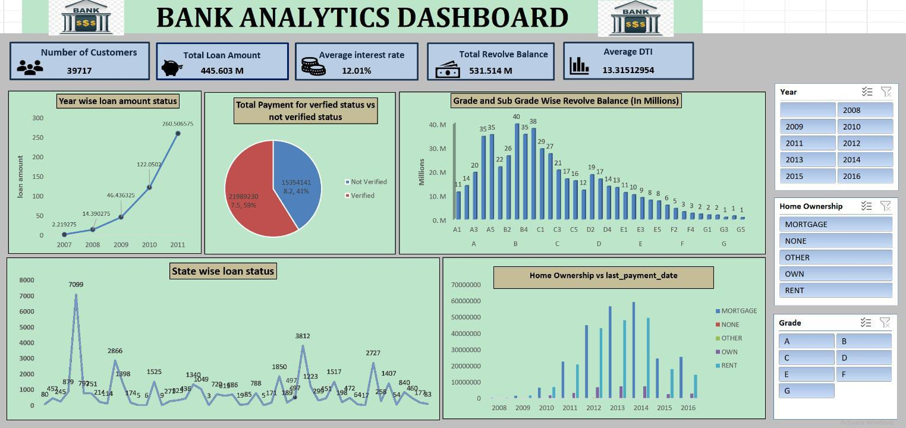
z
Excel Dashboard
Created an interactive Bank Analytics Dashboard using Excel.
Displayed key loan and customer KPIs.
Analyzed loan amount, payment, and revolving balance trends.
Compared verified and not verified payments.
Analyzed state-wise and home ownership trends.
Added Year, Home Ownership, and Grade filters.
Used PivotTables and PivotCharts for visualization.

Slide 12
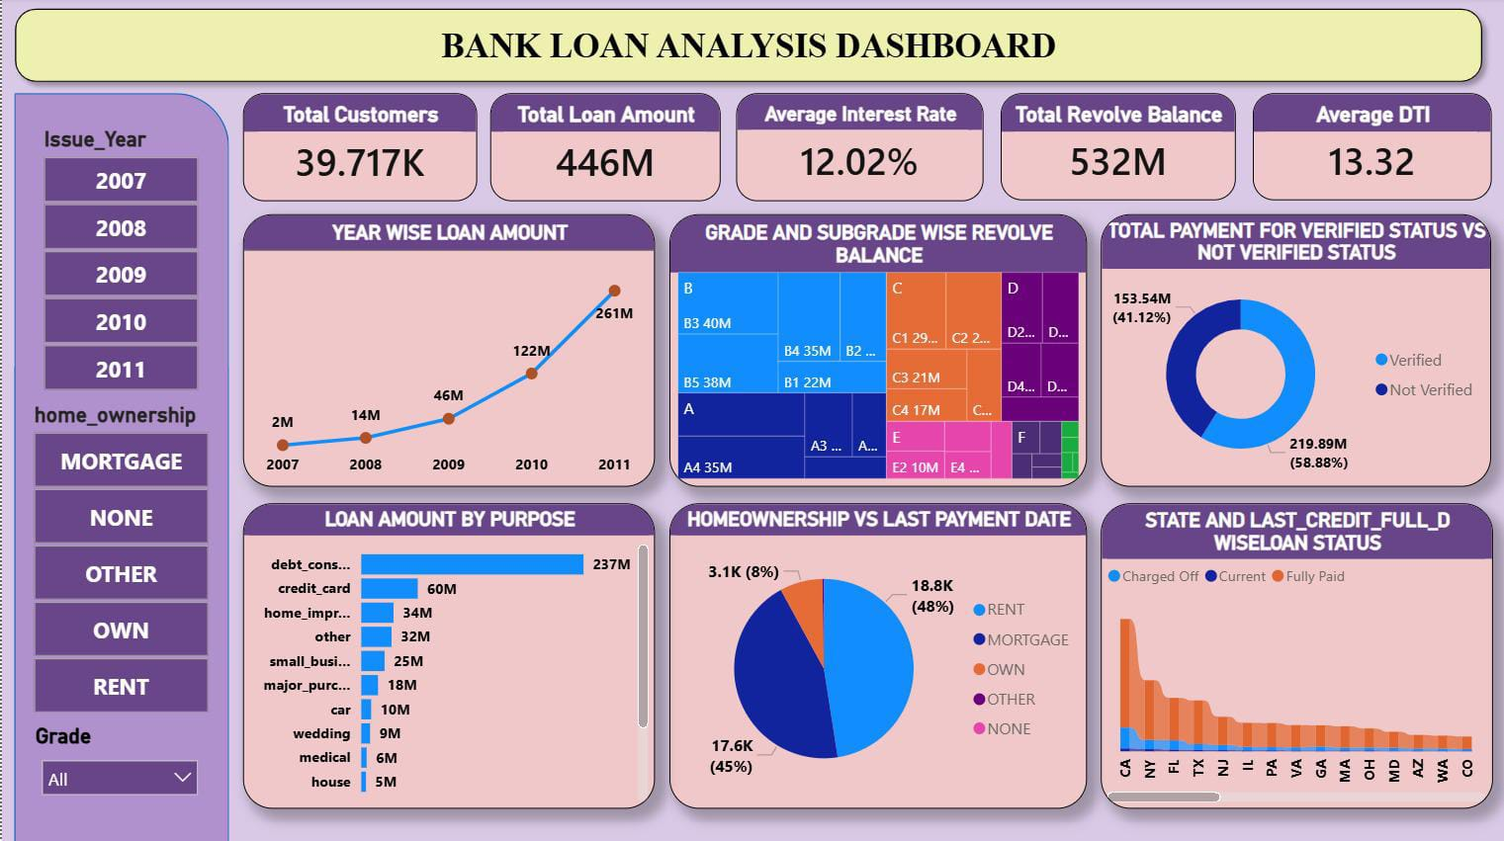
z
PowerBI Dashboard
Built a dynamic Bank Loan Analysis dashboard using Power BI.
Used DAX measures to calculate important KPIs.
Created interactive visuals for loan trends and customer segments.
Used drill-down and filtering to explore the data in detail.
Added slicers for Year, Home Ownership, and Grade.
Used interactive charts and cards to present insights clearly.
Designed the dashboard for quick business decision-making.

Slide 13
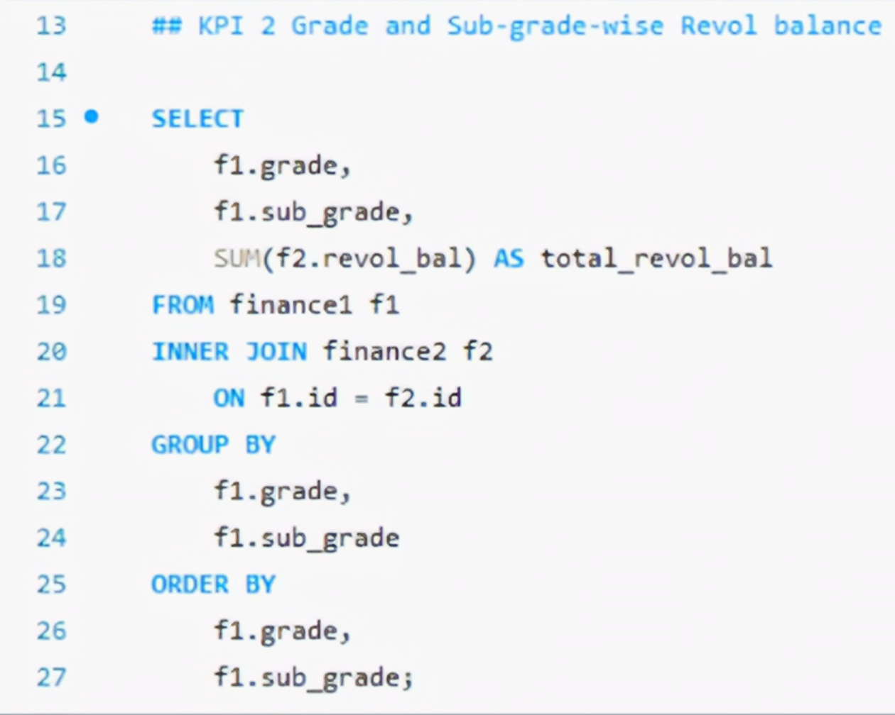
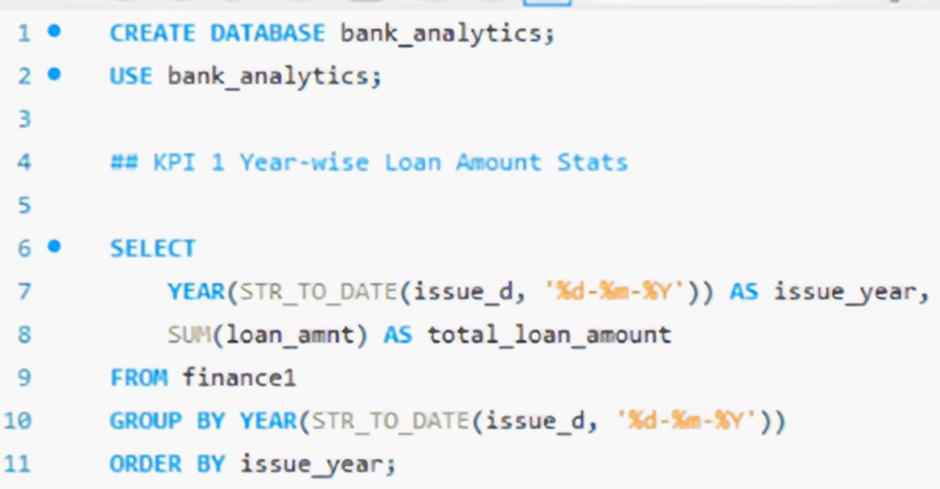
MySQL Queries
z

Slide 14
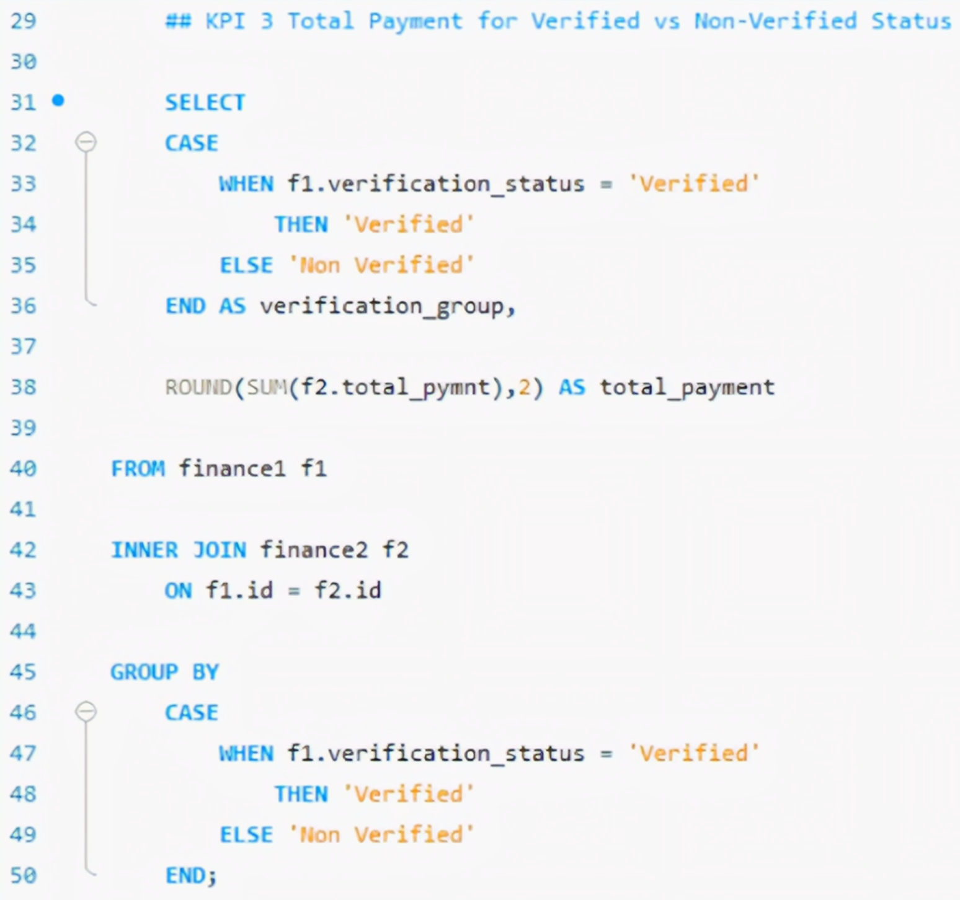
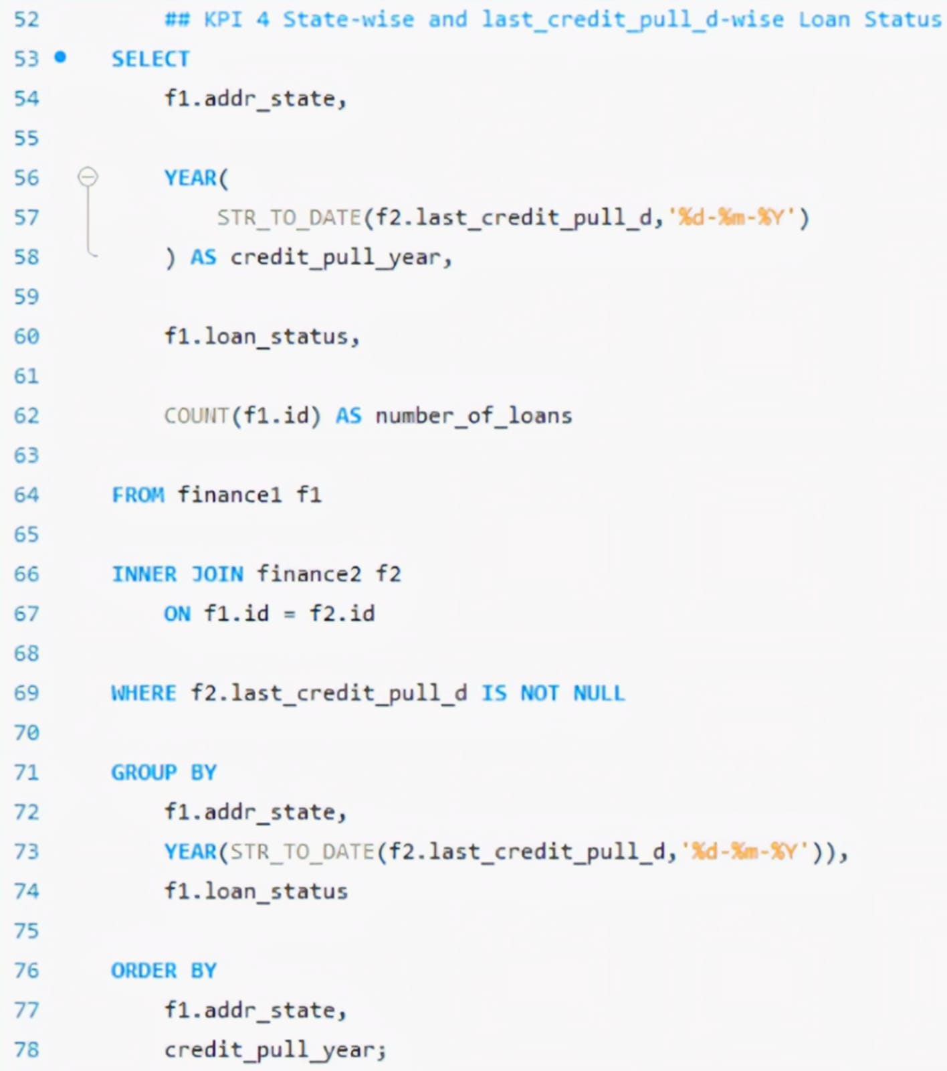
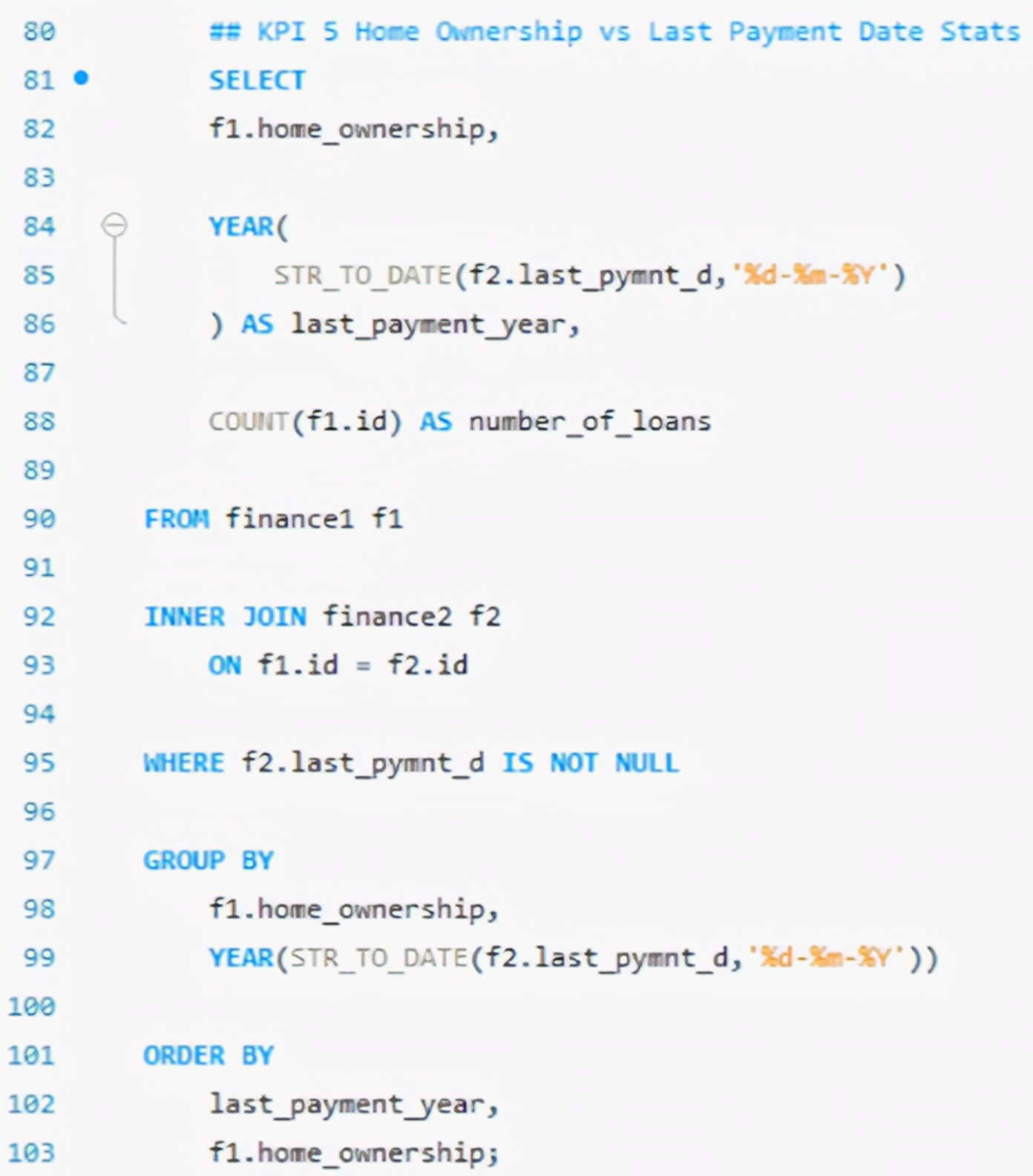
z

Slide 15
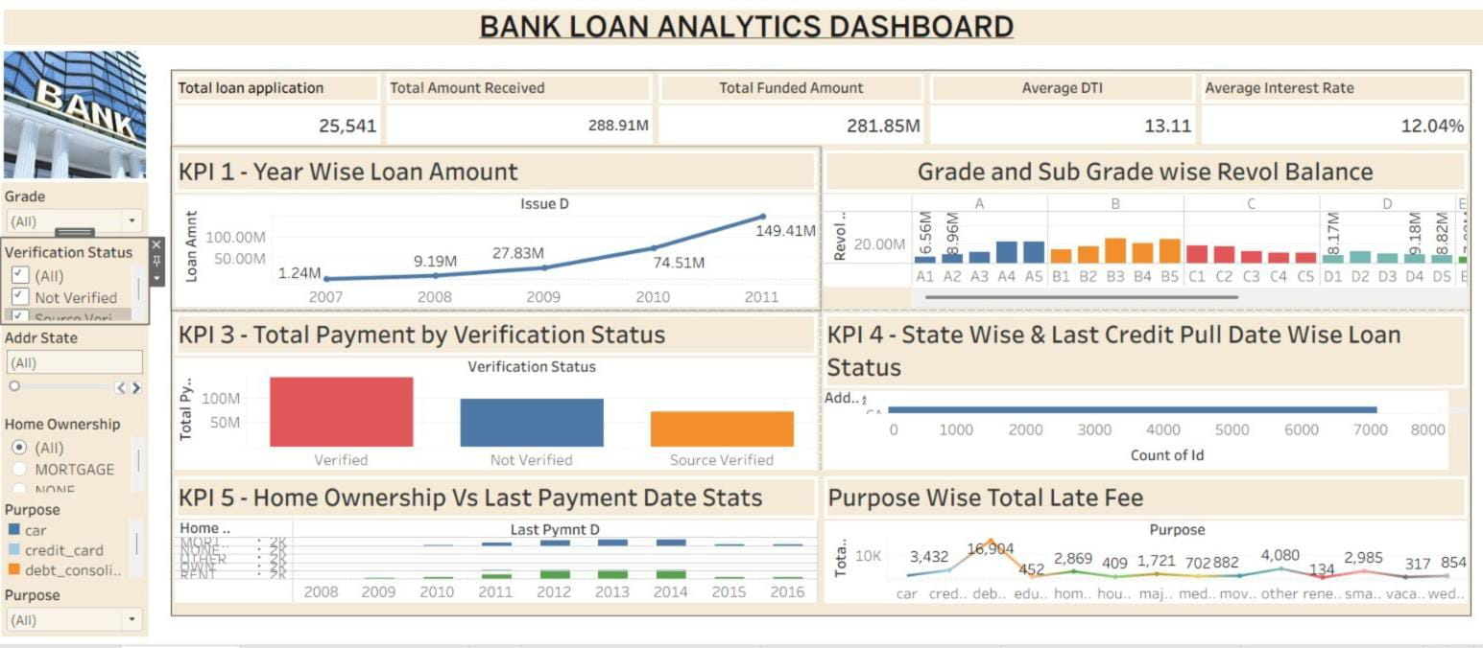
z
Tableau Dashboard
Presents loan data through interactive Tableau visualizations.
Uses filters and dashboard actions for detailed exploration.
Highlights loan purpose and late-fee patterns.
Provides state-level loan status comparisons.
Enables quick comparison of grade and sub-grade performance.
Offers a user-friendly visual interface for exploring loan insights.

Slide 16
z
Key Challenges
Handling large and complex loan datasets.
Identifying and handling missing and duplicate data.
Creating the correct relationship using Loan ID.
Creating calculated fields and measures for Power BI and Tableau.
Creating accurate SQL queries for KPIs.
Designing dashboards with clear and meaningful visualizations.
Ensuring KPI values were accurate and consistent across tools.

Slide 17
z
Conclusion
The project successfully transformed raw bank loan data into meaningful and actionable insights using MySQL, Excel, Power BI, and Tableau. Through data cleaning, modeling, and analysis, five key KPIs were developed to evaluate loan trends, revolving balances, payment patterns, verification status, and loan performance. The interactive dashboards provide a clear and comprehensive view of the data, making it easier to identify trends, compare performance, and support data-driven business decisions.

Slide 18
z
THANK YOU

